Slide 1

COVID-19 Research paper classification
using ML
SUBMITTED BY :
Bita Faraji
Sindhura Vemuri
Yash Choksi
GUIDED BY :
Professor Woo

Slide 2




INTRODUCTION
Immediate requirement Data Cleaning
Arranging Data Providing it to
medical professionals

Slide 3

GOALS
To provide accurate information for medical professionals from over around 33000 published papers and articles in different journals from all around the world using classification algorithms to identify them as useful or not useful.

Slide 4
Dataset
In this serious pandemic situation it’s really urgent need that all medical and research community act towards it as soon as possible. And there is so this dataset is hosted by Kaggle.com and dataset contains more than 30,000 different research papers.
Every research paper is having few keywords and format of research paper is JSON which is provided by Allen institute of AI. The dataset is mostly comprised of Covid-19 and SARS-COV-2 and some other related to corona virus.
This is classical unsupervised machine learning algorithms and we created labels with clustering first and then we trained our models using pyspark algorithms.

Slide 5
Dataset Features Target
Paper_id | Abstract_summary
doi | Abstract_count
abstract | Body_count
body_text | Body_unique_words
authors | languages
tiitle | Processed_text
journal
y

Slide 6
ABOUT DATASET
Dataset URL : https://www.kaggle.com/allen-institute-for-ai/CORD-19-research-challenge/
Dataset Size : 8GB
Data Format : JSON
Number of files in dataset: More than 33,000

Slide 7



TECHNICAL SPECIFICATION
Free Workspace
10 GB storage
Single node
Data Bricks Subscription
Cluster 5.2 (includes Apache Spark 2.4.0, Scala 2.11)
6 GB Memory, 0.88 Cores, 1 DBU
Python Version 3
Cluster 5.2 (includes Apache Spark 2.4)
2.20 GHz Memory, 802 GB Storage
Python Version 3

Slide 8
Algorithms Used
Azure ML
Logistic Regression
Decision Forest Classifier
Bayes point match classifier
Boosted Decision Tree
Spark ML
Naïve Bayes
Logistic Regression
Decision Tree Classifier
Random Forest Classifier
Cross-validation in Logistic Regression

Slide 9
FLOW CHART
DATASET SOURCE
DOWNLOAD FILES
VISUALIZE
DATA CLEANING
STORE AND PROCESS DATA
FEATURE EXTRACTION

Slide 10
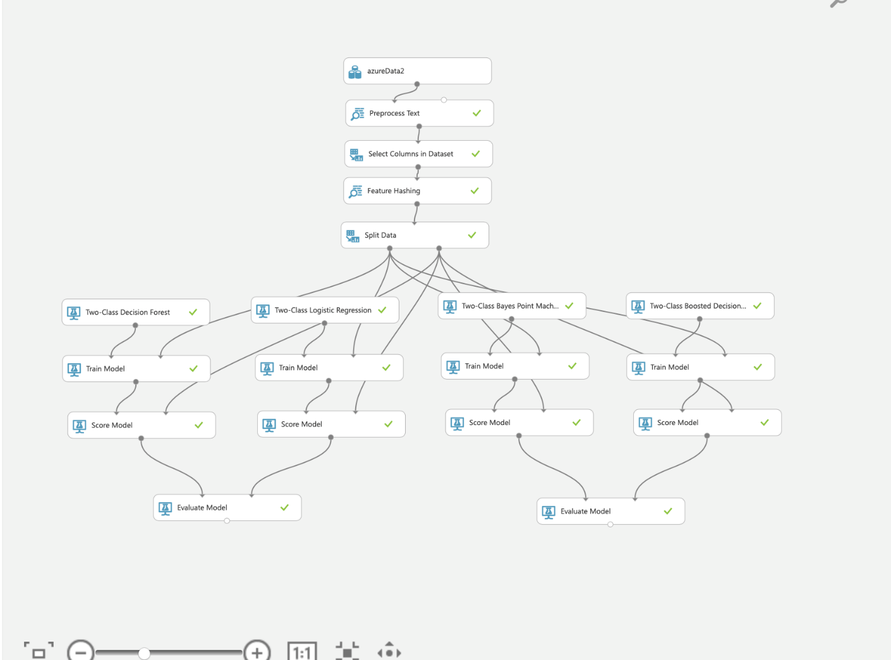
Two-Class Decision Forest
1.9% Sample
Time Taken : 15 Mins
70:30 Split Train/Test
Processed_text
1024 new columns created by hashing those text
Target column y

Slide 11
Two-Class Logistic Regression
1.9% Sample
Time Taken : 9 Mins
70:30 Split Train/Test
Processed_text
1024 new hashed columns
Target column y

Slide 12
Two-Class Bayes Point Match
1.9% Sample
Time Taken : 20 Mins
70:30 Split Train/Test
Processed_text
1024 new hashed columns
Target column y

Slide 13
Two-Class Boosted Decision Tree
1.9% Sample
Time Taken : 28 Mins
70:30 Split Train/Test
Processed_text
1024 new hashed columns
Target column y

Slide 14

Comparison
 | Two Class Decision Forest | Two Class Logistic Regression
Precision | 0.913 | 0.917
Recall | 0.943 | 0.951
F1 Score | 0.928 | 0.94
Accuracy | 0.9 | 0.917
AUC | 0.951 | 0.965

Slide 15
Comparison
 | Two Class Bayes Point Match | Two Class Decision Forest Boosted
Precision | 0.884 | 0.922
Recall | 0.992 | 0.959
F1 Score | 0.935 | 0.94
Accuracy | 0.906 | 0.917
AUC | 0.856 | 0.977

Slide 16
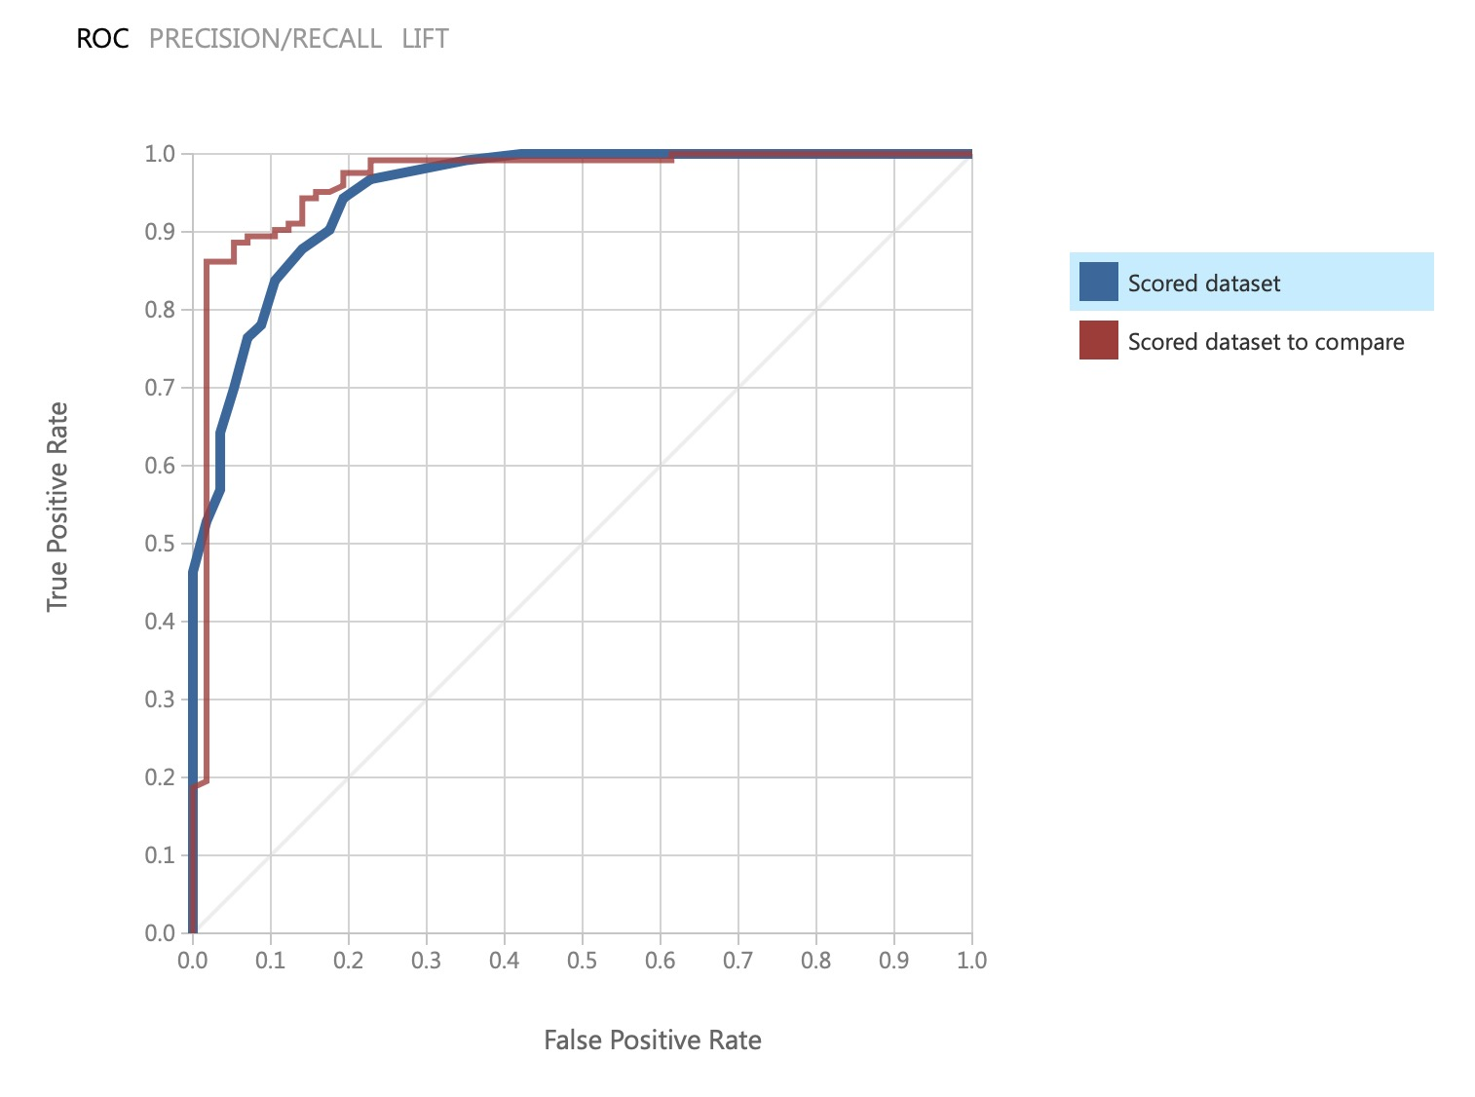
Comparison of Decision Forest and Logistic Regression

Slide 17
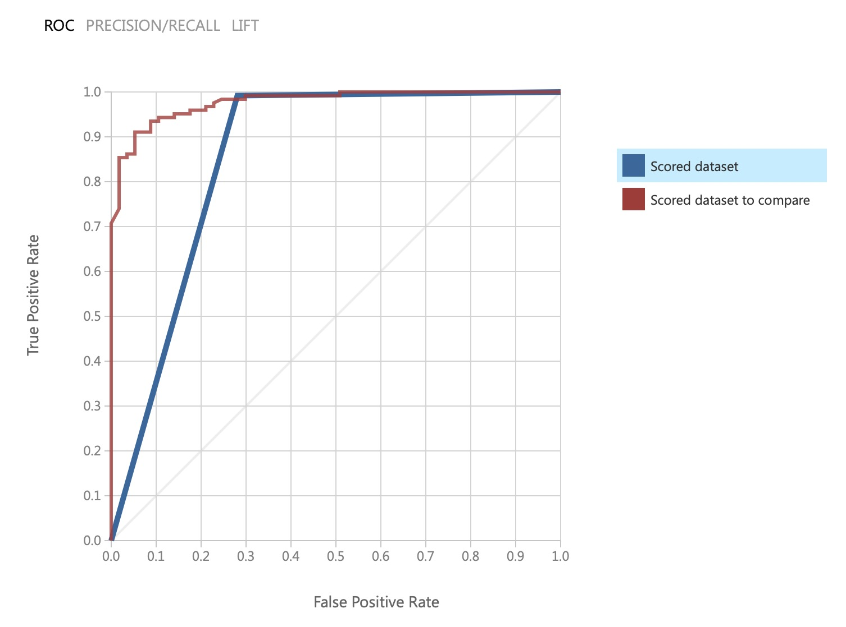
Comparison of Two Class Bayes Point and Boosted Decision Tree

Slide 18
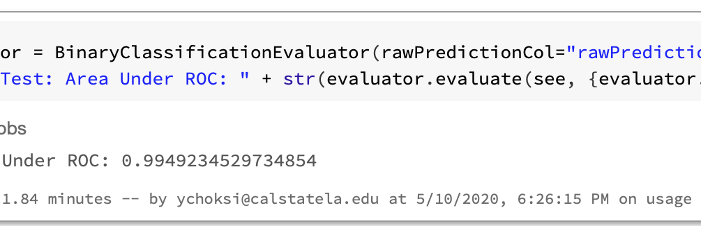
Logistic Regression in Databricks

Slide 19
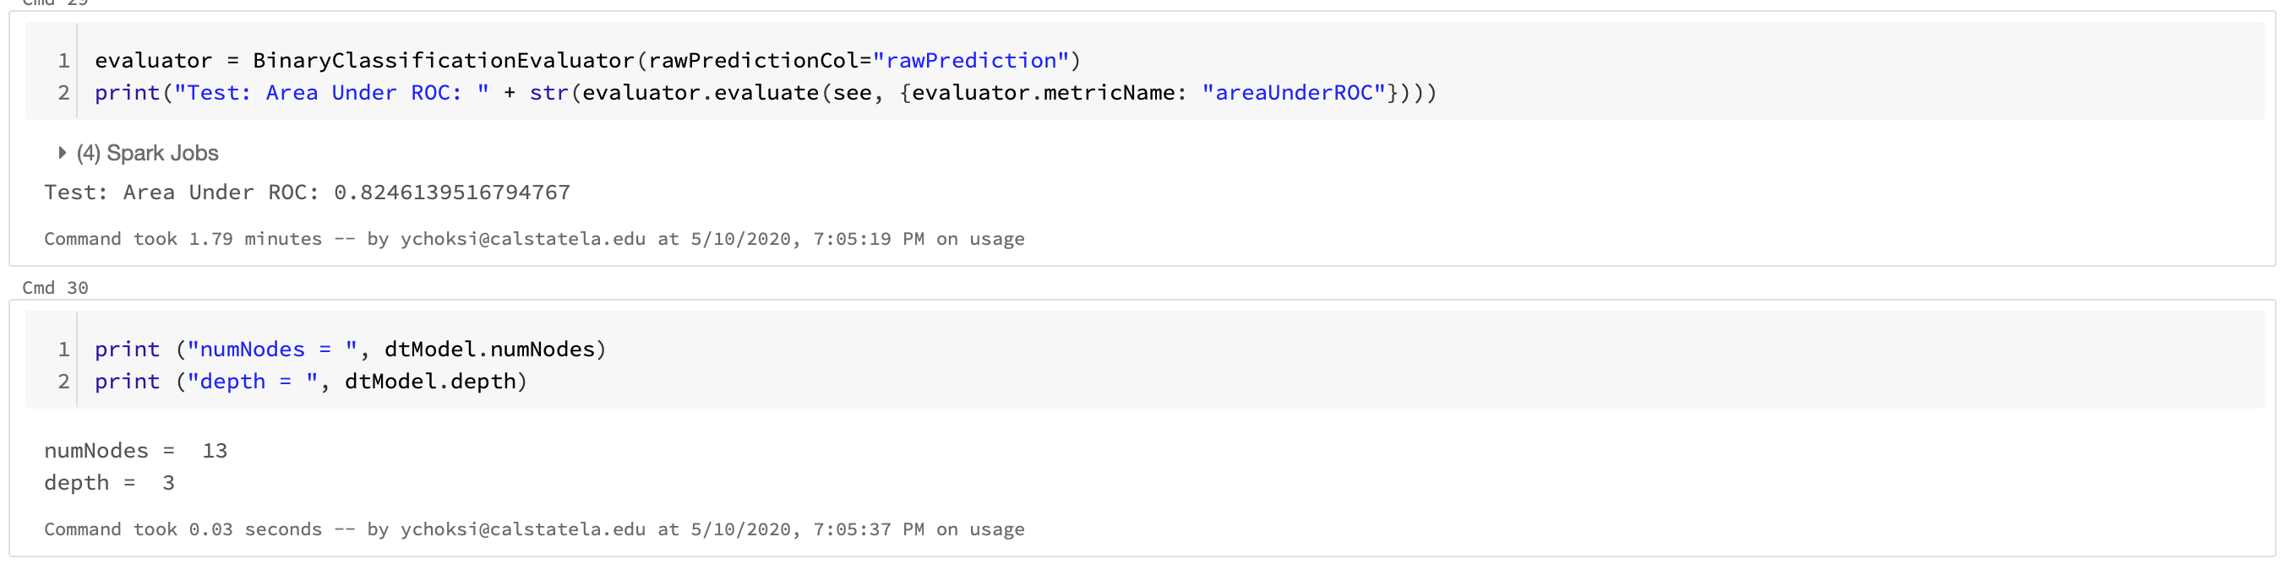
As you can see here number of nodes and depth and we have to reduce it here because this dataset is bigger than Azure ML. And efficiency is reduced significantly.
So computing environment is big impact.

Slide 20
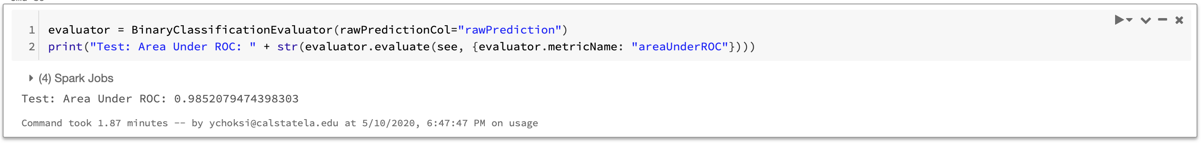

Random Forest Classifier in Databricks
Naïve Bayes Classifier

Slide 21
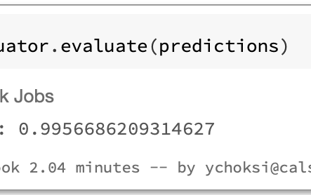
Cross Validation in Databricks

Slide 22
Comparison
AUC | k-means | Bisecting k-means | Logistic Regression | Decision Forest | Naive Bayes | Random Forest Classifier & Decision Forest Boosted
Oracle | 0.289 | 0.232 | 0.99 | 0.89 | 0.38 | 0.824
 | 2 min | 2 min | 32 min | 45 min | 22 min | 40 min
Data bricks | 0.305 | 0.299 | 0.899 | 0.8303 | 0.134 | 0.9622
 | 7 min | 8 min | 8 min | 13 min | 10 min | 14 min
Azure ML | 0.479 | - | 0.951 | 0.8 | 0.37 | 0.977
 | 1.5 min | - | 1 min | 5 min | 3 min | 17 min

Slide 23
Conclusion of all models
By looking at comparison modules and tables we can clearly says that Two class Decision Forest Boosted tree is the best with all metric parameter
It’s very obvious that this model will perform best because it’s very complex as it’s containing most updated methods.
So far accuracy is highest in this model and if we want to go other than this model it would be Logistic Regression.
By looking at this Non-Boosted Decision Tree gives almost same after tuning hyper-parameter and I tuned that original value of number of trees from 10 to 30.
By keeping this in measure when we use actual dataset as this is just sample it will create very big issues.
We tried to implement this same with pyspark with full dataset and we get same types of errors of maximum heap.

Slide 24
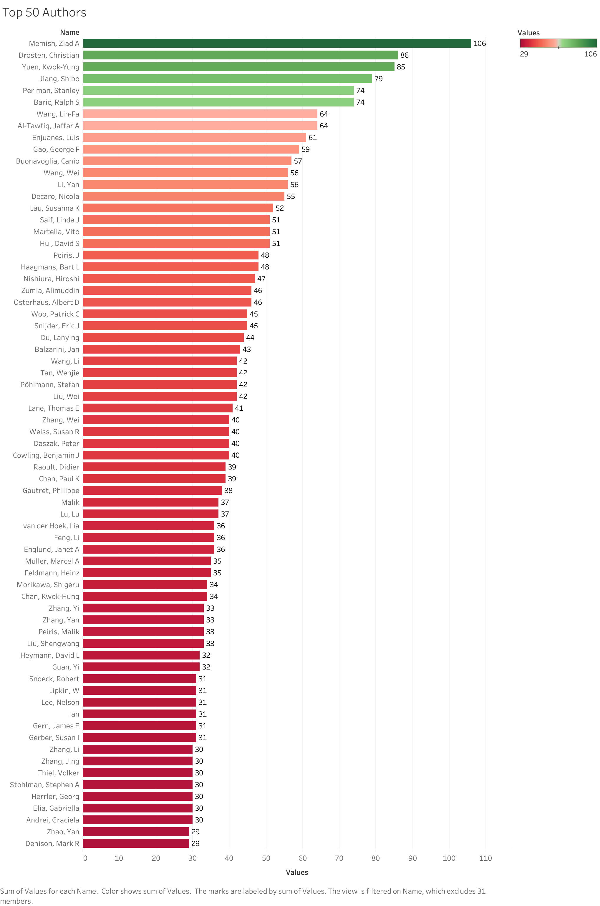

Slide 25
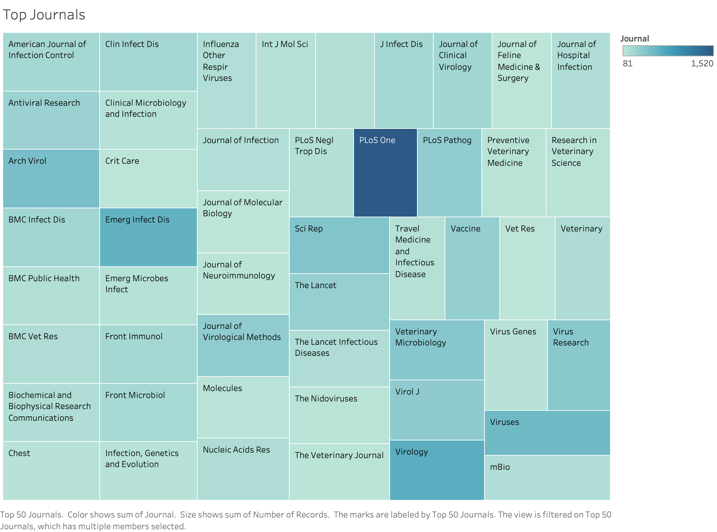

Slide 26
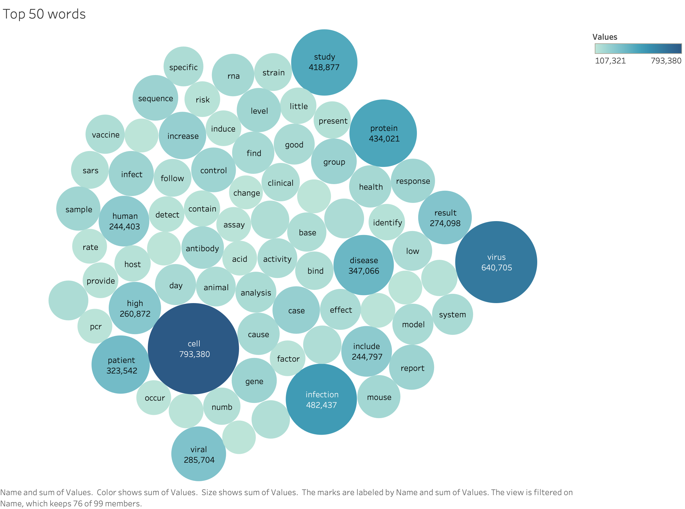

Slide 27

https://github.com/yashchks87/covid_19_nlp

Slide 28

https://gallery.cortanaintelligence.com/Experiment/CIS5560Final

Slide 29

QUESTIONS

Slide 30

THANK YOU

