Slide 1

Flipkart
09th September 2019
Trainer:
Srikala Gudavalli
Trainees :
Yash Satish Choube
Jaideep Kurapati

Slide 2
User stories
Making login Automated
Check for Broken Links in the MainPage(Categories)
Make Search Automated
Validate Products after Sorting and Filtering
Automate Add to Cart Functionality

Slide 3
Architecture
Flipkart
Test Scripts
Selenium WebDriver
TestNG
Test Data from Properties File
Test Results
(Reports)

Slide 4
US1: Login
Test Scenario
Login to Flipkart
Test Cases
Check Login Page
Do Login

Slide 5
US2: Links
Test Scenario
Check for Broken Links
Test Cases
Check all links in the categories are working or not with rest assured

Slide 6
US3: Searching
Test Scenario
Make Searching Automate
Test Cases
Check for Search Bar
Make search with any keyword
Check the Size of the Results

Slide 7
US4: Sort And FIlter
Test Scenario
Validate Sort and Filter Functions
Test Cases
Check for Search Bar
Make search with any keyword
Check the Size of the Results
Apply Sort and Filter Functions
Validate products in the results

Slide 8
US5:AddToCart
Test Scenario
Automate Add to cart Functionality
Test Cases
checkSearchBar
checkResults
addFirstProduct
checkIncrease
checkDecrease

Slide 9
What we used
TestNG
Selenium Wed Driver
ExtentReports

Slide 10
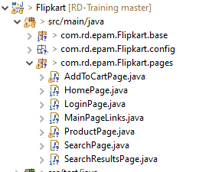
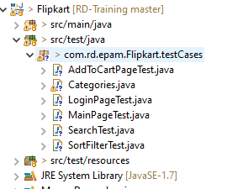
Structure of Project
Page Objects
PageTest Objects

Slide 11
THANK YOU

