Slide 1
Road Anomalies Prediction System (Bumpy)

Slide 2

Preview

Slide 3
Road Accident Statistics in India
Over 1,37,000 people were killed in road accidents in 2013 alone, i.e. more than the number of people died in all our wars put together after freedom.
Almost 16 death every hour.
Major contributors :
Drunken driving
Bad road conditions

Slide 4
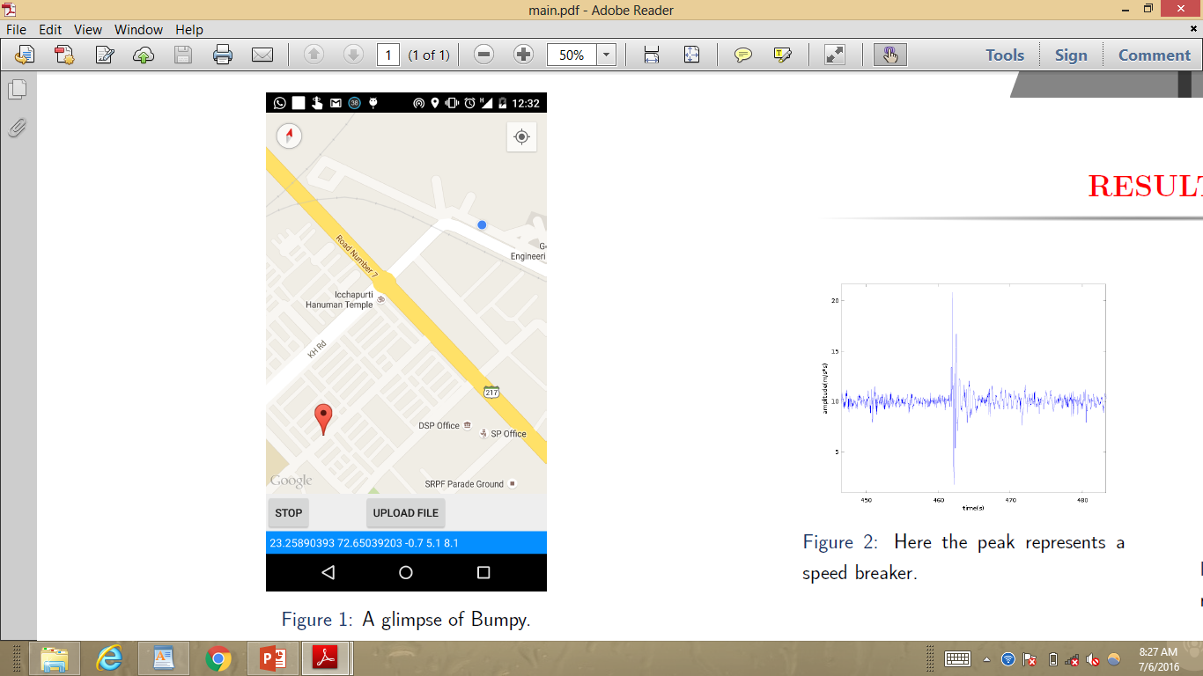
What is it?
Bumpy is an android application made just for your ease. It collects the information about the road you are traveling on and detects the road anomalies. It alerts you about the breakers, potholes etc ahead.

Slide 5
Description
I created an application which will collect data about a road or a track on which the user travels. It will then store this data to analyze and predict the upcoming barriers or bumps on the roads
This data will be stored on a server and we can be retrieved by any smartphone. It will be updated regularly so that we can store the latest changes on several tracks and add the data about new tracks with time.

Slide 6
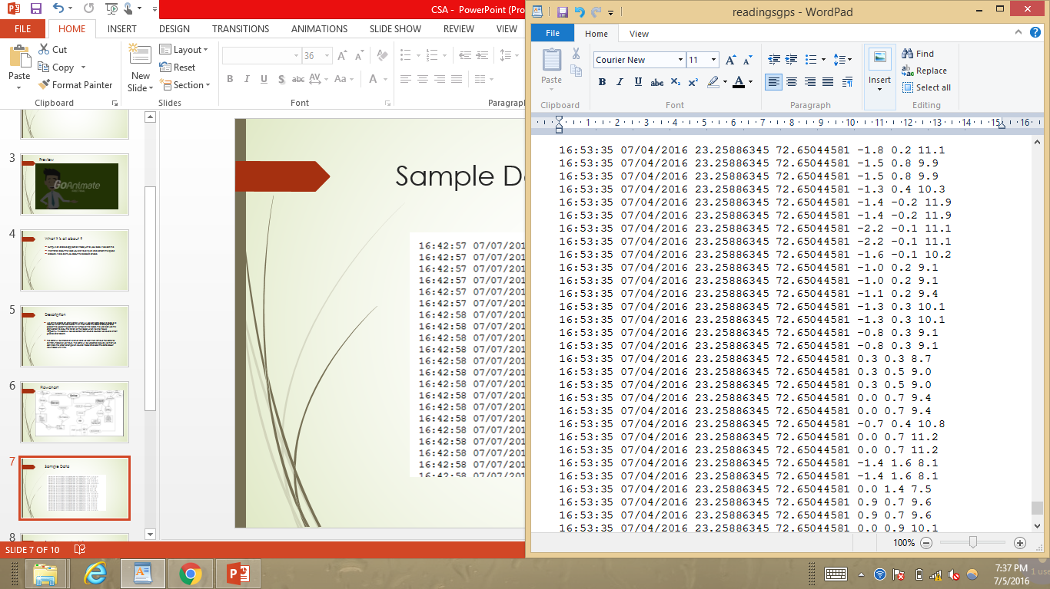
Sample Data

Slide 7
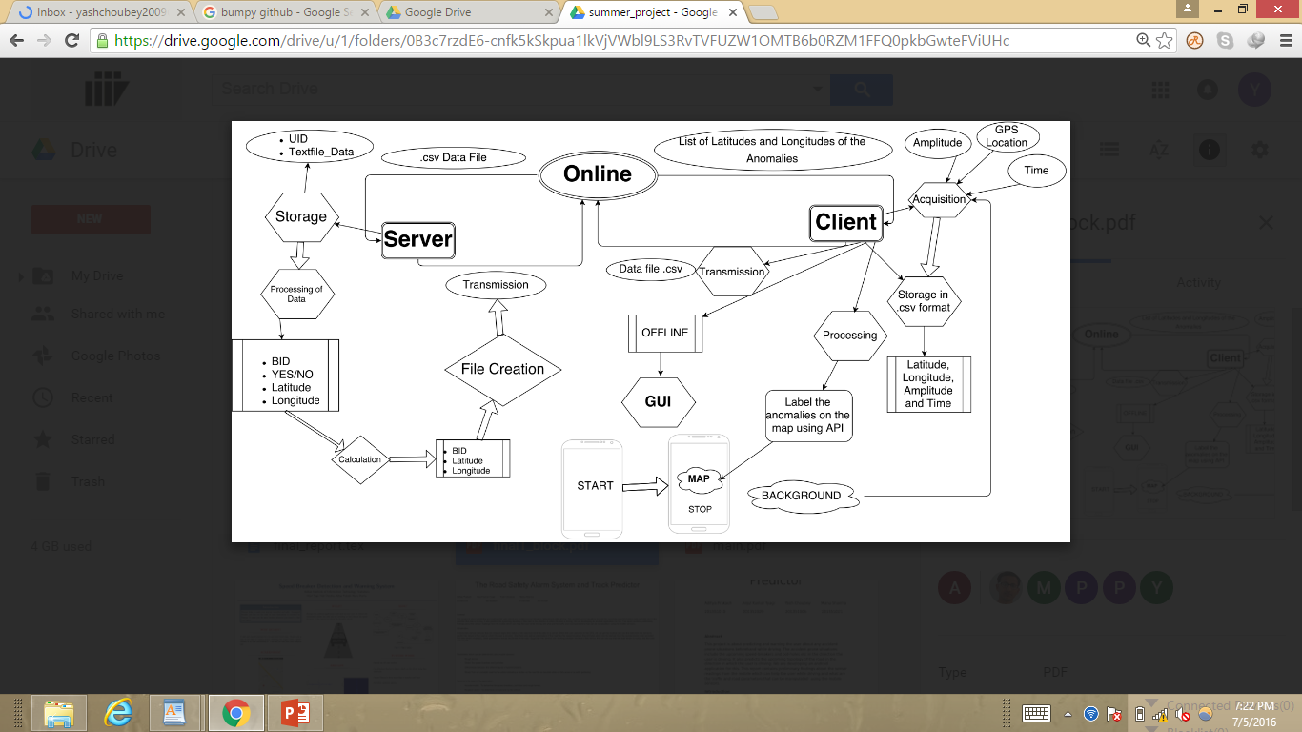
Flowchart

Slide 8
Detection ?
I collected the readings of accelerometer and observed the patterns when a pothole or speed breaker comes.
To observe the patterns I used spectrogram analysis, which show change in energy frequency when speed breaker comes.
Then further if any such change pattern is noticed then the corresponding GPS readings are saved in a database of road anomalies over the server.
Now any other user will get this reading while travelling on this road.

Slide 9
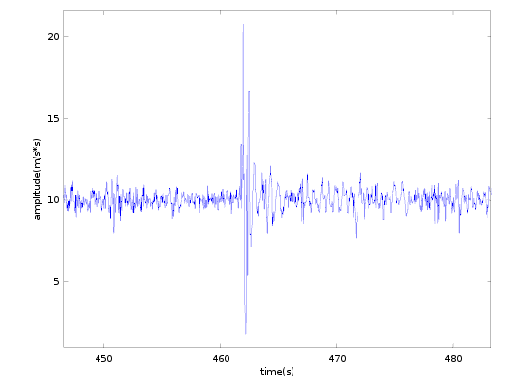
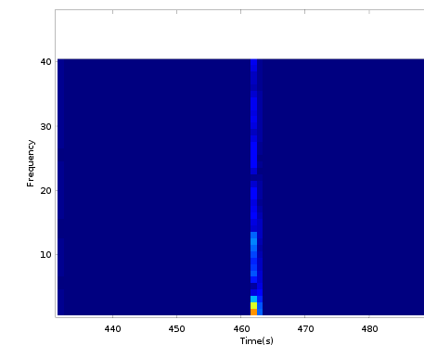
Spectrogram Analysis

Slide 10
Future work
Emergency auto dialer.
Off-track detection using image processing.
Driver Activity detection using face recognition.
Fully automated vehicles.

Slide 11
Thank You!

