Slide 1
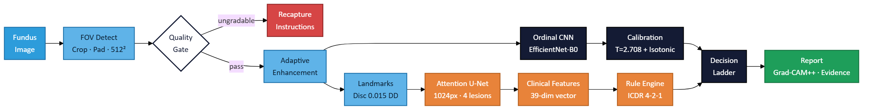
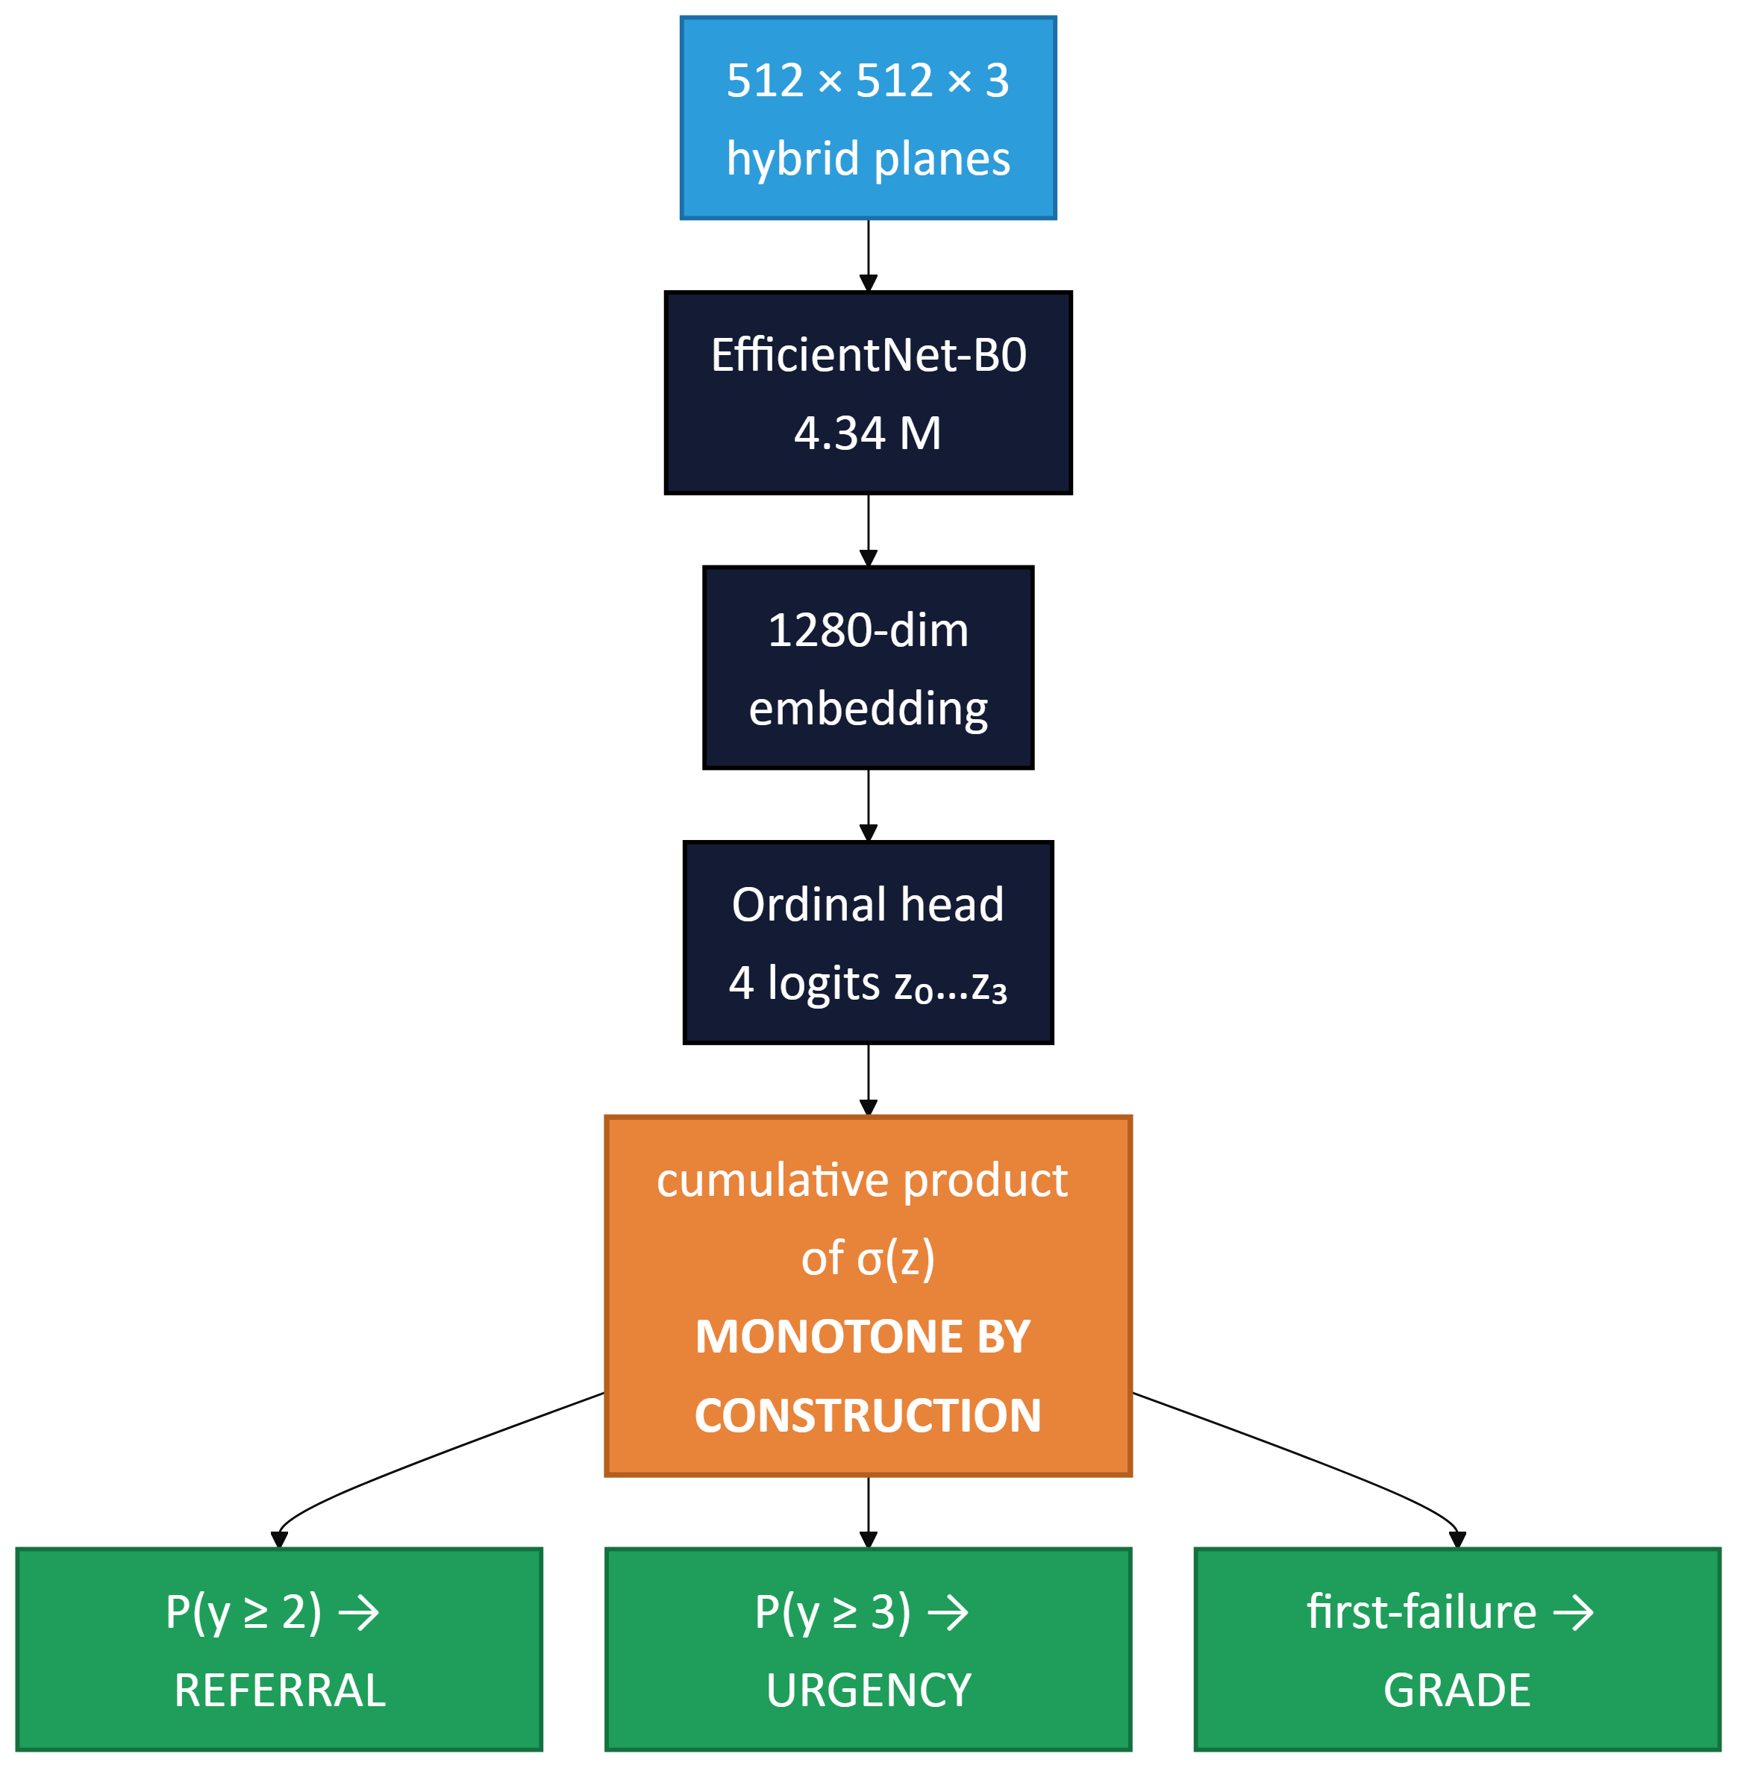
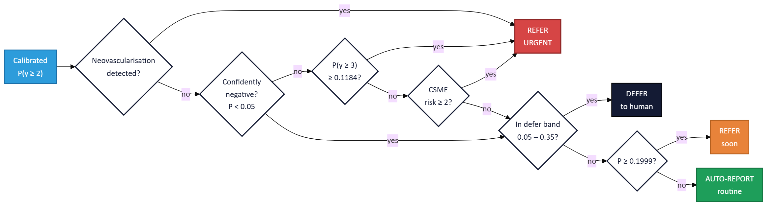
SIH-26038
TECHNICAL APPROACH
SMART INDIA
HACKATHON
2025
SPECIFICATION
PIPELINE
Grader
EfficientNet-B0 · 4.34 M
Segmenter
Attention U-Net · 4.43 M
CORN HEAD
Training
ORDINAL GRADER
SEGMENTATION & FEATURES
2,925 · APTOS + IDRiD
Splits
1. Hybrid 3-plane input at 512² — CLAHE-green, Ben-Graham, L*.
1. Attention U-Net 4.43 M, deep supervision, focal Tversky (β>α).
subject-grouped, zero overlap
External
2. Four logits model P(y>k | y>k−1).
2. MA Dice 0.000 @512 → 0.481 @1024.
A 5-way softmax has no ordering — nothing stops P(grade 4) exceeding P(grade 2).
Messidor-2 · 1,744 held out
3. Cumulative product ⇒ monotone by construction.
3. Unsupervised channels excluded; NV reads "not assessed".
VALIDATED — ZERO-SHOT
4. sqrt-stratified sampler lifts grades 3–4 to 27% per batch.
4. 39-dim vector: quadrant counts, beading, fovea distance.
97.3%
sight-threatening
107 / 110 caught
EVERY CUT-POINT FITTED
Internal sight-threat
105 / 105
Referral
0.1999
P(y≥2)
Referable sens
0.986
Urgency
0.1184
P(y≥3)
Referable spec
0.873
Grade
.30/.39/.39/.36
boundary
AUC internal
0.988
DECISION LADDER
Lesion
0.60 – 0.95
per class
AUC Messidor-2
0.908
Queued for review
24.3%
Temp
T = 2.708
isotonic
Within one grade
91.4%
Fitted on the validation split — never on test or Messidor-2.
Consume the referral flag, not the printed grade.
Idea
Technical Approach
Feasibility & Viability
Impact & Benefits
Research & References
Notes:
Deployed: image-only ordinal CNN (EfficientNet-B0 + CORN head) at 512px, plus an Attention U-Net at 1024px supplying lesion evidence and the classical ICDR rule trail. Trained on APTOS 2019 + IDRiD (2,925 images). Messidor-2 (1,744) is held out entirely — no training, no threshold selection, no calibration — so every external number is zero-shot. Every decision cut-point is fitted on the validation split. The referral flag is the validated output; the printed ICDR grade is materially less reliable and is presented as triage context only.

