Slide 1
Pivotal-Based Classical and Bayesian Estimation for the Lomax Distribution under Block Generalized Progressive Hybrid Censoring
DA 2141 Statistics for Data Science · Course project
[Student name(s) and roll number(s)] · October 2026
MLE
Pivotal
Bayes (joint prior)
Order-restricted
Notes:
Introduce the title. We study how to estimate the parameters of a heavy-tailed lifetime model (Lomax) when units are tested in several facilities and the tests are stopped early under a flexible censoring rule. Four estimation approaches are compared: maximum likelihood, pivotal quantities, Bayes with a joint prior, and order-restricted versions.

Slide 2
The project at a glance
1
2
3
4
5
Background & likelihood
Estimation
Simulation
Real data
Report & code
Lomax model, block GPHC scheme, likelihood function
MLE, pivotal, Bayes (joint prior), order-restricted MLE & Bayes
18 designs × 2,000 replications, 12 estimators
British coal-mining disasters in 3 periods
Reproducible Python package + 29-page report
New for Lomax: an MLE existence condition, a decreasing & bounded pivot (truncated algorithm), and an exact importance sampler for joint and ordered priors.
Notes:
Five deliverables, matching the project brief. The bottom line lists the parts that are genuinely new compared with the reference papers.

Slide 3
Why this problem?
1
Several test facilities
2
Stop the test early (censoring)
Not enough equipment to test all n units at once → split into k blocks (block censoring)
Identical-looking facilities still give different results → model a facility effect αᵢ
Common failure mechanism → shared parameter λ
Type-I (fixed time) may give too few failures; Type-II (fixed count) may take too long
Generalized progressive hybrid censoring: at least κ failures, stop by time T or the m-th failure
Units may be withdrawn during the test (progressive removals)
Goal: estimate the facility effects αᵢ, the common λ, and the reliability R(t), hazard h(t) and median lifetime of each facility — with point and interval estimates, with and without the natural ordering α₁ ≤ α₂ ≤ α₃.
Notes:
Two practical issues. First, the units are tested in several facilities. Second, the test is stopped early and units can be withdrawn. Censored units are not failures and not missing; the likelihood uses the fact that they survived.

Slide 4
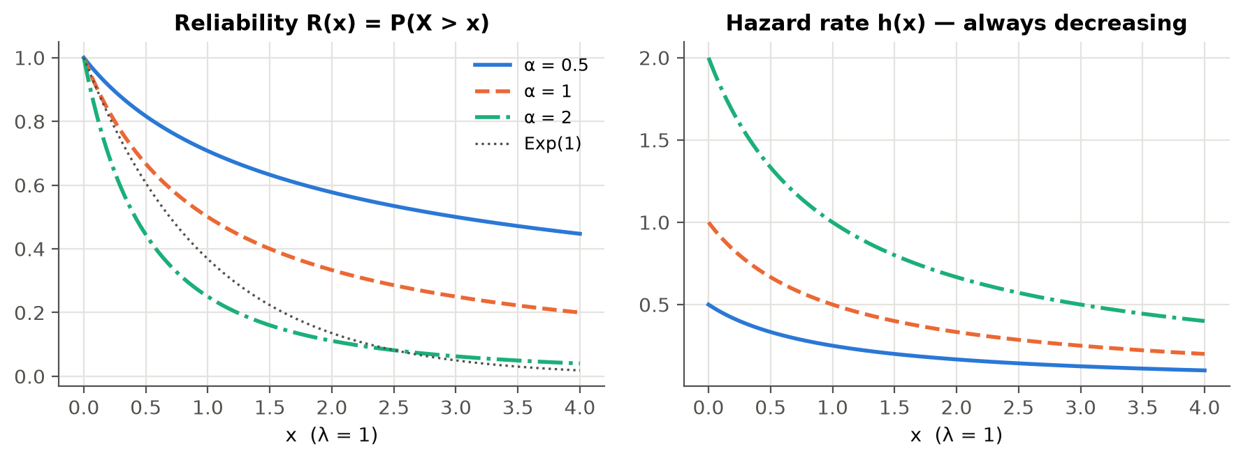
The Lomax (Pareto II) lifetime model
Heavy (polynomial) right tail; mean infinite if α ≤ 1
Hazard always decreasing
Gamma mixture of exponentials; exceedances over a high threshold
Exponential limit: λ → 0, α → ∞
Key trick:
Notes:
The Lomax density, reliability and hazard. Smaller alpha means a heavier tail. The transformation U = alpha log(1 + lambda X) is exponential with mean 1; it is the key to every result that follows.

Slide 5
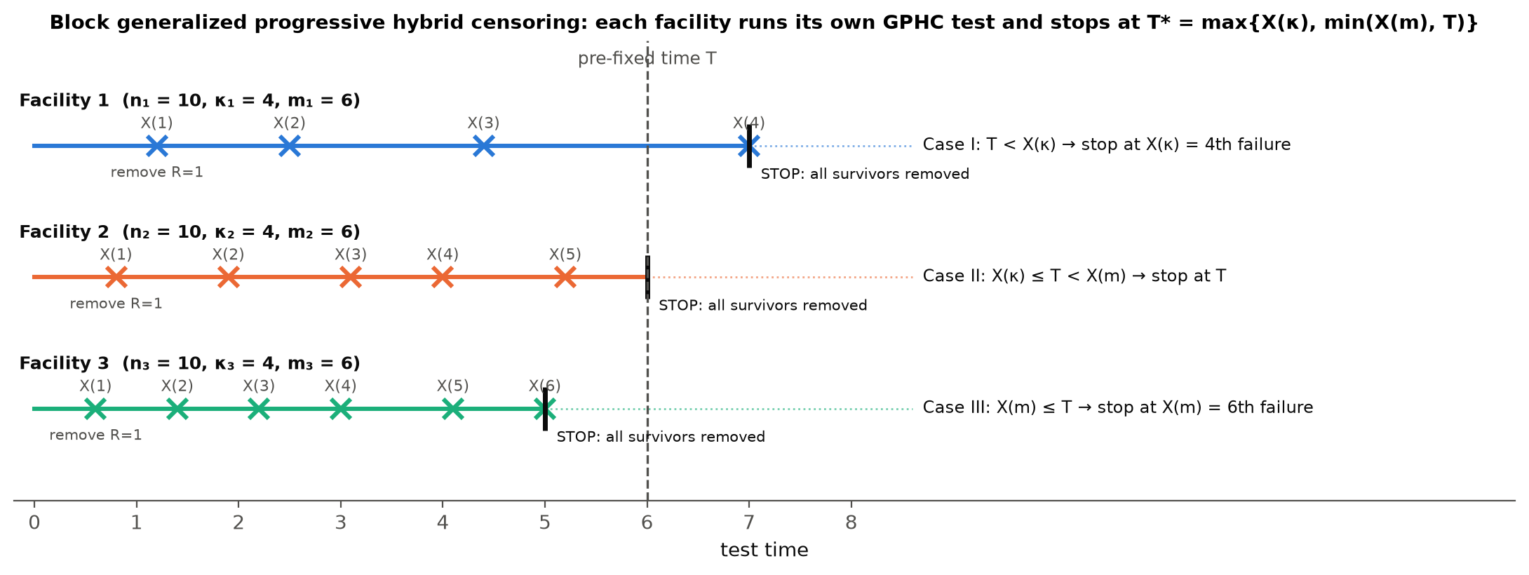
Block generalized progressive hybrid censoring (BGPHC)
Case I: stop at the κ-th failure · Case II: stop at T · Case III: stop at the m-th failure. Each facility i records Dᵢ failures, removals Rᵢⱼ and Rᵢᵀ units withdrawn at T.
Notes:
Each of k facilities runs its own GPHC test (Cho, Sun and Lee, 2015). At least kappa failures are always seen. Contains block progressive Type-II censoring (T infinite) and block Type-I hybrid censoring as special cases.

Slide 6
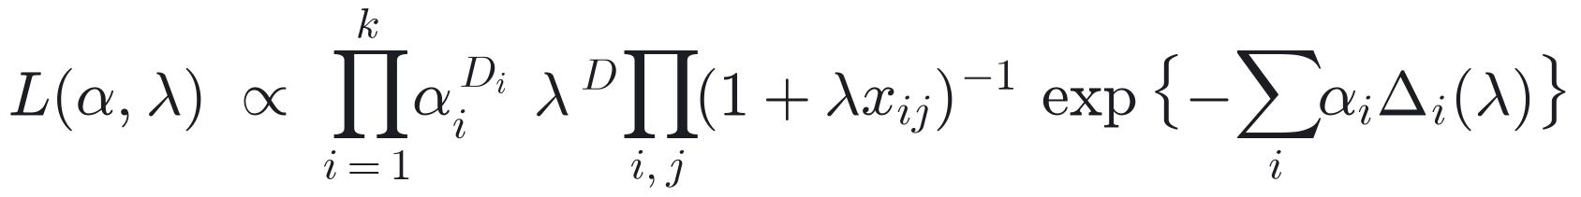
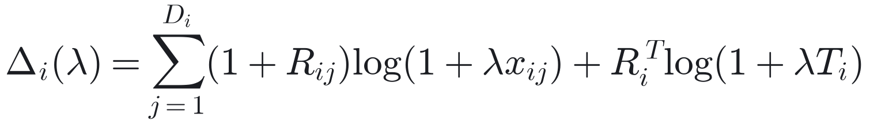
One likelihood covers all three cases
Key insight
Δᵢ(λ) is the total time on test on the exponential scale log(1 + λx)
For fixed λ, αᵢ appears only as αᵢ^Dᵢ e^(−αᵢΔᵢ) — a gamma kernel
→ closed-form MLE of αᵢ, chi-square pivots, gamma posterior conditionals, isotonic order-restricted solution
Notes:
Failures contribute the density, withdrawn units contribute the survival function. The gamma-kernel structure in alpha is what makes all four methods tractable.

Slide 7
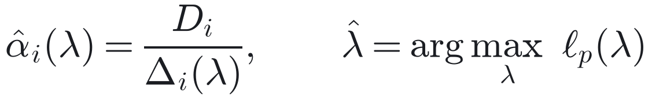
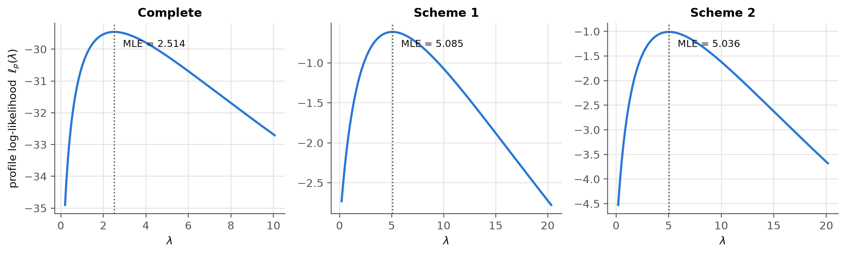
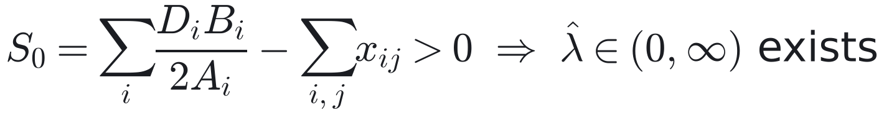
Maximum likelihood estimation
Profile likelihood ℓp(λ) → 1-D search (grid + Brent)
Theorem 2: MLE exists if S₀ > 0 — for one complete sample this is CV > 1 (data more variable than exponential)
Otherwise λ̂ → 0, α̂ → ∞ (exponential limit)
Asymptotic CIs: observed Fisher information + delta method for R(t), h(t), MdTF
Profile log-likelihood of λ, coal-mining data (complete, Scheme 1, Scheme 2): a single maximum
Notes:
For fixed lambda the MLE of alpha_i is D_i over Delta_i. Substituting gives a one-dimensional profile likelihood. Existence requires the data to look more variable than an exponential; this explains why the MLE can break down in small samples.

Slide 8
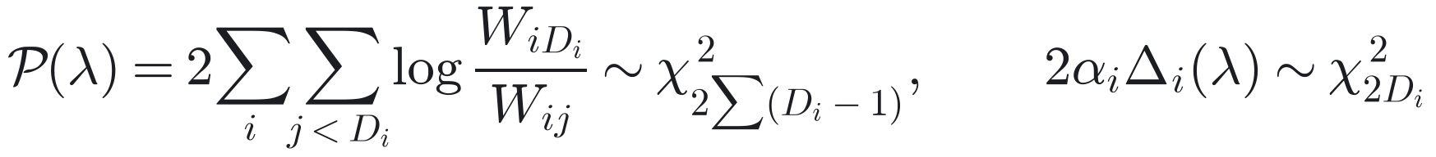
Pivotal (generalized pivotal quantity) inference
Theorem 3 (new for Lomax)
1
Draw c ~ χ² truncated to (0, 𝒫(0⁺)); solve 𝒫(λ) = c (bisection)
𝒫(λ) is strictly decreasing in λ
𝒫(λ) → 0 as λ → ∞, but 𝒫(0⁺) is finite (exponential limit)
So 𝒫(λ) = c has a root only if c < 𝒫(0⁺) → draw c from a truncated χ²
IER/Burr-XII pivots (refs 1–2) increase from 0 to ∞ — no truncation needed there
2
Draw χ²(2Dᵢ) and set αᵢ = χ² / (2Δᵢ(λ))
3
Repeat N times → point estimate = median, 95% GCI = 2.5% and 97.5% quantiles
Median, not mean: the pivotal draws are very right-skewed.
Notes:
The ratio pivot does not depend on alpha. For Lomax it decreases in lambda and is bounded, which is different from the reference papers, so we truncate the chi-square draws. Given lambda, a second chi-square pivot gives alpha_i. We use the median of the draws because the mean is unstable.

Slide 9
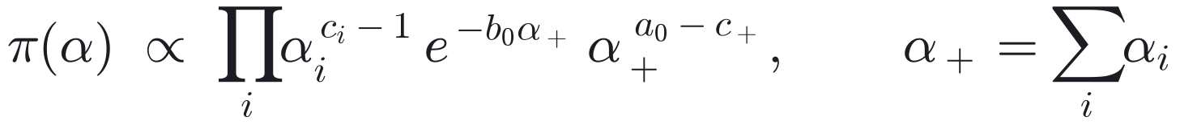
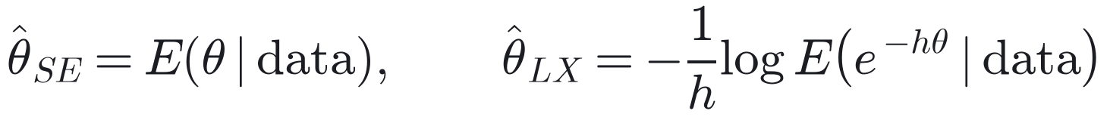
Bayesian estimation with a joint Gamma–Dirichlet prior
Importance sampler (exact, no MCMC)
Sum α₊ ~ Gamma(a₀, b₀); shares αᵢ/α₊ ~ Dirichlet(c) (ref. 3)
Dependent prior: correlation > 0 if a₀ < c₊, = 0 if a₀ = c₊, < 0 if a₀ > c₊
λ ~ Gamma(a, b) — must be proper: vague priors give an improper posterior
1
Sample λ from its 1-D marginal on a fine grid
2
Sample αᵢ | λ ~ Gamma(Dᵢ + cᵢ, b₀ + Δᵢ(λ))
3
Weight w = α₊^(a₀ − c₊) → posterior means, LINEX, HPD
Squared-error and LINEX (h = 1) loss; 95% HPD credible intervals
No burn-in, no tuning, fully vectorised; exact when a₀ = c₊.
Notes:
The joint prior links the facility effects through their sum and shares. The posterior factorises into an easy part times a simple weight, so importance sampling is exact and fast. A proper prior on lambda is essential because the likelihood does not vanish at lambda to zero.

Slide 10
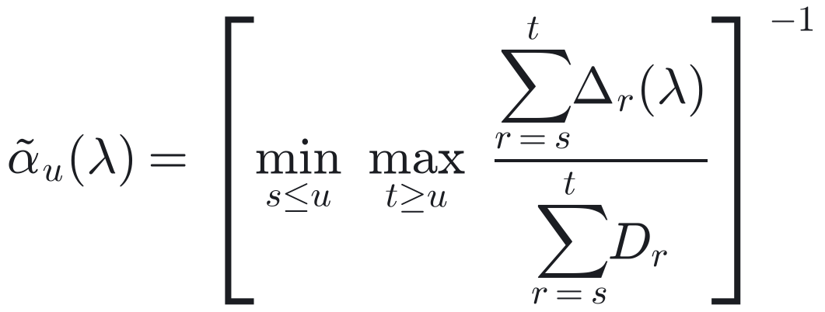
Order-restricted inference: α₁ ≤ α₂ ≤ … ≤ αₖ
19–42%
Order-restricted MLE (isotonic regression)
of simulated samples had unrestricted MLEs in the wrong order
Stress levels, operators or time periods often have a known ordering
Coal data: mine safety improved, so tails got lighter
Computed by pool-adjacent-violators; then maximise over λ.
Order-restricted Bayes (ordered GD prior, ref. 3)
Prior = density of the order statistics of a GD vector (sum over k! permutations)
Sampler: draw αᵢ' from the gamma conditionals, sort them, re-weight by target / density of the sorted vector
Notes:
When we know the ordering, imposing it removes impossible estimates. The OR-MLE pools adjacent facilities that violate the order. The Bayesian version uses the ordered Gamma-Dirichlet prior; sorting the proposals keeps every draw inside the ordered region.

Slide 11
Simulation design
Facilities / truth | k = 3; α = (0.50, 0.75, 1.00) (ordered), λ = 1, t₀ = 1
Sizes (nᵢ, mᵢ, κᵢ) | S1 = (20, 15, 10), S2 = (30, 24, 15), S3 = (40, 32, 20)
Time limit | T = 3 (short test), T = 8 (long test)
Removal schemes | A: all at m-th failure; B: all at 1st failure; C: half / half
Replications | 2,000 per design × 18 designs; 1,000 pivotal draws; 2,000 IS draws
Priors | P1 informative (a₀ = 4), P2 weakly informative (a₀ = 1)
Criteria | Bias, MSE, median abs. error; length and coverage of 95% intervals
Heavy tails (α ≤ 1) keep the Lomax clearly away from its exponential limit; a light-tailed pilot (α = 1–2) gave non-existent MLEs in about 20% of samples.
Notes:
Eighteen designs. Samples are generated with the Balakrishnan-Sandhu algorithm and cut by the GPHC rule. Each design produces estimates from twelve estimators.

Slide 12
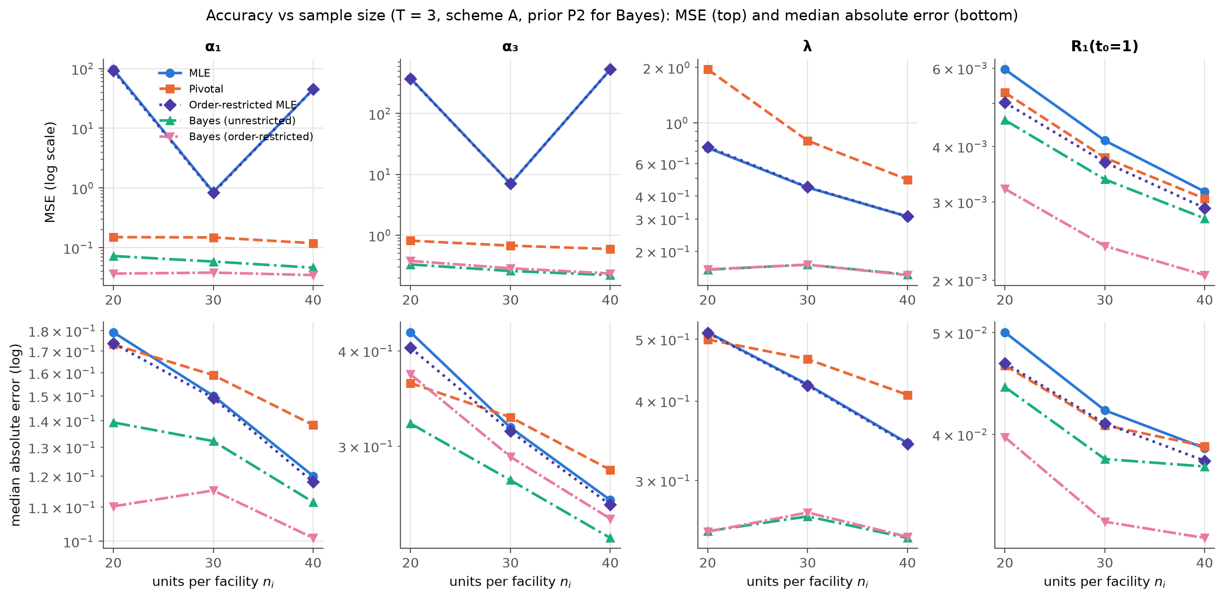
Accuracy: Bayes-OR is best; the MLE has rare but huge failures
96.6 vs 0.15
MSE of α₁: MLE vs pivotal (n = 20, T = 3) — same typical error (0.18 vs 0.17)
18 / 18
designs where order-restricted Bayes has the lowest MSE for α₂, R₂, R₃
Bottom row: median absolute error — robust to the few runaway MLEs.
Notes:
Top: MSE; bottom: median absolute error. The MLE's MSE explodes because a few near-exponential samples push alpha-hat to huge values, while its typical error is fine. Pivotal estimates are stable. Bayes, especially order-restricted, is the most accurate.

Slide 13
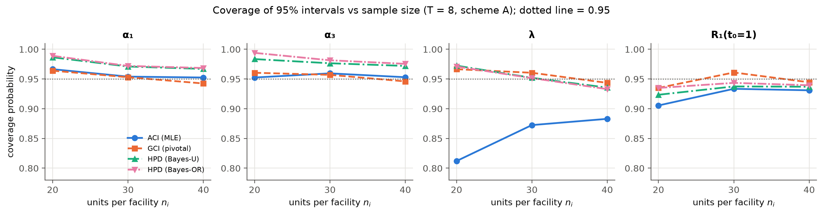
Intervals: pivotal GCIs keep their promise of 95%
93.5–97.5%
81–90%
Shortest
coverage of pivotal GCIs in all 18 designs
coverage of MLE-based ACIs for λ (Wald fails)
Bayes HPD intervals, coverage ≥ 95% for α, λ; 92–96% for R(t)
Notes:
The normal approximation is poor for lambda, so ACIs under-cover. Pivotal intervals are wider but honest. Bayes HPD intervals are the shortest; they over-cover slightly because the priors are centred at the truth.

Slide 14
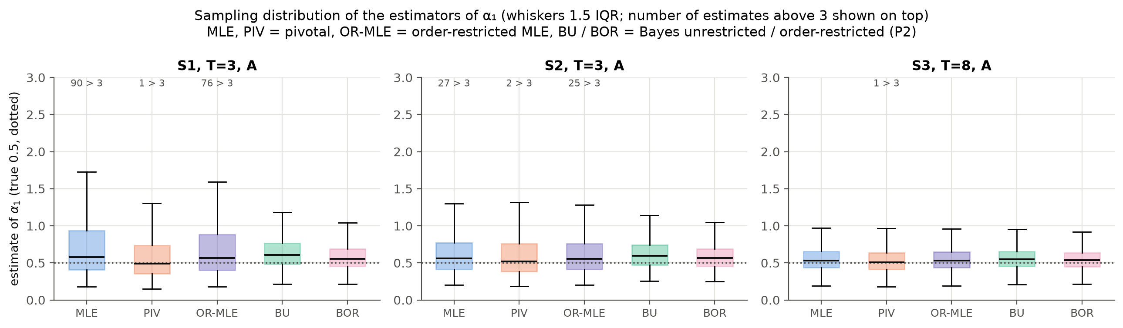
Why the MLE's MSE explodes
Typical MLE is fine — the medians sit near the truth (0.5)
But 90 of 2,000 MLEs exceed 3 when nᵢ = 20, T = 3: the sample looks exponential, λ̂ → 0, α̂ explodes (Theorem 2)
Pivotal and Bayes estimators are robust; the problem fades for nᵢ ≥ 30 with a long test
Notes:
Box plots of 2,000 estimates of alpha_1. The counts on top show how many MLEs fall above 3. This is the practical message: do not trust the plain MLE for Lomax shapes in small or short tests.

Slide 15
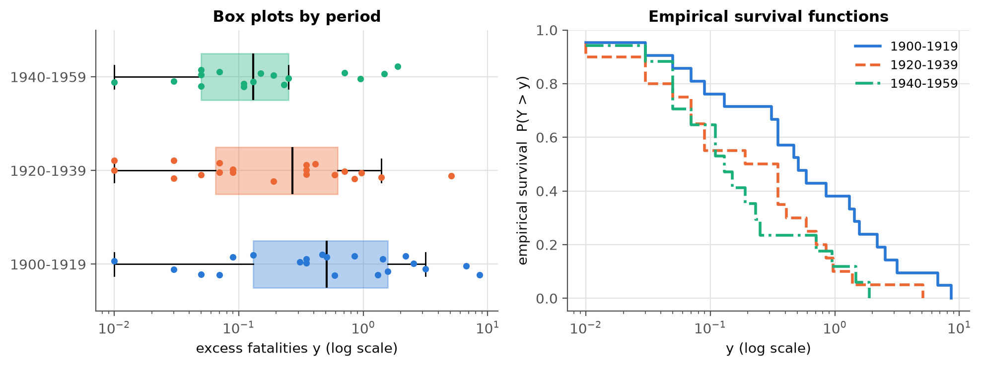
Real data: fatalities in British coal-mining disasters
Disasters with ≥ 10 deaths (data from ref. 2); 3 periods = 3 "facilities": 1900–19 (n = 21), 1920–39 (n = 20), 1940–59 (n = 17)
Model the excess over the recording threshold: y = x − 0.19 (peaks over threshold)
Prior knowledge: safety improved, so tails get lighter: α₁ ≤ α₂ ≤ α₃
All three periods are right-skewed with coefficient of variation > 1 → Lomax MLE exists.
Notes:
This is the coal-mining data analysed in the IER reference paper. The excess over the threshold is the natural Lomax variable. Later periods have lighter tails, consistent with improved safety.

Slide 16
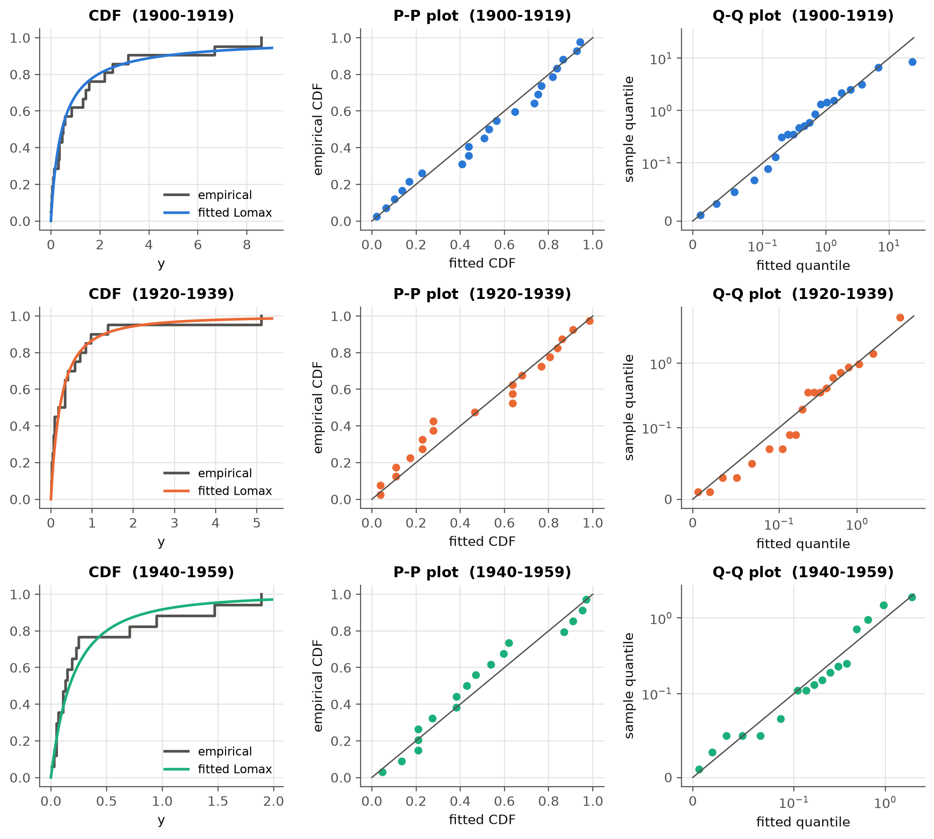
Model checking: Lomax fits, common λ is supported
p > 0.54
p = 0.65
KS tests, Lomax with common λ, all periods
LRT: H₀ λ₁ = λ₂ = λ₃ not rejected
p = 0.051
p = 0.026
LRT: H₀ α₁ = α₂ = α₃ (complete data)
same test, censored Scheme 2
Lomax beats the exponential on AIC in every period; the exponential is rejected for 1920–39 (KS p = 0.035).
Notes:
Goodness of fit with KS tests and probability plots, then likelihood ratio tests from the course: a common lambda is supported, and there is evidence that the shapes differ across periods.

Slide 17
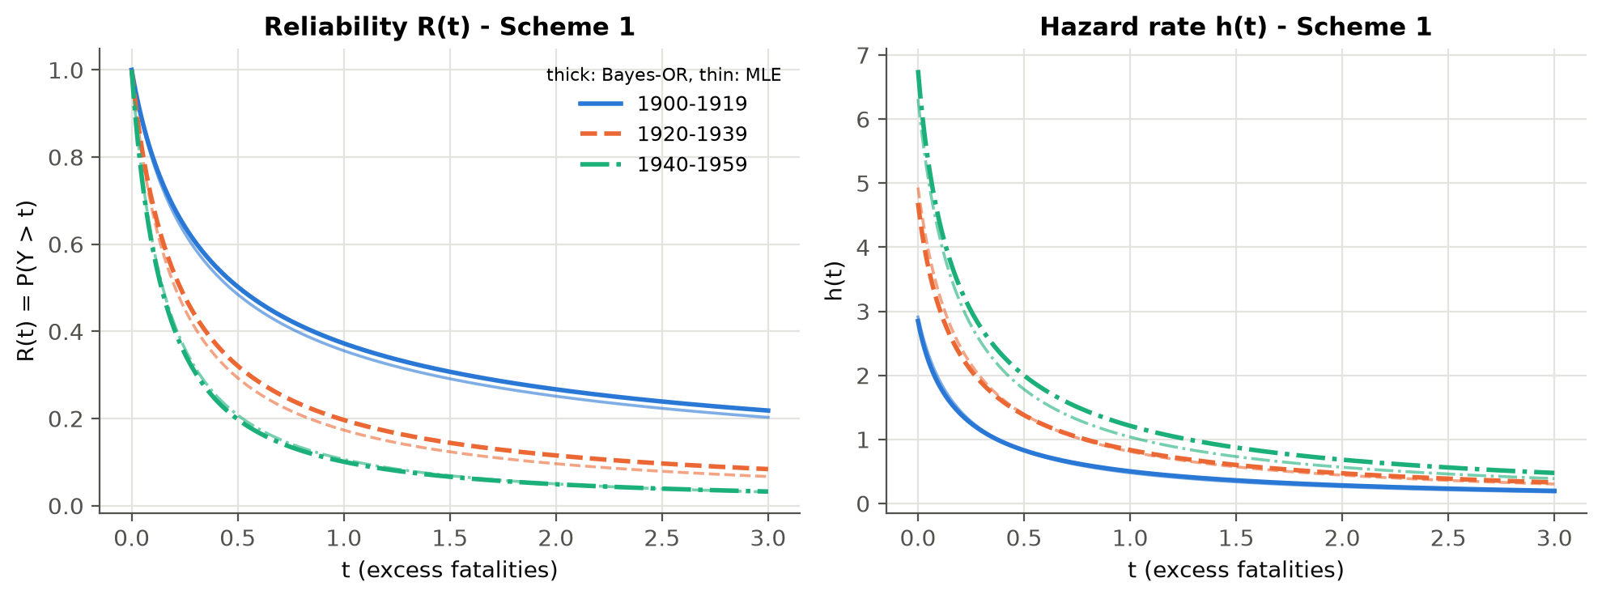
Estimates: large disasters became much less likely
Complete data | MLE | Pivotal | Bayes-U | Bayes-OR
α₁ (1900–19) | 0.913 | 0.794 | 0.980 | 0.981
α₂ (1920–39) | 1.602 | 1.342 | 1.753 | 1.663
α₃ (1940–59) | 1.981 | 1.638 | 2.178 | 2.328
λ | 2.514 | 3.326 | 2.675 | 2.663
R₁(0.5) | 0.476 | 0.470 | 0.487 | 0.488
R₂(0.5) | 0.271 | 0.275 | 0.287 | 0.303
R₃(0.5) | 0.199 | 0.208 | 0.218 | 0.192
P(a disaster kills > ~35 people) fell from ≈ 0.48 (1900–19) to ≈ 0.20 (1940–59)
Censoring (Schemes 1, 2) widens intervals for λ but barely moves R(t)
Bayes-OR gives the shortest HPD intervals for the reliabilities
Notes:
All methods agree on the ordering. R_i(0.5) is the probability that a qualifying disaster kills more than about 35 people; it dropped by more than half. The curves show Bayes-OR (thick) versus MLE (thin) for censored Scheme 1.

Slide 18
Conclusions and recommendations
Pivotal → honest intervals
Order-restricted Bayes → most accurate
Be careful with the plain MLE
Truncated, median-based GPQs give near-95% coverage without priors or large-sample theory.
The joint GD prior plus a known ordering gives the smallest errors and the shortest intervals.
Lomax shapes need visible tails: small or short tests can make the MLE (and Wald CIs) unreliable.
Future work: exact pivots under GPHC, bootstrap intervals for the OR-MLE, optimal censoring plans, facility-specific λᵢ.
Notes:
Three take-home messages, then possible extensions.

Slide 19
References
[1] Kumari, Tripathi, Lodhi & Wang (2025). Pivotal based reliability inference for Burr-XII distribution under block progressive type-II censoring. Comm. Stat. – Simulation & Computation 55(8).
[2] Lodhi, Gangopadhyay & Bhattacharya (2025). Likelihood and pivotal-based reliability inference for inverse exponentiated Rayleigh distribution under block progressive censoring. QTQM 22(4), 779–804.
[3] Sultana, Çetinkaya, Raqab & Kundu (2026). Inference for block Type-I hybrid censored Weibull populations. Comm. Stat. – Theory & Methods 55(11), 3436–3459.
[4] Cho, Sun & Lee (2015). Exact likelihood inference for an exponential parameter under generalized progressive hybrid censoring scheme. Statistical Methodology 23, 18–34. (the one additional reference)
Course texts: Casella & Berger, Statistical Inference; Hogg, McKean & Craig, Introduction to Mathematical Statistics.
Notes:
Three reference papers from the brief plus one extra paper that defines the censoring scheme.

Slide 20
Thank you — questions?
Code, results, report and this deck are fully reproducible (fixed random seeds).
Notes:
Open the floor for questions.

