Slide 1

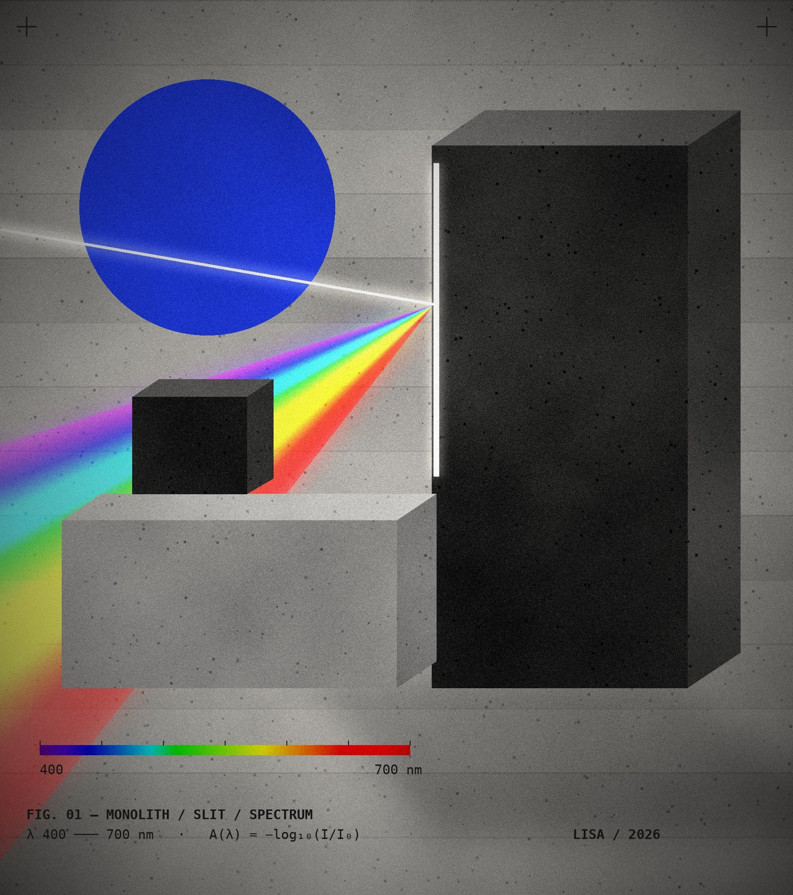
ASHOKA STARTUP CHALLENGE · 2026
LISA
Light-based In-field
Spectral Analyser
A ₹500 clip-on optic and a physics-informed engine that turn any smartphone into a calibrated water-chemistry lab, and that refuse to guess when they can’t be sure.
400–700
151
<50 ms
100%
nm range
spectral bands
on-device DSP
offline
Built on Feng et al., Sensors & Actuators B 462 (2026) 140011
Notes:
Stuti opens (15 s). "Judges, twelve years ago Foldscope proved that a sheet of paper could become a clinical microscope. Today we present LISA, which does the same thing for water chemistry." Pause and let the cover art sit: light goes in through a slit and comes out as a spectrum. That is the whole instrument.

Slide 2
02 — THE PROBLEM
LISA / ASHOKA STARTUP CHALLENGE 2026
2.1B
FIG. 02 — % OF GROUNDWATER SAMPLES ABOVE BIS LIMIT
people, 1 in 4 on Earth, still lack safely managed drinking water.
And in India the contamination is chemical and invisible. You cannot see nitrate, fluoride or iron in a glass of water.
15,259
56%
263
groundwater samples, CGWB 2024
of districts hit by nitrate
districts with excess fluoride
Sources: WHO/UNICEF JMP 2025 (Progress on household drinking water 2000–2024); CGWB Annual Ground Water Quality Report 2024, via Mongabay India (Jan 2025).
02 / 24
Notes:
"One in four people on Earth lacks safely managed drinking water. In India the threat is chemical: the CGWB tested 15,259 wells and one in five failed on nitrate. Fluoride shows up in 263 districts, including the belt near us in Haryana. None of it has a colour, a smell or a taste."

Slide 3
03 — THE BLIND SPOT
LISA / ASHOKA STARTUP CHALLENGE 2026
India already has the testers.
It doesn’t have the instrument.
24.8 lakh
93.8 lakh
0
rural women trained under Jal Jeevan Mission to test water with Field Testing Kits (FTKs)
water samples tested in 2024–25, and 47.6 lakh in 2025–26 so far
objective readings: FTK results are matched by eye against a printed colour chart
“Results obtained through FTKs serve as indicative screening results and are supplemented through confirmatory testing in laboratories.”
PIB · MINISTRY OF JAL SHAKTI
16 MARCH 2026
Source: Press Information Bureau, “Field Testing Kits under JJM for community water monitoring”, 2026. FTK = colour-chart chemical kit.
03 / 24
Notes:
"The government has already done the hard part and trained 24.8 lakh women. But their kits ask a human eye to compare a shade of blue against a paper card, in sunlight or under a tube light. So the government itself calls these results indicative. There is no GPS, no timestamp and no audit trail."

Slide 4
04 — THE TRADE-OFF
LISA / ASHOKA STARTUP CHALLENGE 2026
Accurate or accessible.
Today, never both.
ACCREDITED LAB
FIELD TEST KIT
LISA
UV-Vis / ICP-MS
Paper colour chart
The third category
High accuracy
Days to weeks of turnaround
₹500–₹2,500 per sample
Trained chemist + cold chain
Far from the handpump
Cheap, minutes, portable
Subjective, reads by eye
Lighting-dependent error
No digital record or GPS
Legally “indicative” only
Full-spectrum measurement
Minutes, at the source
₹8–12 per test (target)
Phone you already own
Geotagged, audited, offline
04 / 24
Notes:
"You either send the sample to a distant NABL lab and wait two weeks, or you hand a rural worker a paper strip and ask her to guess a shade of blue. LISA is a third category: lab-grade measurement at field-kit cost, on a phone she already owns."

Slide 5




05 — THE INSIGHT
LISA / ASHOKA STARTUP CHALLENGE 2026
Every smartphone is already
¾ of a spectrometer.
01
02
03
04
LIGHT SOURCE
SAMPLE CELL
DISPERSION
DETECTOR + CPU
White LED
10 mm cuvette
Grating + slit
CMOS + SoC
ALREADY IN YOUR POCKET
ALREADY IN YOUR POCKET
← LISA ADDS THIS, ~₹200
ALREADY IN YOUR POCKET
A ₹10-lakh benchtop spectrophotometer has four parts. 700 million Indians already carry three of them. LISA supplies the missing optical geometry, and the software that makes a consumer camera behave like an instrument.
05 / 24
Notes:
"A lab spectrometer is four parts: light, sample cell, something that splits colour, and a sensor with a computer. Your phone has three of the four. We add the fourth, a diffraction grating and a razor-blade slit in a folded card, and then the software does the heavy lifting."

Slide 6
06 — RESEARCH FOUNDATION
LISA / ASHOKA STARTUP CHALLENGE 2026
What it proved
THE PAPER WE BUILD ON
“A consumer-ready smartphone spectrometer for accessible intelligent pocket sensing”
RESULT IN THE PAPER | NUMBER | WHAT IT MEANS FOR LISA
Optical module | 69×47×26 mm · 35 g | Form-factor target for v2
Range / wavelength accuracy | 400–700 nm · ±1 nm | Identical design range
Signal-to-noise · intensity drift | >500:1 · <1.5% | Benchmark for our hardware
Total-phosphorus accuracy | <10% rel. error · RSD <1% | Phone + chemistry works
Real wastewater (20 samples) | MAE 0.020 mg/L · 16/20 ≤10% | Field screening, honestly framed
AI model (GAF + 2D-CNN, 480 spectra) | R² 0.996 vs PLSR 0.960 | Our v2 model at scale
Cross-device calibration | R² 0.42–0.64 → 0.91–0.97 | Why we fingerprint each phone
Price | < $700 (bench > $10k) | We go 10× cheaper
Feng J, Liu Y, Fu Y, Li X, Ai B
Chongqing University
Sensors & Actuators B: Chemical
Vol. 462 · 140011 · 1 Sep 2026
DOI 10.1016/j.snb.2026.140011
40+ min → <5 min
TOTAL-PHOSPHORUS ANALYSIS TIME
Figures as reported in Feng et al. 2026. The paper measured total phosphorus; LISA measures orthophosphate and says so.
06 / 24
Notes:
"This is not hackathon vapourware. A peer-reviewed paper published this month in Sensors and Actuators B shows a phone spectrometer measuring phosphorus with under 10% error, cutting a 40-minute lab test to under 5 minutes. Their cross-device result is the reason LISA fingerprints every phone. Be precise if asked: they measured total phosphorus with filtration only, so we call real-sample agreement a practical consistency check."

Slide 7
07 — RELATED WORK
LISA / ASHOKA STARTUP CHALLENGE 2026
A decade of pocket optics.
LISA is the field-ready synthesis.
2014
2014
2016
2016
2018
2021
2023
2026
Foldscope
Mobile diagnostics
Colorimetric biosensing
SpectroPhone
Field review
Which phone?
Dual-beam
Pocket sensing
Cybulski, Clements, Prakash · PLoS ONE
Ozcan · Lab on a Chip
Wang et al. · Analyst
Das, Wahi, Kothari, Raskar · Sci. Reports
McGonigle et al. · Sensors
Pitula, Koba, Śmietana · Opt. Laser Tech.
Jarujareet et al. · J. Chem. Educ.
Feng et al. · Sens. Actuators B
Origami paper microscope for under $1. Our form-factor DNA.
Phones as imaging and measurement instruments.
Smartphone spectrometer reads biochemical assays.
Wireless phone spectrometer grades fruit ripeness.
State of smartphone spectrometers and CFL calibration.
Camera choice changes the spectrum. Calibrate per device.
Low-cost reference-beam spectrometer for teaching.
Consumer-ready, AI app, <10% error on phosphorus.
2026 · LISA Foldscope-cheap optics + Feng-grade chemistry + calibration, QC and refusal logic built for India’s field testers
07 / 24
Notes:
"We did not invent phone spectroscopy, and we say so. Foldscope showed frugal optics could scale, Raskar's lab and others proved phone spectrometers, Pitula showed every camera is different, and Feng proved the chemistry. LISA packages all of it for one user: a JJM tester at a handpump."

Slide 8
08 — OUR CONTRIBUTION
LISA / ASHOKA STARTUP CHALLENGE 2026
Same physics.
Rebuilt for a village handpump.
LAYER | FENG ET AL. 2026 | LISA
OPTICS | Machined module, magnetic mount, fibre coupling | Folded 300 gsm card, razor-blade slit, film grating
COST | Under $700 retail | ₹500 prototype → ₹250–320 at 10k units
CHEMISTRY | One analyte (total P), lab/industry users | Swappable packs for India: phosphate → iron → fluoride
INTELLIGENCE | GAF + 2D-CNN in a cloud app | Beer–Lambert vs Ridge, auto-selected by cross-validation
SAFETY | Reports a value | OOD + 5-gate QC: refuses to report a number
USER | English UI, connected | Hindi voice, offline-first, WhatsApp share, GPS log
08 / 24
Notes:
"If a judge asks whether this is just the Chinese paper: the paper proves the physics with a $700 device. We rebuilt it for a few hundred rupees, Foldscope-style, and added what a field tester needs: an engine that refuses bad samples, local-language output and offline logging."

Slide 9
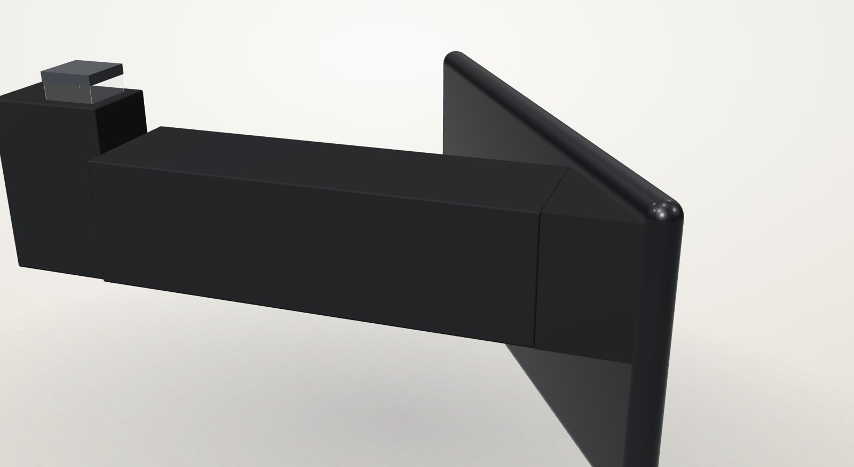
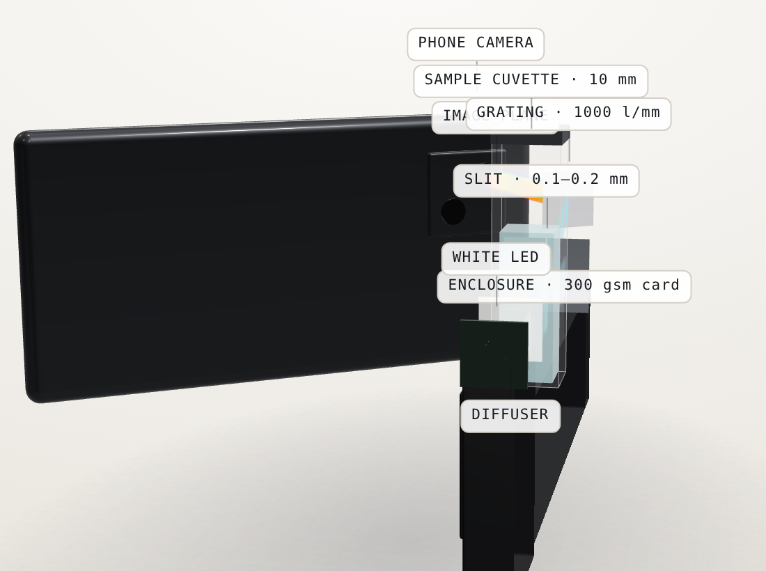
09 — HARDWARE
LISA / ASHOKA STARTUP CHALLENGE 2026
The ₹500 clip-on lab
COMPONENT | PROTOTYPE | AT 10K UNITS
Optical tube: 300 gsm black card + AR tape | ₹150 | ₹110
Grating film + twin razor-blade slit | ₹200 | ₹75
Constant-voltage USB LED module | ₹150 | ₹65
Total hardware kit | ₹500 | ₹250–320
Reagent refill, 50 tests | ₹100 | ₹50–70
FIG. 09 — DIGITAL TWIN,
ASSEMBLED + EXPLODED.
LIVE 3D IN THE APP.
LED → 10 mm cuvette → 0.1–0.2 mm razor slit → 1000 lines/mm grating at 33.4° → phone camera
30×30 mm
33.4°
R² ≈ 1
light-tight tube
wedge: 550 nm mid-sensor
CFL Hg-line λ calibration
BOM from LISA build plan; at-scale costs are targets. Wavelength fit: λ(p) = 0.3333·p + 383.67 nm on CFL lines 435.8 / 546.1 / 611.2 / 631.0 nm.
09 / 24
Notes:
Parth lifts the device. "Folded card, two razor blades, a grating film over the camera. Five hundred rupees today, under three hundred at scale. A household CFL tube is our wavelength ruler: its mercury lines at 436, 546 and 611 nm let us calibrate every phone to within a nanometre."

Slide 10
10 — THE CHEMISTRY
LISA / ASHOKA STARTUP CHALLENGE 2026
Chemistry detects.
Physics measures.
FIG. 10 — MOLYBDENUM-BLUE ABSORBANCE A(λ) · SIMULATED
Orthophosphate + ammonium molybdate + ascorbic acid forms molybdenum blue (US EPA 365.3 · Murphy & Riley 1962). The more phosphate, the more red light the sample swallows.
A(λ) = −log₁₀( I_sample / I_blank ) = ε(λ) · ℓ · c
BEER–LAMBERT · ℓ = 10 mm · λ BAND 630–690 nm
Why phosphate first?
Clean groundwater has almost none. A spike is a tracer for sewage, detergent or fertiliser runoff, and it is the chemistry Feng et al. validated. Iron (IS 10500, 0.3 mg/L) is pack #2.
Curves generated from LISA’s physics simulator model (ε·ℓ·c, logistic onset toward the 880 nm peak). Illustrative, not wet-lab data.
10 / 24
Notes:
Raj. "AI cannot see molecules in clear water. Chemistry makes the contaminant visible, turning phosphate into molybdenum blue. Physics then measures how much red light disappears. Double the phosphate and you double the absorbance: that is Beer–Lambert. The AI's job is to make that measurement reliable on a cheap phone in a real field."

Slide 11









11 — THE ENGINE
LISA / ASHOKA STARTUP CHALLENGE 2026
Hardware captures imperfect light.
Software reconstructs the truth.
01
02
03
04
05
06
07
08
09
Capture
Extract
Register
Blank
Physics
Ridge
Validate
Uncertainty
Verdict
AE/AWB locked camera, upload, CSV or simulator
CV finds the spectral band; column binning ~10× less noise
CFL Hg lines → pixel-to-λ fit, <1 nm residual
Instrument + matrix blanks strip colour and turbidity
Beer–Lambert on the 630–690 nm band
Full 151-band L2 regression; best CV model wins
5 QC gates + Mahalanobis OOD
95% interval: ± δ, never a bare number
SAFE / CAUTION / ALERT / REJECTED
< 50 MS PER SCAN
100% ON-DEVICE
DETERMINISTIC, SEEDED
EVERY RESULT BADGED WITH ITS SOURCE
11 / 24
Notes:
Yash. "Nine stages, under 50 milliseconds, fully offline. We lock the camera so the phone stops beautifying the image, find the rainbow, calibrate it against a tube light, subtract blanks, then run two models side by side. Quality control and uncertainty come before any number reaches the screen."

Slide 12
12 — INTELLIGENCE LAYER
LISA / ASHOKA STARTUP CHALLENGE 2026
Two models compete.
Data picks the winner.
FIG. 12 — GROUPED CROSS-VALIDATION RMSE (mg/L)
LOWER WINS · LEAD RESEARCH TRACK · SIMULATED
MODEL A
Beer–Lambert
A_band = k·c + b
One chromophore band. Transparent, auditable, the chemist’s baseline.
MODEL B
Full-spectrum Ridge
ŵ = (XᵀX + αI)⁻¹ Xᵀy
3.3×
0.9996
0
All 151 bands, L2-regularised. Absorbs baseline skew, scatter and mild interferents.
lower error with Ridge
grouped-CV R²
concentration leakage
Leave-one-concentration-out CV: replicates never leak between train and test.
Phosphate engine in the app: Ridge selected, grouped-CV RMSE 0.0481 mg/L, calibration R² 0.9990. Chart: lead track, 33 standards × 151 bands (LISA_LEAD_IMPLEMENTATION_REPORT).
12 / 24
Notes:
Yash. "Technical judges hate AI for the sake of AI, and so do we. LISA fits the classical Beer–Lambert model and a full-spectrum ridge model, cross-validates both by leaving out whole concentrations, and uses whichever wins. If simple physics is better, LISA uses simple physics."

Slide 13

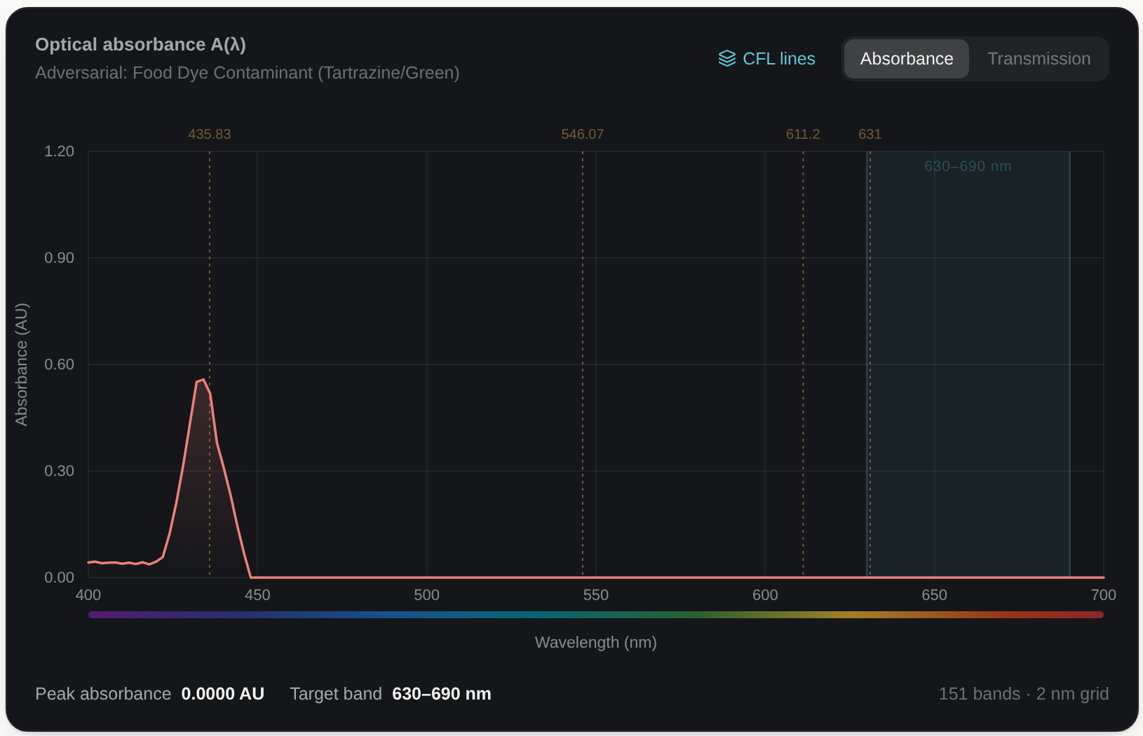
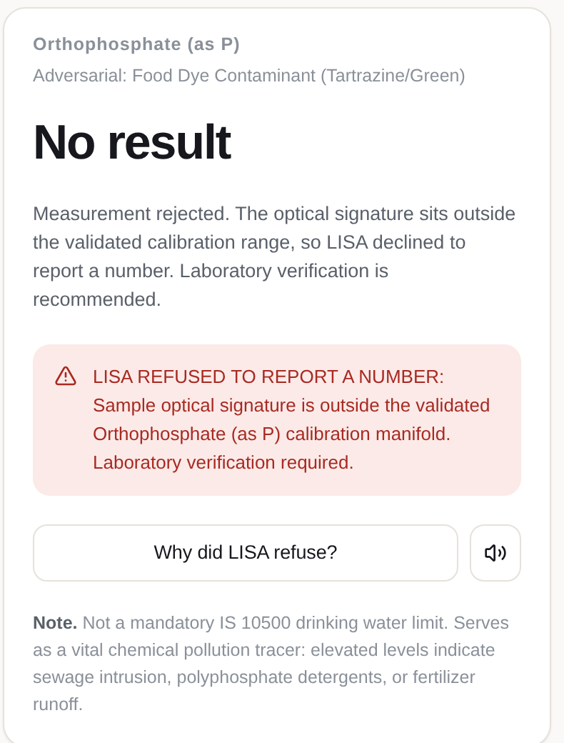
13 — THE SAFETY FEATURE
LISA / ASHOKA STARTUP CHALLENGE 2026
A confident wrong answer
can hospitalise a village.
So LISA refuses.
6 gates before any number
01
Saturation
pixel ≥ 250/255
02
Signal
throughput too low
03
Alignment
cuvette shift > ±6 px
04
Range
above top standard → dilute
05
Turbidity
baseline 400–450 nm
06
OOD
Mahalanobis D > threshold
7/7
0
failure cases
intercepted
false
acceptances
LIVE APP · TARTRAZINE DYE INSERTED AS “PHOSPHATE” → OUT OF DISTRIBUTION → NO NUMBER
13 / 24
Notes:
The mic-drop. Yash inserts the adversarial sample. "The most dangerous sensor is one that guesses when a child's drinking water is at stake. This dye has never been in our calibration space, so LISA refuses and asks for lab verification. Across our failure library (unknown dye, saturation, misalignment, over-range, uncalibrated metal, low light) it intercepted 7 out of 7."

Slide 14
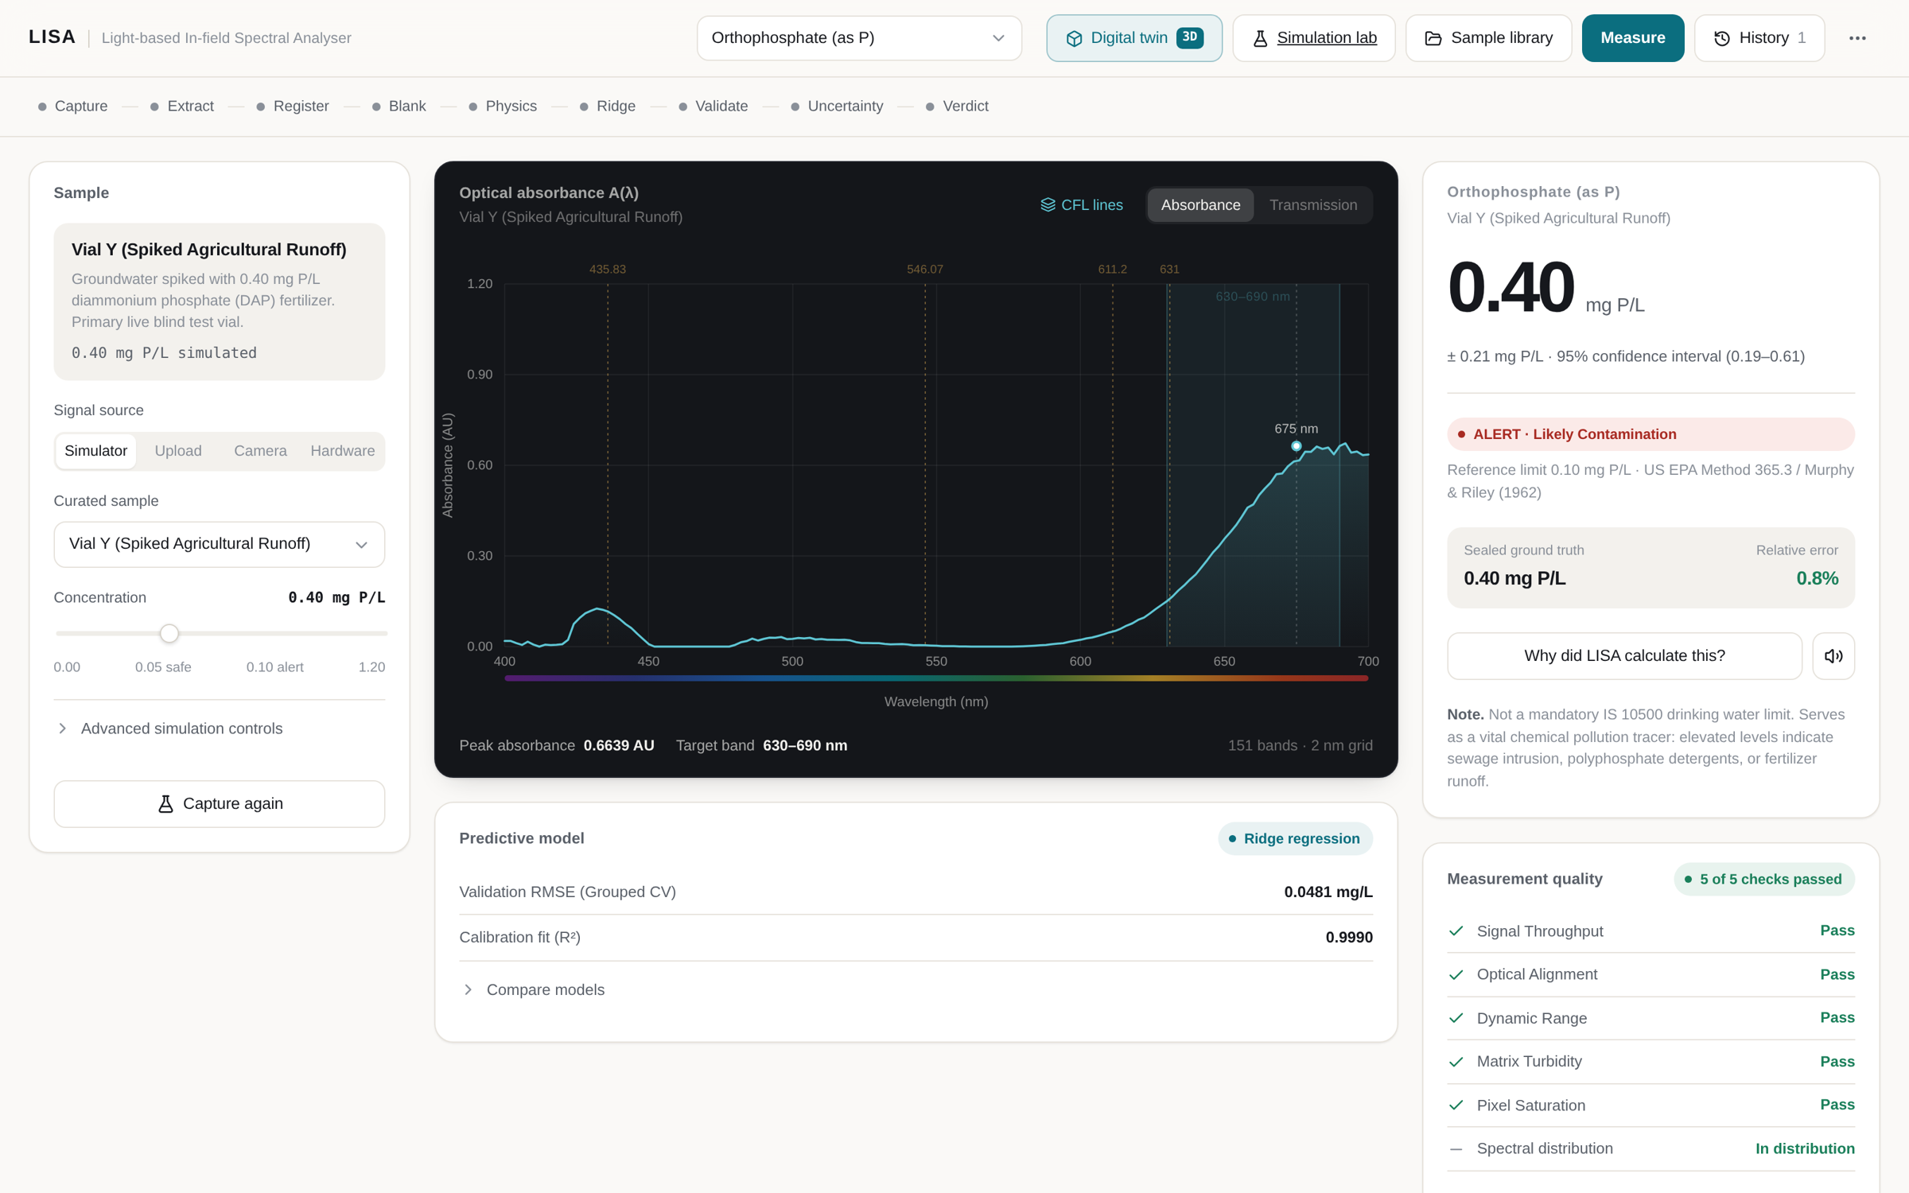






14 — THE PRODUCT
LISA / ASHOKA STARTUP CHALLENGE 2026
Built. Running. Offline.
Hindi + English voice
“फॉस्फेट की मात्रा 0.41 मिलीग्राम प्रति लीटर है”
Offline-first PWA
Measures and stores with zero signal
Geotagged history
GPS, time, device fingerprint, raw spectrum
WhatsApp share
One tap to the panchayat group
3D digital twin
Optics, faults and chemistry, live
20-sample library
Tap water to industrial effluent
14 / 24
Notes:
Screen-mirror the live app here. Demo modes: Run Demo (2 minutes), Judge Blind Test (vials X/Y/Z, sealed truth), Adversarial, Calibrate Phone (device fingerprint LISA-XXXX-XXXX), Hardware. Tap the speaker icon so the Hindi readout plays aloud.

Slide 15
15 — VALIDATION
LISA / ASHOKA STARTUP CHALLENGE 2026
Tested like an instrument,
not a demo.
FIG. 15 — LISA vs BENCHTOP UV-Vis, SPLIT-SAMPLE PROTOCOL
SIMULATED · 7 STANDARDS · mg P/L
50/50
0.034
verification tests passed
MAE, mg/L, 20 scenarios
−0.012
0 · 0
mean bias, mg/L
false accepts · false rejects
144
1e-9
field-stress combinations
run-to-run reproducibility
1.3–3.9% relative error across 0.1–1.0 mg/L
All figures from LISA’s automated test suite and simulated split-sample protocol (LISA_SAMPLE_TEST_REPORT, labBenchmark). Physical NABL split-samples are Month 1.
15 / 24
Notes:
"We built an instrument test suite, not a pitch demo. Fifty verification tests, 144 field-stress combinations of noise, turbidity, misalignment and four phone profiles, zero false acceptances, and bit-for-bit reproducibility. Every number on this slide is computed by the engine, and anything simulated is badged as simulated. Our first milestone is running the same protocol on 100 real samples against a NABL lab."

Slide 16
16 — BLIND TEST
LISA / ASHOKA STARTUP CHALLENGE 2026
Judge picks the vial.
The truth stays sealed.
VIRTUAL FIELD STRESS MATRIX
3 × 3 × 4 × 4
noise × turbidity × slit shift × phone profile = 144 runs on a 0.40 mg/L sample
VIAL | SAMPLE | TRUTH | LISA | OUTCOME
B-01 | Tap water | 0.03 | 0.03 | Accurate
B-02 | Borewell | 0.08 | 0.07 | Accurate
B-03 | DAP runoff | 0.40 | 0.39 | 2.5% err
B-04 | Village pond | 0.45 | 0.42 | 6.4% err
B-05 | Stormwater drain | 0.65 | 0.62 | 4.9% err
B-06 | RO permeate | 0.005 | 0.00 | Below LOD
B-07 | Turbid river | 0.35 | 0.16 | QC warned → sample blank
B-08 | Unknown dye | — | REFUSED | No number
0.053
mg/L mean absolute error
51.4%
rejected: every shift > 6 px caught
0.181
mg/L worst accepted error
mg P/L · 8 HIDDEN VIALS · SIMULATED FIELD LIBRARY
16 / 24
Notes:
Aditi holds three coded vials. "Judges, pick any one. Only I hold the sealed key." Run it, then unseal the envelope. Be upfront about B-07: turbid river water reads low and QC flags it, which is exactly why the protocol adds a sample blank. We show our misses because the refusal logic is the product.

Slide 17
17 — COMPETITION
LISA / ASHOKA STARTUP CHALLENGE 2026
Nothing else sits in
this column.
 | NABL LAB | FTK CHART | HANDHELD PHOTOMETER | RGB PHONE APPS | FENG 2026 DEVICE | LISA
Accuracy | Highest | Low–med, by eye | High | Low–med (RGB) | High, <10% err | High, validating
Time to result | Days–weeks | Minutes | Minutes | Minutes | < 5 min | ~5–10 min
Device cost | Lab + ₹10L gear | Low | ~₹45,000 | ₹0 | < $700 | ₹1,500–2,500
Multi-analyte | Yes | Yes | One per meter | Partial | TP only | Swappable packs
Digital + GPS record | Paper report | None | Some | Some | Cloud | Offline + GPS
Refuses bad samples | Analyst | No | No | No | Not reported | Yes (OOD + QC)
Local-language voice | — | — | — | — | — | Hindi + English
Handheld photometer price is indicative for single-parameter field colorimeters. LISA device cost is target retail. FTK = JJM colour-chart field test kit.
17 / 24
Notes:
"Paper strips are cheap but subjective. Handheld meters cost about forty-five thousand rupees and test one parameter. RGB phone apps read three colour channels. LISA reads 151 spectral bands, handles several chemistries, logs everything offline, and is the only option that refuses a sample it does not understand."

Slide 18
18 — MARKET
LISA / ASHOKA STARTUP CHALLENGE 2026
A government wedge.
Three markets behind it.
TIER 1 · B2G
TIER 2 · B2B
TIER 3 · STEM
TIER 4 · B2C
Jal Jeevan Mission
Aquaculture + agri
Schools + colleges
RWAs + NGOs
24.8 lakh trained testers and 93.8 lakh samples a year, all read by eye today.
Ammonia and phosphate spikes can kill a shrimp pond in hours.
60 students sharing one broken colorimeter.
“Is my borewell or RO water okay?”
Objective, geotagged, audit-ready FTK readings
Pond-side checks without a ₹45k meter
A flat-pack spectrometer per student, on the DBT–Foldscope path
Screening before paying for a lab
12.9 crore tests / year if each JJM tester runs one LISA test a week · about ₹129 crore/yr in refills at ₹10 a test
Illustrative arithmetic: 24.8 lakh × 52 weeks. JJM figures: PIB, March 2026.
18 / 24
Notes:
"We don't ask the government to build new labs. We plug into a network that exists: 24.8 lakh testers. If each one runs a single LISA test a week, that is about 13 crore digital, geotagged tests a year. Aquaculture, schools and housing societies are the markets that follow."

Slide 19
19 — BUSINESS MODEL
LISA / ASHOKA STARTUP CHALLENGE 2026
Razor at cost.
Blades at 80%+.
STREAM | COST | PRICE | MARGIN
Hardware kit | ₹250–320 | ₹1,499–2,499 | 78–84%
Refill (50 tests) | ₹50–70 | ₹399–599 | 82–88%
Panchayat dashboard | ~₹10/device/mo | ₹1,200/yr | 90%+
FIG. 19 — COST AT SCALE vs RETAIL (₹)
₹8–12
~₹1–5
0
per test to the user
chemical cost per test
marginal software cost
Distribute the reader near cost to states, NGOs and farms. Earn on sealed dry-reagent pods and on the water-grid dashboard.
Unit economics are estimates from the LISA build plan, to be validated in pilots. Chart uses mid-points.
19 / 24
Notes:
"Classic razor-and-blade. The reader goes out near cost. Revenue recurs from sealed reagent pods at about ten rupees a test and 80%+ margin, plus a dashboard subscription for panchayats and state missions."

Slide 20
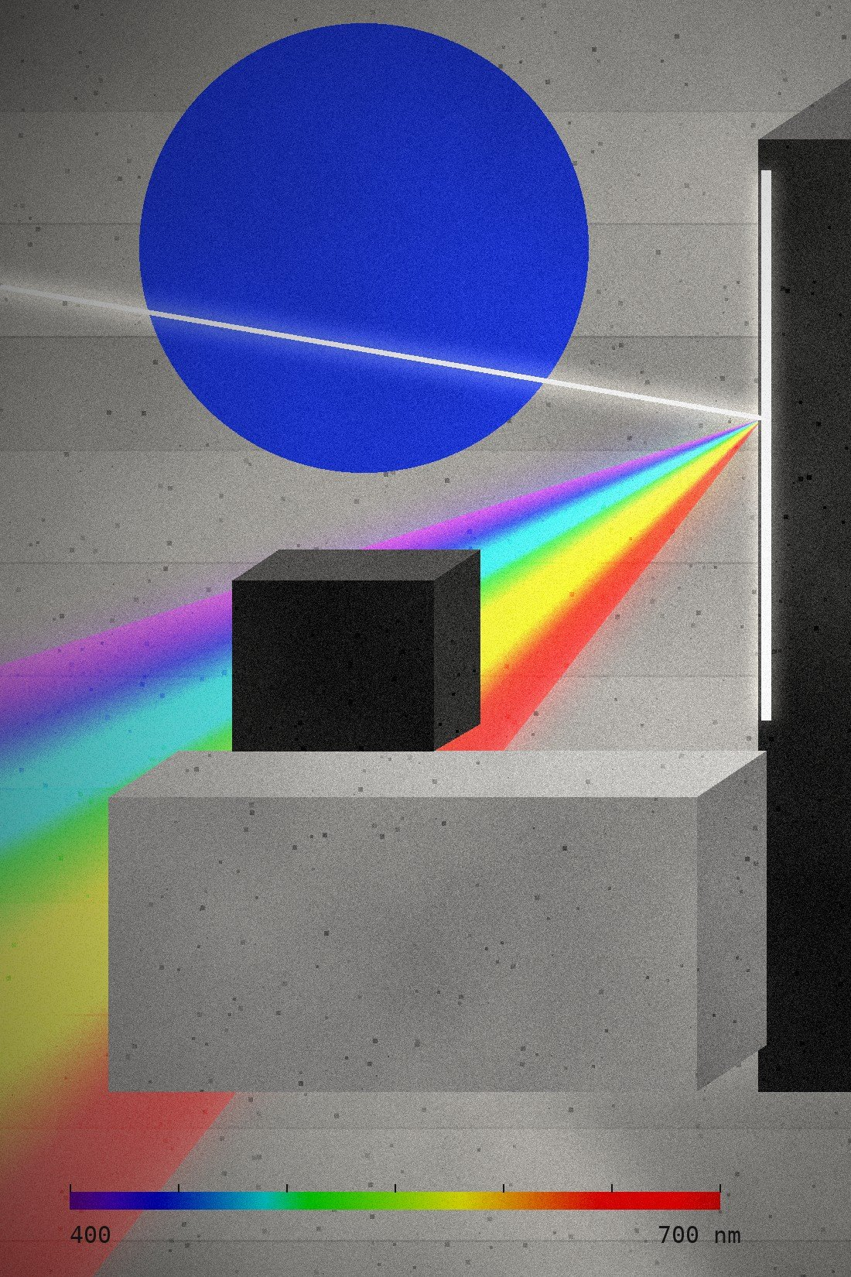
20 — THE MOAT
LISA / ASHOKA STARTUP CHALLENGE 2026
Every test becomes
a pixel on India’s
water map.
GPS + timestamp
Concentration ± δ
where and when
with 95% interval
151-band spectrum
Device fingerprint
raw optical evidence
LISA-XXXX-XXXX
WHAT A COPYCAT CAN’T CLONE
Cross-phone calibration data across hundreds of camera models
Sealed dry-reagent pod formulations
The largest in-field spectral dataset in the Global South
Integration into state water surveillance (JJM / IMIS)
20 / 24
Notes:
"Cardboard and gratings can't be patented. The moat is data. Every validated test uploads a geotagged spectrum, so we learn real Indian water matrices, not synthetic lab water. States see contamination plumes spread in real time instead of waiting months for paper reports."

Slide 21
21 — ROADMAP
LISA / ASHOKA STARTUP CHALLENGE 2026
From hackathon bench
to 25 panchayats.
M1
M2
M3
M6
M12
NABL split-samples
Fluoride pack
Dry reagent pods
Panchayat pilot
State tender
100 real samples (Sonipat + campus), 5 phone models, public white paper
SPADNS assay for Haryana’s fluoride belt + flash-powered v2 optics
Sealed blister chemistry, injection-moulded clip, shared phone model
25 units across 2 Sonipat gram panchayats with VWSC testers
JJM / state-mission procurement + schools edition
CHEMISTRY PACK PIPELINE
Phosphate
Iron
Fluoride
Nitrate
Lead
630–690 nm
510 nm · IS 10500
570 nm · SPADNS
540 nm · Griess
520 nm · dithizone
LIVE
IN DEVELOPMENT
MONTH 2
ROADMAP
RESEARCH · SIMULATED
21 / 24
Notes:
"Month 1 is uncomfortable honesty: a hundred blind split-samples against a NABL lab, published openly. Month 2 is fluoride for Sonipat. By month 6, 25 units with real village testers. Lead stays a research track: at 10 ppb it needs pre-concentration, and we will not overclaim."

Slide 22
22 — HARD QUESTIONS
LISA / ASHOKA STARTUP CHALLENGE 2026
We attacked it first.
Here’s what survived.
“Can it detect lead or arsenic?”
“Isn’t this a DVD taped over a camera?”
Not today, and we won’t pretend. The lead limit is 10 ppb, about 0.003 AU in a 10 mm cell, below a phone’s noise floor. It stays on the research track (pre-concentration), simulated and labelled.
The optics are 200 years old. The instrument is the software: CFL λ-registration, sub-pixel alignment, dual blanks, CV model selection, OOD refusal.
“Phones auto-edit colour.”
“Sulfuric acid in a village?”
We lock exposure, ISO, focus and white balance, then fingerprint each phone. Feng et al. took cross-device R² from 0.42–0.64 to 0.91–0.97 this way.
On stage, cuvettes are sealed and pre-reacted. In production, dry-powder blister pods like the kits 24.8 lakh women already use safely.
22 / 24
Notes:
Golden 30-second rule for Q&A: a direct answer (5 s), empirical proof with a number or citation (15 s), then the roadmap (10 s). Raj takes chemistry questions, Yash takes optics and software, Stuti takes policy and market.

Slide 23
23 — TEAM + ASK
LISA / ASHOKA STARTUP CHALLENGE 2026
Built in 24 hours.
Ready for 24 lakh hands.
Y
R
S
A
P
THE ASK
₹15 lakh
SEED GRANT
YASH
RAJ
STUTI
ADITI
PARTH
Systems & code
Analytical chemistry
Policy & story
Data & verification
Build & hardware
NABL lab partner for 100-sample validation
Pilot access: 2 Haryana gram panchayats
Mentors in B2G procurement and diagnostics
Optics DSP, ML engine, live demo
Reagents, Beer’s law, LOD/LOQ, safety
Narrative, JJM fit, market
Blind vials, validation protocol
Enclosure, BOM, field logistics
Chemistry, software, policy, data and hardware in one room.
23 / 24
Notes:
Stuti closes. "We brought analytical chemistry, software, policy, data and hardware together and took LISA from a paper to a working instrument in 24 hours. We are asking for a seed grant, a NABL validation partner and pilot access to two Haryana panchayats."

Slide 24
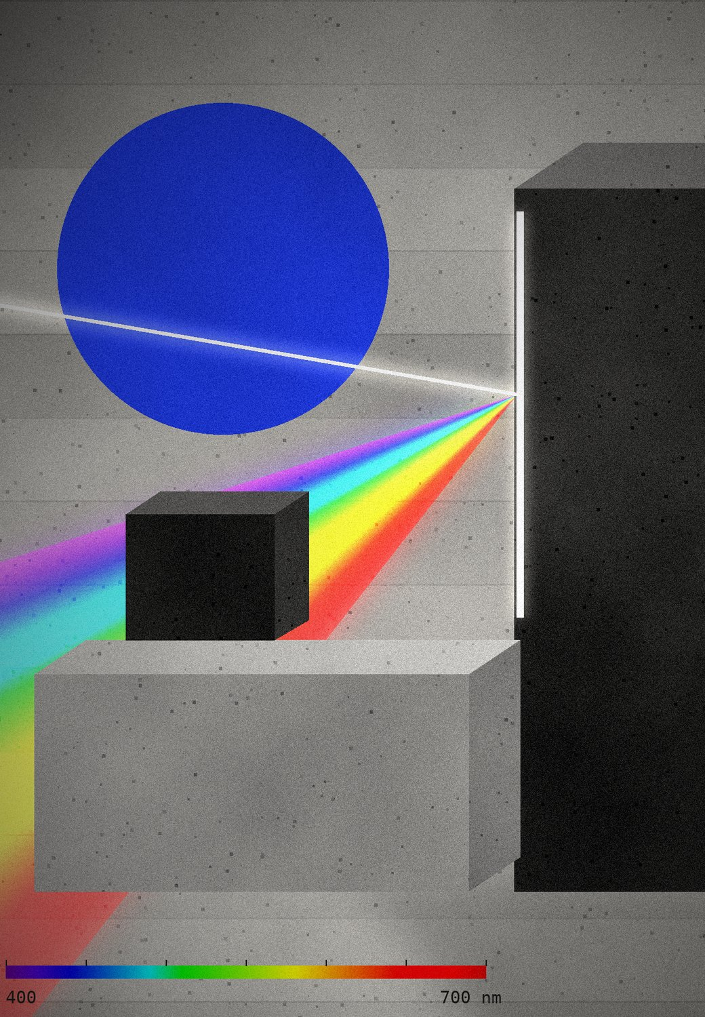
24 — CLOSE
Foldscope put a microscope in every pocket.
LISA puts a water lab there.
REFERENCES
1. Feng J, Liu Y, Fu Y, Li X, Ai B. A consumer-ready smartphone spectrometer for accessible intelligent pocket sensing. Sens. Actuators B 462 (2026) 140011. doi:10.1016/j.snb.2026.140011
2. Cybulski JS, Clements J, Prakash M. Foldscope: origami-based paper microscope. PLoS ONE 9(6) (2014) e98781.
3. Ozcan A. Mobile phones democratize and cultivate next-generation imaging, diagnostics and measurement tools. Lab Chip 14 (2014) 3187.
4. Wang Y et al. Smartphone spectrometer for colorimetric biosensing. Analyst 141 (2016) 3233.
5. Das AJ, Wahi A, Kothari I, Raskar R. Ultra-portable, wireless smartphone spectrometer… Sci. Rep. 6 (2016) 32504.
6. McGonigle AJS et al. Smartphone spectrometers. Sensors 18(1) (2018) 223.
7. Pitula E, Koba M, Śmietana M. Which smartphone for a smartphone-based spectrometer? Opt. Laser Technol. 140 (2021) 107067.
8. Jarujareet U et al. A low-cost dual-beam smartphone visible spectrometer. J. Chem. Educ. 100 (2023) 546.
9. Murphy J, Riley JP. Anal. Chim. Acta 27 (1962) 31–36 · US EPA Method 365.3 (1978).
10. Bureau of Indian Standards. IS 10500:2012 Drinking Water Specification.
11. CGWB. Annual Ground Water Quality Report 2024 · WHO/UNICEF JMP 2025 · PIB, FTKs under JJM (2026).
LISA · LIGHT-BASED IN-FIELD SPECTRAL ANALYSER · THANK YOU
Notes:
"Foldscope proved you don't need a ten-lakh microscope to save lives. LISA proves you don't need a ten-lakh spectrophotometer to know what's in your water. Thank you, and we welcome your hardest questions."

