Slide 1
CONTEXTOPS · THE PROBLEM
Companies are pouring money into AI coding tools, and can’t tell what it buys.
86%
2028
98%
of engineering leaders can’t say which AI tools pay off
AI coding costs pass the average developer salary
of FinOps teams now manage AI spend, up from 31%
Why it matters: engineering managers now own a budget that grows every month, with no way to tie it to what actually shipped.
Sources: DX survey of 275 leaders · Gartner, Jun 2026 · FinOps Foundation, State of FinOps 2026
Notes:
Every engineering team is now paying for AI coding tools like Claude Code, Cursor and Copilot, and many pay for several at once. That bill is growing fast: Gartner expects AI coding costs to pass the average developer's salary by 2028. But 86% of engineering leaders say they can't tell which of these tools actually pays off. The person stuck in the middle is the engineering manager. They now own a budget that grows every month, and they have no way to connect that spend to the work that actually shipped. That's the problem we're solving.

Slide 2
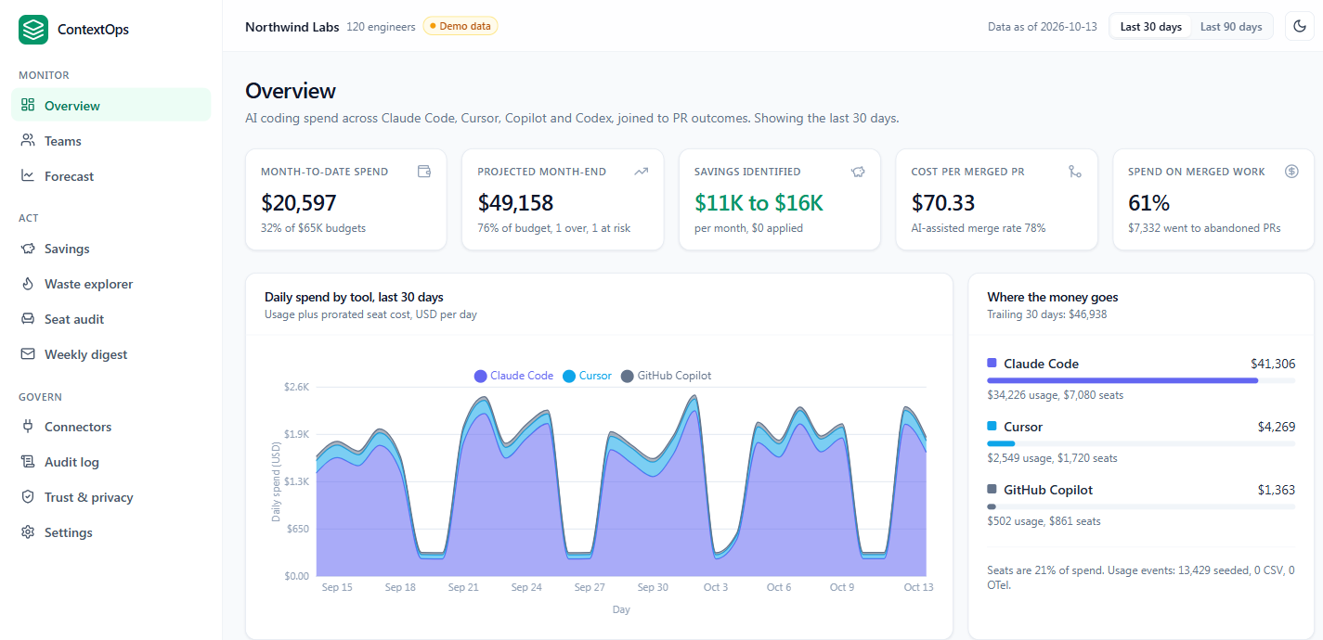
CONTEXTOPS · THIS SEMESTER
From research to a working product
01 Researched
2,200+ engineer posts and 35 startup ideas scored. This one won every round.
02 Built
A working MVP that ties Claude Code, Cursor and Copilot spend to merged code, and fixes waste in one click.
03 Next
20 customer interviews and 5 design partners.
Notes:
This semester we went from an idea to a working product. First, we did the research: we read over 2,200 posts from engineers and managers, and scored 35 different startup ideas against the same rubric. This one won every round. Then we built it. Our MVP connects Claude Code, Cursor and Copilot, shows a team what it spends and what that spending actually shipped, and fixes waste like idle seats or runaway agents in one click, with approval. Next, we're talking to 20 engineering leaders and signing 5 design partners to prove they'll pay for it.

