Slide 1

Changing Lives across the world
Kiva loans

Slide 2
Will people lend there hard earn money???

Slide 3
Where are they?

Slide 4
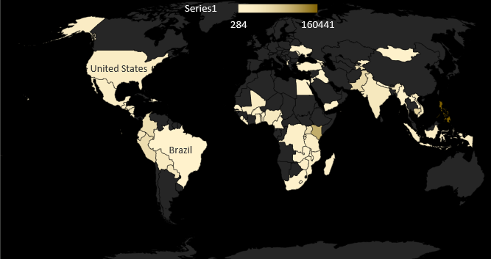

Slide 5
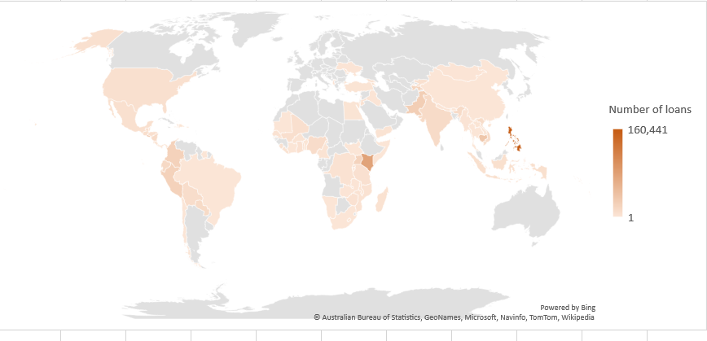
People of Philippines leads in loans

Slide 6
What industries?

Slide 7
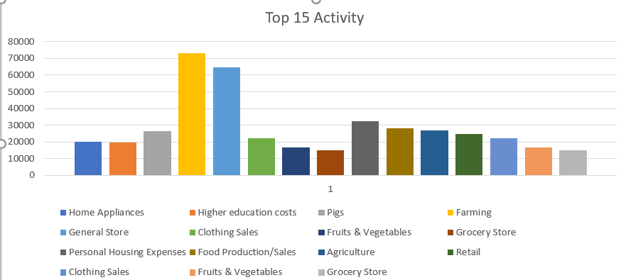
Top 15 activity

Slide 8
Loans for Farming is the most sought after

Slide 9
Continue giving loans to farmers

Slide 10
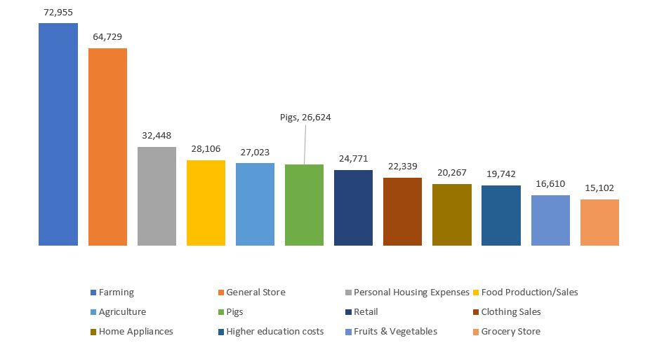
After farming general stores contributes to almost more than 60k loans.

Slide 11
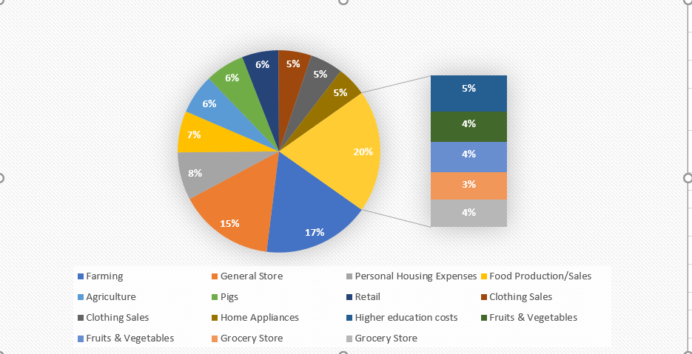
FARMING SECTOR is still most dominating sector among all

Slide 12
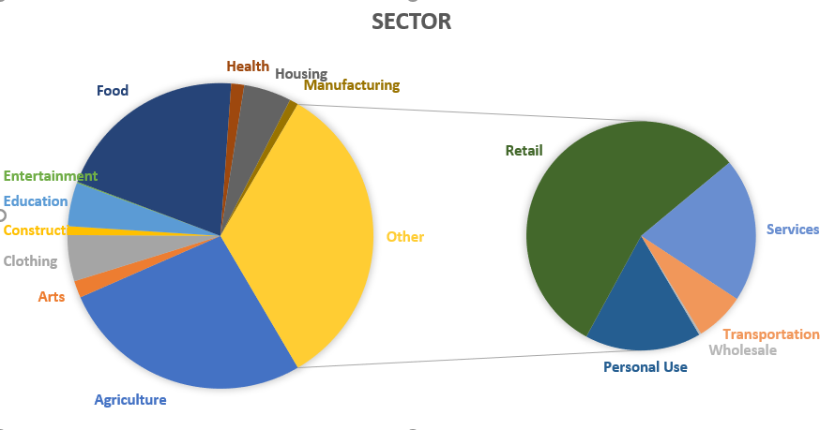
Grow Retail sector among the smaller ones

Slide 13
Will I lose my money?

Slide 14
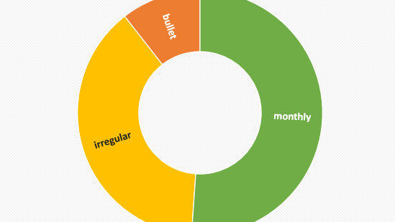
More than half pay on time

Slide 15
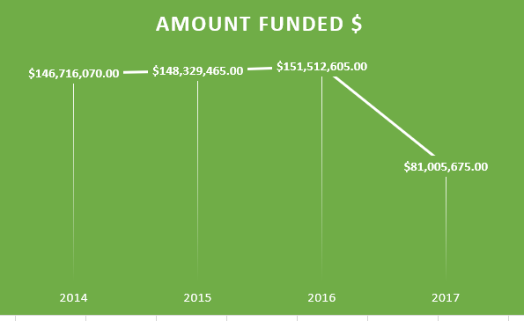
Dramatic decline in 2017….

Slide 16
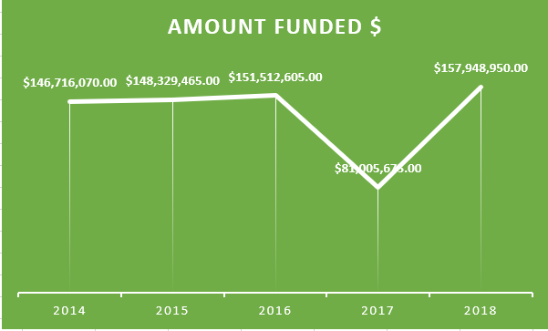
But wait…

Slide 17
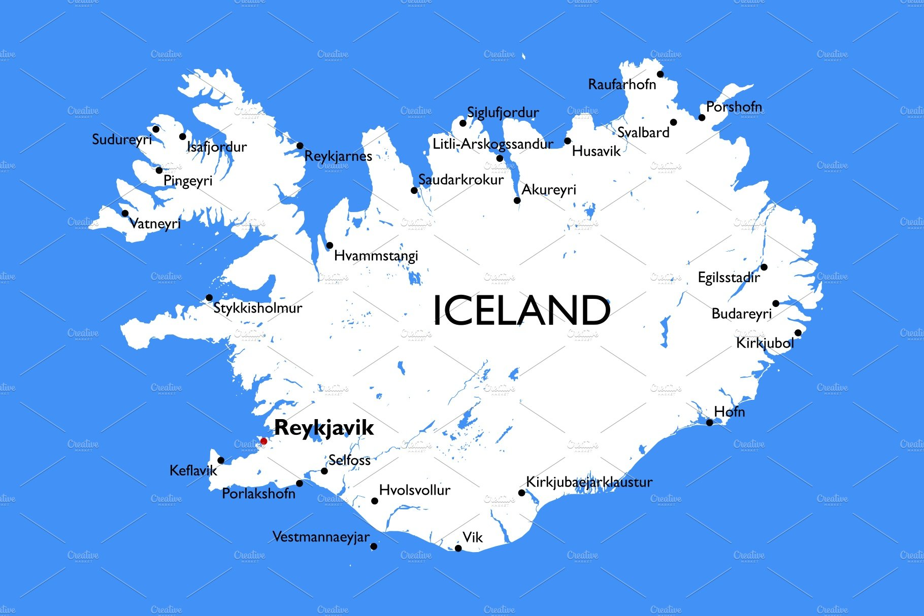
Will people give?
Take the population of Iceland and multiply by 10. That’s the number of people who have given money

Slide 18
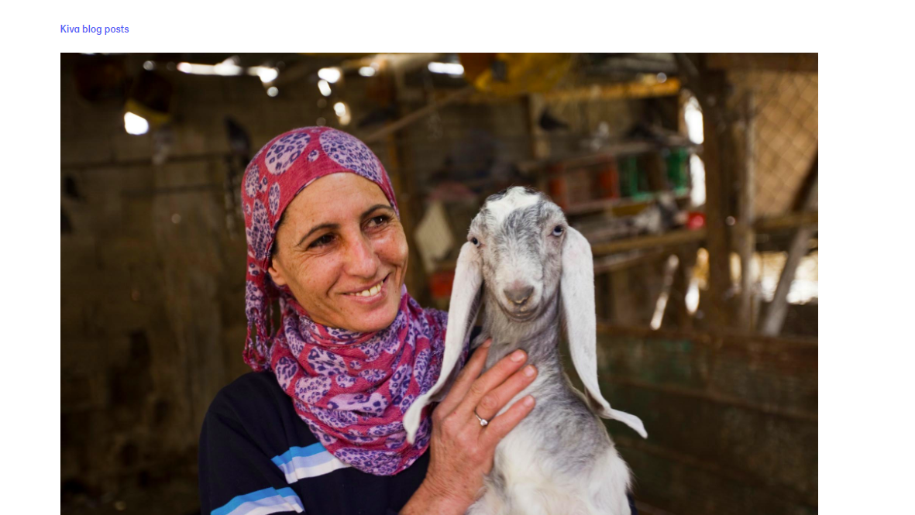
KHAN from Kuwait has changed her life forever !!
INSPIRING BILLIONS

