Slide 1


Major Project
Title: Kolmogorov-Arnold Networks in Recurrent Recommenders: Session-Based and Next-Basket Prediction
End-Term Evaluation
Presented by:
Abhishek Yadav | R2142231410 | SAP 500124297
Saksham Agrawal | R2142231383 | SAP 500121969
Yash Dagar | R2142231424 | SAP 500125147
Mentored by:
Dr. Amar Jindal
Assistant Professor,
Data Science Cluster

Slide 2
Content
1
Introduction
5
Working Model
2
Literature Review
6
Results
3
Objectives
7
Conclusion
4
Methodology
8
References

Slide 3
1. Introduction: Technical Background
Session-based recommendation
Next-basket recommendation
Anonymous browsing session
Returning grocery customer
Input: the clicks so far, i1, i2, ..., it
Output: a ranking of all items for the next click
No user profile: visitors are anonymous
Model: GRU4Rec (gated recurrent unit)
Data: YooChoose (RecSys Challenge 2015)
Input: the customer's past baskets B1 ... BT
Output: a ranking of all items for basket BT+1
Long histories, most items are re-purchases
Model: basket-GRU (van Maasakkers et al., 2023)
Data: Instacart, Dunnhumby Complete Journey
Common core: both tasks use a GRU. This project asks where, if anywhere, Kolmogorov-Arnold Network (KAN) layers improve these GRU recommenders when compared fairly.
Notes:
Two sequential recommendation tasks; both are modelled with GRUs, which gives a common place to insert KAN layers.

Slide 4
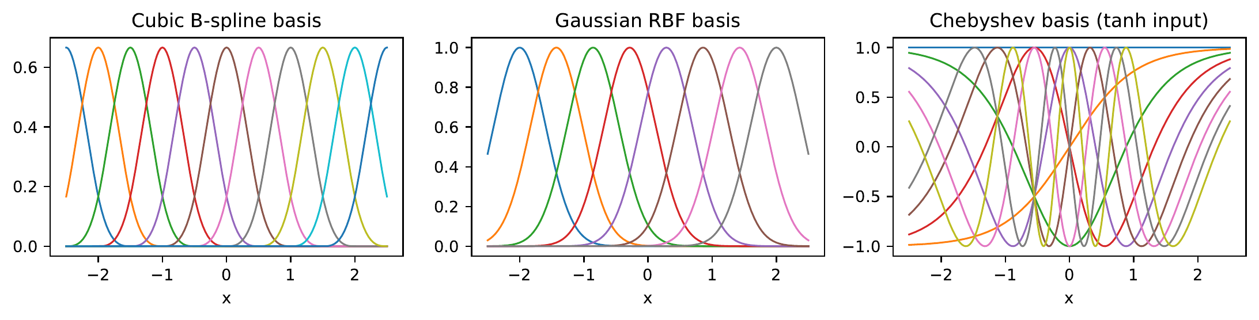
1. Introduction: Technical Concepts Used
Kolmogorov-Arnold Network (KAN) layer
A learnable univariate function on every edge:
y_o = Σ_i φ_o,i(x_i), φ(x) = w·silu(x) + Σ_k c_k B_k(x)
Four basis families B_k implemented: cubic B-spline, Gaussian RBF (FastKAN), Chebyshev, group-rational (GR-KAN)
GRU4Rec: official PyTorch code, session-parallel mini-batches, 2048 shared negatives, cross-entropy with logQ correction
Basket-GRU: multi-hot basket in, sigmoid score for every product out
Parameter-matched MLP control for every KAN block, so gains from extra parameters are not credited to the KAN
Basis functions used inside the KAN layers (from our code)
Residual KAN block
h' = h + KAN(LayerNorm(h))
Output layer initialised to zero, so each variant starts exactly as its baseline.
Notes:
KAN: learnable functions on edges instead of fixed activations on nodes.

Slide 5
1. Introduction: Motivation and Problem Statement
Motivation
Problem Statement
Anonymous and privacy-restricted sessions make profile-based recommenders unusable
KANs are claimed to be more accurate per parameter and more interpretable than MLPs
Later studies (Yu et al. 2024; Hou et al. 2025) find KANs rarely win when parameters are matched
Our first draft compared KAN and GRU on a leaky split with a broken B-spline, so its numbers could not support any conclusion
Determine whether, and where, KAN layers improve GRU-based session and next-basket recommenders, under a protocol that allows a fair conclusion:
standard, leakage-free splits comparable with published work
verified implementations of baselines and KAN layers
parameter-matched MLP controls for every KAN
evaluation on both session and basket data

Slide 6
1. Introduction: Applications and Datasets
Area of application
Datasets and input format
1
E-commerce
next product in a browsing session
 | YooChoose 1/64 | Instacart | Dunnhumby
Task | next click | next basket | next basket
Raw input | session, time, item | user, order, product | household, basket, day, product
Model input | item ID sequence | multi-hot baskets | multi-hot baskets
Users / sessions | 139,628 sessions | 20,620 users* | 2,478 households
Items | 17,264 | 12,058 groups | 10,370
Test targets | 55,357 clicks | 10,310 baskets | 1,239 baskets
Split | by time (last day) | last basket, users 50/50 | last basket, users 50/50
2
Online grocery
pre-filled next basket, reminders
3
Streaming and news
next video, song or article
4
Privacy-first platforms
no long-term tracking needed
* Mac profile: random 10% of Instacart users; the GPU profile uses all 206,209. Preprocessing follows GRU4Rec / SR-GNN and van Maasakkers et al. (2023).

Slide 7
2. Literature Review: Related Work
Work | Year | Model | Relevance / limitation
Hidasi et al. | 2016/18 | GRU4Rec | Strong session baseline; tuned version used here
Hidasi & Czapp | 2023 | Reimplementation study | Third-party GRU4Rec ports score 30-99% lower
Wu et al. (SR-GNN) | 2019 | Graph NN | Standard yoochoose1/64 benchmark table
Hu et al. (TIFU-KNN) | 2020 | Frequency + kNN | Simple model beats most neural NBR models
Li et al. | 2023 | NBR reality check | Repeat items dominate next-basket accuracy
van Maasakkers et al. | 2023 | Basket-GRU | Our basket baseline and protocol
Liu et al. (KAN) | 2025 | KAN | Learnable edge functions; slow to train
Yu et al. | 2024 | KAN vs MLP | With matched size, KAN wins only on symbolic formulas
Genet & Inzirillo (TKAN) | 2024 | KAN in LSTM | KAN inside a gated recurrent cell
Park et al. (CF-KAN) | 2024 | KAN autoencoder | Only KAN recommender with a matched MLP
Xu et al. (KANRec) | 2026 | KAN interest fusion | KAN in sequential recommendation

Slide 8
2. Literature Review: Inference and Research Gap
Session-based models
Next-basket models
KANs
GRU4Rec remains a strong baseline when the official code is used
Weak GRU4Rec results in many papers come from flawed reimplementations
Repeat purchases carry most of the signal
Personal-frequency baselines and TIFU-KNN are very hard to beat
Interpretable learned functions, but slower than MLPs
Gains often vanish against an MLP of the same size
Research gap
No published work places KAN layers inside GRU4Rec or applies KANs to next-basket recommendation
Few KAN recommenders control for model size with a parameter-matched MLP
Our question: where in a GRU recommender does a KAN layer help, compared with an MLP of the same size, on standard benchmarks?

Slide 9
2. Literature Review: SWOT Analysis
S
Strengths
W
Weaknesses
Official GRU4Rec and published protocols
Parameter-matched MLP control for every KAN
Unit-tested KAN layer with four bases
Three datasets, two tasks
KAN layers are slower to train
Extra hyperparameters (basis, grid size)
Mac runs limited to one seed and a 10% Instacart sample
O
Opportunities
T
Threats
Interpretable models for repeat purchasing (KAN-NBR)
GPU runs on the UPES Blackwell cluster
KAN in attention models (SASRec)
Results may show no KAN advantage over MLPs
Transformer recommenders dominate recent work
Compute time for many variants

Slide 10
3. Objectives
Main objective
Build and fairly evaluate KAN-augmented GRU recommenders for session-based and next-basket prediction, and report where KAN layers help and where they do not.
Sub-objectives
1
Correct the methodological and reporting errors of the first draft
2
Implement and unit-test a KAN layer with B-spline, RBF, Chebyshev and rational bases
3
Add KAN layers to official GRU4Rec in three places: head, input, GRU cell
4
Apply the same placements to the basket-GRU on Instacart and Dunnhumby
5
Compare with parameter-matched MLPs and strong non-neural baselines, with significance tests
6
Propose KAN-NBR, an interpretable additive KAN over repeat-purchase features

Slide 11
4. Methodology: Reference Software Model
KAN placements in GRU4Rec (same placements in the basket-GRU)
Item i_t
(or basket)
Embedding
E[i_t]
Input block
S2: KAN / MLP
GRU cell
S3: KAN-GRU cell
Head block
S1: KAN / MLP
Scores
E·h' + b
Placement | What changes | Matched control
S1 KAN head | h' = h + KAN(LN(h)) before dot-product scoring | +MLP head
S2 KAN input | x' = x + KAN(LN(E[i])) before the GRU | +MLP input
S3 KAN-GRU cell | gates stay linear + sigmoid; candidate n = tanh(KAN([x, r⊙h])) | MLP-GRU cell
Draft models | first-draft ungated Pure KAN and Hybrid, re-run fairly | Draft Hybrid (MLP)
KAN-NBR: for baskets, an additive KAN over 7 repeat-purchase features (recency, count, share, decayed frequency, popularity, overdue ratio, in-history) gives one plottable curve per feature.

Slide 12
4. Methodology: Steps and Deliverables
1
Data pipelines
2
KAN module
3
Baselines
YooChoose, Instacart, Dunnhumby with leakage checks
4 bases, residual block, matched MLP, unit tests
official GRU4Rec, basket-GRU, Pop, kNN, TopFreq, TIFU-KNN
Deliverable: dataset tables, EDA
Deliverable: kanrec/kan.py, 41 tests
Deliverable: reproduction check
4
KAN variants
5
Evaluation
6
Report
head, input, cell; MLP controls; KAN-NBR
Recall, MRR, NDCG, P@|B|, repeat/explore, Wilcoxon + Holm
notebook-generated tables in LaTeX, SRS, slides
Deliverable: results per model and seed
Deliverable: tables, figures
Deliverable: report, SRS, decks

Slide 13
4. Methodology: Timeline
W1
W2
W3
W4
W5
W6
W7
W8
W9
W10
W11
W12
W13
W14
W15
W16
Literature review
Data acquisition and preprocessing
KAN module and unit tests
Baselines and reproduction
KAN variants and MLP controls
Next-basket models and KAN-NBR
Ablations and GPU runs (3 seeds)
Analysis, report, SRS, slides
Mid-term
End-term

Slide 14
5. Working Model: Requirements and Architecture
Requirement analysis
Technical diagram: pipeline
Full SRS: KAN_Rec_SRS.docx
Functional: download, preprocess, train, evaluate and report every model from one notebook
Hardware profiles: Mac (Apple MPS), UPES Blackwell GPU, Google Colab
Resumable: one result file per (dataset, model, seed)
Software: Python 3.12, PyTorch, pandas, Jupyter, LaTeX
Kaggle data
kagglehub
Preprocessing
data_session / data_basket
Training + eval
experiments.py, metrics.py
Models
kan.py, session.py, basket.py, kannbr.py
Results
JSON + NPZ per run
Report
report.py: LaTeX tables, figures
Code and results
github.com/yashdagar/kan-rec

Slide 15
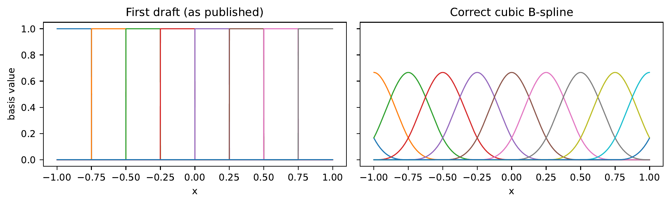
5. Working Model: Attained Deliverables
41
3
0.690
60
unit tests passing
datasets with published protocols
GRU4Rec Recall@20 (SR-GNN table: 0.606)
finished model runs (resumable)
Fixes to the first draft
Leaky sample-level split replaced by session- and time-based splits
Test set no longer used for model selection
Degree-0 'B-spline' replaced by a verified cubic B-spline
Ungated recurrent KAN replaced by gated KAN placements
Every KAN paired with a parameter-matched MLP
First-draft basis (step functions) vs. corrected cubic B-spline

Slide 16
6. Results: Test Cases and Reproduction
Test case (pytest) | Checks | Status
B-spline basis | partition of unity; equals closed-form cubic | Pass
KAN layer | shapes, gradients, parameter count formula | Pass
Matched MLP | parameters within 2% of the KAN it controls | Pass
GRU4Rec wrapper | identical outputs to the official model | Pass
Session iterator | same batches as the official iterator | Pass
Metrics | toy rankings; vectorised = loop version | Pass
Splits | no session or user in two splits; time order | Pass
KAN-NBR | batched scores = per-user scores | Pass
Reproduction (YooChoose 1/64)
Test Recall@20. Our GRU4Rec uses the tuned official settings (Hidasi & Karatzoglou 2018), so it exceeds the older number in the SR-GNN table.

Slide 17
6. Results: Session-Based (YooChoose 1/64)
Baseline
KAN
Matched MLP
Findings
KAN head and KAN input do not beat their MLP controls
Putting the non-linearity inside the GRU cell helps both KAN and MLP
Best: KAN-GRU cell with rational basis, 0.7095 vs matched MLP 0.7035 and GRU4Rec 0.6901
A wider GRU4Rec with the same parameters does not help, so the gain is not just size
Seed 43 agrees; third seed pending

Slide 18
6. Results: Next-Basket (Instacart, Dunnhumby)
Finding: KAN head and input blocks hurt the basket-GRU; a KAN-GRU cell helps a little but its matched MLP helps as much or more. Frequency models win, and KAN-NBR matches the best of them while staying interpretable.

Slide 19
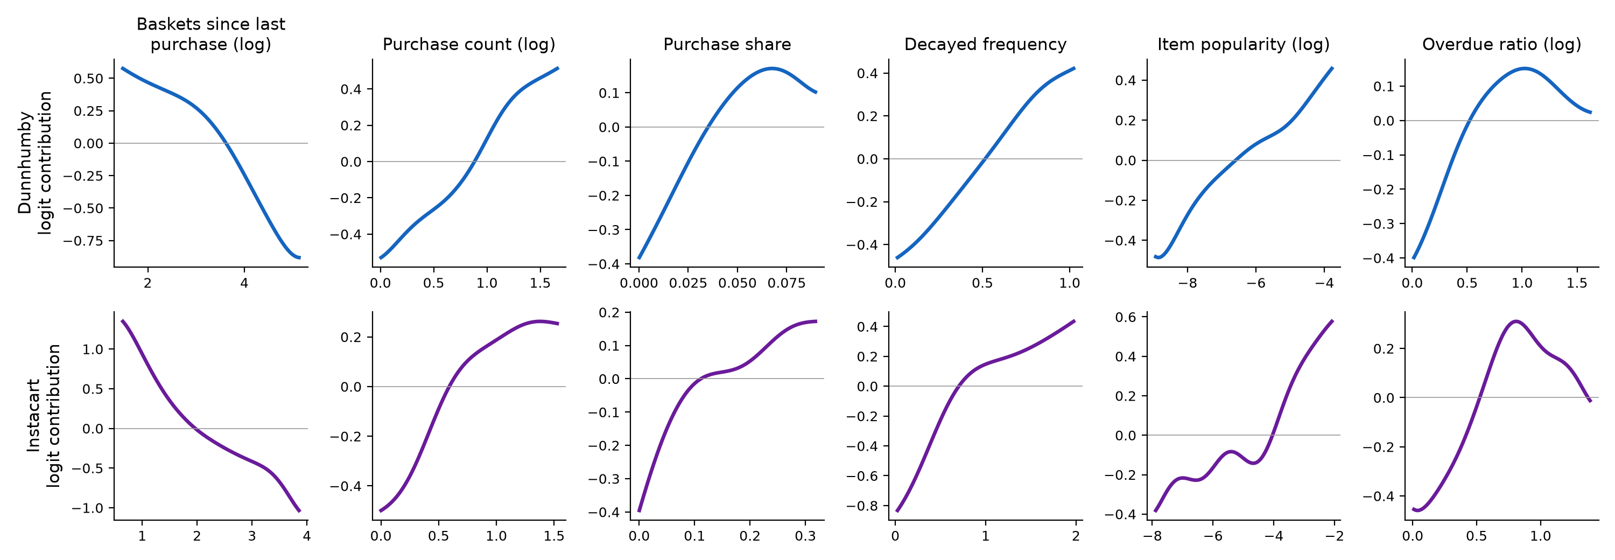
6. Results: Interpretability of KAN-NBR
Each curve is one learned KAN function: its contribution to the purchase logit.
Overdue ratio: the purchase probability peaks when an item is about one usual interval overdue, then falls; a logistic model can only fit a straight line here.
Recency and frequency: recent and frequent items score higher, with diminishing returns.

Slide 20
6. Results: KAN vs Matched MLP
Dataset | Placement | Metric | KAN | MLP | Winner
YooChoose | Head | Recall@20 | 0.6832 | 0.6878 | MLP
YooChoose | Input | Recall@20 | 0.6669 | 0.6854 | MLP
YooChoose | GRU cell (RBF) | Recall@20 | 0.6926 | 0.7016 | MLP
YooChoose | GRU cell (rational) | Recall@20 | 0.7095 | 0.7035 | KAN
Instacart | Head | Recall@10 | 0.1420 | 0.2375 | MLP
Instacart | Input | Recall@10 | 0.1067 | 0.2293 | MLP
Instacart | GRU cell | Recall@10 | 0.2517 | 0.2639 | MLP
Dunnhumby | Head | Recall@10 | 0.1535 | 0.1722 | MLP
Dunnhumby | Input | Recall@10 | 0.1634 | 0.1787 | MLP
Dunnhumby | GRU cell | Recall@10 | 0.1709 | 0.1726 | tie
Dunnhumby | KAN-NBR vs MLP-NBR | Recall@10 | 0.2101 | 0.2050 | KAN
2
KAN better
8
MLP better
1
within 0.002
Same parameter count in every pair; single seed (Mac profile), difference threshold 0.002.

Slide 21
7. Conclusion: Justification of Objectives
Objective | Outcome
Fix first-draft errors | Done: new splits, verified B-spline, gated placements, errata appendix
KAN layer, four bases | Done: unit-tested; rational basis is the most efficient
KAN in GRU4Rec | Head/input: no gain over MLP. Cell (rational): best Recall@20 on YooChoose
KAN in basket-GRU | No gain; frequency methods dominate next-basket accuracy
Fair comparison | Matched MLPs, wide GRU, significance tests, published protocols
KAN-NBR | Matches TIFU-KNN-level accuracy with readable feature curves
Take-away: KAN layers are not a free accuracy gain. Where they help, an equally large MLP usually helps as much; their clearest value is interpretability on small, meaningful inputs.

Slide 22
7. Conclusion: Future Scope
1
GPU runs
2
Attention models
three seeds, yoochoose1/4 and full Instacart on the UPES Blackwell GPU
group-rational KAN in the feed-forward block of SASRec
3
Covariates
4
More data
KAN curves over time of day and days since last order
Diginetica as a second session benchmark
5
KAN training
6
Deployment
grid extension during training; faster fused kernels
a small KAN-NBR service for interpretable basket suggestions

Slide 23
References
A: Paper published. None yet; a paper on the KAN-GRU cell and KAN-NBR results is in preparation.
B: Cited papers
Hidasi, B., Karatzoglou, A., Baltrunas, L., & Tikk, D. (2016). Session-based recommendations with recurrent neural networks. ICLR.
Hidasi, B., & Karatzoglou, A. (2018). Recurrent neural networks with top-k gains for session-based recommendations. CIKM, 843-852.
Hidasi, B., & Czapp, A. T. (2023). The effect of third party implementations on reproducibility. RecSys, 272-282.
Wu, S., Tang, Y., Zhu, Y., Wang, L., Xie, X., & Tan, T. (2019). Session-based recommendation with graph neural networks. AAAI, 346-353.
Hu, H., He, X., Gao, J., & Zhang, Z.-L. (2020). Modeling personalized item frequency information for next-basket recommendation. SIGIR, 1071-1080.
Li, M., Jullien, S., Ariannezhad, M., & de Rijke, M. (2023). A next basket recommendation reality check. ACM TOIS, 41(4), 116.
van Maasakkers, L., Fok, D., & Donkers, B. (2023). Next-basket prediction in a high-dimensional setting using gated recurrent units. Expert Systems with Applications, 212, 118795.
Liu, Z., Wang, Y., Vaidya, S., et al. (2025). KAN: Kolmogorov-Arnold networks. ICLR.
Yu, R., Yu, W., & Wang, X. (2024). KAN or MLP: A fairer comparison. arXiv:2407.16674.
Hou, Y., Ji, T., Zhang, D., & Stefanidis, A. (2025). Kolmogorov-Arnold networks: A critical assessment of claims, performance, and practical viability. arXiv:2407.11075.
Genet, R., & Inzirillo, H. (2024). TKAN: Temporal Kolmogorov-Arnold networks. arXiv:2405.07344.
Yang, X., & Wang, X. (2025). Kolmogorov-Arnold Transformer. ICLR.
Park, J.-D., Kim, K.-M., & Shin, W.-Y. (2024). CF-KAN: Kolmogorov-Arnold network-based collaborative filtering. arXiv:2409.05878.
Xu, Y., Fang, X., Gong, J., et al. (2026). Enhancing global and local interests fusion based on Kolmogorov-Arnold networks for sequential recommendation. Multimedia Systems, 32(2), 81.

Slide 24
Thank You

