Slide 1


Major Project
Title: Session Based Recommendation System
Presented by:
Abhishek Yadav 500124297
Saksham Agrawal 500121969
Yash Dagar 500125147
Guided by:
Dr. Amar Jindal
Assistant Professor,
Data Science Cluster

Slide 2
Content
  Introduction
  Literature Review
  Problem Statement
  Objectives
  Methodology
  Swot Analysis
  Pert Chart
  References

Slide 3
1. Introduction
Technical Concept
  A session-based recommendation system predicts the next item a user is likely to interact with by analyzing only the current interaction sequence, without relying on long-term user profiles. This approach is essential in scenarios where user identity is unknown, short-lived, or privacy-restricted.
  Kolmogorov–Arnold Networks (KANs) provide a function-approximation framework based on learnable univariate functions, enabling more interpretable and efficient modeling compared to traditional neural networks. By integrating KANs into session-based recommendation pipelines, the model can capture complex nonlinear patterns in user behavior while maintaining structural transparency and reduced parameter redundancy.
Motivation
  Many platforms operate with anonymous or short sessions where persistent user profiles are unavailable.
  Traditional recommendation models depend heavily on historical user data, limiting their effectiveness in cold-start or privacy-focused environments.
  Existing deep learning approaches often act as black boxes, offering limited interpretability.
  KAN networks introduce a mathematically grounded architecture that improves function approximation while providing clearer insight into learned relationships.
  The combination of session-based modeling and KAN architectures aims to deliver accurate, efficient, and interpretable recommendations.

Slide 4
1. Introduction
Area of Application
  E-commerce: Real-time product recommendations during a browsing session.
  Streaming platforms: Suggesting movies, music, or videos based on recent interactions.
  News and content portals: Recommending articles during a single reading session.
  Online advertising: Context-aware ad placement without long-term user tracking.
  Search and discovery systems: Improving next-item or next-query suggestions in short user sessions.

Slide 5
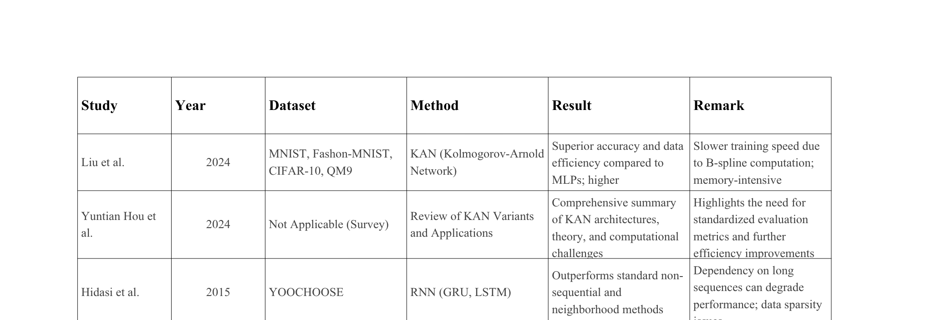
2.Literature Review

Slide 6
2. Inference from Literature
Session-Based Recommendation Systems:
GRU4Rec effectively model sequential behavior but rely on MLP layers with fixed activations
Limitation: Parameter inefficiency, black-box nature, and catastrophic forgetting in long sequences
Kolmogorov-Arnold Networks:
Learnable univariate spline functions on edges provide adaptive feature transformation
Grounded in Kolmogorov-Arnold representation theorem with superior function approximation
KAN for Sequential Tasks:
TKAN/RKAN: Successfully integrated KAN with LSTM for time-series forecasting
T-KAN/MT-KAN: Achieved 40-60% parameter reduction without accuracy loss
KANRec : Applied KAN to sequential recommendation with global-local interest modeling
Research Gap:
No prior work applies KAN-RNN to session-based recommendation (anonymous, transient sequences)
Parameter efficiency and interpretability of KAN unexplored in session-based contexts
Missing benchmark evaluation on RecSys15/YOOCHOOSE for KAN-based session recommendation
Our Contribution: First KAN-RNN hybrid for parameter-efficient, interpretable session-based recommendation on standard benchmarks

Slide 7
3. Problem Statement
  Design a session-based recommendation model that predicts the next most probable item from short, noisy, and highly variable interaction sequences, without relying on long-term user profiles or historical data.
  The solution must achieve high accuracy, computational efficiency, and interpretability through a KAN-based architecture.

Slide 8
4. Objectives
Primary Goal:
Develop a parameter-efficient KAN-RNN hybrid architecture for session-based recommendation that matches or exceeds MLP-RNN baseline performance while reducing model complexity.
Specific Objectives:
  Replace MLP layers with KAN layers in RNN-based recommenders for adaptive feature transformation
  Achieve competitive accuracy (Recall@20, MRR@20) on RecSys15 and YOOCHOOSE benchmarks
  Reduce parameter count by 40-60% compared to traditional MLP-RNN architectures
  Enhance interpretability through visualization of learned B-spline activation patterns
  Establish KAN as a theoretically grounded alternative to MLPs in sequential recommendation tasks

Slide 9
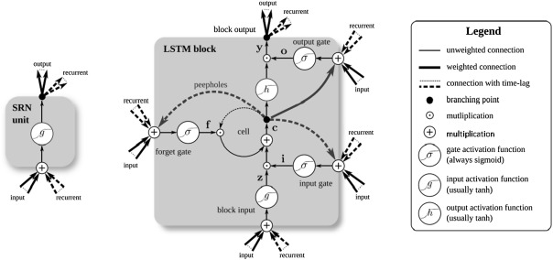
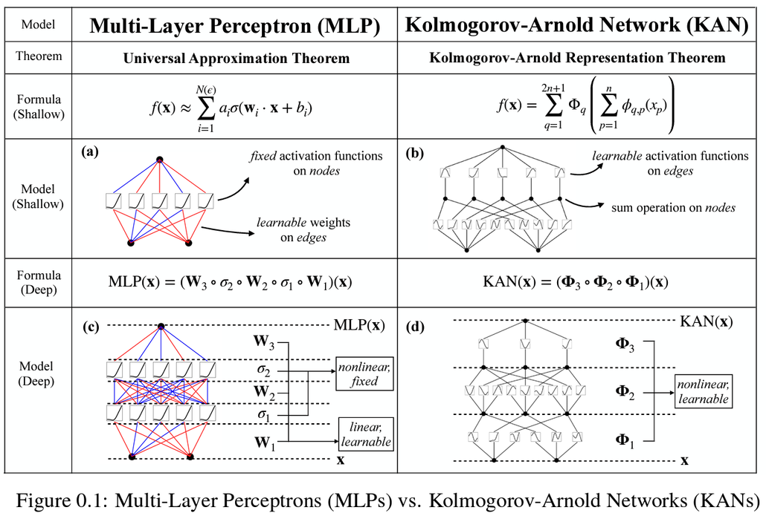
5. Methodology
Reference Software model:
Fig.1 Long Short Term Memory
Fig.2 Kolmogorov Arnold Network

Slide 10
5. Methodology
Steps:
  KAN-RNN Architecture Design: Design a hybrid framework replacing MLP layers with KAN layers. Implement B-spline parameterized activation functions for adaptive feature transformation. Integrate KAN with GRU/LSTM encoders for temporal dependency modeling.
  Model Implementation: Build KAN layers with learnable univariate spline functions. Define hidden-state transformation. Implement output projection: ŷ = softmax(KAN(h_T)) for next-item prediction.
  Hyperparameter Tuning & Training: Grid search over KAN parameters (spline order, grid size) and RNN parameters (hidden units, dropout). Train models using cross-entropy loss and Adam optimizer. Apply early stopping on validation loss.
  Performance Evaluation: Compute metrics: Recall@20, MRR@20. Compare parameter counts and model sizes. Statistical significance testing for performance differences.
  Interpretability Analysis: Visualize learned B-spline activation patterns across layers. Generate feature transformation heatmaps. Compare interpretability with black-box MLP baselines.
  Ablation Study: Analyze the impact of spline order, grid size, and number of KAN layers. Evaluate different RNN encoders (GRU vs. LSTM). Assess single vs. multi-layer KAN configurations.

Slide 11
6. SWOT Analysis
Strengths
Weaknesses
  Theoretically grounded (Kolmogorov-Arnold theorem)
  Enhanced interpretability via B-spline visualization
  First KAN-RNN application to session-based recommendation
  Leverages proven GRU/LSTM temporal encoders
  Higher implementation complexity (B-spline parameterization)
  Increased hyperparameter tuning requirements (grid size, spline order)
  Potential training overhead vs. standard activations
  Limited prior validation at production scale
Opportunities
Threats
  Emerging hot research area (KAN for sequences)
  Cross-domain applicability (video, music, clickstream)
  Growing industry demand for explainable recommendations
  Strong publication potential in active field
  Transformer-based model dominance
  Advanced MLP variants may close performance gap
  Time/compute constraints for exhaustive evaluation

Slide 12
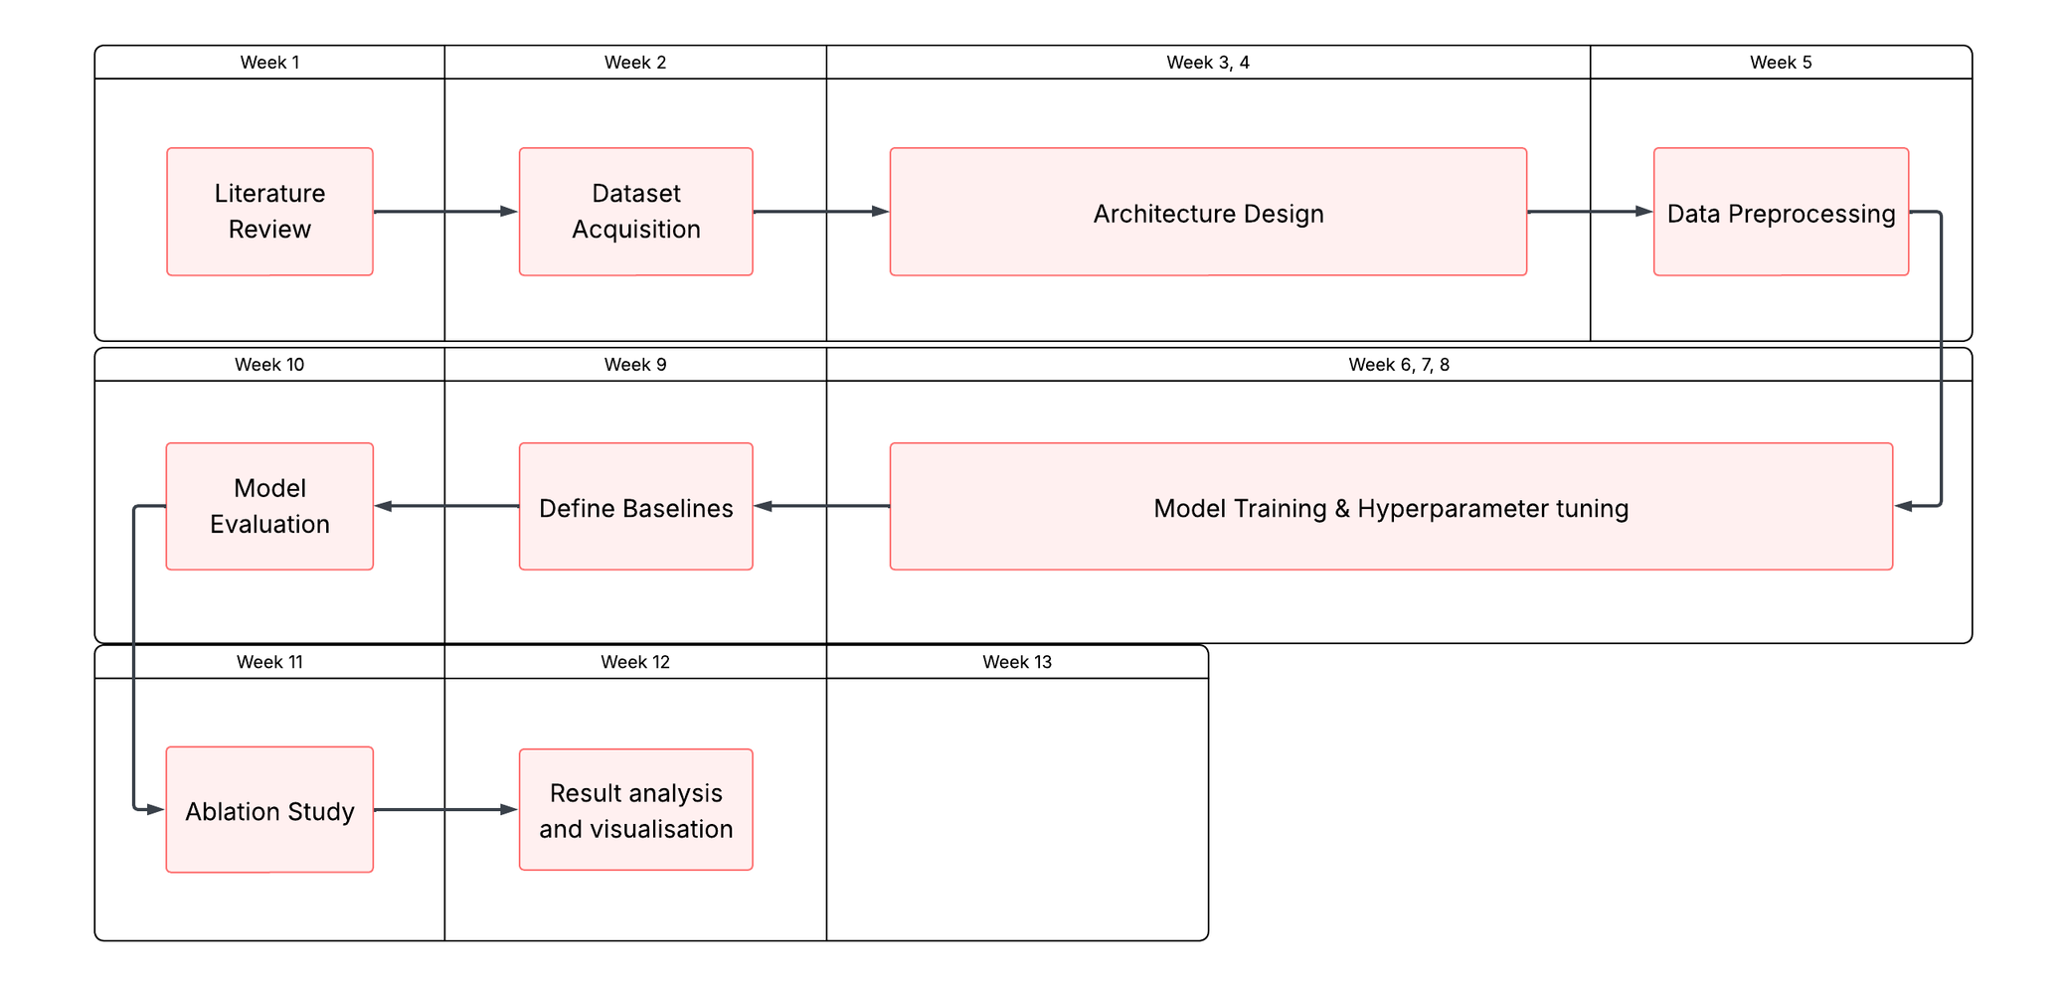
7. PERT Chart

Slide 13
8. References
Genet, R., & Inzirillo, H. (2024). TKAN: Temporal Kolmogorov-Arnold Networks. ArXiv. https://arxiv.org/abs/2405.07344
Hou, Y., Ji, T., Zhang, D., & Stefanidis, A. (2024). Kolmogorov-Arnold Networks: A Critical Assessment of Claims, Performance, and Practical Viability. ArXiv. https://arxiv.org/abs/2407.11075
Hidasi, B., Karatzoglou, A., Baltrunas, L., & Tikk, D. (2015). Session-based Recommendations with Recurrent Neural Networks. ArXiv. https://arxiv.org/abs/1511.06939
Liu, Z., Wang, Y., Vaidya, S., Ruehle, F., Halverson, J., Soljačić, M., Hou, T. Y., & Tegmark, M. (2024). KAN: Kolmogorov-Arnold Networks. ArXiv. https://arxiv.org/abs/2404.19756
Sun, F., Liu, J., Wu, J., Pei, C., Lin, X., Ou, W., & Jiang, P. (2019). BERT4Rec: Sequential Recommendation with Bidirectional Encoder Representations from Transformer. ArXiv. https://arxiv.org/abs/1904.06690
Xu, Y., Fang, X., Gong, J. et al. Enhancing global and local interests fusion based on Kolmogorov-Arnold networks for sequential recommendation. Multimedia Systems 32, 81 (2026). https://doi.org/10.1007/s00530-025-02142-4
Xu, K., Chen, L., & Wang, S. (2024). Kolmogorov-Arnold Networks for Time Series: Bridging Predictive Power and Interpretability. ArXiv. https://arxiv.org/abs/2406.02496

Slide 14
Thank You

