Slide 1
AI Agent-Based Claims Processing System Prototype
Journey, Prompt Evolution and Architecture
Yashodhan Dhore

Slide 2
1. Business Problem and Vision
1.1 Business Problem
User Prompt Summary: 'What is an end-to-end claims processing system for an insurance company?'
1.2 Vision for Agentic Claims Processing
User Prompt Summary: 'I want to build each step as an agent, so the FNOL moves through intake, validation, adjuster review, processing, and reporting.'
1.3 High-Level Architecture
User Prompt Summary: 'Can we simplify this using Python, CSV files, GitHub, and Streamlit because I need to build this in less than 24 hours?'

Slide 3
2. Rapid Prototype Design
2.1 Synthetic Data Design
User Prompt Summary: 'Create synthetic data files with at least 100 records including USA, UK, and Australia.'
2.2 CSV Data Model and Relationships
User Prompt Summary: 'Walk me through these tables and explain what each CSV file does and how they relate.'
2.3 Python Data Store Layer
User Prompt Summary: 'Give me data_store.py full downloadable code.'
2.4 Agent Design
User Prompt Summary: 'I want Intake, Validation, Adjuster, Processing, and Reporting agents.'
2.5 Agent Orchestration
User Prompt Summary: 'I want the request to move from one agent to another with visible workflow steps.'

Slide 4
3. Workflow Implementation
3.1 FNOL Intake Screen
User Prompt Summary: 'I should be able to enter an FNOL on one of the screens.'
3.2 Policy Verification Logic
User Prompt Summary: 'The next agent should check backend policy and coverage data.'
3.3 Adjuster Assignment and Risk Scoring
User Prompt Summary: 'The third agent should act as an adjuster and evaluate the claim.'
3.4 Claim Processing and Decision Explanation
User Prompt Summary: 'Show why a claim was approved, denied, or escalated with detailed explanations.'
3.5 Agent Events and Audit Trail
User Prompt Summary: 'Show that the request came in and moved through the workflow step by step.'
3.6 Agent Command Center
User Prompt Summary: 'Create an Agent Command Center showing what each agent does and the timeline of decisions.'

Slide 5
4. Business Visibility and Insights
4.1 Operational Dashboards
User Prompt Summary: 'Show claims by status, country, fraud risk, severity, and paid amount.'
4.2 Executive Insights
User Prompt Summary: 'Executives need ROI, financial reports, open claims, exposure, and business insights.'

Slide 6
5. Deployment and Enterprise Roadmap
5.1 GitHub Repository and Version Control
User Prompt Summary: 'How do I move this to GitHub, and which files should I move?'
5.2 Streamlit Cloud Deployment
User Prompt Summary: 'Now I am going to connect my app.py to Streamlit. Walk me through the steps.'
5.3 Final Outcome and Next Steps
User Prompt Summary: Act as a critic and check the outcome. See if we are missing any steps. Suggest next steps.'

Slide 7
Prototype Outcomes
Built end-to-end prototype in less than 24 hours
Demonstrated explainable AI-style claim orchestration
Created operational audit trail and workflow visibility
Established migration roadmap into Microsoft ecosystem (TBD)
Enabled future transition into Copilot Studio and Power Platform (TBD)

Slide 8
Architectural Visual
User
FNOL
Agent
Validation
Agent
Adjuster
Agent
Processing Agent
Reporting Agent
Dashboards
Current Prototype
- Streamlit - Python - CSV Files
Suggested Future Enterprise State - Copilot Studio
Power Automate
Enterprise Dataverse
Power BI
Enterprise APIs

Slide 9
Possible Business Outcomes
Explainable claim decisioning
Foundation for AI-assisted claims operations
Demonstrates “Art of Possible”
Build confidence and trust among team members

Slide 10
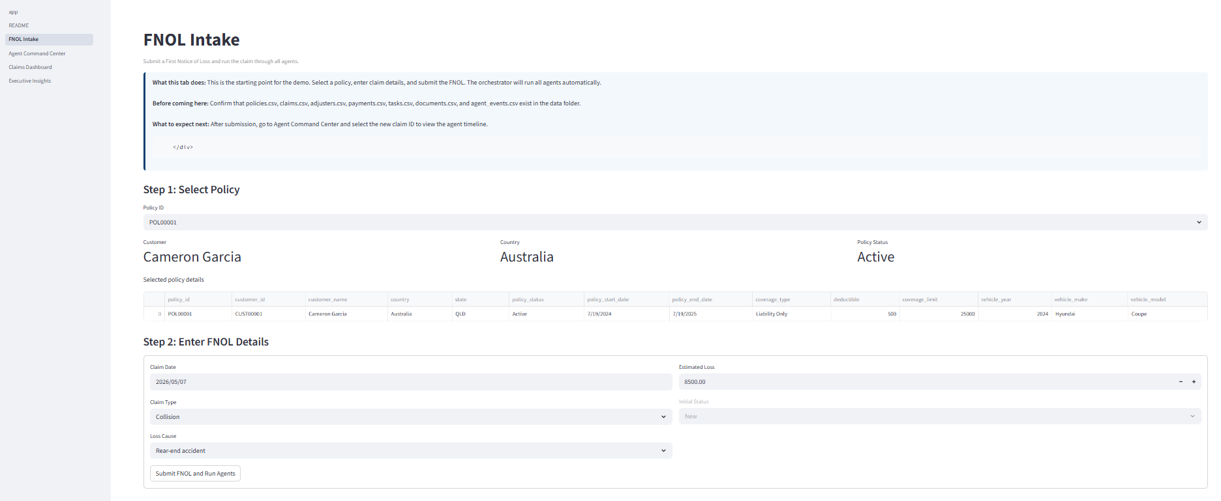
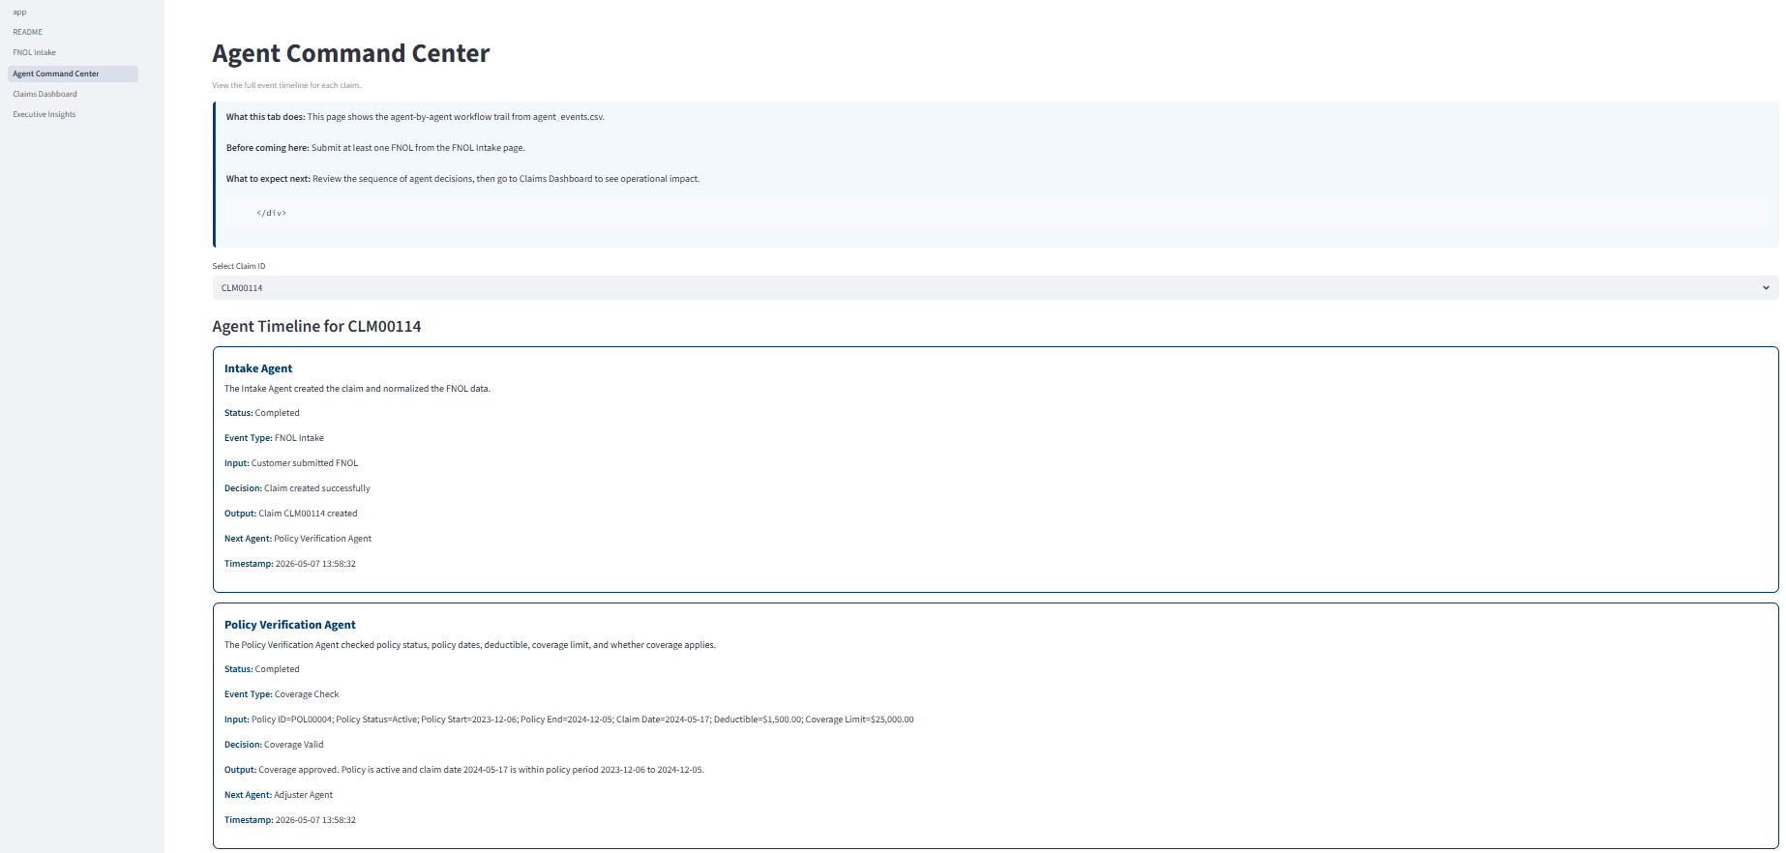
Appendix A - Proof Of Concept Visual

Slide 11
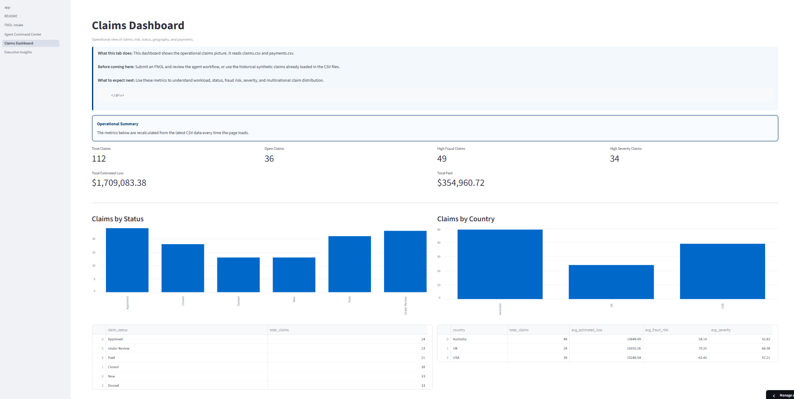
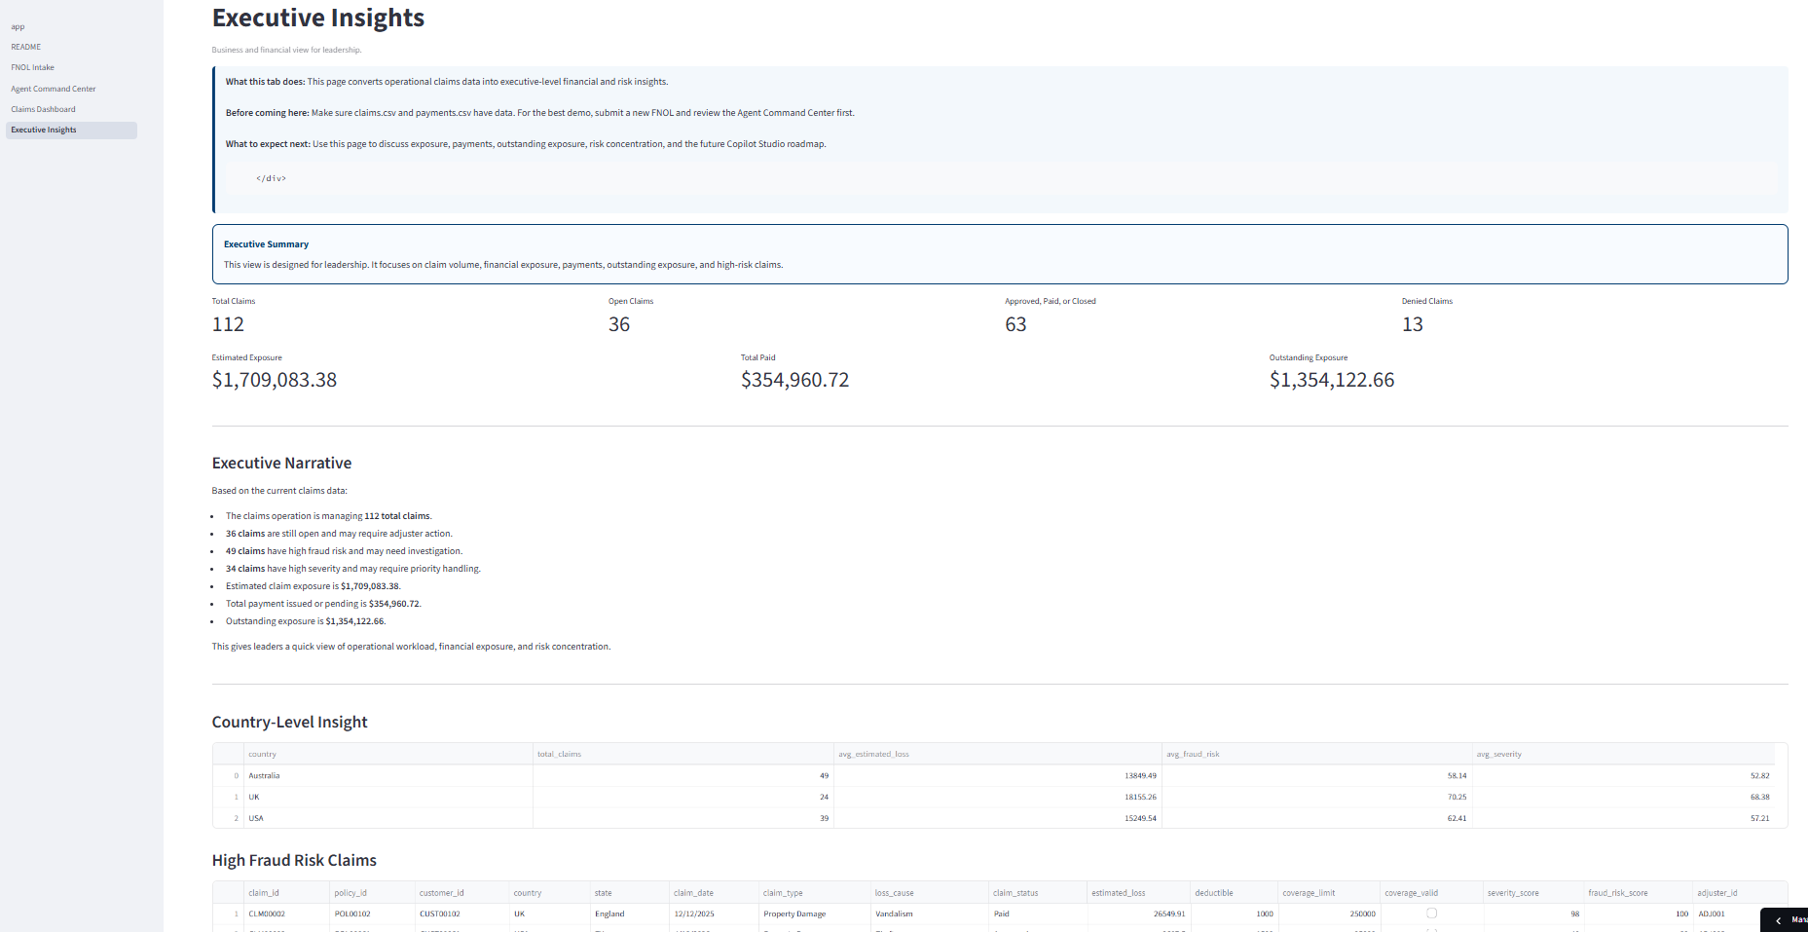
Appendix A - Proof Of Concept Visual Continued…

