Slide 1

Academic Presentation
Precision-Aware Adaptive Incremental SVD
Bounding Orthogonality Drift in Streaming Subspaces
Presenters
M B Thejesshwar & Yash Atul Dighade
Course
Computational Linear Algebra
Institution
IIT Kharagpur
Notes:
Hello everyone, and respected Professor. Today, Thejesshwar and I will present our course project on the Precision-Aware Adaptive Incremental SVD. We set out to solve a fundamental problem in computational linear algebra: how do we maintain mathematically rigorous, machine-precision low-rank subspaces on infinite data streams without destroying our computational budget?

Slide 2

Academic Presentation
The Bottleneck of Batch SVD
Goal: Isolate moving objects via optimal low-rank matrix extraction.
The Math: For a video matrix X ∈ ℝp×q (where q → ∞).
The Problem: Batch SVD requires O(pq min(p,q)) operations.
Conclusion: Batch SVD is computationally impossible for continuous streams.
Presenters
M B Thejesshwar & Yash Atul Dighade
Course
Computational Linear Algebra
Institution
IIT Kharagpur
Notes:
In tasks like video surveillance, we use the SVD to find the optimal low-rank background. However, for a video stream where time 'q' grows infinitely, computing a batch SVD requires cubic time complexity. It is computationally intractable. We need a sequential approach.

Slide 3
Academic Presentation
The Baseline: Deferred SVD (Brand, 2006)
The 5-Factor Representation: X ≈ U U′ Σ V′ᵀ Vᵀ
U (Tall Basis): Never rotated, grows via cheap column appends.
U′ (Small Core): Absorbs all plane rotations in O(r³).
Result: Strictly linear-time O(pqr) processing.
Presenters
M B Thejesshwar & Yash Atul Dighade
Course
Computational Linear Algebra
Institution
IIT Kharagpur
Notes:
In 2006, Matthew Brand introduced the five factor deferred SVD. Instead of rotating the massive tall basis matrix U at every frame—costing O(pr²)—Brand inserted a small r × r core matrix, U′. All plane rotations are absorbed by this tiny core in O(r³) time, while U only grows via cheap appends. This achieves strictly linear-time processing.

Slide 4


Slide 5
Academic Presentation
The Fatal Vulnerability
Finite-Precision Reality:
fl(a ∘ b) = (a ∘ b)(1 + δ)
Consequence:
Cumulative basis orthogonality drift (||UᵀU - Iᵣ||F > 0)
Brand (2006):
"It is an open question how often [re-orthogonalization] is necessary to guarantee numerical precision."
The Dilemma:
Naive Gram-Schmidt repair costs O(pr²), destroying linear-time speed.
Presenters
M B Thejesshwar & Yash Atul Dighade
Course
Computational Linear Algebra
Institution
IIT Kharagpur
Notes:
But there is a fatal vulnerability. In finite-precision floating-point arithmetic, unit roundoff errors accumulate. The aim is to keep the drift below a safe level at the lowest possible cost. Over thousands of frames, U slowly loses its orthogonality. Brand explicitly stated in his paper that bounding this drift was an unresolved open problem. The dilemma is: if we naively run Gram-Schmidt on U at every frame to fix it, we incur an O(pr²) penalty, destroying the linear-time guarantee.

Slide 6
Academic Presentation
Our Solution: PA-ISVD
Exact O(pr) Drift Tracking: No explicit Gram matrix.
Wilkinson’s Adaptive Trigger: Mathematical precision bounds.
Lossless Subspace Absorption: Safe basis repair.
Presenters
M B Thejesshwar & Yash Atul Dighade
Course
Computational Linear Algebra
Institution
IIT Kharagpur
Notes:
To solve this, we developed the Precision-Aware Adaptive Incremental SVD. We introduced three novel mathematical components that guarantee machine-precision stability while strictly preserving the linear-time budget.

Slide 7


Academic Presentation
Contribution 1: Exact O(pr) Drift Tracking
Theorem (Recursive Frobenius Drift):
Standard Gram Check: O(pr2) flops.
Our Recursive Check: strictly O(pr) flops.
Note: Scalar tracker runs in float64 to prevent meta-drift.
Presenters
M B Thejesshwar & Yash Atul Dighade
Course
Computational Linear Algebra
Institution
IIT Kharagpur
Notes:
(Use Laser Pointer on equation) "First, how do we measure drift without spending O(pr²) flops to compute UᵀU? We derived a recursive Frobenius drift estimator. As you can see here, the updated drift is exactly the previous drift, plus the norm of the cross-terms and the new vector deviation. This tracks exact drift in strictly O(pr) time. We run this specific scalar tracker in float64 to prevent meta-drift."

Slide 8
Academic Presentation
Contribution 2: Wilkinson’s Adaptive Trigger
Wilkinson’s Backward Error Bound: Inner product roundoff ≈ r · u.
Adaptive Threshold: τ = k · r · u (where u = unit roundoff)
Two-Tier Repair Hierarchy:
• Tier 1: Core refactor in O(r³) flops.
• Tier 2: Tall MGS in O(pr²) flops (Invoked strictly if dU > τ).
Presenters
M B Thejesshwar & Yash Atul Dighade
Course
Computational Linear Algebra
Institution
IIT Kharagpur
Notes:
Second, when do we trigger a repair? Using Wilkinson's backward error bounds, an r-term inner product accumulates roundoff of r times the unit roundoff u. We defined an adaptive threshold: τ = k · r · u We only trigger a repair when our tracker exceeds this theoretical bound. And when we do, how do we fix the tall matrix without destroying the streaming video data? I’ll hand it over to Thejesshwar to explain our Subspace Absorption lemma and empirical results.

Slide 9
Academic Presentation
Contribution 3: Lossless Subspace Absorption
Lemma (Subspace Absorption Invariance):
UU′Σ = (QR)U′Σ = Q(RU′)Σ
Step 1: U ← Q (Restored to machine precision).
Step 2: Fold R into the core: M = RU′.
Step 3: Compute SVD of MΣ.
Result: Spatial basis repaired, but data matrix X remains algebraically identical.
Presenters
M B Thejesshwar & Yash Atul Dighade
Course
Computational Linear Algebra
Institution
IIT Kharagpur
Notes:
Thank you, Yash. When we are forced to run Gram-Schmidt on U, we use our Subspace Absorption Lemma. (Use Laser Pointer) If we decompose U into QR, by associativity, we simply slide the upper-triangular R out of the tall matrix and absorb it entirely into the small core matrix U′. We then run a fast SVD on the core to re-diagonalize it. The tall basis U is restored to machine precision, but the underlying data matrix X remains mathematically untouched.

Slide 10
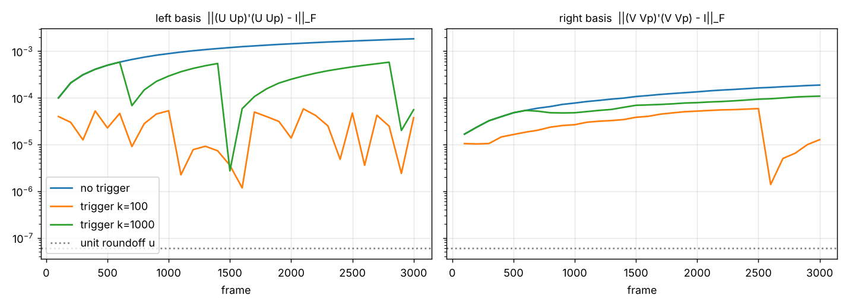
Academic Presentation
Empirical Validation: Bounding Orthogonality Drift
Amortized Complexity: Repairs occur every Ω(k) frames — total time remains strictly O(pqr).
Presenters
M B Thejesshwar & Yash Atul Dighade
Course
Computational Linear Algebra
Institution
IIT Kharagpur
Notes:
We tested this on a 3,000-frame drifting stream in float32. The unmonitored Brand baseline—the blue line—exhibits unbounded monotonic drift, eventually corrupting the subspace. Our PA-ISVD, in green and orange, triggers our absorption repair precisely when the threshold is crossed. This creates a saw-tooth pattern that locks the error near machine precision. Because repairs are so rare, the amortized cost per frame remains strictly linear.

Slide 11
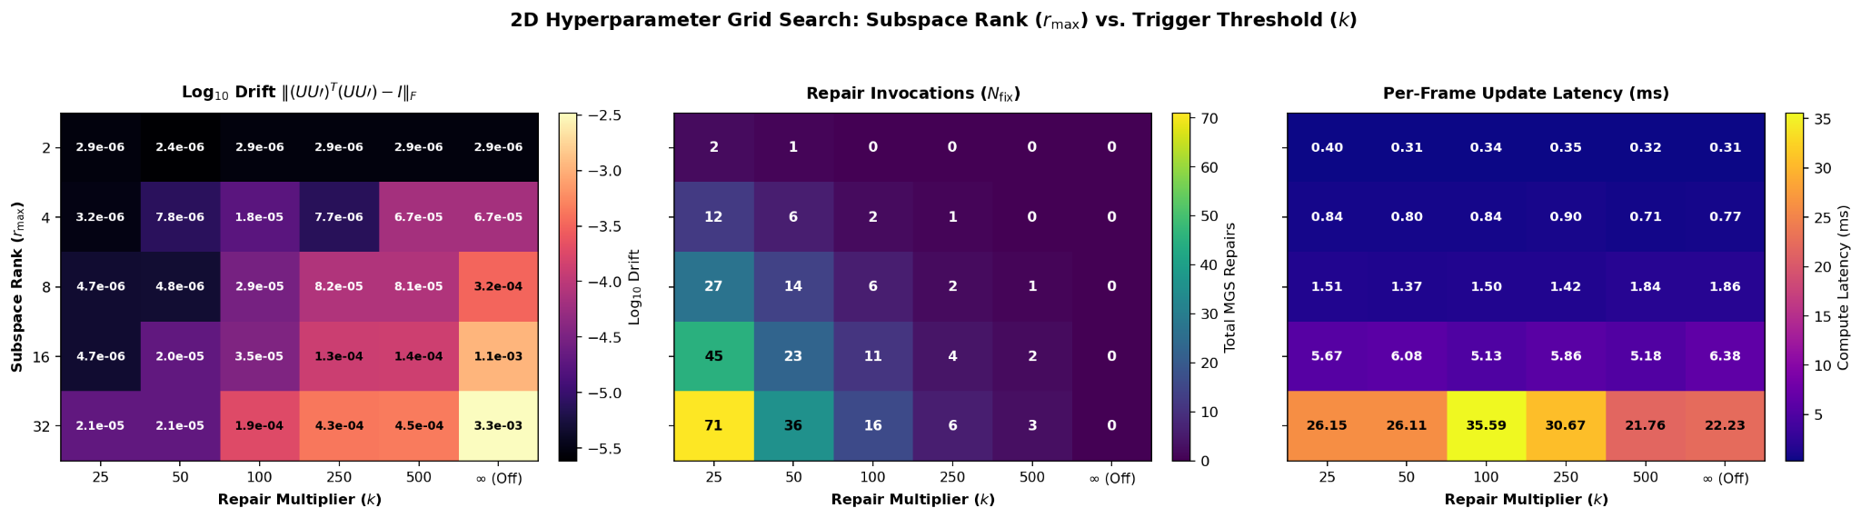
Academic Presentation
2D Pareto Hyperparameter Grid Search
Evaluated 30 configurations (r × k).
Left: Drift bounded to ≤ 10⁻⁵ across all ranks.
Center: Repair frequency scales inversely with k.
Right: Update latency is dominated by r; repairs add zero observable overhead.
Presenters
M B Thejesshwar & Yash Atul Dighade
Course
Computational Linear Algebra
Institution
IIT Kharagpur
Notes:
(Pause for 2 seconds to let the professor absorb the image) "To prove the system's robustness, we ran an exhaustive 30-configuration grid search. The left heatmap shows we successfully bounded drift to 10⁻⁵ across all ranks. The middle map shows our repair invocations scale inversely with k, exactly as theory predicts. Most importantly, the right heatmap proves that compute latency is dictated entirely by the rank r. Our selective MGS repairs add effectively zero overhead to the average frame latency."

Slide 12
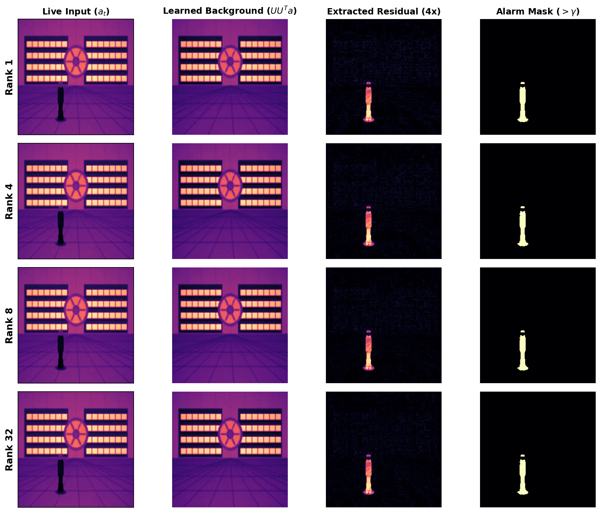
Academic Presentation
Subspace Capacity Ablation
Rank 1: 4.4× higher numerical clutter floor.
Rank 32: Subspace leakage (overfitting), 24ms latency penalty.
Rank 8: Pareto Optimal (4.7× SCR, 1.86ms latency).
Presenters
M B Thejesshwar & Yash Atul Dighade
Course
Computational Linear Algebra
Institution
IIT Kharagpur
Notes:
You might ask: 'If Rank 1 looks visually identical to Rank 32 on the screen, why not just use Rank 1 to save compute?' The answer is the numerical noise floor. A static vault is intrinsically rank-1, so it looks fine to the human eye. But our metrics revealed Rank 1 has a 4.4x higher clutter floor. Under dynamic lighting, this triggers false alarms. Conversely, Rank 32 overfits, absorbing the intruder into the background, and drops our speed by 28 times. Rank 8 is the true Pareto optimal point.

Slide 13
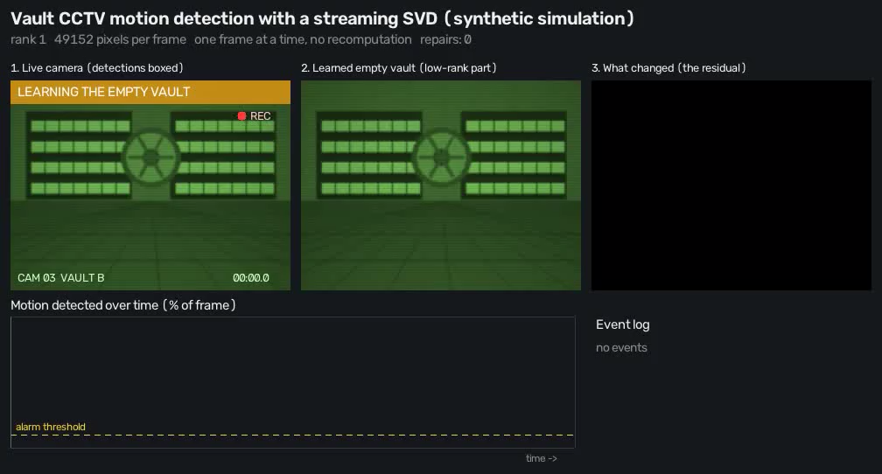

Slide 14
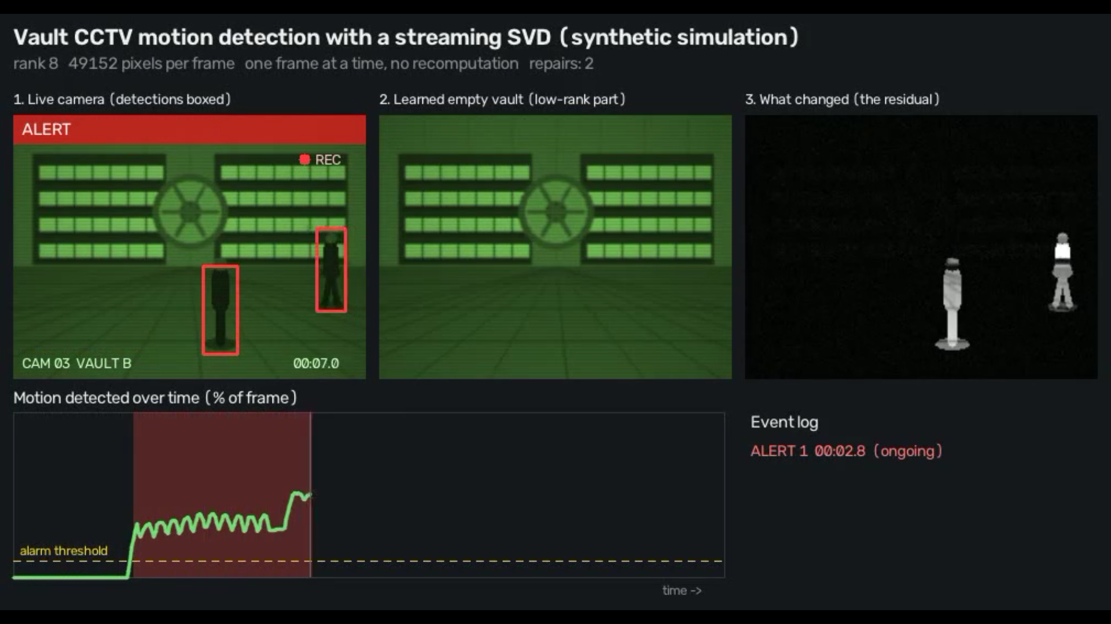
Academic Presentation
Real-World Deployment: Vault CCTV
Dimensionality: p = 49,152 pixels.
Throughput: > 500 FPS (sub-2ms latency).
Hardware Efficiency: Entire core matrix (< 4 KB) resides in CPU L1-Cache.
Presenters
M B Thejesshwar & Yash Atul Dighade
Course
Computational Linear Algebra
Institution
IIT Kharagpur
Notes:
We deployed this on a high-dimensional CCTV stream. To prevent 'ghosting' artifacts, we use a brief Calibration Phase where the camera looks at the empty vault for 2.5 seconds to initialize the basis. Because our core matrix is just 4 kilobytes, it avoids memory bottlenecks entirely and stays within the CPU's L1 cache, processing 50,000-pixel frames in under 2 milliseconds. Over this entire incident, the system maintained a pristine background and executed exactly 6 adaptive repairs with zero memory leakage.

Slide 15

Academic Presentation
Conclusion
Resolved Brand's (2006) Open Problem with mathematically guaranteed numerical stability.
Novel Contributions:
O(pr) drift tracker
Wilkinson adaptive trigger
Lossless subspace absorption
Impact:
Infinite-horizon streaming PCA with strict O(pqr) complexity guarantees.
Code:
github.com/yashdighade774/CLA-Project
Presenters
M B Thejesshwar & Yash Atul Dighade
Course
Computational Linear Algebra
Institution
IIT Kharagpur
Notes:
To conclude, we resolved a nearly two-decade-old open problem in numerical linear algebra. By combining exact recursive drift tracking, Wilkinson's error bounds, and algebraic subspace absorption, PA-ISVD guarantees machine-precision stability for infinite-horizon streaming data, without sacrificing the linear-time complexity budget. Our complete Python source code and test suites are open-sourced on GitHub. Finally, we would like to thank Prof. Swanand Khare for his excellent course and guidance this semester. Thank you, and we welcome any questions.

Slide 16
Academic Presentation
Backup: Amortized Complexity Proof
Amortized Cost Breakdown
Bounded Overhead
Since repairs only happen every Ω(k) frames, and k ≥ r, the amortized overhead is ≤ O(pr).
Global Complexity Guarantee
Total time remains strictly O(pqr).
Presenters
M B Thejesshwar & Yash Atul Dighade
Course
Computational Linear Algebra
Institution
IIT Kharagpur

Slide 17

Academic Presentation
Backup: Temporal Subspace Audit (fixV)
Periodic Drift Monitoring
Audit every v_gap = r frames.
Selective Re-orthogonalization & Absorption
If drift > τ: re-orthogonalize VV′ = Q_v R_v via MGS.
Absorb R_v into (U′Σ) via SVD.
Complexity Guarantee
Preserves mathematical invariance in amortized O(qr) time.
Presenters
M B Thejesshwar & Yash Atul Dighade
Course
Computational Linear Algebra
Institution
IIT Kharagpur

Slide 18
Academic Presentation
Backup: One-Sided Jacobi (Hestenes) SVD
Avoids Normal Equations
Avoids condition-number squaring κ(KᵀK) = (κ(K))² inherent to normal-equation formulations.
Minimal Root Solver
Solves minimal root of t² + 2ζt − 1 = 0 via t = sgn(ζ) / (|ζ| + √(1 + ζ²)).
Numerical Stability
Guarantees maximal numerical stability and prevents angle/rotation stalls.
Presenters
M B Thejesshwar & Yash Atul Dighade
Course
Computational Linear Algebra
Institution
IIT Kharagpur

