Slide 1


PharmaPulse AI
Intelligent Pharmacy Sales Forecasting &
Inventory Decision Support System
Presented By:
Bit by Bit
Project Link:
https://pharmapulse-pwue.onrender.com/

Slide 2

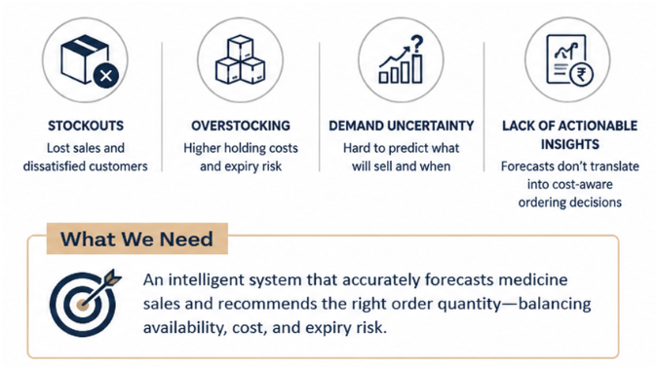
Problem Statement
Pharmacies struggle to maintain the right medicine inventory due to uncertain demand. Understocking causes stockouts and lost sales, while overstocking leads to higher costs and expiry risk. Existing forecasting methods often predict sales but do not provide actionable, cost-aware ordering decisions.

Slide 3

Our Solution
Every pharmacy guesses how much to order. We calculate it with the odds, the cost of being wrong, and the reason behind the number.
Demand forecasting Predicts future medicine sales with uncertainty ranges.
Cost-aware inventory decisions Recommends the right quantity to order based on shortage and overstock costs.
Explainable & risk-based insights Shows why a forecast is made and highlights critical inventory risks.
Smart & actionable pharmacy management Helps pharmacists decide what to order, how much to order, and when to order.

Slide 4
USP
Features
AI Demand Forecasting :
Forecasts medicine sales across daily, weekly and monthly periods.
Smart Order Recommendation :
Calculates how much to order based on demand, stock and costs.
3. Inventory Risk Detection:
Identifies stockout, overstock and demand anomaly risks.
4. Forecast Explainability :
Displays the factors influencing predictions and their reliability.
Uncertainty-Aware Forecasting
Demand is represented as a range, not a single value.
No manual configuration
Models are automatically selected per medicine.
Explainable Decisions
Every recommendation comes with a clear reason.
Risk-Based Prioritization
Focuses attention on the decisions with the highest monetary impact.

Slide 5
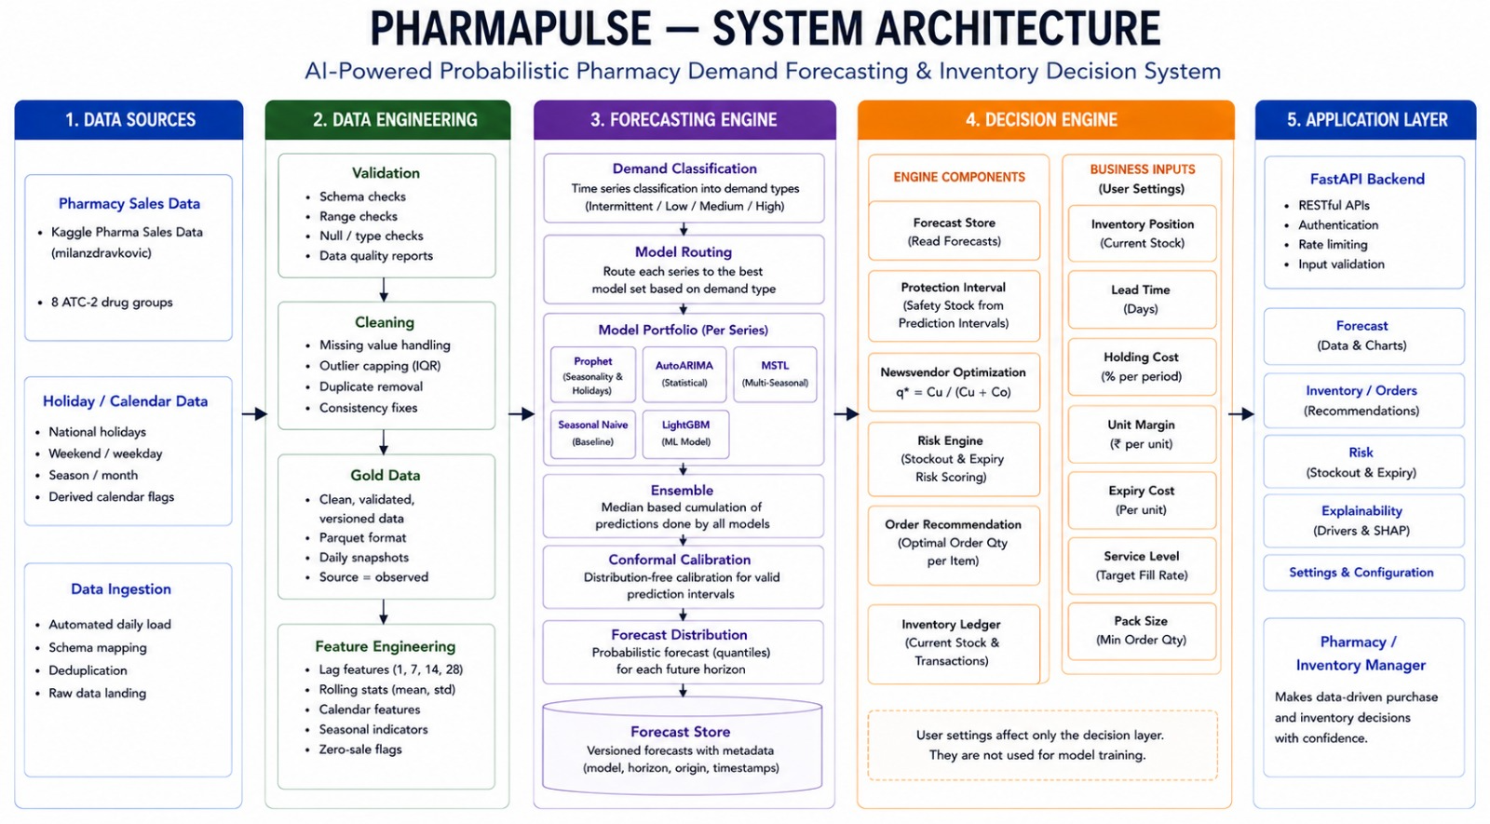
System Architecture

Slide 6
Forecast
The data decides how each medicine is forecast. Different demand patterns → different models → reliable demand ranges.
ERRATIC
Steady timing, varying sales sizes Models: LightGBM · MSTL · SeasonalNaive · AutoARIMA
LUMPY
Irregular timing & varying sales sizes Models: LightGBM · SeasonalNaive No major lumpy series observed in the dataset.
01 | Statistical AutoARIMA • MSTL • Seasonal Naive
02 | Machine Learning LightGBM — Global
Quantile Forecasting
SMOOTH
Regular sales, stable quantities Models: Prophet · AutoARIMA · MSTL SeasonalNaive · LightGBM
INTERMITTENT
Long gaps between sales Models: LightGBM · SeasonalNaive
03 | Structural Prophet
04 | Intermittent CrostonOptimized • TSB
05 | Ensemble Median of selected model forecasts
ADI → Measures the gap between sales
CV² → Measures variation in sales quantity
ADI ≥ 1.32 → Longer gaps
CV² ≥ 0.49 → Higher variation

Slide 7
Language: Python 3.11, TypeScript Data: pandas 2.2.3, NumPy 1.26.4, DuckDB, PyArrow / Parquet, SQLite
Forecasting: statsforecast (AutoARIMA, AutoETS, MSTL, Croston, TSB, Theta), mlforecast, LightGBM 4.5, Prophet 1.1.6 / cmdstanpy
API: FastAPI, Pydantic v2, Uvicorn — 17 endpoints
Frontend: React 18, TypeScript, Vite, Tailwind CSS, TanStack Query — charts are raw SVG, no charting library
Ship / quality: Docker Compose, GitHub Actions CI, pytest (139 tests), ruff, Hypothesis for property tests
Deck: pptxgenjs, generated from artifacts/benchmarks.json so it cannot drift from the numbers
Tech
Stack

Slide 8
Potential Impacts & Users
Impact on Pharmacy Operations
The Purchasing Buyer
“What should I order?” Gets the recommended order quantity, service level and risk. Decisions → Order
The Pharmacy Owner
“Is my capital in the right stock?” Reviews inventory costs, risks and business impact. Risk → Replay
Fewer Stockouts: Better forecasting helps maintain medicine availability.
Reduced Overstock: Avoids unnecessary inventory and expiry risk.
Faster Decisions: Provides clear, actionable ordering recommendations.
Better Inventory Planning: Supports daily, weekly and monthly stocking decisions.
The Decision Maker
“Why should I trust this?” Checks accuracy, calibration and forecast explanations. Why → Evidence

Slide 9
Thank You
Yash Kailas Doke 8236346
Yadni Prabhakar Mali 8243735
Arya Jitendra Chandak 8246760
Shruti Sachin Chavan 8243636
Samiksha Nitin Gaikwad 7873346
Sanika Ashok Misal 8180859
Sarvesh Rajesh Nagawade 8245178
Bajrang Yelure 8232476

