Slide 1
COGNIZANT CAMPUS DRIVE · HEALTHCARE · PHARMA SALES ANALYSIS & FORECASTING
PharmaPulse
Every pharmacy guesses how much to order.
We calculate it — with the odds, the cost of being wrong,
and the reason behind the number.
THE PROPOSED SOLUTION
six years
of real sales
→
a demand
distribution
→
intervals we
checked and fixed
→
a purchase order,
in packs
Almost every tool in this
market stops after box two.
0.907
69.5%
138
ensemble MASE
18.8% better than the benchmark
lower inventory cost than a
min/max policy, replayed on real days
tests, and a benchmark that
reruns from a clean clone in CI
Notes:
Open here. Do not read the slide. Say: every pharmacy makes this decision every week, from memory or a spreadsheet - this is what it looks like when you calculate it instead. The USP is the last box in the chain.

Slide 2
USE CASE #14 · WHAT WAS ASKED
Analyse pharmaceutical sales.
Forecast future demand.
THE BRIEF
THE DATA WE WERE GIVEN
Analyse historical pharmaceutical sales, identify demand patterns and seasonality, and forecast future sales so that inventory can be planned.
2,106
days · 1 Jan 2014 to 8 Oct 2019
8
ATC drug categories, sold in fractional units
HOW WE READ IT
“So that inventory can be planned” is the actual deliverable. A forecast nobody can act on is a chart. We took the brief to its end — the purchase order.
3
grains — daily, weekly, monthly
0
columns for stock, price, promotion or cost
Kaggle · Pharma Sales Data (milanzdravkovic) — a real pharmacy's point-of-sale export. That last row is the constraint the whole architecture is built around.
Notes:
Point at the zero. Everything a judge will ask - where did the cost data come from, how do you know the stock level - traces back to that row, and the lanes slide is the answer.

Slide 3
THE DECISION UNDERNEATH THE FORECAST
Getting it wrong costs money in two directions at once.
Cu
Order too little
Co
Order too much
A patient asks for a medicine you do not have. They go to the pharmacy across the road.
Cash sits on a shelf. Medicines reach their expiry date and are thrown away.
The lost gross margin — and often the customer, permanently.
Holding cost on the capital, plus a total write-off at expiry.
In our settings: the unit margin.
In our settings: 22% annual holding + 1.5% expiry risk.
q* = Cu / (Cu + Co)
The newsvendor fractile. A hundred years old, and exact — not an approximation and not a heuristic. If a shortage costs 3× an excess, order the quantity you exceed only one cycle in four. It is closed form, which is why the slider recomputes in the browser.
WORKED, ON PARACETAMOL — EXACTLY WHAT THE PRODUCT DOES ON THE NEXT SLIDE BUT ONE
1
2
3
4
5
YOUR COSTS
→
q* = 94.8%
→
545 units
→
− 310 on hand
→
240 units
margin lost if short,
holding + expiry if long
the fractile those two
costs imply
the 94.8th percentile of
demand over 11 days
the live shelf position,
from the ledger
235 rounded up to 24
whole packs
Notes:
The maths is not the novelty - shipping it is. Walk the five boxes left to right; that is the entire product in one line. Note step 4: the shelf position is live, not a stored field, so accepting an order changes the next recommendation.

Slide 4
WHO THIS IS FOR
Three people open it, and each one
opens a different screen.
The purchasing buyer
The pharmacy owner
Whoever signs it off
MONDAY MORNING · TEN MINUTES
END OF MONTH
BEFORE IT GOES LIVE
“What do I order this week?”
“Is my capital in the right stock?”
“Why should I trust this number?”
A quantity, in packs, with the money at risk if they ignore it. Not a chart.
The cost of the current policy against the alternative, over real days, in rupees.
Attribution in units, calibration measured against outcomes, and the series where it loses.
Decisions → Order
Replay → the business case
Why → Evidence
Seven screens, but nobody has to visit all seven. The navigation is ordered the way the questions actually arrive: decide, order, forecast, why, replay, evidence, settings.
Notes:
Name the buyer first. The whole product is built for ten minutes on a Monday morning; the other two roles exist so that somebody will let the buyer use it.

Slide 5
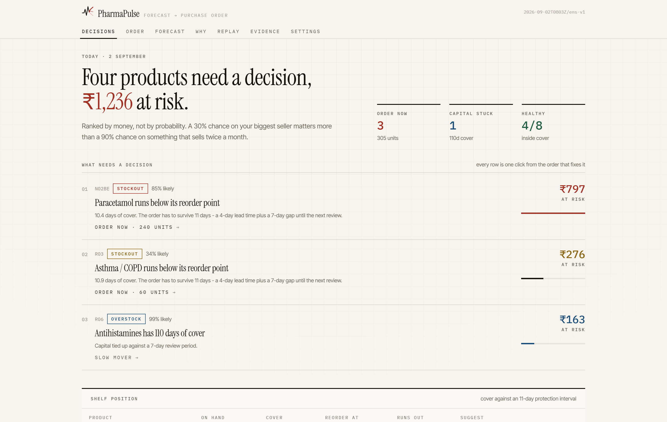
THE PRODUCT · WHAT THE BUYER SEES FIRST
It opens on the decision, not on a chart.
Ranked by money
₹276 at 34% likely is ranked above ₹163 at 99%. Probability is not the ranking a buyer needs — exposure is.
One click to the fix
Every row links straight to the order that resolves it — there is no hunting.
Live, not nightly
Position = seeded opening stock + every ledger movement since. Accept an order and the shelf actually moves.
live screenshot
Notes:
Do not narrate the screen. One sentence - it opens on what needs a decision, ranked by rupees - then move. The live demo is where this lands.

Slide 6
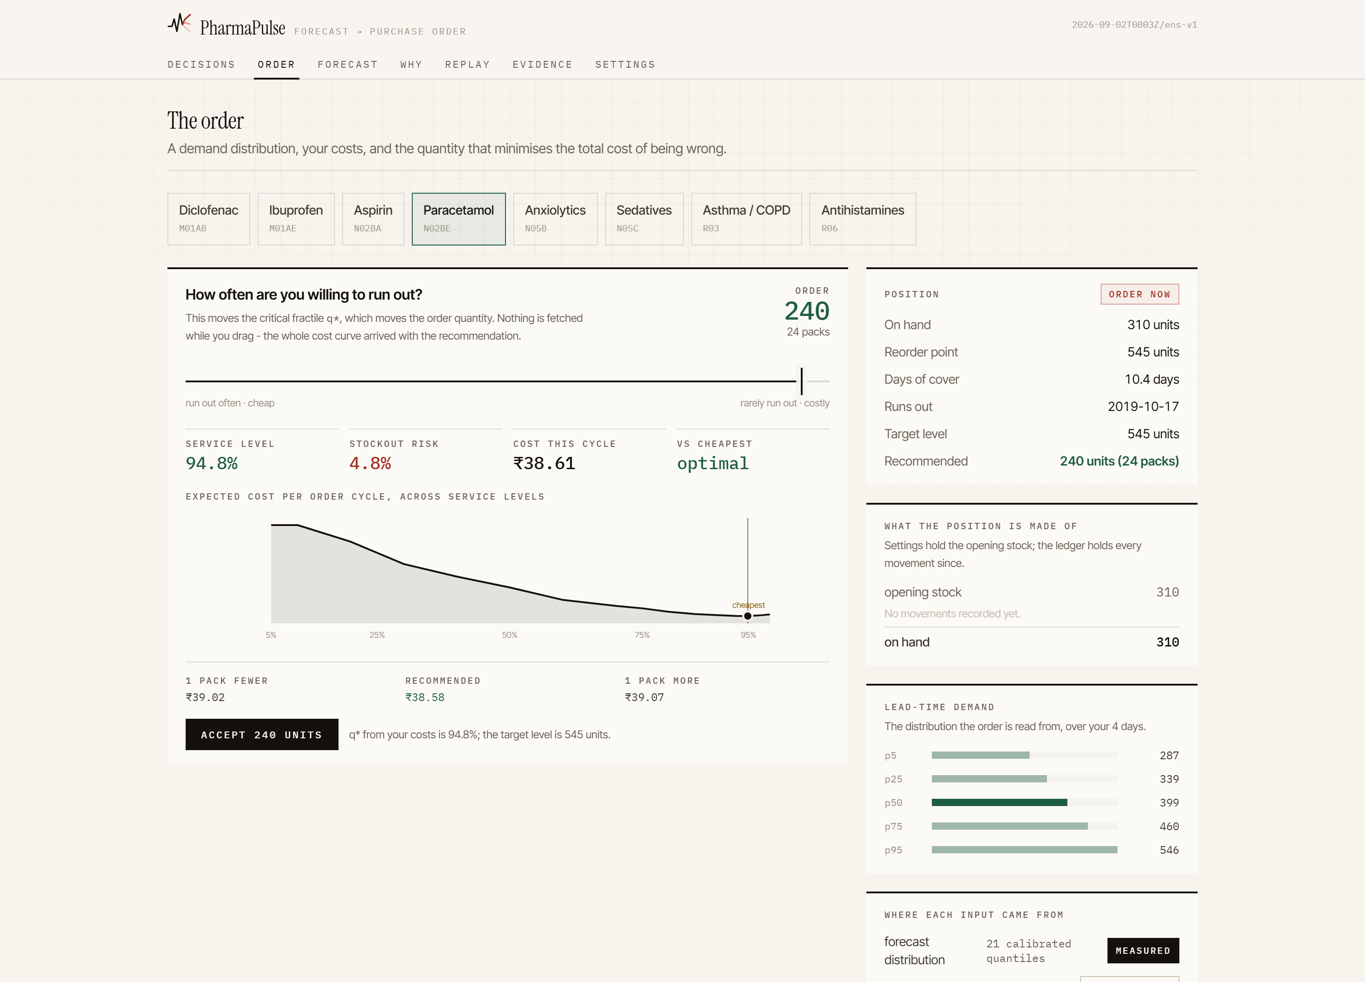
THE PRODUCT · THE SCREEN THE WHOLE SYSTEM EXISTS FOR
The slider is the cost ratio. Drag it, the order moves.
The quantile, made physical
Service level, stockout risk, cost this cycle and the distance from optimal — all recomputed as you drag.
±1 pack, priced
One pack fewer and one pack more, each with what it costs. That is a sensitivity a buyer can argue with.
The position is auditable
Opening stock, then every receipt and sale, summing to the number on the shelf.
zero network calls while dragging
Notes:
This is the demo moment. Drag from 80 to 95 and let them watch the quantity and the cost move together. Then say: that is the newsvendor formula from three slides ago, and nothing was fetched.

Slide 7

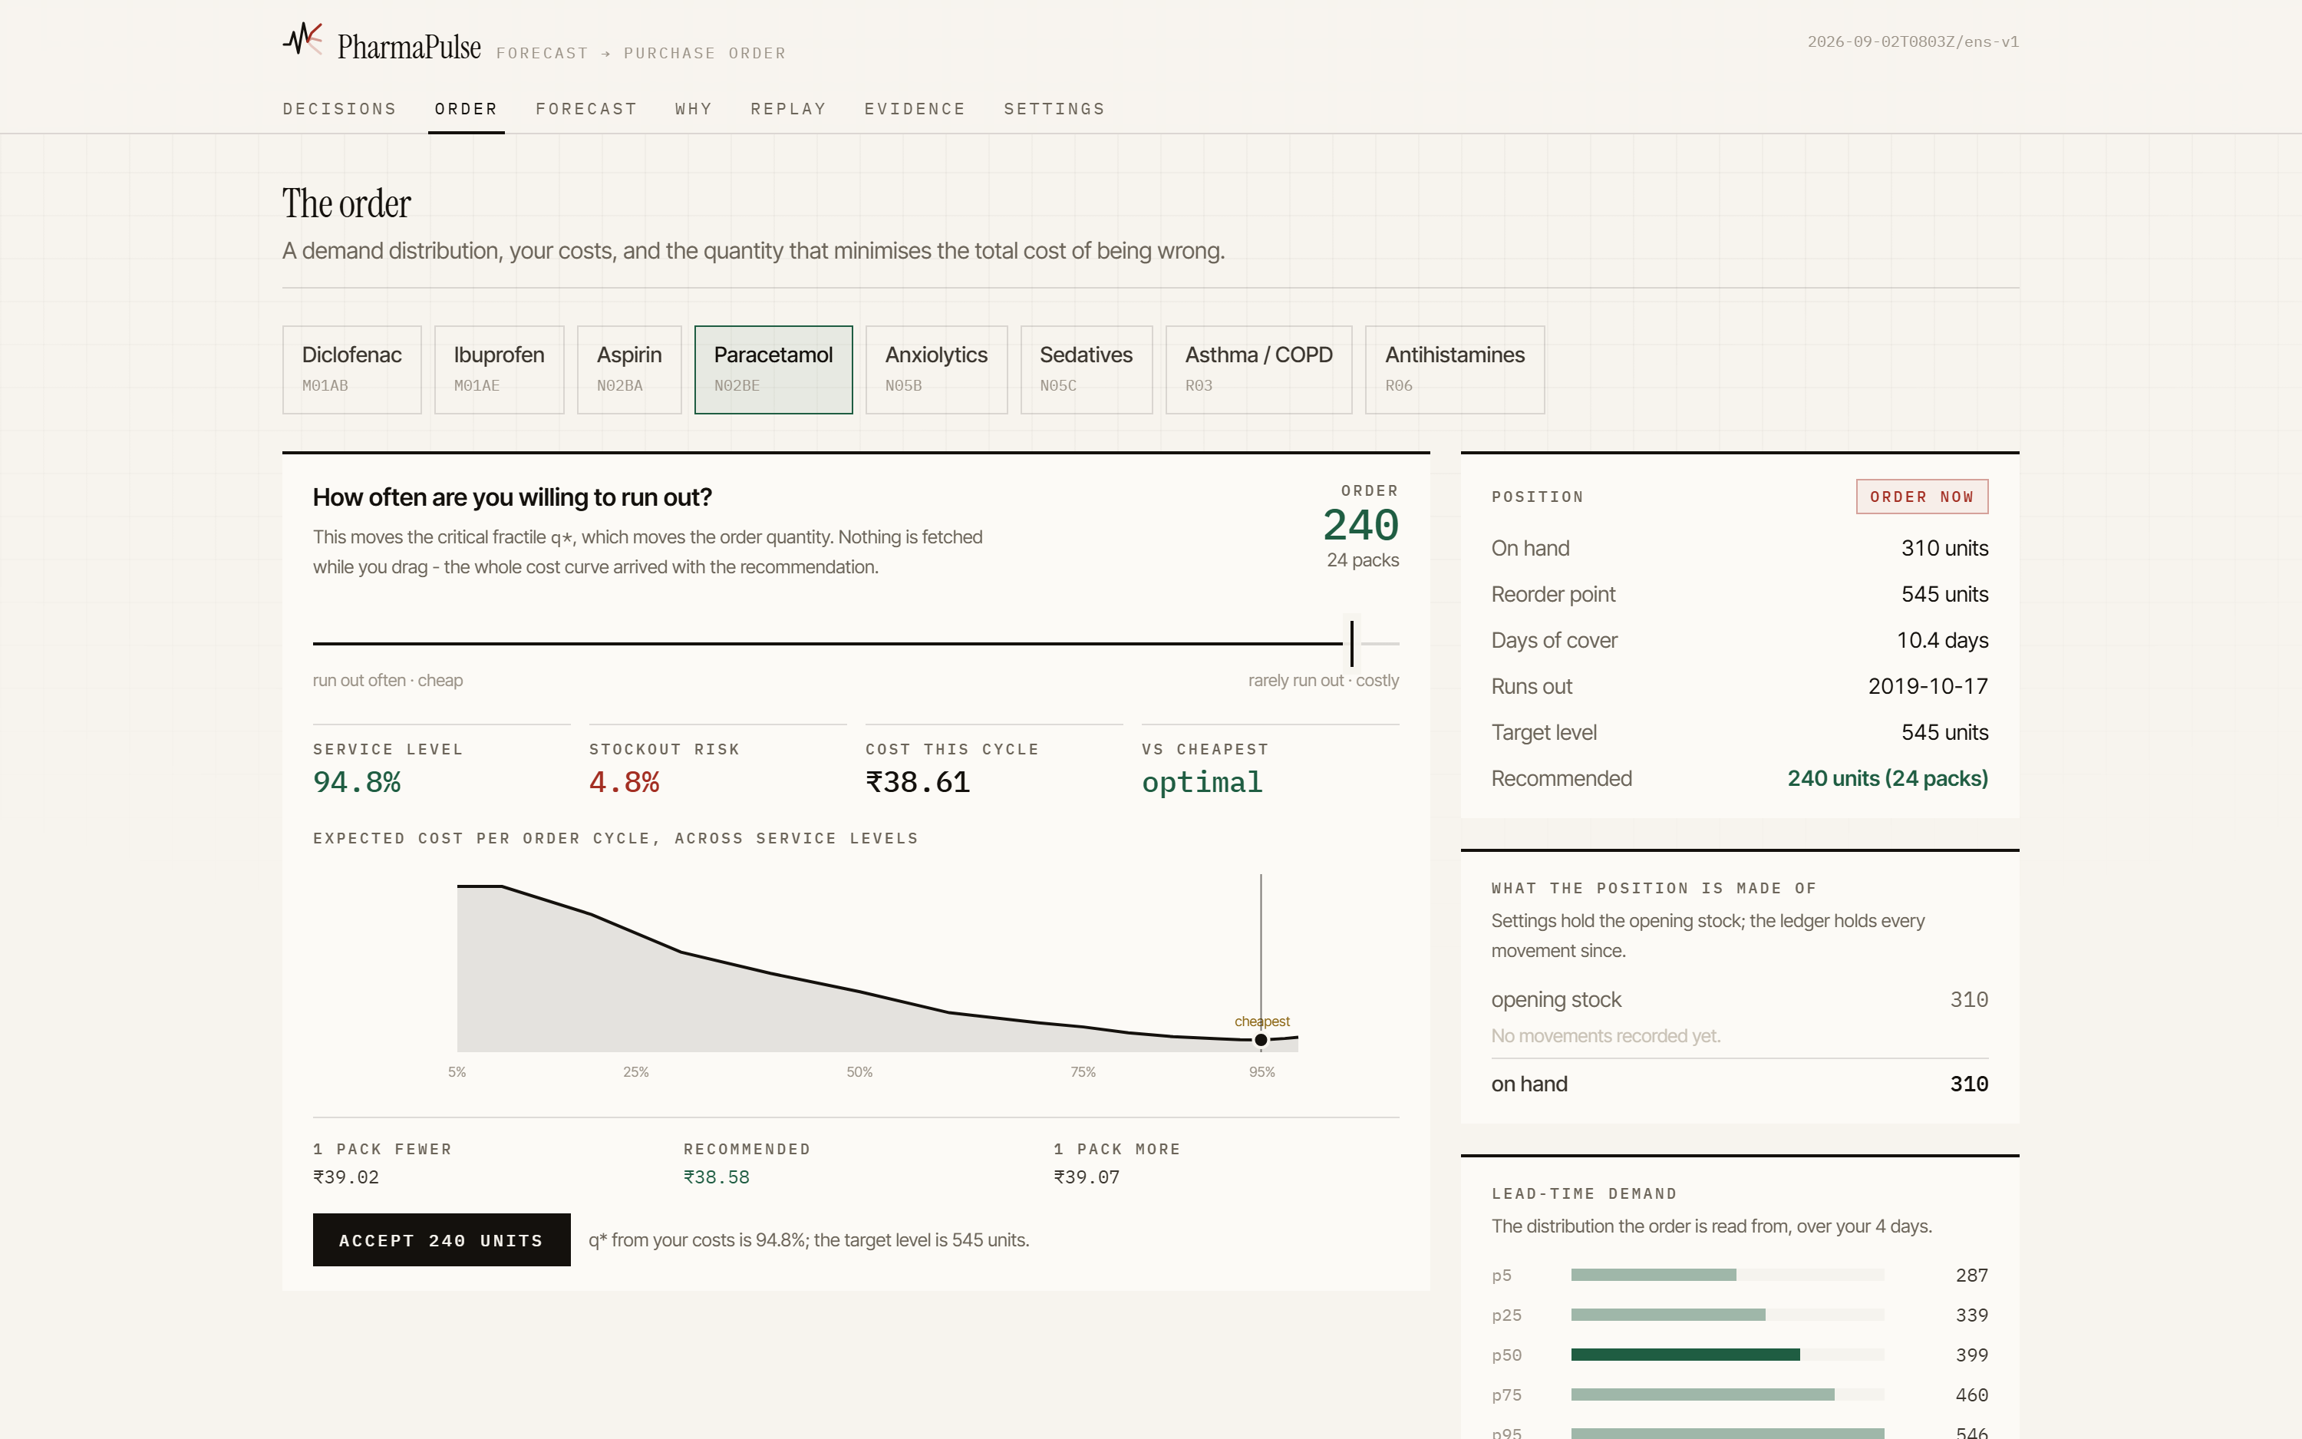
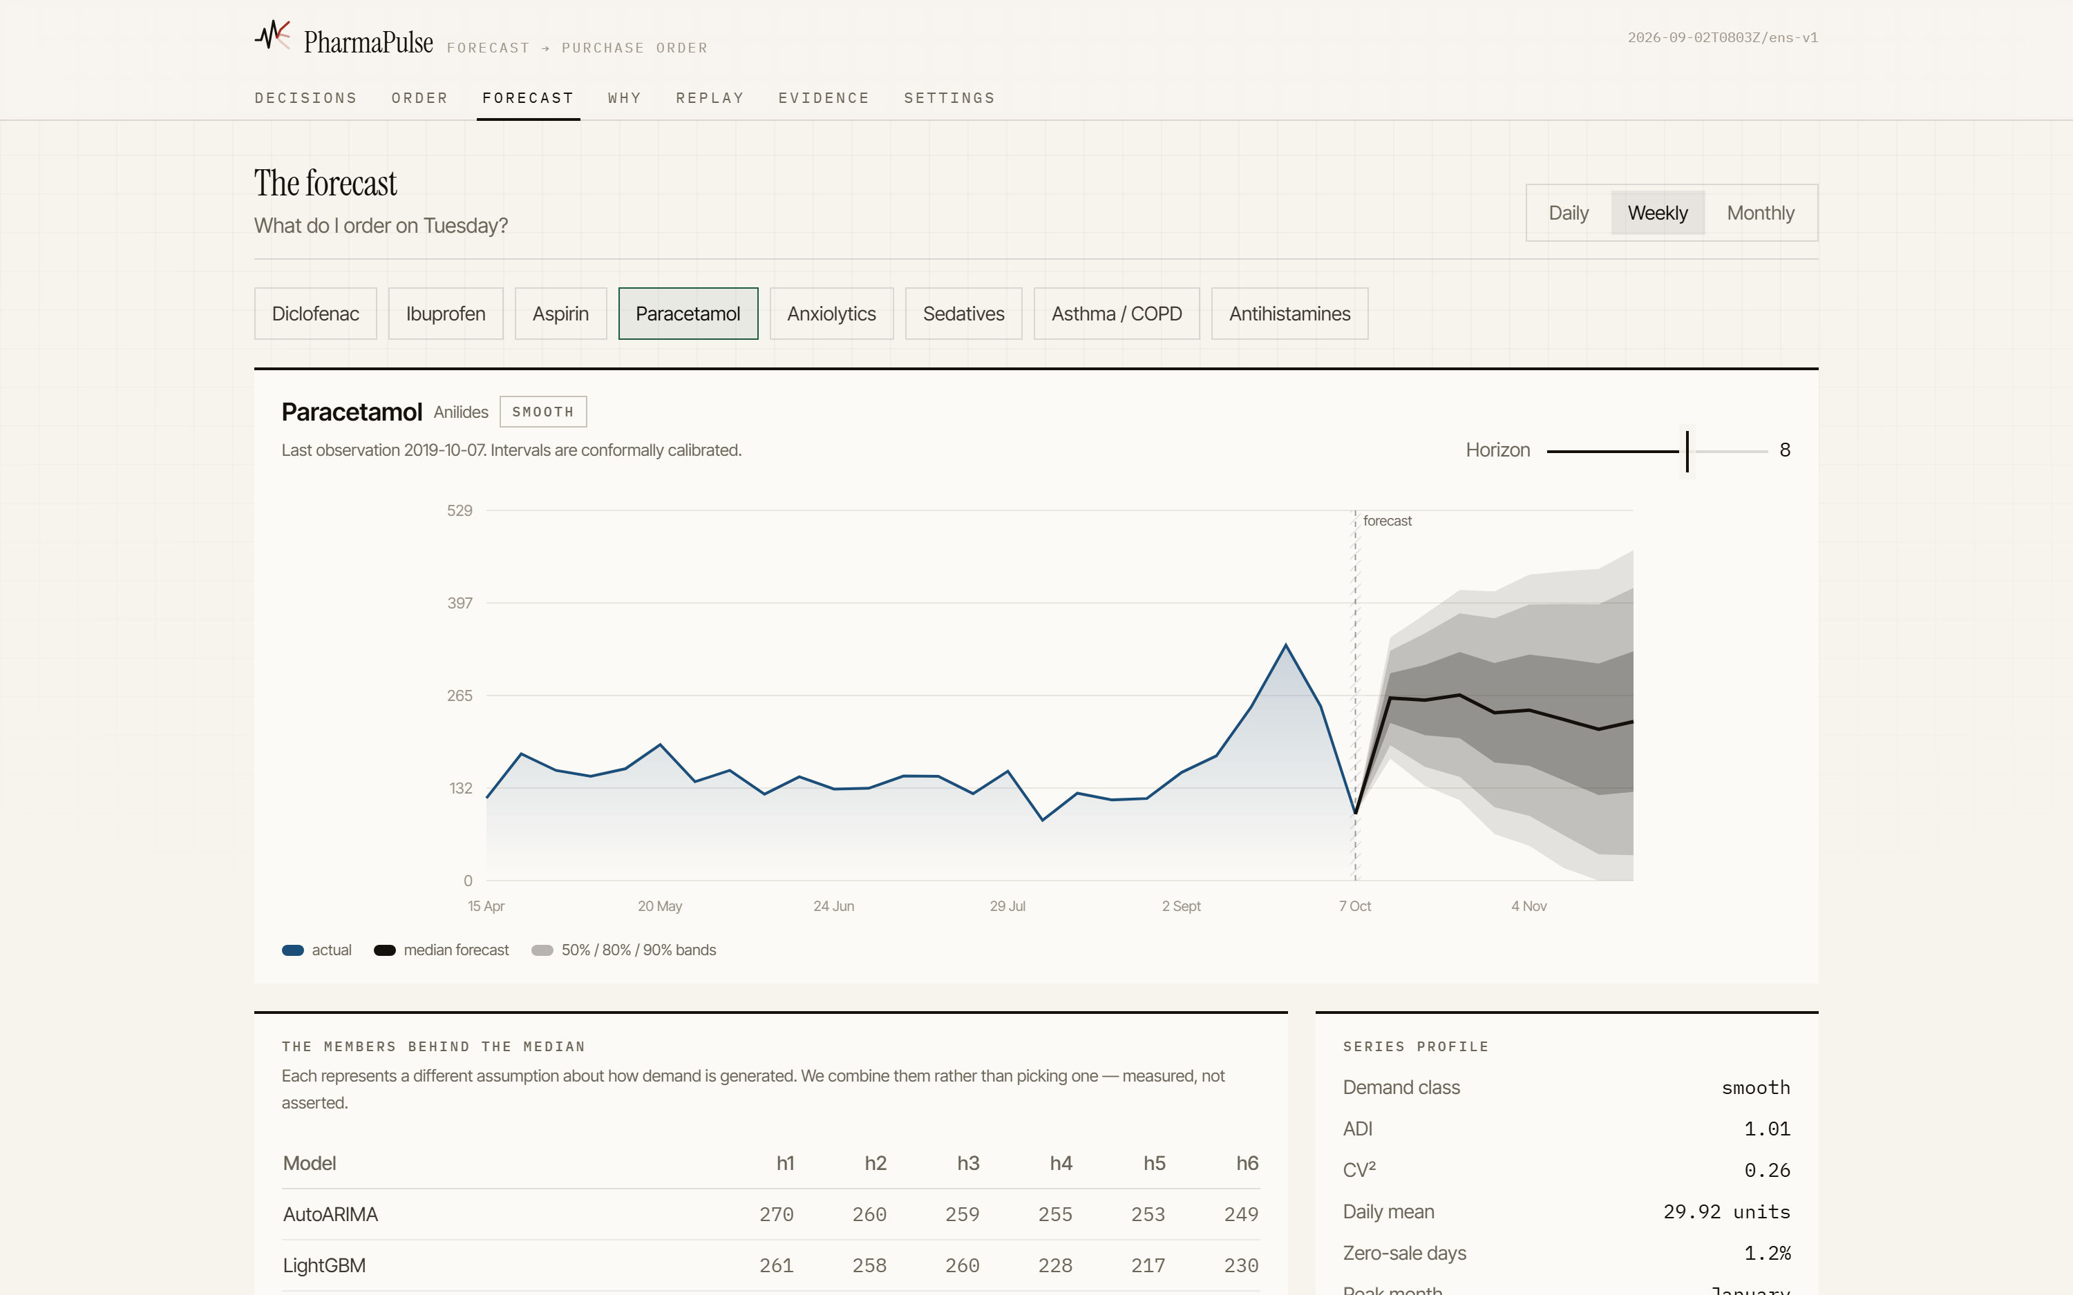
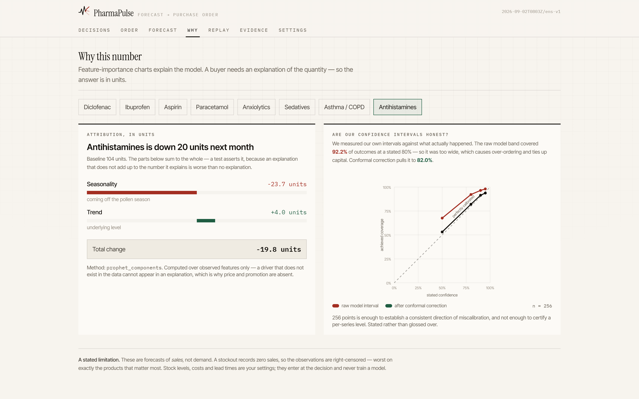
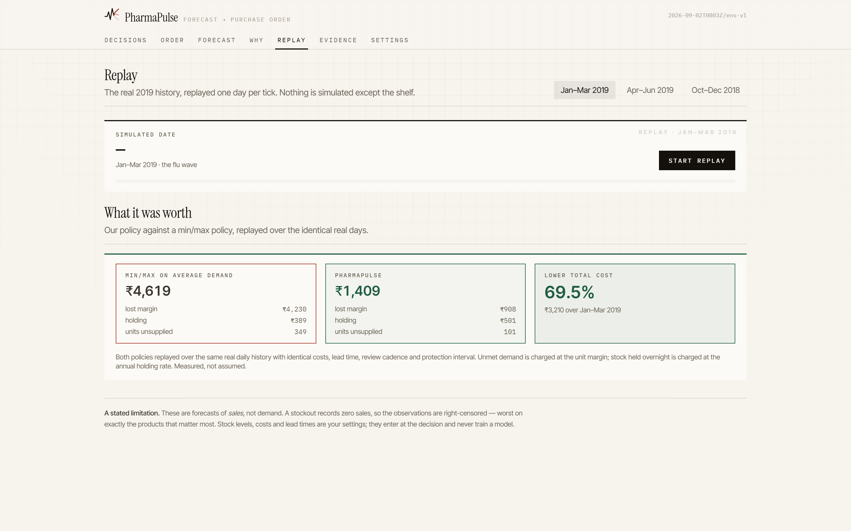
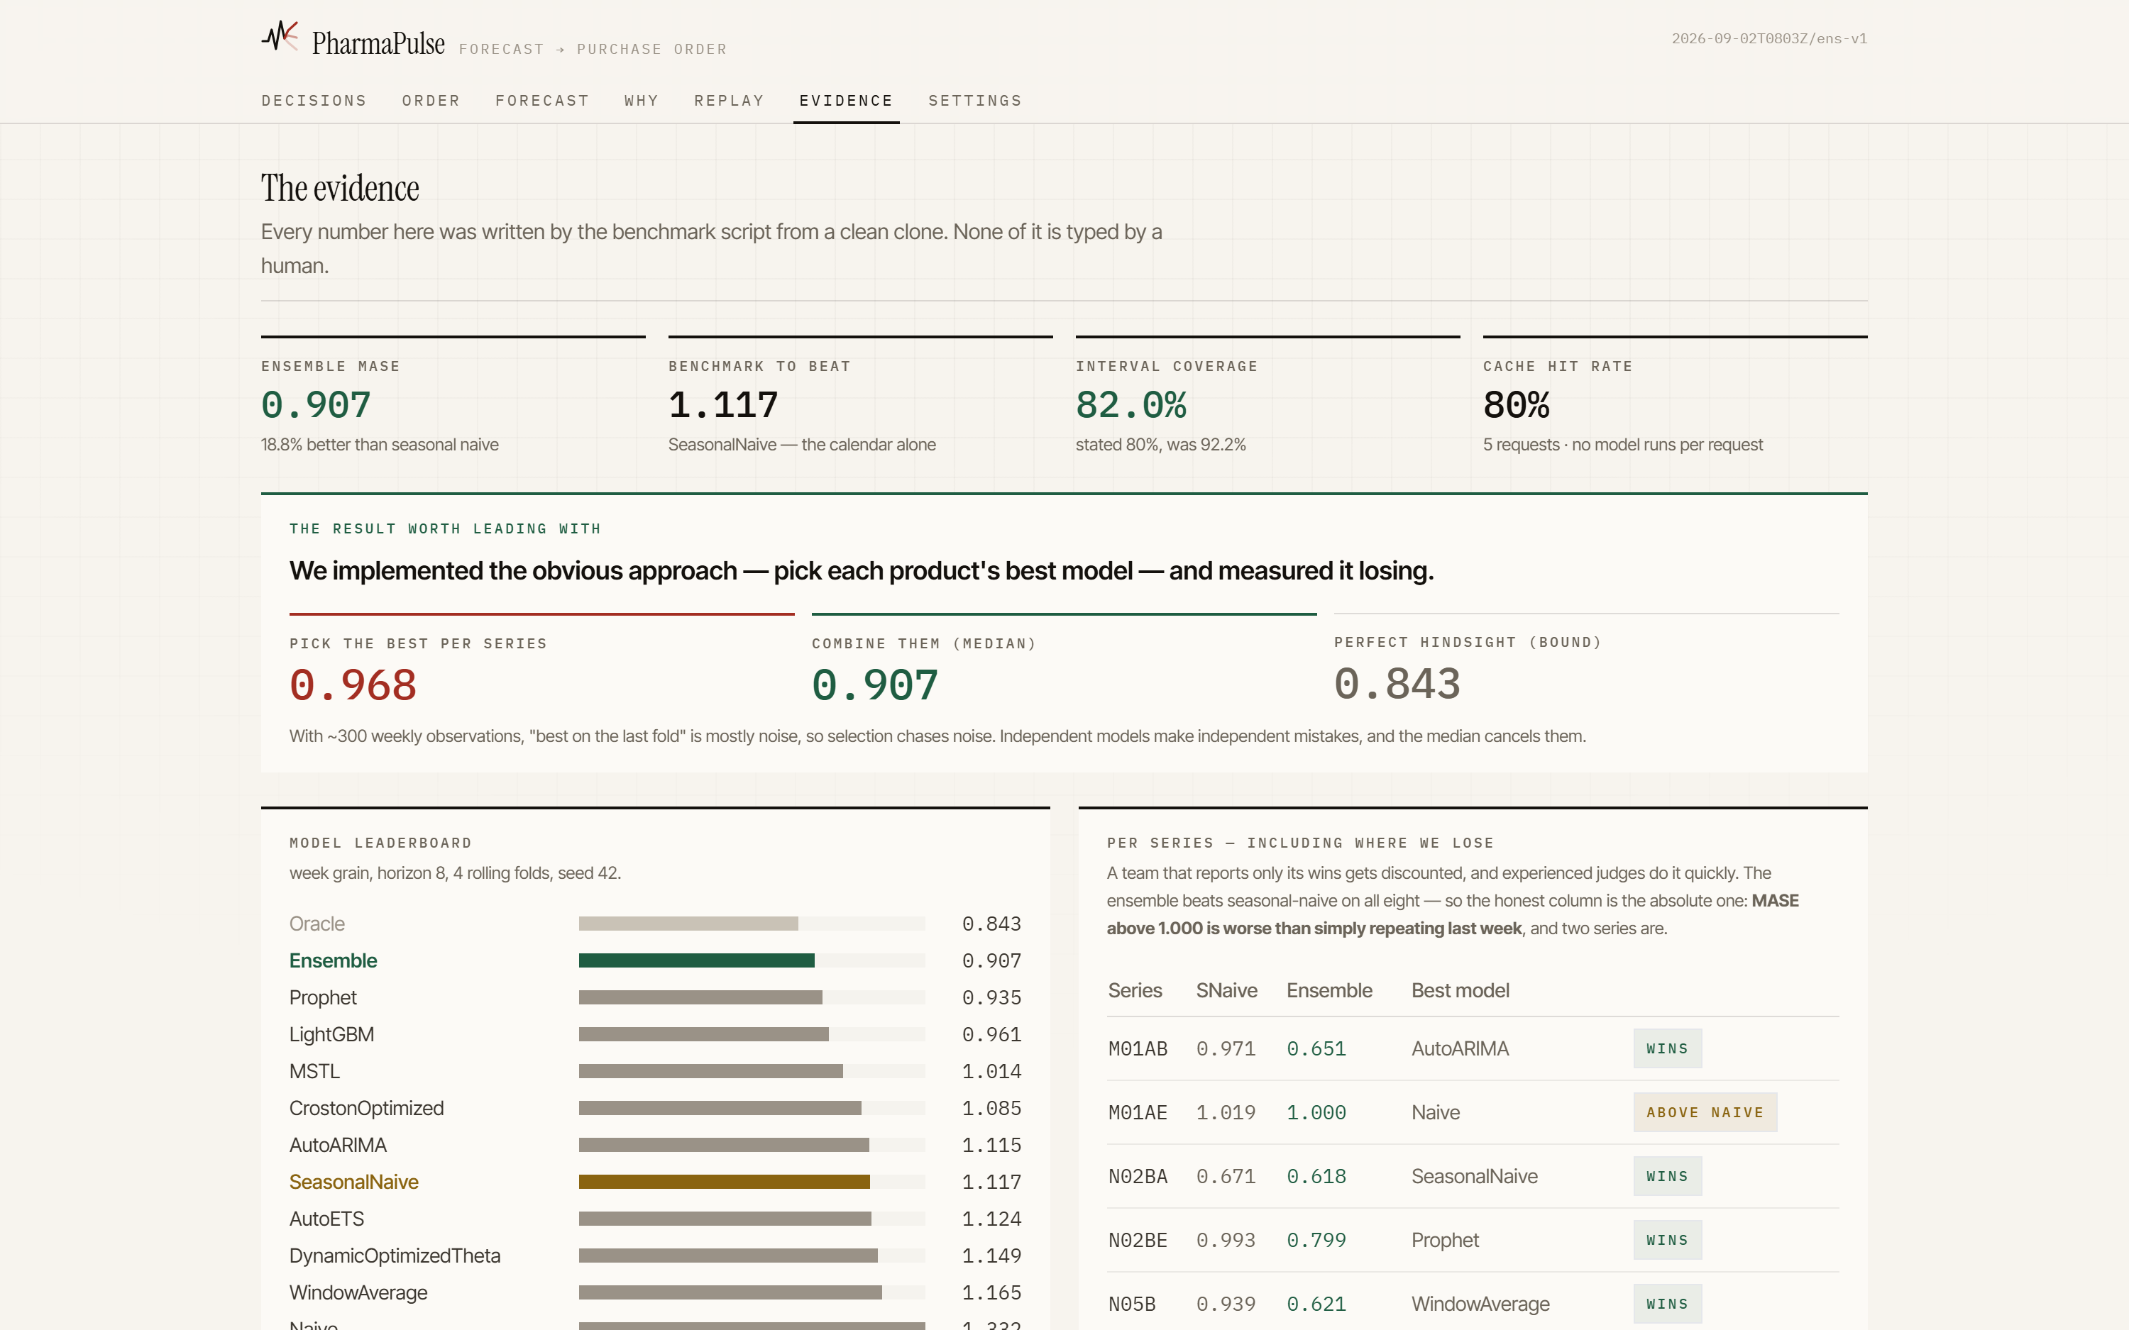
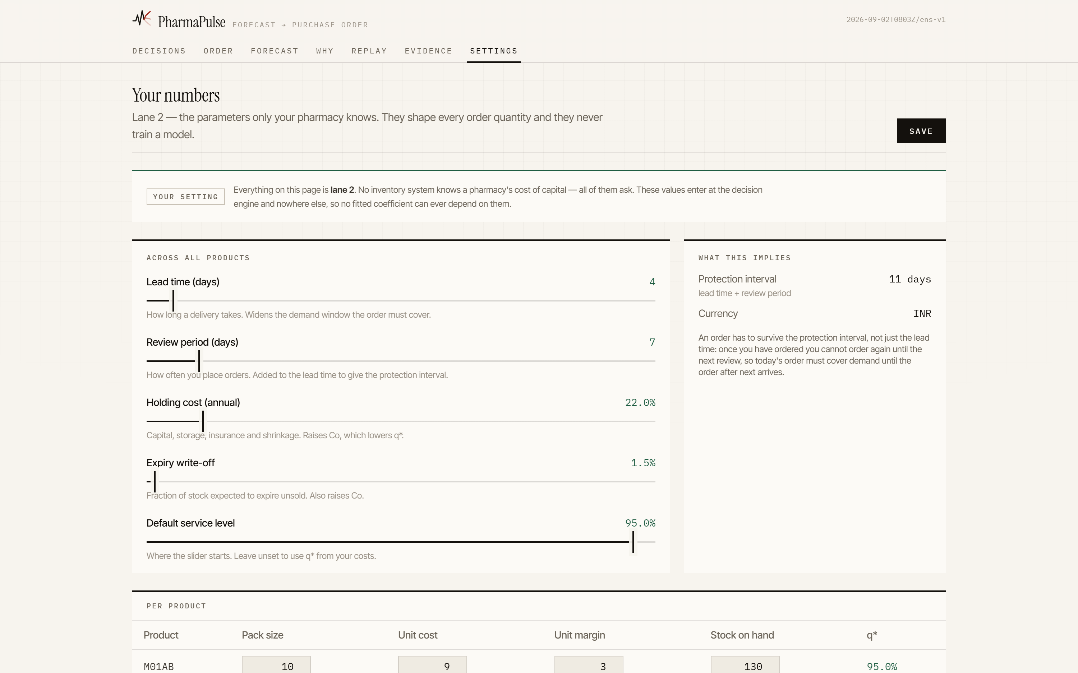
THE PRODUCT · ALL OF IT
Seven screens, in the order the questions arrive.
01 Decisions
02 Order
03 Forecast
04 Why
What needs my decision today?
What do I actually buy?
What will sell, and how sure are we?
Where did that number come from?
05 Replay
06 Evidence
07 Settings
What would it have been worth?
Prove the accuracy claims.
These are my shop's numbers.
Nobody has to visit all seven. A buyer lives in the first two; the other five exist so that somebody will let them.
Notes:
One slide so the panel can see the whole surface at once. Do not talk through it - name the first two and move on, or go to the live demo.

Slide 8
ARCHITECTURE · EVERY COMPONENT, AND WHERE IT LIVES
The system as built — not as designed.
LAYER 1
1.1
Ingester
1.2
Validator
1.3
Cleaner
1.4
Feature Builder
1.5
Gold Store
DATA
· daily file only
· append-only, idempotent
· SHA-256 snapshot id
· 9 quality gates
· day/week/month must agree
· raises, never warns
· 26 closure days masked
· outliers flagged, not cut
· partial periods flagged
· lags and rolling means
· calendar and holidays
· truncate, then compute
· Parquet + DuckDB
· 3 grains from the daily
· origin lane on every row
pipelines/
LAYER 2
2.1
Classifier
2.2
Portfolio
2.3
Combiner
2.4
Calibrator
2.5
Forecast Store
2.6
Attribution ◂
FORECAST
· ADI / CV² quadrants
· recomputed per grain
· a rule, not a setting
· 11 models, 5 shipped
· routed by demand class
· ARIMA LGBM MSTL
· Prophet Croston
· median of five
· not best-of-five
· quantiles stay monotonic
· conformal, so assumes
· no residual shape
· 92.2% → 82.0% coverage
· versioned, immutable
· CURRENT written last
· so a read is never torn
· Prophet's components
· expressed in units
· parts must sum to whole
core/
ABOVE runs offline, once, about 4 minutes BELOW runs per request, under a second
LAYER 3
3.1
Order Calculator
3.2
Risk Detector
3.3
Stock Ledger
3.4
Replay ◂
DECISION
· newsvendor fractile, closed form
· protection interval = lead + review gap
· rounded up to whole packs
· 4 rules, read at the current position
· before any order is placed
· ranked by rupee exposure
· opening stock + every movement since
· hash-chained order log
· accepting an order moves the shelf
· real 2019 days, one per tick
· serialised under a per-session lock
· carries a rival min/max policy
decision/
LAYER 5
FastAPI · 16 endpoints · one provenance envelope on every response · fixture fallback when the store is missing, so the app always runs
SERVICE
/forecast /explain /risk /recommend /orders /ledger /replay /benchmarks /series /settings /health /metrics
api/
LAYER 6
Decisions
Order
Forecast
Why
Replay
Evidence
Settings
PRODUCT
web/
◂ moved down a layer from the submitted design. Removed and not built: the reconciler (2.5), the scenario engine, the assistant, the stress harness — and with attribution and replay moved down, LAYER 4 · INTELLIGENCE no longer exists as a layer. Redis became an in-process cache, Postgres became SQLite, MLflow became one JSON file the API can only read.
Notes:
The honest architecture slide. Every other team shows the design; this shows the build and names what is missing. Do not read the cards - point at the dashed line and say the split, then point at the footnote and say what was cut. Full delta is docs/ARCHITECTURE_DELTA.md.

Slide 9
ARCHITECTURE · THE SPLIT THAT MAKES IT FAST
No model runs inside a request.
Everything expensive happens in a batch that writes a versioned forecast store. Everything a screen does is a read. The two halves are joined by a single pointer file, written last — so a reader is never caught mid-publish.
BATCH · minutes, offline
SERVE · milliseconds, per request
1
ingest 2,106 days, validate, derive grains
1
read the version CURRENT points at
2
fit 11 models across 3 grains
CURRENT
2
scale to the protection interval
3
combine by median, calibrate conformally
3
newsvendor fractile → order quantity
4
write a new version, then swap CURRENT
4
wrap in the provenance envelope
python -m pipelines.run_nightly --stage all
uvicorn api.main:app --port 8000
DATA
MODELS
SERVICE
PRODUCT
SHIP
pandas · DuckDB · Parquet · SQLite
statsforecast · mlforecast · LightGBM · Prophet
FastAPI · Pydantic v2
React 18 · TypeScript · Vite · Tailwind
Docker Compose · GitHub Actions · ruff · pytest
Notes:
If a judge asks about latency or scale, this is the slide. The store is immutable per version and the pointer swap is atomic, so publishing during a live demo cannot corrupt a screen.

Slide 10
WHAT WE MEASURED BEFORE DESIGNING ANYTHING
Six properties of the file
that drove every design decision.
01
The supplied monthly file is corrupt
02
26 days are closures, not zero demand
53 series-months disagree with a daily rollup by more than 5%. We ingest the daily file only and derive the rest.
21 map to the Serbian Orthodox calendar. Masked from the loss — never imputed, never deleted.
03
The last bucket is truncated
04
One series is genuinely intermittent
October 2019 looks like a 70% collapse and is not. Partial periods stay visible, and hatched.
N05C sells nothing on 67.9% of days, ADI 3.12. It routes to Croston/TSB automatically.
05
Seasonality has a different phase per drug
06
Weekday effects run in opposite directions
Antihistamines peak in May, paracetamol in January. One global profile would smear both.
OTC sells more at weekends, prescription less. A shared coefficient would cancel them out.
Two of these contradict our own submitted design document. Both corrections are written down rather than quietly fixed.
Notes:
Every architectural choice traces to a measured property of the file. This is what stops it being a generic pipeline with a pharma label on it.

Slide 11
THE RULE THAT PROTECTS THE PROJECT
The file has dates and units sold.
It has no stock, costs or lead times.
A system that invents those and trains on them is learning from a random number generator — and any explanation it then produces is an explanation of noise. So every value belongs to exactly one lane, and the lanes have different rights.
1 · observed
salesdaily.csv and the calendar features derived from it
trains models · explains · backs a claim
2 · your setting
lead time · holding cost · margin · stock on hand · pack size
explains only — never trains, never backs a claim
3 · synthetic
any demo-only generated data
none of the three — blocked in code, asserted by a test
Enforced, not intended: the ingest entrypoint raises on a synthetic path, every row carries its origin, the API returns it, and the interface renders a badge from it.
Notes:
This converts the project's biggest vulnerability into its most credible feature. Say it before a judge asks where the cost data came from.

Slide 12
INSIDE THE FORECAST ENGINE
Nothing is hardcoded to a product name.
The data decides which models it gets.
Two numbers describe how a medicine sells. ADI is the average gap between sales — irregular TIMING. CV² is how much the sale sizes vary — erratic SIZE. They put every product in one of four quadrants, and the quadrant chooses the models. It is recomputed every night, per grain, so when a product's behaviour changes its model family changes with it.
THE ELEVEN MODELS, BY FAMILY
Baselines
Naive · SeasonalNaive · WindowAverage
SeasonalNaive is the one to beat, not a strawman
CV² ↑
sale size
varies
cut at
0.49
ERRATIC
LUMPY
Statistical
AutoARIMA · AutoETS · DynamicOptimizedTheta
steady timing,
wild sizes
irregular timing
AND wild sizes
short-run autocorrelation, fitted per series
Decomposition
LightGBM · MSTL
SeasonalNaive · ARIMA
Croston · LightGBM
SeasonalNaive
MSTL
pulls trend and multiple seasonalities apart
Intermittent
SMOOTH
INTERMITTENT
CrostonOptimized · TSB
models sale size and sale timing separately
sells most days,
stable sizes
long gaps between
sales
Machine learning
LightGBM (global, quantile)
Prophet · ARIMA · MSTL
SeasonalNaive · LightGBM
Croston · SeasonalNaive
LightGBM
one model across all series, learns shared shape
Structural
Prophet
ADI → gaps between sales get longer cut at 1.32
trend, yearly season, holidays — and it explains
Five of the eleven make the shipped ensemble. At weekly grain all eight classify as smooth; at daily grain the sedatives route to Croston. Measured, not asserted.
Notes:
This is the slide for the question 'why so many models'. The answer is that they are not interchangeable - a Croston model exists because averaging methods return a flat fractional line on a series that is zero most days, which is useless to a buyer.

Slide 13
RESULT 1 · FORECAST ACCURACY
18.8% better than the benchmark
everything has to beat.
0.843
0.907
0.907
0.935
what we ship — the median of
five independent models
0.961
1.014
1.117
1.085
1.115
SeasonalNaive — repeat what happened
this week last year. The honest
benchmark, and a hard one.
1.117
1.124
Weekly grain · horizon 8 · rolling-origin CV over 4 non-overlapping folds · MASE against an in-sample naive denominator · 8 series · seed 42. MAPE is undefined on a series with zero-sale days, and one of ours has them on 67.9% of days.
Notes:
Lead with the benchmark, not with our number. SeasonalNaive is hard to beat on retail pharmacy data, and any team that does not name its baseline is hiding one.

Slide 14
RESULT 2 · THE FINDING WORTH LEADING WITH
We implemented the obvious approach
and measured it losing.
0.968
0.907
0.843
Pick each product's
best model
Combine them
(median of five)
Perfect hindsight
the intuitive answer — and
the one most teams ship
what we ship
a bound, not a model
Five different models win across the eight series, so per-series selection looks obviously right. But with ~300 weekly observations, “best on the last fold” is mostly noise — selection chases the noise and locks in whichever model got lucky. Combination does the opposite: independent models make independent mistakes, and the median cancels them.
Scored honestly: the choice for fold k uses only folds 1…k−1, so it never sees the answer it is graded on.
Notes:
This is the strongest slide in the deck. 'We tested the obvious approach and it lost' is a result. 'We averaged some models' is not - same code, different claim.

Slide 15
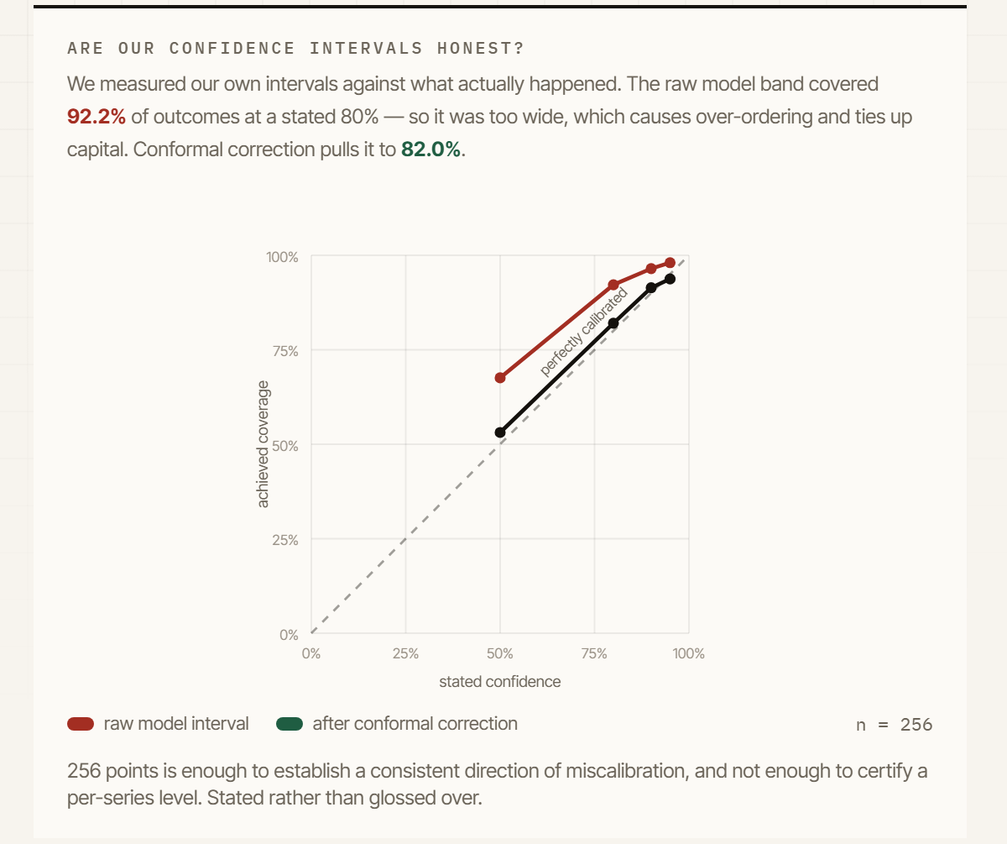
RESULT 3 · ARE OUR OWN CONFIDENCE INTERVALS TRUE?
We measured whether to believe
ourselves, then corrected it.
A stated 80% interval actually covered 92.2% of outcomes. Too wide — which sounds like the safe direction and is not: an over-wide interval pushes the order quantity up, and the buyer pays holding cost for confidence the model has not earned.
92.2%
82.0%
the raw model interval,
at a stated 80%
after conformal correction —
distribution-free, assuming nothing
about the shape of the residuals
Our own design document predicted the opposite direction — 75%, over-confident. The measurement contradicts it. The lesson is unchanged; the business story flips, and we say so out loud.
the same diagram, inside the product's Why screen
Notes:
Most teams never check calibration at all. Point out that the diagram lives in the product, not just the deck - the buyer can see it too.

Slide 16
RESULT 4 · WHAT IT IS ACTUALLY WORTH
Against four policies, including the two
that are hard to beat.
Every policy sizes off the same trailing window of real sales, so the only thing being compared is how the quantity is chosen. The rung that carries the claim is the third one: it gets our forecast and our service level, and differs in exactly one thing — it sizes with a normal approximation instead of reading the quantile off the calibrated distribution.
Min/max on the mean
(s, S) safety stock
Our forecast, normal sizing
no system at all
what an ERP does
the claim
Jan–Mar 19
+6.0%
Jan–Mar 19
-2.9%
Jan–Mar 19
+17.9%
Apr–Jun 19
+48.8%
Apr–Jun 19
+23.1%
Apr–Jun 19
+8.1%
Oct–Dec 18
+61.1%
Oct–Dec 18
-1.8%
Oct–Dec 18
+0.4%
we win all three
we lose two of three
we win all three
What this says, and what it does not
We beat the normal approximation on every window with forecast quality held constant — so the distribution is earning its place. Against a well-tuned ERP policy we are level, winning one and losing two by a couple of percent, and we say so. What separates us there is not cost: it is that z comes from the pharmacy's own margins instead of a consultant, the interval behind it is calibrated, and the number explains itself.
Notes:
Do not lead on min/max - anyone who works in inventory discounts it instantly, because every ERP carries safety stock. Lead on the third card. If asked why we do not dominate the ERP column: every policy here sizes off a trailing window, so none of them can anticipate a seasonal turn - on 1 January the last 180 days are autumn. Anticipating it is what the forecast layer is for, and exercising it needs a forecast produced at each review point rather than one vintage. That is the next piece of work and it is written down.

Slide 17
WHERE IT DOES NOT WORK
A system that only shows you where it wins
is not telling you anything.
Series | SeasonalNaive | Ensemble | Best single model
M01AB | 0.971 | 0.651 | AutoARIMA
M01AE | 1.019 | 1.000 | Naive
N02BA | 0.671 | 0.618 | SeasonalNaive
N02BE | 0.993 | 0.799 | Prophet
N05B | 0.939 | 0.621 | WindowAverage
N05C | 1.174 | 0.785 | CrostonOptimized
R03 | 1.294 | 1.137 | CrostonOptimized
R06 | 1.880 | 1.646 | Prophet
R06 · 1.646
Our worst series, and well above 1.0. The May pollen peak is sharp and its timing moves year to year — we have six observations of it.
R03 · 1.137
Asthma / COPD. Better than the 1.294 seasonal-naive manages, but still above 1.0. We do not claim a win here.
The ensemble beats seasonal-naive on all eight, so the relative column is not the interesting one. MASE above 1.000 means worse than simply repeating last week — and two series are.
Both are on the product's own Evidence screen, flagged, alongside the wins.
Notes:
Say this before anyone finds it. A team that reports only wins gets discounted, and experienced judges do that quickly.

Slide 18
THE DEEPEST LIMITATION, STATED BEFORE ANYONE ASKS
We forecast sales, not demand.
A stockout records zero sales — indistinguishable from zero demand. So our observations are right-censored, and the censoring is worst on exactly the products the system most needs to get right.
a stockout
→
recorded sales fall
→
the forecast falls
→
the order falls
→
another stockout
Self-reinforcing, if left uncorrected.
What we do: flag days where sales hit a suspicious ceiling and treat them as censored.
What we cannot do: verify it — this dataset has no on-hand-stock column.
It is named in the model card, and it is the first thing a real deployment fixes.
Notes:
Saying this out loud is the strongest thing in the presentation. It bounds every claim the system makes, and volunteering it separates a team that measured from a team that demoed.

Slide 19
IN CONCLUSION
Every pharmacy guesses how much to order.
We calculate it — with the odds,
the cost of being wrong, and
the reason behind the number.
It forecasts
MASE 0.907 — 18.8% better than the seasonal-naive benchmark, over 4 rolling-origin folds.
It decides
The forecast becomes a purchase order through the newsvendor fractile, sized against the full protection interval.
It is honest
Calibration measured and corrected, the two series where it loses shown inside the product, and the censoring limitation named.
It is real
138 tests, a benchmark that reruns from a clean clone in CI, and docker compose up.
github.com/yashdoke7/pharmapulse · docs/PHARMAPULSE_SYSTEM.md · docs/ARCHITECTURE_DELTA.md
Notes:
End on the claim and take questions. Do not add a thank-you slide.

