Slide 1

Silver oak university

Slide 2
Create website detail
website name: home design
name : yash dudhat
div : D
MODEL : M1A3

Slide 3
Home design
Introduction to Home Design
Home design is the process of creating a unique, personalized living space that reflects the tastes and needs of its inhabitants. It is an art form that requires creative vision, knowledge of materials, and a deep understanding of how to use space in a functional yet aesthetically pleasing way.
Whether it is a single room or an entire home, home design can be a complex and rewarding process. It can also be a great way to express your personality and create a space that you can be proud of.

Slide 4
Home design
Introduction to Home Design
The Basics of Home Design
Designing the Perfect Home
Home Design Styles
Home Design Tips
Conclusion

Slide 5
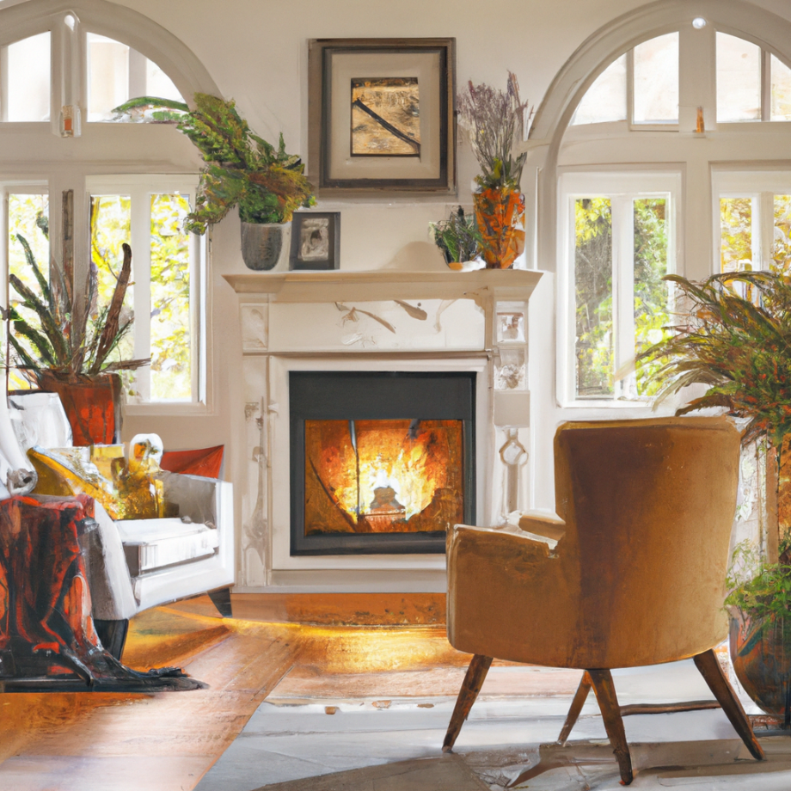
The Benefits of Home design
Home design is an investment in your home and your lifestyle. It adds value to your property, and can help to improve efficiency, comfort, and even safety.
Designing your home can also be a great way to express yourself and create an inviting atmosphereome Design for family and friends. It can be an enjoyable and rewarding experience, and the results are sure to impress.

Slide 6
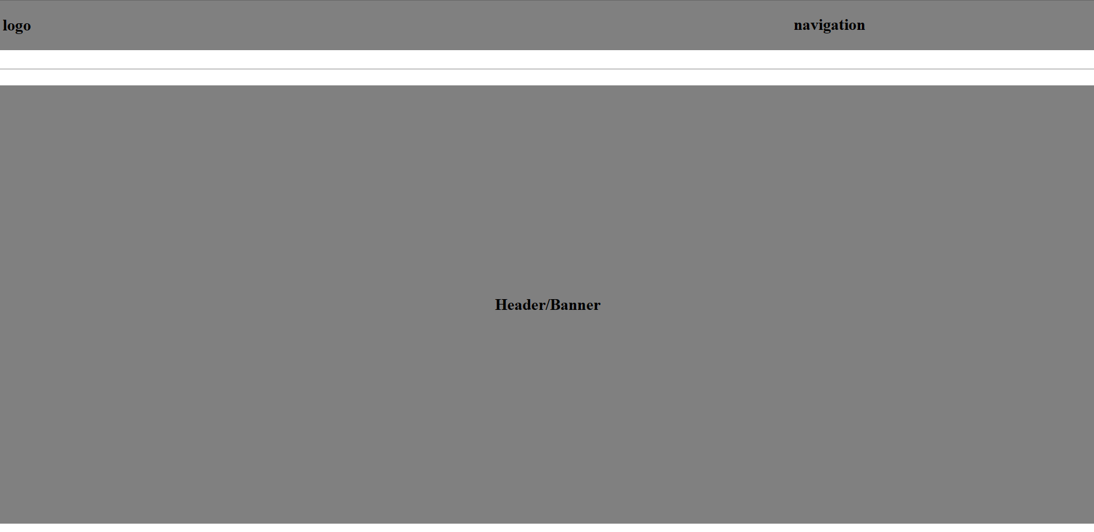

Slide 7


Slide 8


Slide 9
Refrence of the website
Houzz
3D animation
Interior Designing Bangalore - Home Design 3D

Slide 10
THANK YOU
SPECIAL ADVICE : MEGHNA MAM

