Slide 1
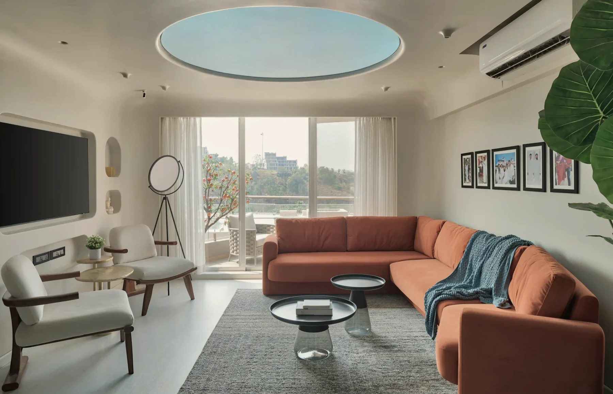

MACK & CO ARCHITECTS
Digital
Foundation
The connected digital layer around MACK’s architecture
Prepared for Ayushi and the MACK & Co team
October 2026 · Yash Sharma
Cover: Agra Fort Project, Dharampur — photography
Notes:
A short, visual plan for the digital layer around the studio: how people discover MACK, what is being built, how it is implemented and measured, and the next steps.

Slide 2
One destination for every way MACK is found
01 — THE DIGITAL DESTINATION
DISCOVERY
DESTINATION
DISCOVERY & TRUST
ACTION
MEASUREMENT
Google Search
Projects
Enquiry
Analytics
MACK
Google Maps
Services
Call
Search Console
Instagram
Website
Architecture
Directions
Publications
Portfolio
Business Profile
Studio identity
Studio
Email
Referrals
Continuous improvement
Notes:
Read left to right. However someone first hears of MACK — a search, Maps, Instagram, a publication or a recommendation — they arrive at the studio's own website. There they explore projects and the studio, then act: an enquiry, a call, directions or an email. Every step is measured, and the measurements feed a monthly round of improvement.

Slide 3
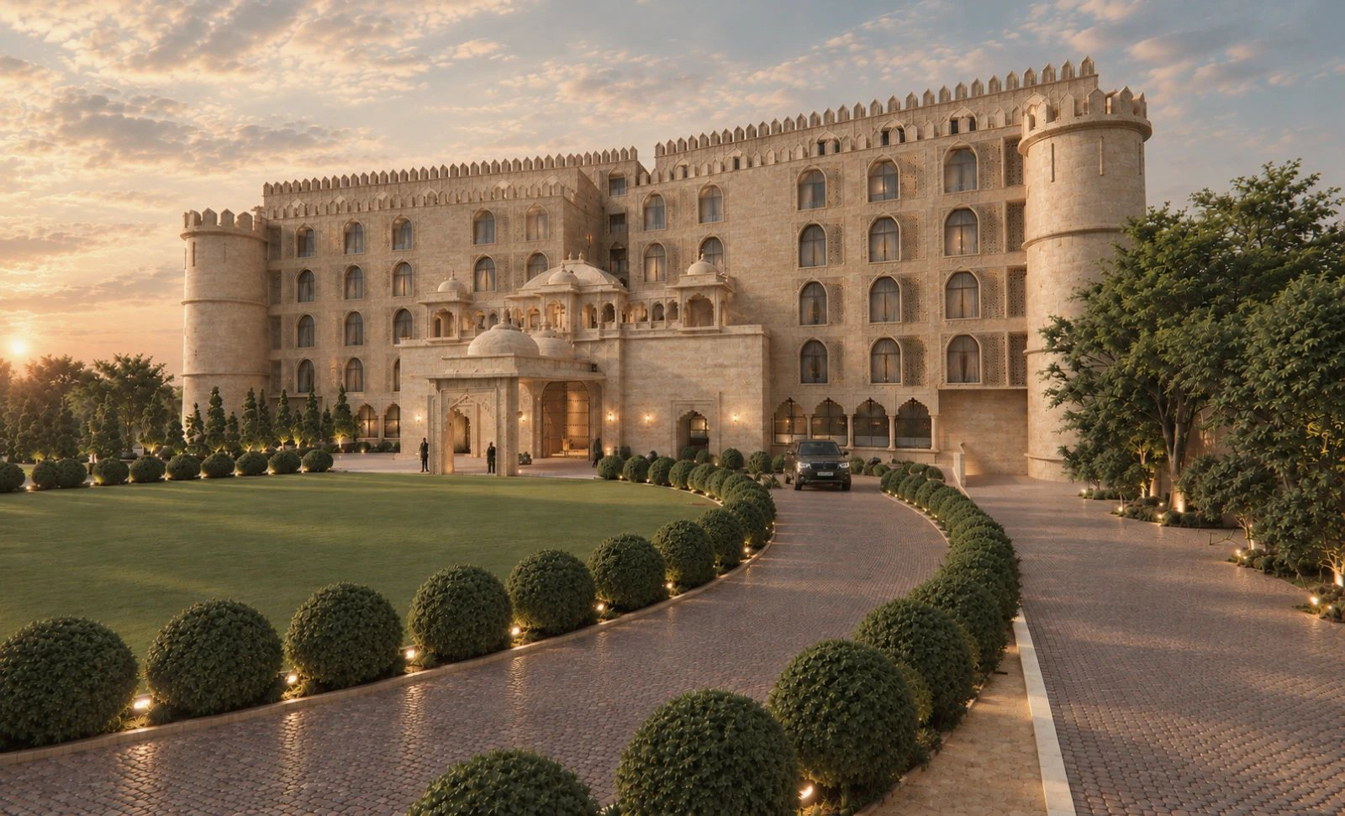
SEO is one part of a connected system
02 — THE DISCOVERY SYSTEM
Content · Social · Publications
Digital marketing
creates and expands discovery
Awareness
Search + Maps
SEO
found when people actively search
MACK website
Website
turns attention into trust
Projects + credibility
Enquiry · Call · Visit
Google Business Profile
calls, directions and visits
Analytics
Analytics
shows what produces enquiries
Udaipur Resort, Rajasthan — visualisation
Notes:
Digital marketing — content, Instagram, publications — creates and widens awareness. SEO makes MACK findable at the moment people actively search, in Google Search and Maps. The website turns that attention into understanding and trust. The Google Business Profile connects local discovery with calls, directions and visits. Analytics shows what actually produces enquiries, which shapes the next round of work.

Slide 4
A complete digital foundation, owned by MACK
03 — WHAT WE ARE BUILDING
THE ROOT
Studio domain
IDENTITY
WORKSPACE
VISIBILITY
Registered to MACK
Professional email
Cloud workspace
Search Console
name@ the studio domain
2–3 TB, shared by project
how Google sees the site
Website
Independent backup
Analytics
launched and indexed
versioned, one copy off-site
visits, enquiries, calls
Every account studio-owned
Access granted to implement
Documented in an access map
Business Profile
Google Search and Maps
Notes:
The studio domain is the root: email, website, workspace and Google's tools all connect to it, so it is registered in MACK's name first. Every account belongs to the studio; access is granted to implement and documented in an access map. First items to confirm: the studio's real-world name, the domain, and how the existing Google listing at the studio address should represent MACK.

Slide 5
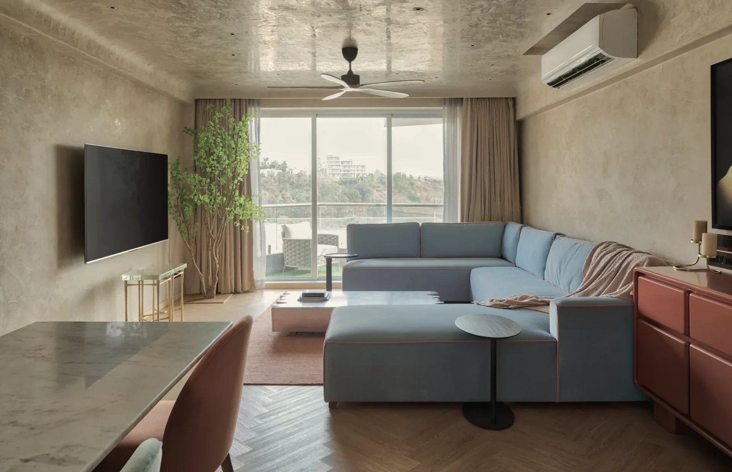
From technical foundation to discovery
04 — SEARCH AND PORTFOLIO
Discovery
found by name, service and project
Authority
publications · Archello · Architizer
Local presence
Business Profile · reviews · new studios
Projects
facts · story · image SEO & credits
Red Fort Project, Dharampur — photography
EVERY PROJECT PAGE
Services
Architecture · Interiors · Objects
Place · type · year
The story of the brief
Technical foundation
indexing · structured data · speed
Credited images
Related work → enquiry
One publishing system for every new project
Notes:
Visibility is built from the ground up. A technical foundation (indexing, structured data, mobile speed); service pages for architecture, interiors and objects; project pages with place, type, year, a written story and credited images; local presence through the Google Business Profile, reviews and a profile for each new studio; and authority through architecture platforms and publications. The result is discovery by name, by service and by project. A publishing system makes every new project follow the same standard.

Slide 6
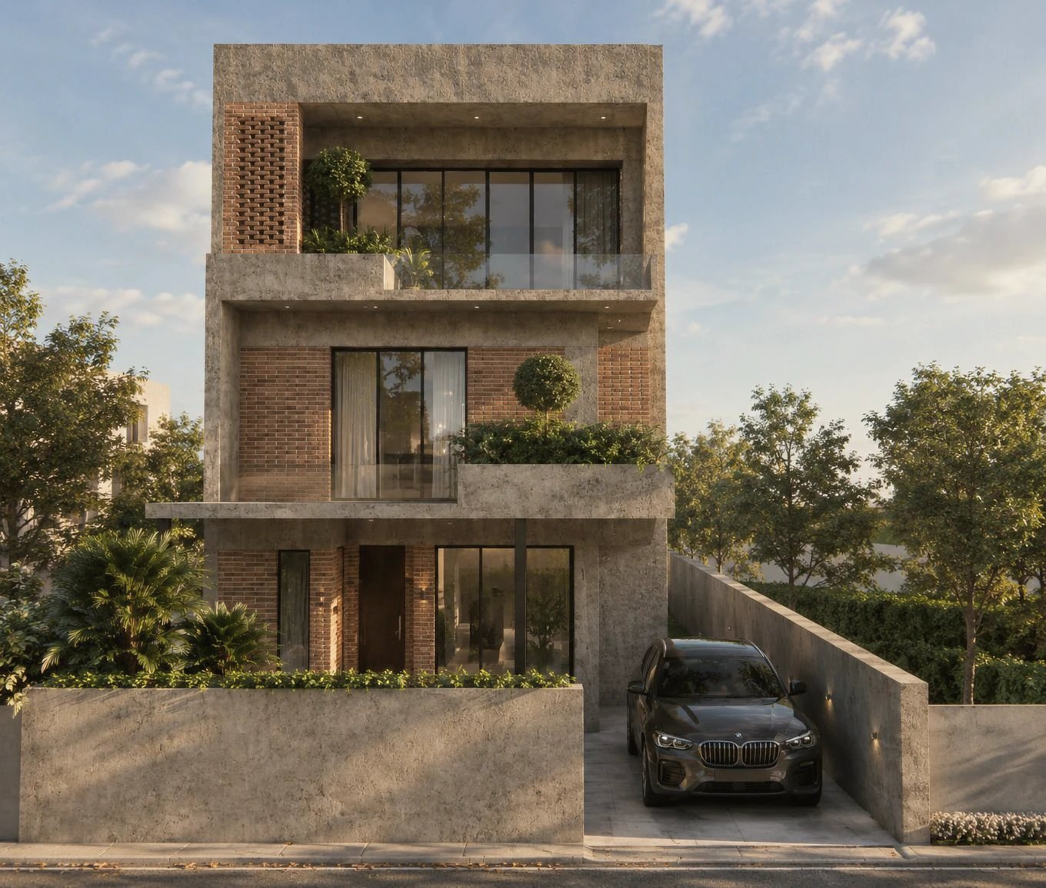
From visibility to enquiries, measured monthly
05 — FROM VISIBILITY TO BUSINESS
Search · Maps · Content
Website
Project exploration
Enquiry · Call · Directions
Measurement
SEARCH CONSOLE
ANALYTICS
ANALYTICS
ANALYTICS + LOG
DASHBOARD
searches and views
visits by source
most-viewed projects
enquiries and contact
what produces enquiries
THE MONTHLY REPORT
What changed?
Why it matters.
What happens next.
One page · live dashboard · owned by the studio
RC House — visualisation
Notes:
The same journey, measured. Searches and Maps views come from Search Console and the Business Profile; visits, project exploration, enquiries, call taps and direction requests from Analytics and the studio's enquiry log. Each month a one-page report and a live dashboard, owned by the studio, answer three questions: what changed, why it matters, and what happens next.

Slide 7
Six milestones, about three months, then monthly
06 — IMPLEMENTATION ROADMAP
Month 1
Month 2
Month 3
Ongoing
01
Foundation
Domain · email · workspace · backup
02
Launch
Site live and connected to Google
03
Local presence
Verified Google Maps presence
04
Portfolio
Projects and services discoverable
05
Authority & digital growth
Platforms · publications · reviews
06
Measure & improve
Dashboard · monthly report
Solid — implementation Outlined — ongoing, every month · Begins after alignment and access
Notes:
Foundation in the first two weeks; the site launched and connected to Google by week four; local presence from week three, depending on Google's verification; portfolio pages from week four, paced by project information from the studio; authority and digital growth from month three; measurement from week six, with a report every month after that.

Slide 8
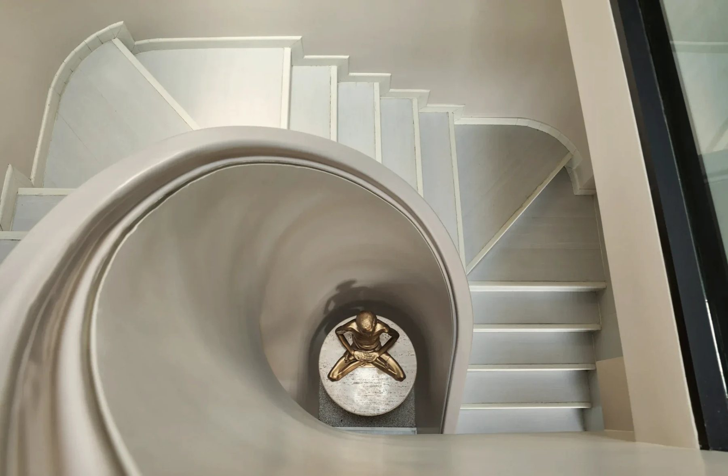
Everything in place, owned by the studio
07 — WHAT MACK RECEIVES
Identity & workspace
Website & search
Studio-owned domain
Professional email
2–3 TB cloud workspace
Independent, tested backup
Access map — MACK owns every account
Site launched and indexed
Technical SEO and structured data
Service and project pages
Image SEO and credits
Project publishing system
Local presence & authority
Measurement & care
Verified Google Business Profile
Consistent studio details
Review process
Architecture platforms and publications
Google presence for each new studio
Search Console and Analytics
Enquiry and call tracking
Live dashboard
Monthly report
Monthly maintenance and improvement
Agra Fort Project — photography
Notes:
Four groups, each something the studio can open, check or use. All accounts and assets remain MACK's property.

Slide 9
Next steps
08 — NEXT STEPS
01
02
03
04
05
Align
Access
Implement
Measure
Improve
Studio name, domain and services
Accounts in MACK’s name, access granted
Milestones one to six
Dashboard and monthly report
Refined every month
Notes:
Align on the studio name, domain and services; set up accounts in MACK's name and grant access; implement the six milestones; measure through the dashboard and monthly report; and improve every month.

