Slide 1
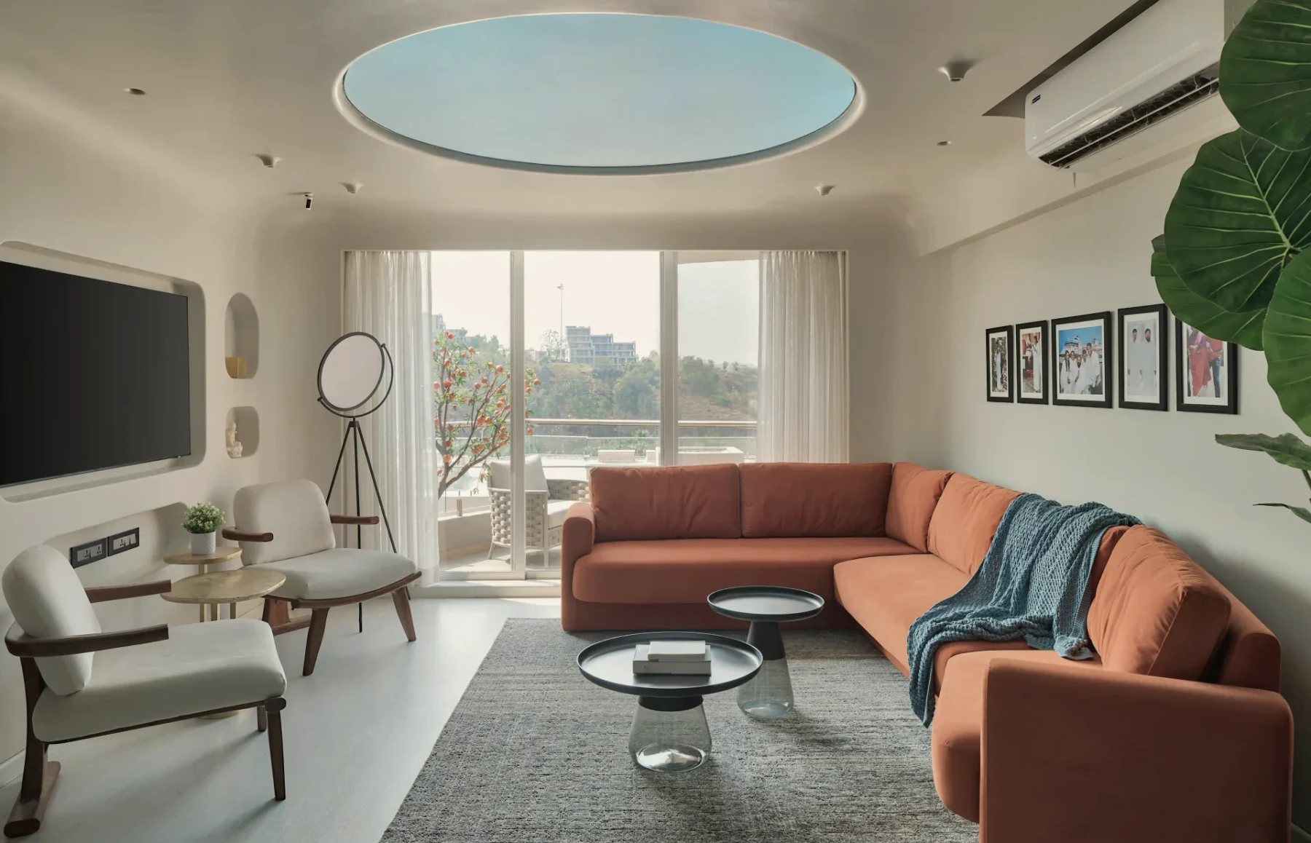

MACK & CO ARCHITECTS
Digital
Foundation
A working plan for search visibility, local presence, measurement and studio infrastructure
Prepared for Ayushi and the MACK & Co team
October 2026 · Yash Sharma
Cover: Agra Fort Project, Dharampur — photography
Notes:
A working plan for what happens if we proceed. Structure: where MACK stands today, how clients find a studio, what needs to be in place, how it will be implemented in milestones, how progress is measured, and the next step. The plan is based on Google's official documentation and on checks of MACK's current site carried out in October 2026.

Slide 2
Where MACK stands today
01 — STARTING POINT
A new website is ready. Search, maps, identity and measurement around it are not yet in place.
AREA
TODAY
WHAT IT MEANS
Search
The live site asks Google not to list it
MACK cannot appear in Google results yet
Maps
The map link opens a listing under another name
Name and Google listing need to be aligned
Identity
A Gmail address; no studio domain in use
No consistent, studio-owned identity
Portfolio
10 projects; most lack place, year and story
Projects can’t be found for what they are
Measurement
No analytics or enquiry tracking
No evidence of what brings clients
Already in place
The new site: structured pages, project markup, an image sitemap, redirects from old links and indexing that can be switched on at launch. The foundation is built — it needs to be connected, filled and measured.
Notes:
Facts, checked in October 2026. Search: the live site carries a "noindex" instruction, so Google is told not to list it. Maps: the map link on the site opens a Google listing named "Karan Desai, Architecture + Design" at the studio's address — the studio decides how its Google listing should represent MACK. Identity: contact email is a Gmail address. Portfolio: 6 of 10 projects state no location, only 2 have a written description. Measurement: nothing is tracked. The positive: the new site already has the technical groundwork — the work now is switching it on, connecting it and filling it with real project information.

Slide 3
Every channel leads to one place
02 — THE DIGITAL DESTINATION
Most clients arrive through a recommendation, then search the studio’s name. What they find should confirm it.
DISCOVER
DESTINATION
EXPLORE
ACT
MEET
Google Search
Projects
Enquiry
Google Maps
MACK website
Services
Call
Consultation or studio visit
Instagram
the studio’s own address
Studio
Directions
Referral
Publications
Credibility
Email
SEO · Google Business Profile · publications
Website experience
Portfolio architecture
Enquiry & call tracking
Studio enquiry log
Analytics and monthly improvement run across every stage.
Notes:
Most new clients of a studio arrive through a recommendation, Instagram or a publication — and then search the studio's name before getting in touch. So the website is the destination every channel leads to, and its first job is to confirm the recommendation. Left to right: discovery channels, the website, what visitors explore, the actions they take, and the consultation. The bottom row shows where each piece of the plan works.

Slide 4
One connected system, owned by the studio
03 — WHAT THE INFRASTRUCTURE INCLUDES
The studio’s domain is the root. Website, email, workspace and Google’s tools all connect to it.
Website
the digital destination, on the studio’s own address
Email
name@ the studio’s domain
Studio domain
Cloud workspace
shared project storage for 2–3 TB
Independent backup, one copy off-site
registered in MACK’s name
decided first
Search Console
how Google sees and shows the site
Analytics
what visitors do; where enquiries come from
One monthly report
Business Profile
the studio’s card on Google and Maps
Principle MACK owns every account. I am given access to do the work.
Notes:
The domain is the root: the website, email, Search Console verification and the workspace all depend on it. That is why it is registered in MACK's name and decided first. Principle: MACK owns every account; I am given access to do the work. If I am unavailable, the studio loses nothing. Search Console, Analytics and the Business Profile feed one monthly report. Backup sits apart from the cloud workspace on purpose.

Slide 5
Built from the ground up
04 — SEARCH VISIBILITY
How a studio becomes visible in Google, layer by layer.
05
Authority
publications, platforms, reviews
Each layer depends on the one below.
04
Local presence
Business Profile, Maps, consistent details
Shortcuts at the top — bought links, keyword tricks — don’t hold without the layers underneath, and they break Google’s rules.
03
Relevance
services and projects that match real searches
06 MEASURED AT EVERY LEVEL
02
Structure & meaning
page architecture, titles, structured data
WHERE MACK IS TODAY
01–02 largely built into the new site. 03–05 need project information, a verified profile and published work.
01
Technical foundation
crawlable, indexable, fast on mobile
Notes:
Search visibility as a building section. 01 technical: Google can find, read and index every page quickly. 02 structure: each page clearly says what it is (titles, headings, structured data). 03 relevance: pages that match how people actually search — services and projects. 04 local: the Business Profile and consistent details for Maps. 05 authority: publications, platforms and reviews. Measurement runs alongside all of them. Today: layers 01–02 are largely built into the new site; 03–05 depend on the studio's project information, a verified profile and published work.

Slide 6
Three kinds of search, three timescales
05 — HOW PEOPLE SEARCH FOR A STUDIO
01
02
03
Confirm
Shortlist
Discover
SEARCHES FOR THE STUDIO’S NAME
LOCAL SEARCHES FOR A STUDIO
SEARCHES FOR WORK, PLACES, IDEAS
“MACK & Co Architects”
“mack architects mumbai”
“architect in Andheri West”
“interior designer Mumbai”
“sandstone resort Rajasthan”
“second home interiors Dharampur”
WHAT WINS
WHAT WINS
WHAT WINS
Website first, a correct Business Profile beside it, consistent details everywhere
A complete, verified profile, reviews, service and studio pages that match the search
Project pages with real facts, a written story and well-described images
Speed
Speed
Speed
Control
Control
Control
Early progress shows first in “Confirm”. “Shortlist” and “Discover” compound over months. Example searches are illustrations, to be validated.
Notes:
Confirm: someone already heard of MACK and searches the name — this is the fastest and most controllable win, and it supports the referrals MACK already gets. Note: "MACK" alone is ambiguous (there is a Mark Mack architecture practice in the US), so the full name is used consistently. Shortlist: local commercial searches like "architect in Andheri West" — decided largely in Google Maps by relevance, distance and prominence; competitive, built over months. Discover: project, typology, place and image searches — long-tail and compounding, but only possible once projects carry real information. Example queries are illustrations to be validated, not targets already won.

Slide 7
What will actually be implemented
06 — SEO IMPLEMENTATION
01
02
03
04
Technical
Pages
Portfolio
Local & authority
Indexing switched on at launch
Titles and descriptions mapped to real searches
Facts per project: place, type, status, year
Business Profile verified and complete
Search Console verified, sitemap submitted
Clean headings and page structure
A short written story for each project
Same name, address, phone everywhere
One domain; old links redirected
Service pages: Architecture, Interiors
Descriptive image names and alt text
Review requests within Google’s rules
Structured data for studio, site and projects
Links between related projects and services
Photographers credited, renders labelled
Archello and Architizer profiles
Faster mobile loading on the home page
Enquiries, calls and emails tracked
A publishing routine for new work
Submission kits for publications
Notes:
SEO as a concrete list of work. Technical items are mostly about switching on and verifying what the new site already supports. Pages: titles, headings, service pages and internal links. Portfolio: the biggest gap — real facts and a short written story per project; renders labelled as visualisation and photographers credited, which is also what editors and Google ask for. Local and authority: profile, consistency, reviews within Google's rules, free platform profiles, and publication kits.

Slide 8
Work, what it produces, why it matters
07 — FROM WORK TO IMPACT
WORK
IMMEDIATE OUTPUT
BUSINESS IMPACT
Technical SEO
Google can crawl and index every page
MACK becomes eligible to appear in search
Business Profile
A verified, complete card on Google and Maps
Calls and directions from Google, measured
Project pages
Each project findable on its own
Reaches people looking for similar work
Image SEO & credits
Images understood by Google Images
Visual discovery, credited to the studio
Analytics & enquiry log
Sources of enquiries become visible
Decisions based on evidence, not assumptions
Domain & studio email
One identity the studio owns
Trust from the first contact
Independent backup
A recoverable copy of every project
The studio’s archive is protected
Notes:
Each activity in the plan, read left to right: the work, what it immediately produces, and the business effect it makes possible. The right-hand column describes what becomes possible and measurable — not a guaranteed number. Technical SEO makes MACK eligible to appear at all; the Business Profile makes calls and directions possible from Google; project pages let the portfolio be found for what it is; analytics and the enquiry log turn opinions into evidence.

Slide 9
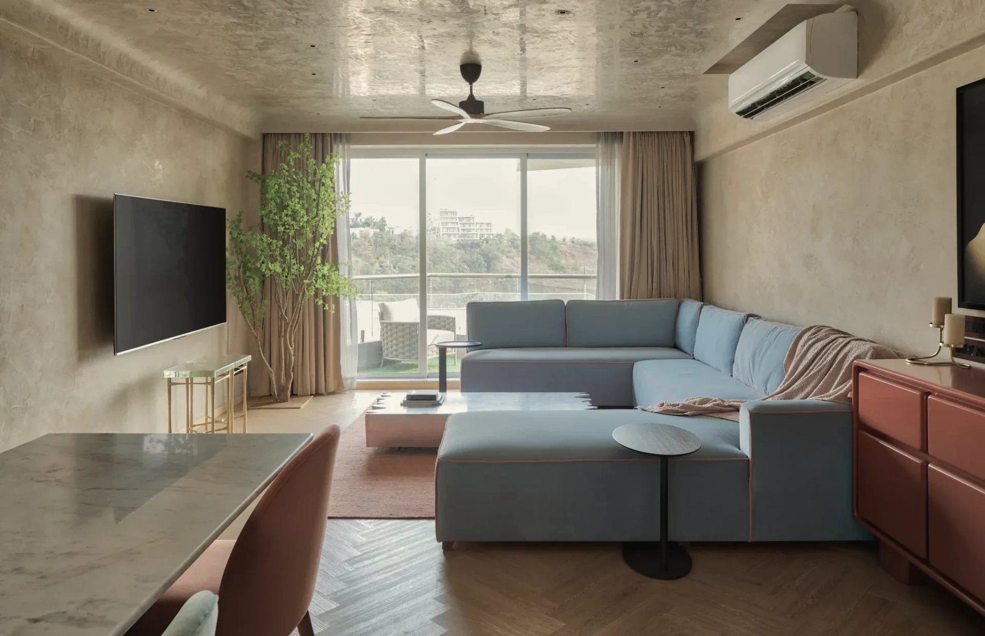
The studio’s card on Google
08 — GOOGLE & LOCAL PRESENCE
SCHEMATIC
studio
01
One verified profile for each real studio — resolving the existing listing at the studio’s address first
team at work
02
The same name, address and phone on the profile, the website and Instagram
MACK & Co Architects
03
The website link tagged, so visits from Google Maps are measured on the site
Studio category · Andheri West, Mumbai
Visits by appointment
04
Reviews requested from every client — never incentivised or filtered
Website
Directions
Call
05
New studios set up ahead: an opening date makes the profile visible 90 days before opening
Reviews from clients · Services · Photos
Each button is measured: calls, direction requests, website visits.
Google ranks local results on relevance, distance and prominence, and states there is no way to pay for a better local ranking. Distance can’t change; completeness and reputation can.
Notes:
The Business Profile is what appears beside the website when someone searches the studio's name, and in Maps. First task: settle the existing listing at the studio's address — Google allows one profile per business per location; duplicates can lead to suspension. Hours: Google's own guidelines say businesses that operate only by appointment should not list opening hours — the profile shows how to book instead. New studios: a profile can be set up with an opening date up to a year ahead and appears 90 days before opening — only for a real, staffed location with signage. Local ranking: Google says it is based on relevance, distance and prominence, and that there is no way to pay for better local ranking.

Slide 10
Every project becomes a way in
09 — PORTFOLIO AS A SEARCH ASSET
Project
Project page
Search & Images
Related work
Enquiry
WHAT EACH PROJECT PAGE CARRIES
Title & place
Red Fort Project, Dharampur
Facts
Type · scope · status · year · collaborators
Story
150–400 words: the brief, the site, what MACK did
Images
Descriptive names, alt text, photographer credited
Links
Related projects, the service, “discuss a similar project”
Data
Structured data, so search engines read it as a project
From the studio: about 10 minutes per project, through a short form.
Red Fort Project, Dharampur — photography
Notes:
Today most visitors can only find MACK by name. Each project page, written properly, becomes its own entry point: someone searching for a resort in Rajasthan, a second home in Dharampur, or a particular detail can land on MACK's work, explore related projects and get in touch. What the studio provides: about ten minutes per project through a short form — place, type, status, year, the brief, what MACK did, credits, and whether the client allows publication. Renders are always labelled as visualisation.

Slide 11
Email, storage and a real backup
10 — PROFESSIONAL INFRASTRUCTURE
01
02
03
Email
Cloud workspace
Backup
Gmail address → name@ studio domain
Shared drives for 2–3 TB of project files
An independent copy outside the cloud account
Authenticated (SPF, DKIM, DMARC) so mail is trusted
One folder system for every project
Versioned: last week’s or last month’s file can be recovered
Shared addresses: studio@, careers@
Access by role; clients see only what is issued
One copy kept off-site
Old address forwarded — nothing lost
Large CAD and render files available on studio machines
Restores tested every quarter
Sync is not backup.
A deleted or overwritten file syncs everywhere within seconds, and cloud version history is time-limited. The backup is a separate copy.
Notes:
Email: moving from a Gmail address to the studio's domain, authenticated so mail is trusted. Storage: 2–3 TB of project files in shared drives with one folder system per project and access by role; clients and consultants only see what has been issued to them. If Revit worksharing is used, central models need a different setup (Autodesk advises against cloud-sync folders). Backup: the cloud keeps old versions only for a limited time (Google Drive: 30 days or 100 versions; deleted items recoverable by an admin for 25 days). A separate, versioned copy — with one copy off-site — is what protects the studio's archive. Restores are tested every quarter.

Slide 12
What we measure, and what we leave out
11 — MEASUREMENT
STAGE
MEASURE
SOURCE
LEFT OUT ON PURPOSE
Visibility
How often MACK appears in Google: name searches and new searches, kept separate
SEARCH CONSOLE
Total page views
Follower counts
Discovery
Which projects and images people find; what they search on Maps
SEARCH CONSOLE · PROFILE
Third-party “authority” scores
Rankings for long keyword lists
Engagement
Which project pages visitors explore
ANALYTICS
EVERY REPORT ANSWERS
What changed?
Action
Enquiries, call taps, email taps, direction requests
ANALYTICS · PROFILE
Why does it matter?
Outcome
Qualified enquiries, by where they came from
STUDIO ENQUIRY LOG
What happens next?
Notes:
Five stages, each with its source. Visibility and discovery come from Google Search Console and the Business Profile; engagement and actions from Google Analytics; the outcome — qualified enquiries — only from the studio's own enquiry log, because online tools can't see a referral conversation or a studio visit. Branded and new (non-branded) searches are always reported separately: one reflects reputation, the other shows the search work reaching new people. Direction requests are an intent-to-visit signal, not a count of studio visits — reported as such.

Slide 13
One page, every month
12 — THE MONTHLY REPORT
MACK & CO ARCHITECTS · DIGITAL REPORT
Month 1
Starts from a baseline
Month 0 is recorded before launch, so every change is compared with a real starting point.
What changed
Why it matters
Next
Name and new searches apart
Reputation and search reach are reported separately.
New-search impressions
New-search clicks
Name-search clicks
—
—
—
vs last month
vs last month
vs last month
A live dashboard alongside
Owned by the studio; the report explains it.
Profile: calls · directions
Enquiries
Qualified enquiries
—
—
—
vs last month
vs last month
vs last month
Twenty minutes to read
MOST-DISCOVERED PROJECTS
HEALTH
Decisions are written down and followed up next month.
1 —
Indexing · Form test
2 —
Speed · Uptime
Values appear as “—”: they fill from launch. No figures are projected.
3 —
Backup · Last restore test
Notes:
This is the structure of the monthly report, shown without numbers on purpose: values fill from launch, starting from a recorded baseline in month zero. No figures are projected. Three lines at the top answer what changed, why it matters and what happens next. Then a short scorecard, the most-discovered projects, health checks, the work completed and the next actions with owners. A live dashboard sits alongside it, owned by the studio. Reading it takes about twenty minutes a month.

Slide 14
Six milestones, each with a visible result
13 — MILESTONE ROADMAP
W0
1
2
3
4
5
6
7
8
9
10
11
12
Ongoing
M1
Digital Foundation
Domain · studio email · workspace · analytics · Search Console
M2
Launch & Search
Live, indexable site · tracked enquiries · sitemap submitted
M3
Local Presence
Verified Business Profile · consistent details · review kit
M4
Portfolio
Project pages · service pages
M5
Authority
Profiles · submission kits · outreach log
M6
Measurement
Dashboard · monthly report · health checks
Week 0: align & access. Dashed: Google verification time varies. Outlined: ongoing. Dots: monthly reports. Timings assume decisions and inputs arrive on time.
Notes:
Week 0 is alignment and access. M1 digital foundation in the first two weeks; M2 launch and search foundation by week four; M3 local presence from week three — Google's verification time varies; M4 portfolio from week four, paced by how quickly project information arrives; M5 authority from around month three and ongoing; M6 measurement — dashboard by week six, then a report every month. Timings depend on decisions and inputs arriving on time — the usual cause of delay is waiting for access or information.

Slide 15
Foundation, launch and local presence
14 — MILESTONES IN DETAIL
M1
Weeks 1–2
M2
Weeks 2–4
M3
Weeks 3–6
Digital Foundation
Launch & Search Foundation
Local Presence
DELIVERABLES
Domain in the studio’s name
Studio email, authenticated
Shared drives and permissions
Analytics and Search Console
Site live on the domain, indexable
Technical fixes
Enquiry and contact tracking
Search-intent map
Verified Business Profile
Consistent name, address, phone
Review request kit
New-studio playbook
FROM MACK
Domain decision
Who needs a mailbox
Where files live today
Launch approval
Contact details confirmed
Privacy wording approved
Decision on the existing listing
Someone at the studio to verify
Photos of the studio
COMPLETE WHEN
Test email passes authentication
Every account has a MACK owner
Pages submitted and crawlable
A test enquiry is recorded
No critical Search Console errors
Profile verified and complete
Visits from the profile measured
Notes:
For each milestone: what is delivered, what is needed from the studio, and how we know it is complete. The "complete when" row is deliberately checkable — a test, a status, a report — not a feeling. M3 depends on one decision only the studio can make: how the existing Google listing at the studio's address should represent MACK.

Slide 16
Portfolio, authority and measurement
15 — MILESTONES IN DETAIL
M4
Weeks 4–10
M5
From month 3
M6
Monthly from week 6
Portfolio Discoverability
Authority & Growth
Measurement & Improvement
DELIVERABLES
Project pages to one standard
Service pages
Image names and credits
Publishing routine for new work
Archello and Architizer profiles
Publication shortlist
Submission kit for a built project
Outreach log
Live dashboard
Monthly one-page report
Health checks
Quarterly review
FROM MACK
About 10 minutes per project
Photo credits and permissions
Approval of submissions
Client permissions
Ideally, professional photography
Twenty minutes a month
Enquiry log kept current
COMPLETE WHEN
Every supplied project meets the standard
Structured data validates
Profiles live
First submission sent — publication is the editors’ decision
Dashboard live
Reports on schedule, decisions recorded
Notes:
M4 is paced by the studio's project information — it cannot be completed from my side alone. M5: professional photography of completed projects is the single most valuable authority investment, and the studio's decision; publication is never guaranteed. M6 turns everything into a monthly rhythm.

Slide 17
Concrete deliverables
16 — WHAT MACK RECEIVES
Owned identity
A searchable website
Local presence
Measurement & care
Domain registered to the studio
The new site live on the domain
Verified Business Profile
Analytics with enquiry tracking
Studio email for each person
Technical fixes and structured data
Consistent details on Google, Bing, Instagram
Search Console
Shared drives with permissions
Project pages to one standard
Review request kit
Live dashboard
Independent, tested backup
Service pages
Playbook for each new studio
Monthly report, quarterly review
Access map: MACK owns every account
Project form and publishing routine
Monthly maintenance and health checks
Notes:
Four groups. Everything listed is a thing the studio can open, check or use — not a vague service. All accounts remain the studio's property.

Slide 18
Implement once, then improve every month
17 — OPERATING MODEL
THEN, MONTHLY
EVERY MONTH
Measure
Search Console and indexing review
Business Profile upkeep, review replies
ONCE
New projects published
Site, form and backup checks
Implement
Launch
Repeat
One-page report and next actions
Report
Improve
EVERY QUARTER
Review meeting
Search-intent map refreshed
Access audit
The studio’s part: project information, approvals, twenty minutes a month.
Backup restore test
Notes:
Implementation and launch happen once. After that the work runs as a monthly cycle: measure, improve, report — and repeat. Every month: Search Console and indexing review, Business Profile upkeep and review replies, new projects published, site, form and backup checks, and the one-page report with next actions. Every quarter: a review meeting, refresh of the search-intent map, an access audit and a test restore of the backup. The studio's part is small but essential: project information, approvals and twenty minutes a month.

Slide 19
What can be committed, and what can’t
18 — REALISTIC EXPECTATIONS
Committed
Not promised
The work in every milestone, to Google’s guidelines
Specific positions — “#1 on Google”
The timeline, given decisions and inputs
Traffic, lead or footfall numbers
Honest monthly measurement and reporting
A Maps position (distance is part of ranking)
Every account owned by the studio
Publication — editors decide
WHAT USUALLY HAPPENS AFTER LAUNCH
Days–weeks
Weeks
1–3 months
3–12 months
Pages indexed
A search for the studio’s full name returns its site
New searches begin to appear
Visibility and actions compound
Google states there is no way to pay for a better local ranking, and that meeting its requirements does not guarantee a page will be indexed or shown.
Notes:
Committed: the work in every milestone, done to Google's guidelines, on the agreed timeline given inputs, with transparent monthly measurement — and the studio owns everything. Not promised: positions such as "number one on Google", traffic or lead numbers, a particular Maps position (distance from the searcher is part of how Google ranks), or publication by editors. What usually happens: pages indexed within days to weeks of launch; the studio's name returning its own site within weeks; new searches starting to show in one to three months; compounding visibility over three to twelve months. Search builds up over time, and the progress is measured every month.

Slide 20
Align, access, audit, implement
19 — NEXT STEP
01
02
03
04
Align
Access
Audit
Implement
Studio name and domain
Services to be found for
How the existing Google listing should represent MACK
Domain and DNS
Google accounts and hosting
Business Profile ownership
Baseline recorded: search, profile, speed, enquiries
Project information form sent
Milestone 1 begins
First progress note at the end of week 2
A first working session of about ninety minutes is enough to begin.
Notes:
The first step is a working session of about ninety minutes to settle the identity questions (studio name, domain, the existing Google listing), agree who owns each account and grant access. Then the baseline audit is recorded, and Milestone 1 begins.

