Slide 1
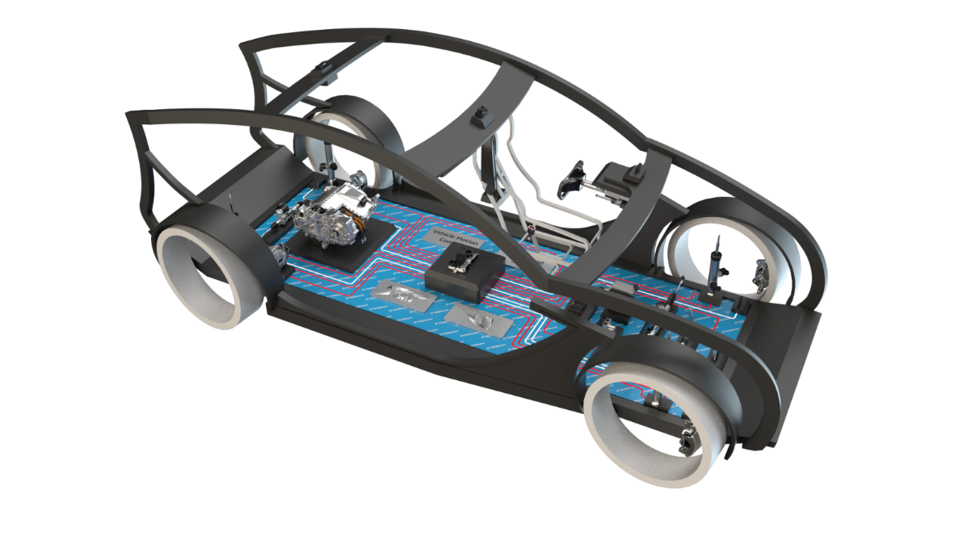

SoA Reference Architecture Layers

Slide 2
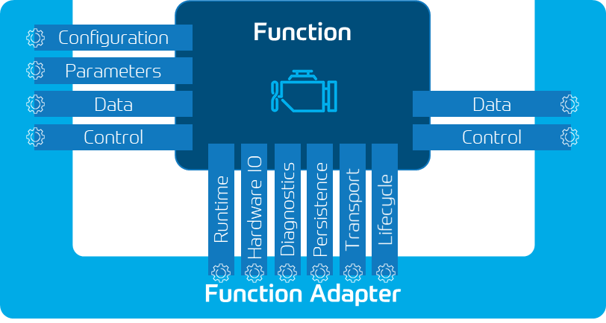

Service Oriented Architecture V1.1
Application Components
(Feature)
Application Layer
Customer
and 3rd party
ZF Functions, Software products or engineering
All Programs running inside Function adapter
Application Service Components
(Function)
Application component examples are trajectory planning, lane centering.
Application service component examples are perception, cubiX, System functions (e.g. BMW System Function Modules)
System Service Components
Middleware Layer
System Service Components examples are CAN-dbc implementations, Diagnostic Management, Mode Management, …
Middleware Stack
MW Stack
Middleware Stack includes Service Manager, it queries platform layer for capabilities, it is stable, executable and dynamically configurable
Operating System
Bootloader
Hardware Support Layer
Platform Software (Drivers, Platform libraries, Hypervisor)
Platform specific applications and libraries:, like drivers, frame server, fan control.
Adaption to different HW and device abstraction.
Type 1 Hypervisor to run Guest OS like POSIX, Linux and Android
Hardware (HPC)
SoC

Slide 3
Proposal - Functional Architecture ADAS/AD
Application Components
Cloud / Services
L2⁽⁺⁾ Driving Function
NCAP (AEB, ACC, Traffic Jam pilot…)
L3 Driving Function
Highway
Parking
L2 Parking Assits
L4 Valet Parking
L4/5 AD Driving
L4 Urban Driving
L4 InterUrban - Highway Pilot
Driving / Customer Functions Layer
Backend Host
Fleet Management
Application Service Components
Environment Model
Vehicle Management
ADAS / AD Base Function Layer
AD Map
Fusion
Perception
Localization
AD Map
HMI
Vehicle Motion Mgmt
Vehicle Actuator Control
Remote Control
ext. Perception
ShadowMode
System Service Components
Sensor Abstraction and Low Level Processing
ADAS / AD Software Base Layer
Middleware Stack
Data Collection
Middleware, AutoSAR (classic/adaptive), Custom (MB.os)
Operating System OS (QNX, certif. Linux, SAFERTOS..)
Platform Layer
HCP – IDC8 incl SoC (SµC & SoC)
Hardware Layer and SoC
Sensor and Actuator
Hardware / Vehicle Layer
USS
CAM
Lidar
Radar
Vehicle Network

Slide 4
Service Oriented Architecture V1.0
Application Components
(Feature)
Application Layer
L2⁽⁺⁾ Driving Function
NCAP (AEB, ACC, Traffic Jam pilot…)
L3 Driving Function
Highway
Parking
L2 Parking Assits
L4 Valet Parking
L4/5 AD Driving
L4 Urban Driving
L4 InterUrban - Highway Pilot
Customer
and 3rd party
ZF Functions, Software products or engineering
All Programs running inside Function adapter
Application Service Components
(Function)
Environment Model
Vehicle Management
Application component examples are trajectory planning, lane centering.
Application service component examples are perception, cubiX, System functions (e.g. BMW System Function Modules)
Fusion
Perception
Localization
AD Map
HMI
Vehicle Motion Mgmt
Vehicle Actuator Control
System Service Components
Middleware Layer
Sensor Abstraction
System Service Components examples are CAN-dbc implementations, Diagnostic Management, Mode Management, …
Middleware Stack
Middleware Stack includes Service Manager, it queries platform layer for capabilities, it is stable, executable and dynamically configurable
Middleware, AutoSAR (classic/adaptive), Custom (MB.os)
Operating System
Operating System OS (QNX, certif. Linux, SAFERTOS..)
Platform Software ( Drivers, Platform libraries, Hypervisor )
Hardware Support Layer
Platform specific applications and libraries:, like drivers, frame server, fan control.
HPC incl SoC (SµC & SoC)
Adaption to different HW and device abstraction.
Type 1 Hypervisor to run Guest OS like POSIX, Linux and Android

Slide 5
Questionnaire Summary for Reference Architecture
Interview for actual architecture and update of Questionnaire is planned for the following Divisions:
Division U (Mr. Kraemer Ulrich & Mr. ACHIR Mounir) on 28th April 2022 --> Done
Division XA (Mr. Dohrmann Stephan) on 2nd May 2022 --> Done
Division XA (Mr. Oprisan Dan) --> In Progress ( Planned meeting on 6th May 2022 )
Division U Perception Team (Mr. Nico Stock) --> In Progress ( Planned to schedule based on availability )
Division U Perception Team (Mr. Carsten Hass) --> In Progress ( Planned to schedule based on availability )

Slide 6
SOA Discussion Result with U Division
Attendees :-
Kraemer Ulrich KBL UDAS392 ulrich.kraemer@zf.com (U Division)
ACHIR Mounir KBL UDAS3 Mounir.Achir@zf.com (U Division)
Geiger Roland Dr. FRD DISS1 roland.geiger@zf.com
Joshi Pratikkumar pratikkumar.joshi.external@zf.com
Bujone Akshay akshay.bujone.external@zf.com
Gole Sachin sachin.gole.external@zf.com
RFQ is more towards cost driven where it is requested to reduce the size of Micro to save the cost
Direction is to have reduced memory for the ECUs (remove not requested SW functions)
Current projects are Classic AutoSAR, camera and sensor based where SOA will not be applicable
For long term, SOA can be considered with hardware resource capabilities needed
Dusseldorf team works on Driving functions and Central ECU platform where SOA can be utilized
In U Division currently they have Classic AutoSAR project, in short term they don’t have project where SOA is needed, current direction to have further reduction of ECU cost and memory.

Slide 7
SOA Discussion Result with XA Division
Attendees :-
Dohrmann Stephan FRD XAXE2 stephan.dohrmann@zf.com (XA Division)
Geiger Roland Dr. FRD DISS1 roland.geiger@zf.com
Joshi Pratikkumar pratikkumar.joshi.external@zf.com
Bujone Akshay akshay.bujone.external@zf.com
Gole Sachin sachin.gole.external@zf.com
Vector AUTOSAR Adaptive platform is used in current projects.
Feature/functions are using ara::com middleware for communication defined by Vector Adaptive stack
Vector Adaptive stack limitation and drawback already taken care by implementing modules like shared memory, zero copy, Faster communication using UDP socket in SOME/IP.
XA team has suggested come up with code examples where they would like to see how Application Service component and System service component can be implemented and how they communicate with each other.

Slide 8
Service Oriented Architecture Middleware
Asynchronous Remote Procedure Call
SOA Consumer
Middleware
Middleware
SOA Provider
HPC / ECU
HPC / ECU
Ethernet

Slide 9
Service Oriented Architecture
Communication Pattern and Service Discovery
Service Provider
Service Registry
Service Consumer
Service Broker
Offer
Find
Publish
Find
Internet / Ethernet
Call (RPC)
Service Consumer
Service Provider
Bind

Slide 10
Service Oriented Architecture
Deployment View
SOA App Process
SOA App Process
SOA App Process
SOA App Process
Feature 1
Feature 2
Feature 3
Feature X
Functions (Shared object / Lib)
Protocol Binding
SOME/IP Communication Middleware
Inter Process Communication Middleware
DDS Communication Middleware
Service Oriented Architecture Middleware
Guest OS
Guest OS
RTOS
Type 1 Hypervisor
Classic AutoSAR OS
Cortex-A CPU
Cortext-M CPU

