Slide 1


Classic Reference Software Architecture - 2022

Slide 2
ZF Reference Software Architecture V1.0
Application Layer
Application Components
- Application layer consists of Application components & Application Service components
- Application component examples are Parking Function, AEB Function.
- Application Service Component is collection of functions supporting features above with defined standard interfaces (Ex: EPP Abstraction)
OEM / 3rd party Application SW
Product Platform SW Compositions
Project SW Compositions
SWC
…
SWC
SWC
…
SWC
SWC
…
SWC
Application Service Components
OEM Wrappers (Application SW)
Standard Functions (System Abstraction, Perception, Cubix)
Middleware Layer
- Middleware layer consist of Basic SW modules, RTE & System Service Components
- System Service components provides interface abstraction of Basic SW modules and allows independent development of Application layer
- System Service components examples are Diagnostic, Memory services
- Optimized ZF RTE is considered for time critical application (where precision is in µsec)
System Service Components --> Function Adapters
OEM Components
(BAC, SUMS)
Diagnostic Services
Memory Access services
Device Abstraction
COM Handler / Services
Mode Management
Secure Services
AUTOSAR Runtime Environment
Optimized ZF RTE
(Multicore) OS
SystemM Fnc.
Diagnostics
EvM & FncInhM
Memory Stack
Ecu Internal Com
Signal & LargeData & PDU-R
Generic Ext Com Protocols
Diagnostics
ComM
Security
Safety
IoHwAb
CDDs
Technology specific Ext Com Protocols
Ext Com Stacks (CANx, FR, LIN, ETHx)
Hardware Support Layer
- It provides interface abstraction for the actual HW used below
- Examples: 3rd party MCAL drivers, ZF Own MCAL drivers
MCAL and HW specific Drivers
ZF MCAL Drivers
Low Level Drivers
Lowlevel Drivers
Multi-/Singlecore-µCs & µPs-PerfCores & Peripherals w/ HW-SafetyMechanisms & HSM
HW Layer
- Actual Microcontroller / Microprocessor
Notes:
Add Application Service component layer

Slide 3
System Service Component Definition
OEM Components: It contains standard reusable OEM service component, which can be used in different products
Ex: BAC Module from BMW, SUM module from GM
Diagnostic Services: It provides interfaces abstraction for an Application layer in order to access daignostic services (ex. DTC reporting / status) in the MW.
Ex: Diagnostic service converts DTC Read/Write (OEM specific names) into standard interface for Application so that Application can be developed independently and does not need to change interfaces
Memory services: It provides interfaces abstraction for an Application layer (NvSWC) in order to access memory services (ex. Read or Write memory block) in the MW
Ex: Memory services collects NVM Jobs (Read/Write) and pass them to BSW. It keeps the same interfaces to Application layer so that Application can be developed independently
Device Abstraction: It creates abstraction for devices (Ex. Sensor (ADCs) and Actuators (Electric Motors))
Ex: Application has interface to read Temperature from Sensor. Device Abstraction will convert this interface to BSW specific interface (ADC channel) through IOHWAbstraction so that Application does not need to change ist interface and can be developed independently.

Slide 4
System Service Component Definition
Communication Services: It provides interface abstraction for an Application layer in order to access communication signals along with scaling (ex. Read or write specific CAN signal values) in the MW.
Ex: Communication Service converts Vehicle speed interface (Name , Scalling, etc..) into the standard interface expected by Application layer so that Application development continues independently.
Mode Management: It provides interface abstraction for Application layer in order to access BSW modes (ex: mapping of BSW modes with Application modes including Sleep/Wakeup qualification)
Ex: Mode management provides standard interface for Application in order to get the status or change of modes. It also provides standard interface inside Application to qualify Sleep & Wakeup source
Security services: It provides interface abstraction for application layer in order to access crypto services (Ex. Key management) in the MW. The Job of this component is to extract Crypto command received over UDS and pass them into CSM module.
Ex: Security services provide standard interface to the application for storage of the keys

Slide 5
Base SW Component Definition
CDD: It is set of complex functions which access the HW directly and they are not part of standard Autosar
Ex: PCB temperature calculation, TLF Voltage diagnosis
IOHWAb: It provides abstraction for sensor & actuator interfaces of the HW. Autosar proides the standard interfaces to be access by System Service components.
Ex: ADC channel read from the sensor, PWM write to the actuator
Safety: It comprises of safety monitoring functions (L3 Microcontroller monitoring). It is provided by Microcontroller vendor.
Ex: SafetyMCAL
Security: It consist of Crypto stack and it is part of standardized cluster within Autosar. It is provided by stack providers. This module needs to configured in the project.
Diagnostic communication: It provides standard diagnostic services defined in UDS and tester communication. This is standard module within Autosar. It is provided by stack providers and needs to configured in the project.
DID 22 02 read / write

Slide 6
Base SW Component Definition
Signal & LargeData & PDU-R: it extracts the signals from the messages received from the layer below irrespective of the bus technology. It provides interface to application to read and write signals via RTE.
Ex: CAN Message 1 contains two signals (Ambient temperature & humidity). These two signals are extracted from the message and make them available for the Application via RTE
Technology specific Ext Com Protocols / Ext Com Stacks (CAN, LIN, Ethernet, Flexray): It contains classic communication stack, which is specific to underlying Bus technology. This stack is provided by BSW stack provider.
Memory stack: It provides the services to the application via RTE for read and write of EoL ECU configuration, tuning parameters into the NVM Memory.
Ex: Storage of VIN (Vehicle Identification Number) inside the NVM Memory.
Diagnostics EvM & FncInhM : It provides interfaces to the application via RTE for setting, clearing and reading of DTCs (Diagnostic Trouble Code). It also contains the configurations mechanism to inhibit the features (Application components) based on event status (DTCs).
Ex: Reading or Writing of specific DTC; Inhibition of Parking feature in case of ULS Sensor HW DTCs

Slide 7
Base SW Component Definition
ECU Internal Com: Internal communication handled within BSW [tbd]
SystemM Fnc : It manages ECU operation modes & BSW operation modes. It also includes Init sequence and sleep-wakeup handling for ECU. It provides the interfaces to the application via RTE to synchronize operation modes & read the sleep-wakeup source.
Ex: Mode Switch event handling from System service component to synchronize operation modes
OS (multicore): It consists of scheduler functionality for correct execution of Application and Middleware layer. It also manages parallel execution on multicore Microcontrollers.
MCAL & HW Specific drivers: It contains Microcontroller specific drivers to access the peripheral components inside or outside Microcontroller. This module is provided by Microcontroller supplier.
Ex: ADC, CAN on Microcontroller, External SBC Chip via SPI
ZF MCAL Drivers: It contains the HW specific drivers developed in-house.
Ex: HWNSW
Low level Drivers: Specific drivers which has been developed to cater special needs of CDD and IoHwAb

Slide 8
Questionnaire Summary for Reference Architecture
Interview for actual architecture and update of Questionnaire is planned for the following Divisions:
Division A on 7th April 2022 --> Done
Division U on 12th April 2022 --> Done
Division T&I on 13th April 2022 --> Done
Division R on 14th April 2022 --> Done
Division CVS on 19th April 2022 → Done
Division C on 22nd April 2022 → Done
Division E on 25th April 2022 → Done
Division XA on 2nd May 2022 --> Done

Slide 9
Reference Architecture – Interview Summary for all the Divisions
All the divisions follows Layered Architecture (close to Reference Architecture layers)- except T&I
SWC are created based on features & functions
Application and Application Service components layers are merged into one layer for most of the division (except Div A) - Div A has Application Service components
System Service layer is created for some of the division but named differently (Ex. Div U, CVS)
Currently Reusability between Projects / Customer is seen on Application layer within each division
Increased amount of Reusability for division where System Service layer is used effectively (Ex. Div CVS with 90% Reusability in Application layer)
Communication between Application layer and Middleware layer is mainly through RTE
Middle ware mainly consist of Vector Autosar Stack across all divisions
CDDs are placed mainly in the Middleware layer

Slide 10
Reference Architecture – Improvement Ideas
Minimizing the configuration of Middleware stack between projects & customer
Pre-configuration of Middleware stack for HW and OEMs
Possibility to validate SW in Virtual Environment without actual HW (HW independent development)
Existing concept used in different divisions
Recommendation for standardization
Possibility to harmonize Processes and Tools across the divisions
HW Specific modules (Safety lib) can be reused between Projects across divisions

Slide 11
Summary of Questionnaire for Reference Classic Architecture
Division | Summary | Deviations against Reference Archtecture | Challanges / Suggestions
A | Layered Architecture (Layered defined based on functions / domains) Application components devided in 2 layers (HW components – Motor, Gearbox & Functions for HW components) SWC along with Interfaces desinged in Rpahsody and imported as ARXML S/R Interface between SWC; C/S ports & direct functions calls used between Application components and Middleware stack Multicore (upto 3 cores) strategy driven by Safety requirements; Each core has own Scheduler Inter core communication is based on Vector mechanism Reusability across projects: 70% (General package (SIP) is used to avoid reconfiguration Complete Architecture (upto LLD) defined in Raphsody; Autocode generated from Architecture; Dynamic and Static view covered in same tool | - Application layer also access Middleware through function call (other than RTE) - Certain HW components (ASIC for computation of complex mathematic algorithms) are accessed directly by application; these components are not managed Autosar Stack | Abstraction of Microcontroller for easy porting of the SW on different projects / customer Better handing of the variants (Pure::Variants shall be integrated) Reference Architecture shall consider automatically generated code and configuration from architecture Reference architecture shall not cause additional development cost

Slide 12
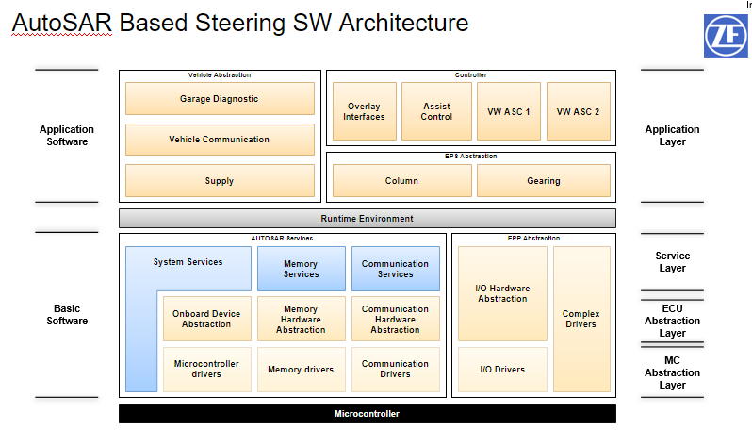
Classic Architecture – Div A

Slide 13
Summary of Questionnaire for Reference Classic Architecture
Divisions | Summary | Deviations against Reference Archtecture | Challanges / Suggestions
E | Layered Architecture (Layered defined based on features & functionality) Internal tool (ARTIST) used to generate properiety XML. It is converted to ARXML for RTE generation Mostly S/R interfaces used between SWC. C/S ports used Application and middleware stack. Direct function calls used between middleware stack modules Multicore (upto 4 cores) strategy driven by performance requirements Inter core communication is based on Vector mechanism 2 CDDs (One for OS and other for Inverter HW access) Reusability across projects: Very high for Application SW (It is developed as one SW and configured with compiler switch for different customer needs) Architecture is developed in EA. Both Static and Dynamic view are covered in EA | - In case time critical Inverter HW access, optimized ZF RTE is used for communication between application and middleware SW | Reusability for Autosar Stack and shall be defined between projects common modules for customer shall be developed centrally and re-used across different divisions Standardization for tools effecient sharing of the information between teams shall be defined

Slide 14
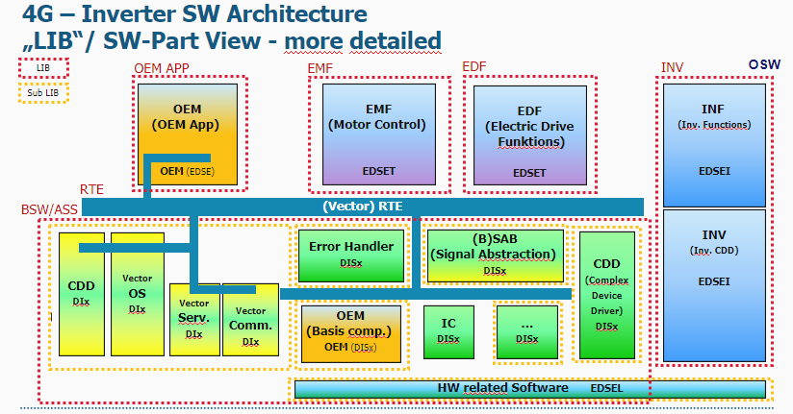
Classic Architecture – Div E

Slide 15
Summary of Questionnaire for Reference Classic Architecture
Divisions | Summary | Deviations against Reference Archtecture | Challanges / Suggestions
U | Layered Architecture (Function, Common Interface, Service, Peripheral, Microprocessor) close to Reference Architecture SWC created as per Features / Functions SWC designed in DaVinci and imported in Rhpasody S/R Interface between SWC, C/S ports for communication to Middleware Communication between Middleware and Application layer is through RTE only Multicore (upto 4 cores) strategy based on performance (Basice SW in one core, Algo in another core) Reusablity across Project : 80% (Algorithm reused across projects) CDDs used for Legacy modules, Time critical functions Complete Architecture (upto LLD) defined in Raphsody - Dynamic and Static view covered in same tool | - Service layer is below RTE - Common Interface layer implements the Function adapter requirements | SWC & Middleware stack needs to be reconfigured for each project due to customer centric changes (DBC, Diagnostic, Feature specific configuration) Interface definition in Architecture shall consider FFI from the beginning Minimize Base SW configuration (modify what is HW related)

Slide 16
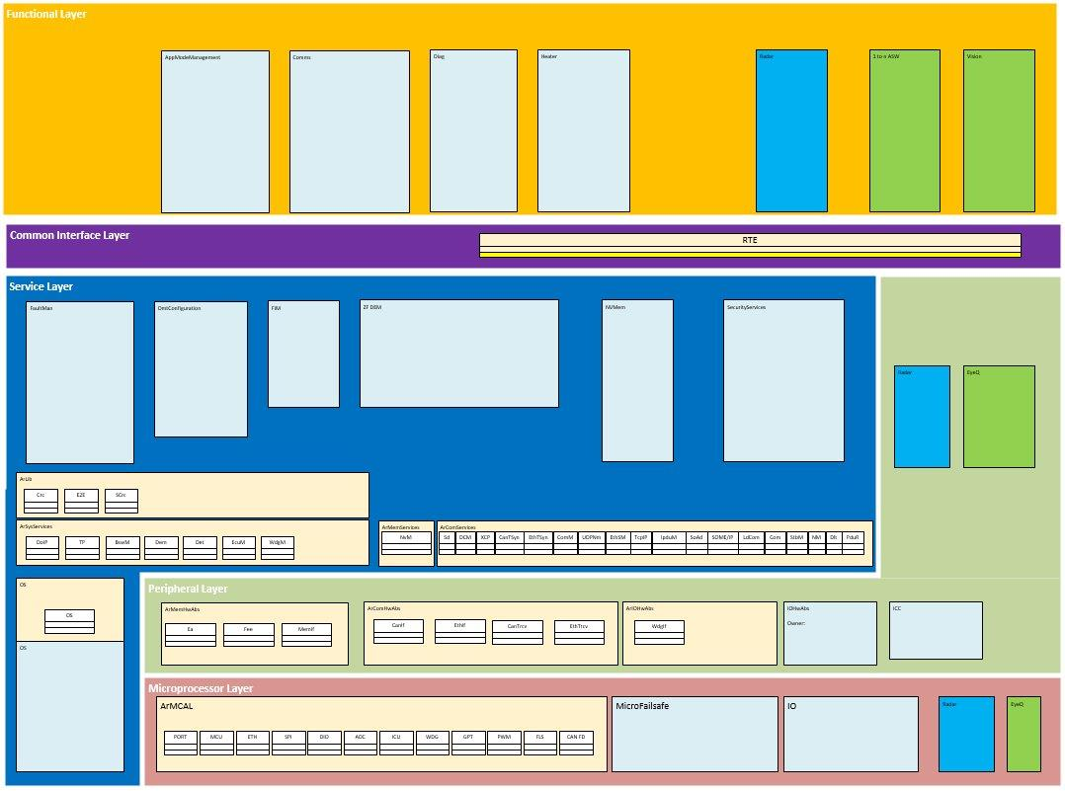
Classic Architecture – Div U

Slide 17
Summary of Questionnaire for Reference Classic Architecture
Division | Summary | Deviations against Reference Archtecture | Challanges / Suggestions
R | Layer Architecture (based on functionality. They are grouped basing on functionality into ECU, System or CDD layers below Rte) Layers: MCAL, ECU, CmplxDrv (7 nos), Services, Rte, SWC and Common(containing i.e. libs ) S/R between SWCs, IoHwAb uses C/S interfaces Reusability: In last project we had overall 40 manual written BSW units. 10 were full re-use from platform 24 were provided as template on platform but got some modifications to improve re-useability 6 were new, With the modifications to improve re-usability we will have more full re-usable units in next project. Highest safety level – QM uC – STM (single core) No multicore system | ECU layer contains ECU abstraction i.e. providing a measured motor current, temperature of motor half bridge driver or SBC watchdog driver. System layer contains higher level functionalities like distributing NVM parameters to the related modules, doing diagnostics of reverse polarity FET | How to handle changes in platform modules. The HW has little differences in different projects. Find a good level of dynamic views in Architectural Design as input for SW Integration Testing Manual updates of PTC surrogate documents for architecture and implementation Common virtual ECU Standardized dynamic views on Architecural Design level which satisfy needs of SW Integration Testing. Harmonized architecture shouldn't contain too much overhead caused by much bigger systems.

Slide 18
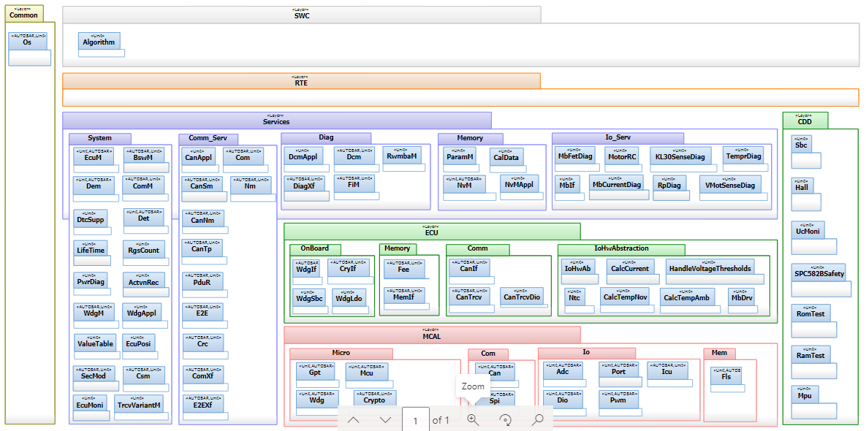
Classic Architecture – Div R

Slide 19
Summary of Questionnaire for Reference Classic Architecture
Division | Summary | Deviations against Reference Archtecture | Challanges / Suggestions
C | Layered Architecture - close to Reference Architecture SWC created as per Features / Functions SWC designed in DaVinci and imported in Rhpasody RTE Interfaces (S/R & C/S) between SWC, RTE Interface (E2EXF & E2EPW) for communication to Middleware Multicore (upto 2 cores) strategy based on Safety (ASIL SW in one core, QM SW in another core) Reusablity across Project : 80% (Platform approach is used for Application SWC) CDDs are clubbed in one composition below RTE CDDs are placed on ASIL Core Complete Architecture (upto LLD) defined in Raphsody - Dynamic and Static view covered in same tool | Created own solution for Reuse but both layers above RTE Application Service components and System Service components are missing | Low Reusability for Autosar Stack between customers

Slide 20
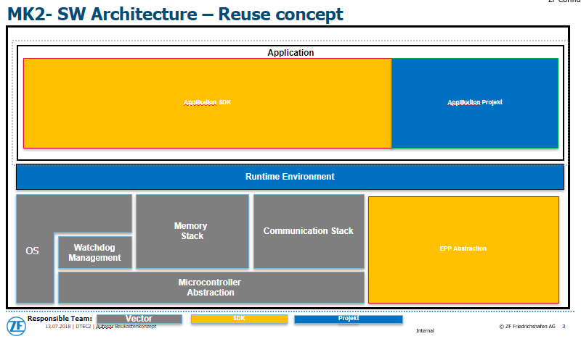
Classic Architecture – Div C

Slide 21
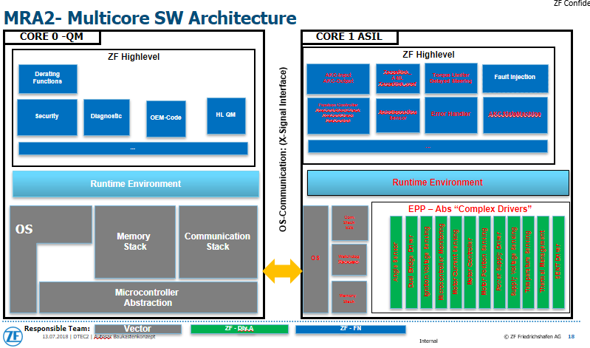
Classic Architecture – Div C

Slide 22
Summary of Questionnaire for Reference Classic Architecture
Division | Summary | Deviations against Reference Archtecture | Challanges / Suggestions
CVS | 1. (brakes projects) by System team SYS.3 2. (non brakes projects) by System team SYS.3 and SW team SWE.2/SWE.3 SWC are divided based on features (ex. ABS, EBS), System team has Platform approach. It is divided into Generic and Project specific SWC. Project Specific SWC create Wrapper for Generic SWC This is like System Service layer in Reference Architecture. SWC are modeled with TargetLink 1. (brakes projects) more than 90% of ASWCs are reused 2. (non brakes projects) less than 50% of ASWCs are reused Standard 2 cores, 3rd Core is used on demand (BSW on one core ASW on different core) Highest safety ASIL D | Yes, L3SafteyManager (DIV-A), FaultManager (CVS), multiple CDDs (CVS) --> Faultmanager is used for certain parameterization for DTCs & FIM, CDDs are used for Sensor / Actuators controls. They are treated as SWC and communicate through RTE | Post build Loadable concepts for Parameter set update, CAN Signal update - What is the standard approach in ZF? Automatically extract required modules from the platform based on the customer variants More alignment on Basic SW configuration across different projects (Everytime there is reconfiguration of Basic SW based on System extract provided by Architecture team) Harmonized Architecture can be applied to all the projects and it is very much of the interest for Div CVS.

Slide 23
Summary of Questionnaire for Reference Classic Architecture
Division | Summary | Deviations against Reference Archtecture | Challanges / Suggestions
T&I | TIP Architecture is traditionally Non-Autosar Architecture. Base SW comes from Pilsen. Pilsen is responsible for final integration and Series. Communication between two SWC is partly done directly (this is generally the case for Safety related functions in Basic SW) and partly through Signal Abstraction layer Middleware is named as TIP Platform (Level 1: Basic level configured by Project, Level 2: Based on detail specification, Pilsen configure the SW and provided accordingly) | It’s fully non-Autosar architecture with legacy SW | To be filled (Mr M Liese will send this offline)

