Slide 1
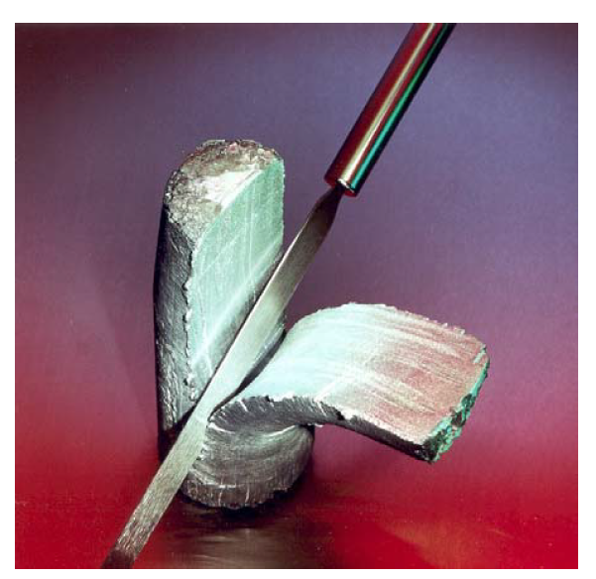
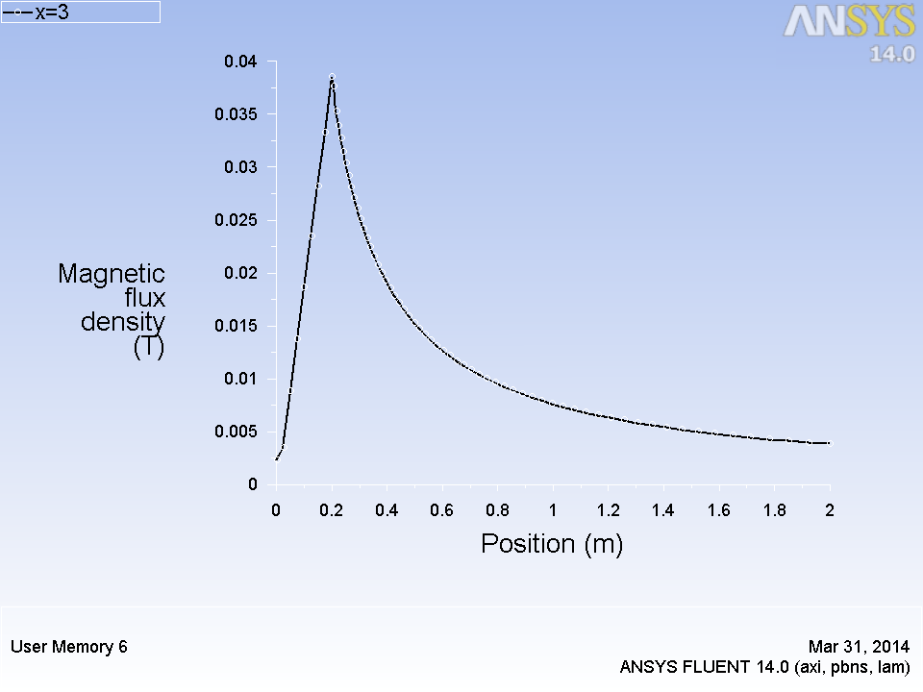
Aluminum alloy semisolid billet (50% solid) being sliced by a knife
Validation of FLUENT UDF with magnetic field due to current carrying conductor
2D axisymmetric model geometry for validation with analytical solutions

Slide 2
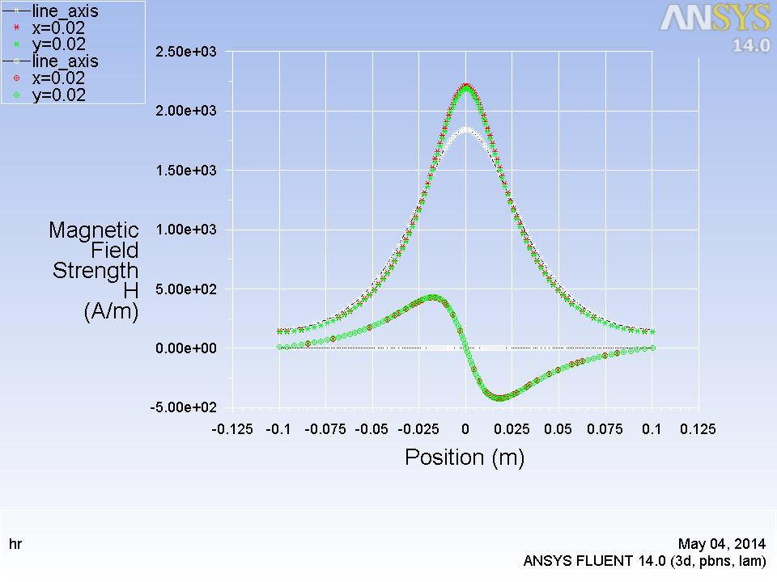
Hz
Hr
Axial Variation of Magnetic field strength for a current carrying coil

Slide 3
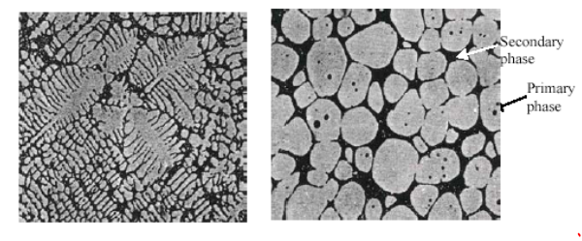
Dendritic microstructure
Spheroidal microstructure
Dendrite fragmentation due to electromagnetic stirring

Slide 4
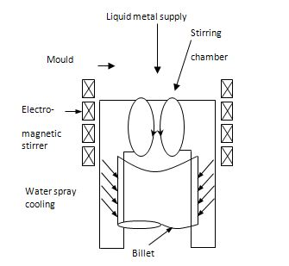
Electromagnetic stirrer schematic

