Slide 1
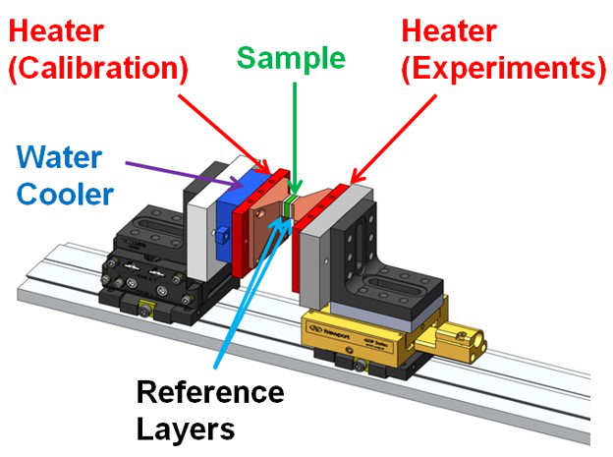
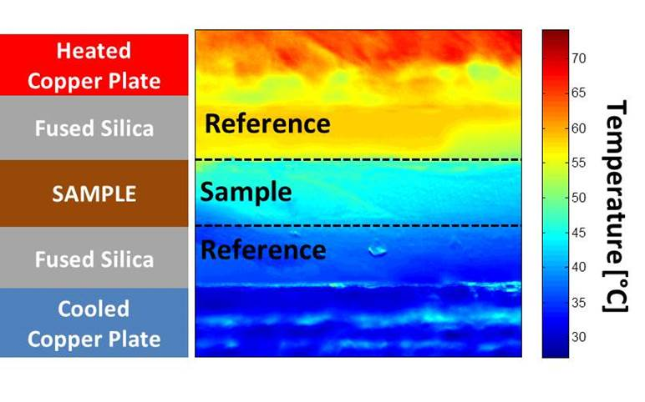
Thermal conductivity measurement rig
2D IR surface temperature map for Chromeric T766 TIM

Slide 2
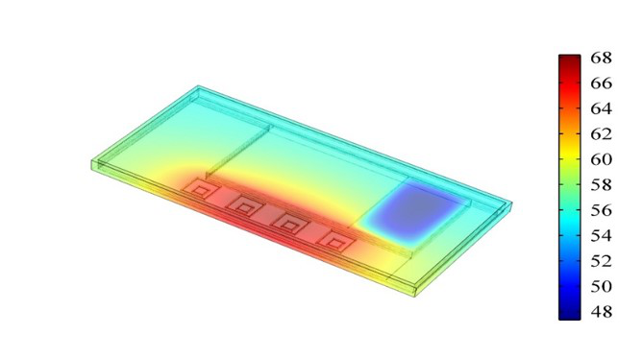
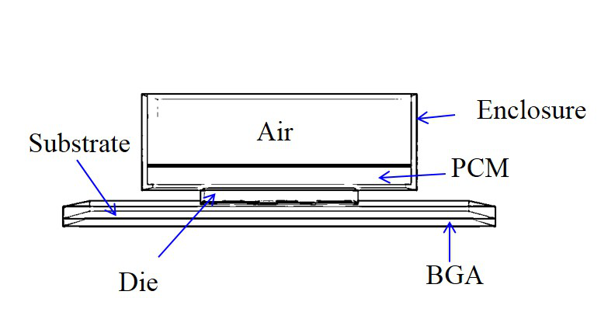
Temperature [°C]
System level heat transfer simulation of Samsung Galaxy S6 smartphone
Processor (die) level model for experiment validation

Slide 3
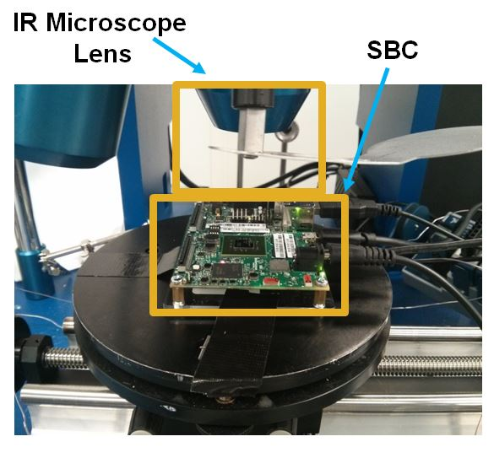
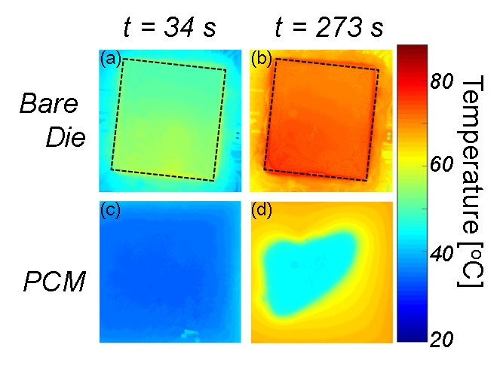
Thermal stress test setup with PCM (contained in enclosure) on top of a Single Board Computer (SBC) processor
2D IR surface temperature maps of (a-b) bare processor die and (c-d) enclosure containing PCM on top of die

