Slide 1
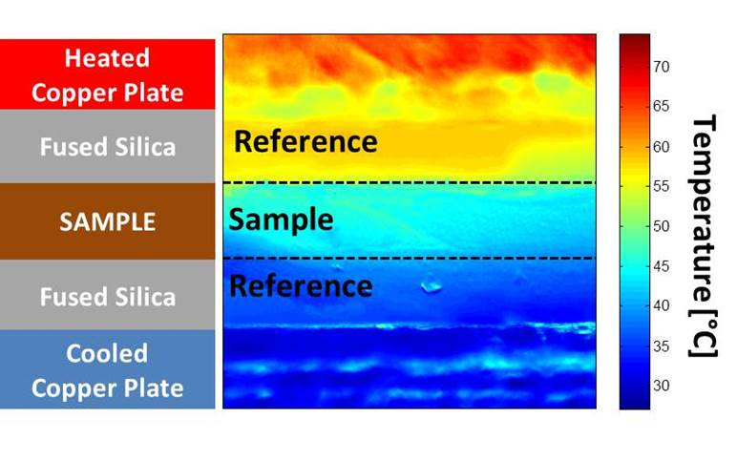
2D temperature map from Infra-red thermal camera to measure thermal conductivity of Chromeric T766 TIM using reference bar method
(ASTM D5470 standard)

Slide 2
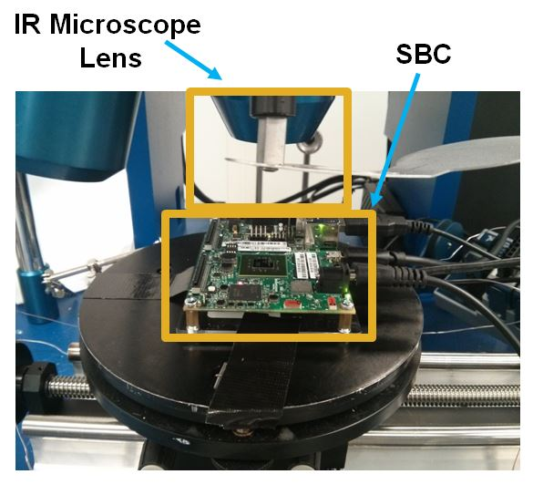
Hardware thermal stress test setup. A single board computer (SBC) with Android OS system is used with LINPACK benchmarking application

Slide 3
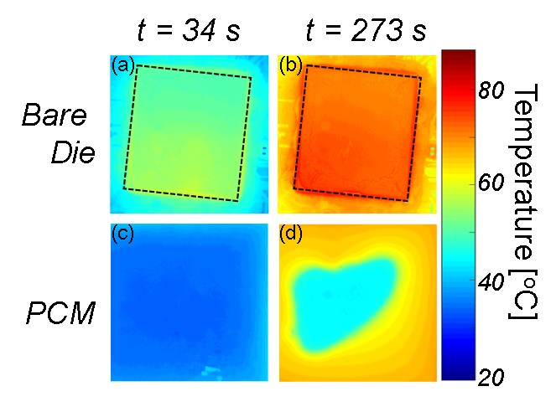
2D surface temperature map from Infra-red thermal camera of die (processor) only and PCM on top of die during thermal stress test. At each time, the surface temperature of the PCM shown in (c-d) are significantly cooler than those of the bare die.

Slide 4
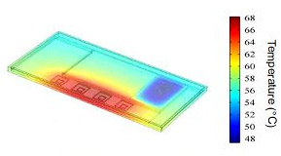
3D heat transfer simulation of a smartphone in COMSOL. High localized temperatures (shown in red) near the processor

Slide 5
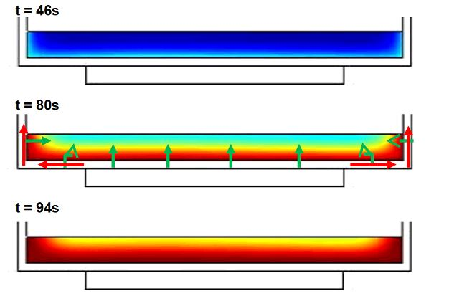
Inward melt front propagation (shown by green arrows) in the PCM due to sideways heat spreading (shown by red arrows) in the copper enclosure walls

