Slide 1
MEE 307 CAD/CAM PROJECT ON HELICAL GEAR – DESIGN, ANALYSIS AND MANUFACTURE USING CNC
Team Members:
Yash Ganatra – 10BME1043
Vivek Varia – 10BME 1109
K Srikanth – 10BME 1057

Slide 2
Introduction
This project aims at designing the gear using SOLIDWORKS CAD software and its machining using CNC TRAIN simulator.
Gears are the most widely used transmission components.
Gear design is a multi-stage iterative process which starts with the selection of type of gear and ends when the appropriate dimensions are found so as to manufacture.
Using Computer Numeric Control to machine a gear improves the surface finish and the accuracy

Slide 3
Objectives
The present study involves design and analysis of spur gear according to Lewis Bending Theory which states that at a given point of time maximum load acts on single tooth. The tooth acts as a cantilever beam.
Validation of the theory is done by analysis on SOLIDWORKS and Von Mises Stress and displacement is found.
CNC Code is generated using CNC Train Simulator. This is presented in the final review.

Slide 4
Literature Review

Slide 5
Problem Specification
Power Transmitted = 37.5 kW
Transmission Ratio = 4.25
Pinion rpm = 1750
Material : ALLOY STEEL
Helix Angle: 15˚
Normal Pressure Angle: 20˚
Normal Module : 3mm (Computed from theory)
Load on a tooth = 10 383 N (calculated from eqn 2)
Yield Strength = 620 MPa

Slide 6
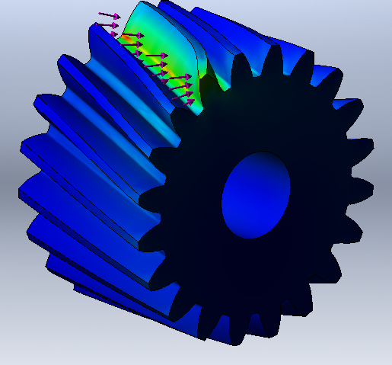
Load Direction

Slide 7
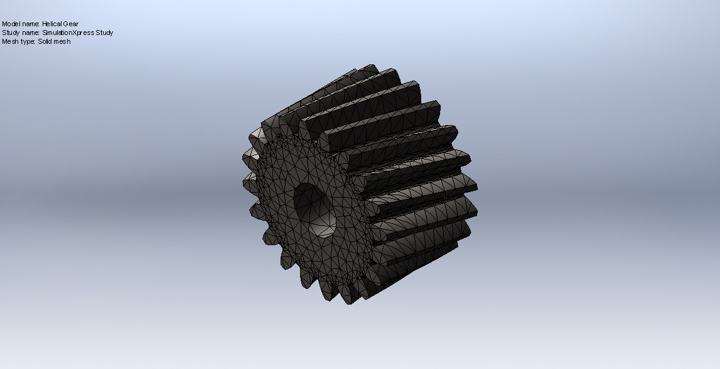
Mesh Details

Slide 8
Mesh Details
Mesh type | Solid Mesh
Mesher Used: | Standard mesh
Automatic Transition: | Off
Include Mesh Auto Loops: | Off
Jacobian points | 4 Points
Element Size | 4.83026 mm
Tolerance | 0.241513 mm
Mesh Quality | High
Total Nodes | 24751
Total Elements | 15568
Maximum Aspect Ratio | 17.786

Slide 9
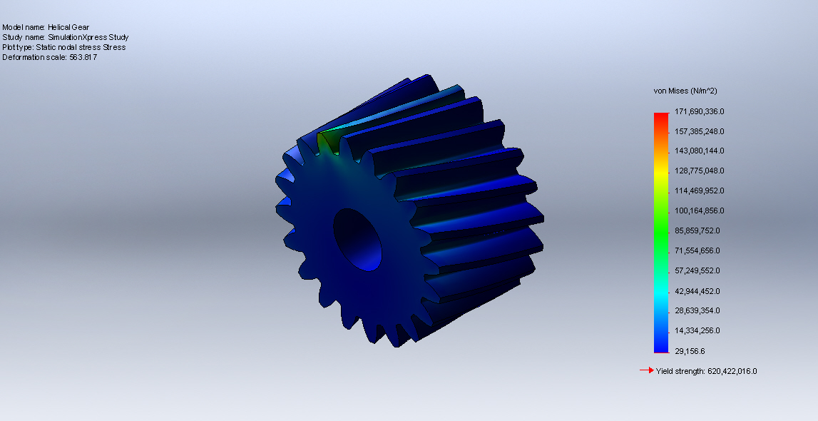
Von Mises Stress

Slide 10
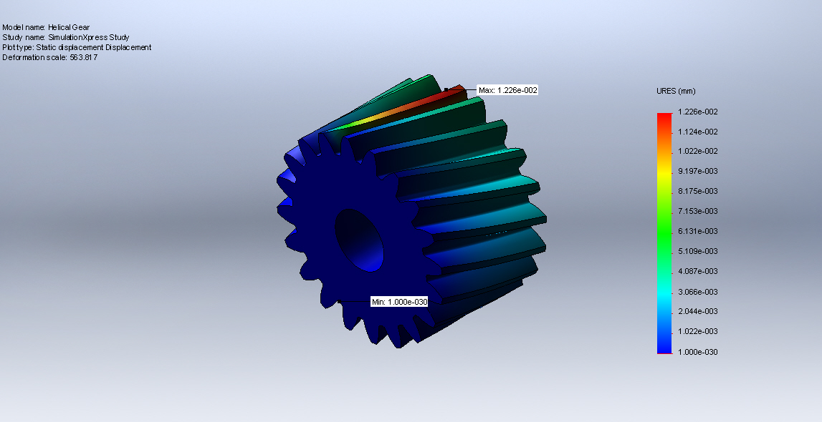
Displacement Plot

Slide 11
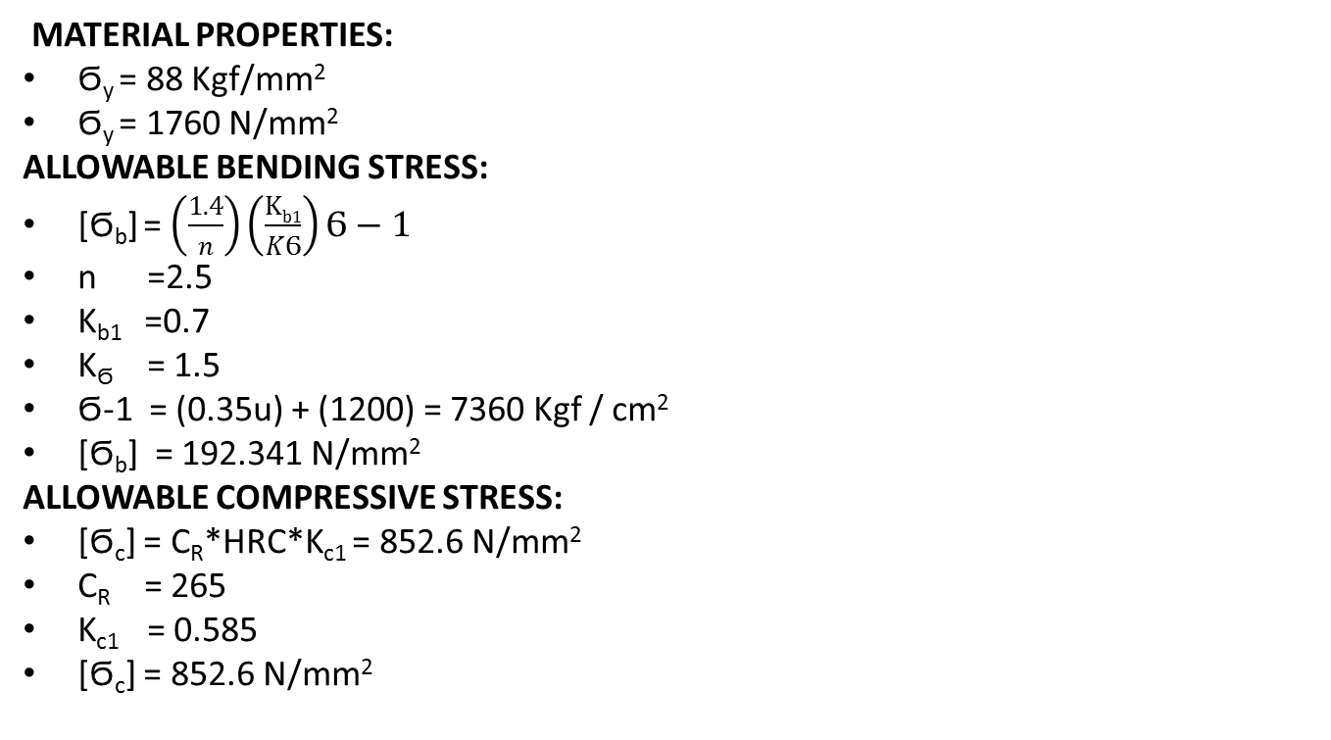
Validation of Results
MATERIAL PROPERTIES:
Ϭ_{y} = 88 Kgf/mm²
Ϭ_{y} = 1760 N/mm²
ALLOWABLE BENDING STRESS:
[Ϭ_{b}] = $\left(\frac{1.4}{n}\right)\left(\frac{Kb1}{KϬ}\right)Ϭ−1$
n =2.5
K_{b1} =0.7
K_{Ϭ} = 1.5
Ϭ-1 = (0.35u) + (1200) = 7360 Kgf / cm²
[Ϭ_{b}] = 192.341 N/mm²
ALLOWABLE COMPRESSIVE STRESS:
[Ϭ_{c}] = C_{R}*HRC*K_{c1} = 852.6 N/mm²
C_{R} = 265
K_{c1} = 0.585
[Ϭ_{c}] = 852.6 N/mm²

Slide 12

CENTRE DISTANCE:
a ≥ (i+1) $\sqrt[3]{\left(\frac{0.7}{\left[Ϭc\right]∗[Ϭc]}\right)\left(\frac{Ex[Mt]}{iΨ}\right)}$
[M_{t}] = M_{t}*K*K_{d}
K*K_{d} =1.3
M_{t} = 2087.57 N-mm
E_{x} = 207 * 10⁹ Pa
$Ψ$ = 0.5 (assumed)
$a$ ≥ 154.44 = 155 mm
Z₁ = 20
Z₂ = 85
M_{n} = $\frac{2acosβ}{\left(Z1\right)+(Z2)}$ = 2.85 = 3 mm
Revised centre to centre distance:
a = $\frac{Mn∗(\left(Z1\right)+\left(Z2\right))}{Cos β}$ = 163.055 mm
d₁ = $\frac{Mn∗Z1}{cosβ}$ = 62.164 mm
d₂ = $\frac{Mn∗Z2}{cosβ}$ = 263.995 mm

Slide 13

REVISED TWISTING MOMENT:
b = Ψ*a = 81.5275 mm
Ψ_{p} = $\frac{b}{d1}$ = 1.3124
K = 1.165
V = $\frac{¶dn}{d160}$ = 5.6917 m/s
K_{d} = 1.2
[M_{t}] = M_{t}*K*K_{d} = 3066.77 * 10² N-mm
INDUCED BENDING STRESS:
Ϭ_{b} = 0.7*$(\frac{i+1}{ ab(Mn)(Yv)}$) = 70.25 Mpa < [Ϭ_{b}]
Z_{v} = $\frac{z}{ cosβ∗cosβ∗cosβ}$ = 22.192
Form Factor (Y_{v}) = 0.402
INDUCED BENDING STRESS:
Ϭ_{c} = 0.7*$(\frac{i+1}{a})$* $\sqrt[2]{\left(\frac{i+1}{ib}\right)\left(\frac{E[Mt]}{1}\right)}$
Ϭ_{c} = 698.7 Mpa < [Ϭ_{c}]

Slide 14
CNC Code Generation of Spur Gear Blank

Slide 15
Process Sheet

Slide 17
References
Khurmi R.S., Design of Machine Elements, S.Chand Publications,2012
Shighley Joseph, Mechanical Engineering Design, Mcgraw Hill Publications, 2012
CAD/CAM/CIM – P. Radhakrishnan, New Age International Publisher
Solidworks Manual - 2012

Slide 18
THANK YOU!

