Slide 1
A lot
Enthusiasm
Expectations
None
Time
Money
BAJA SAE life

Slide 2
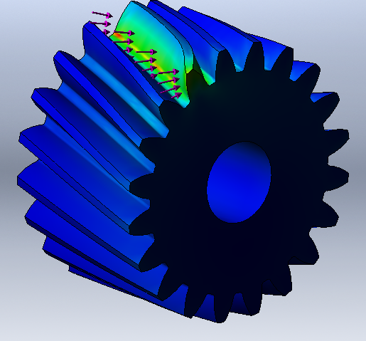
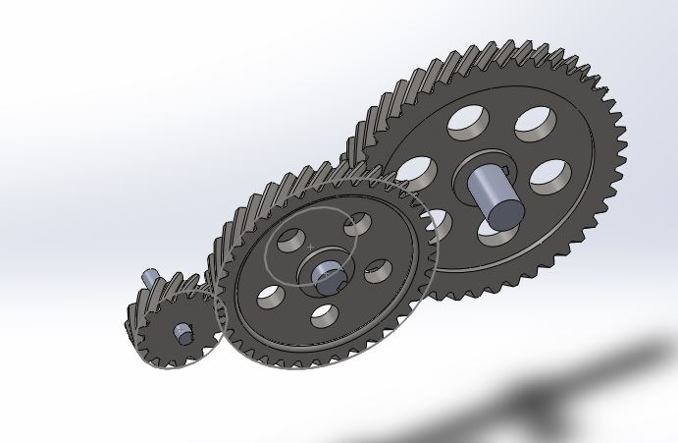
SolidWorks CAD model of spur gears

Slide 3
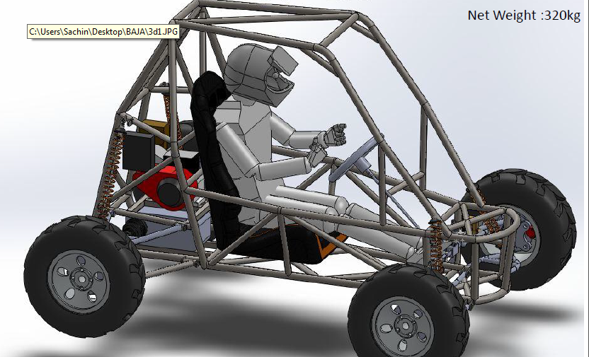
SolidWorks CAD prototype

Slide 4
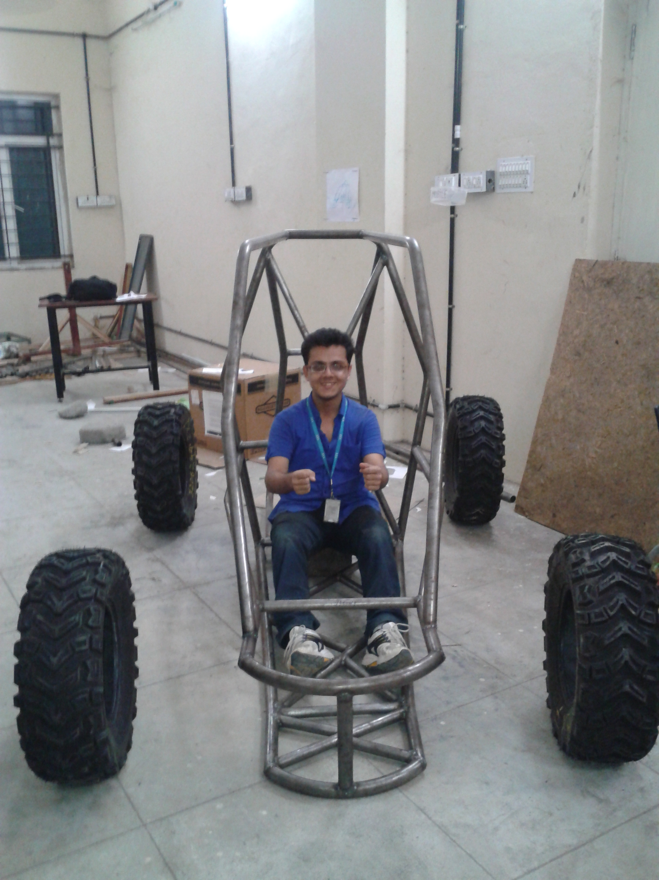
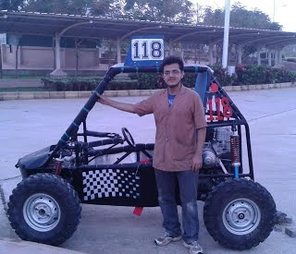
Getting there! With the rollcage
After first successful test!

Slide 5
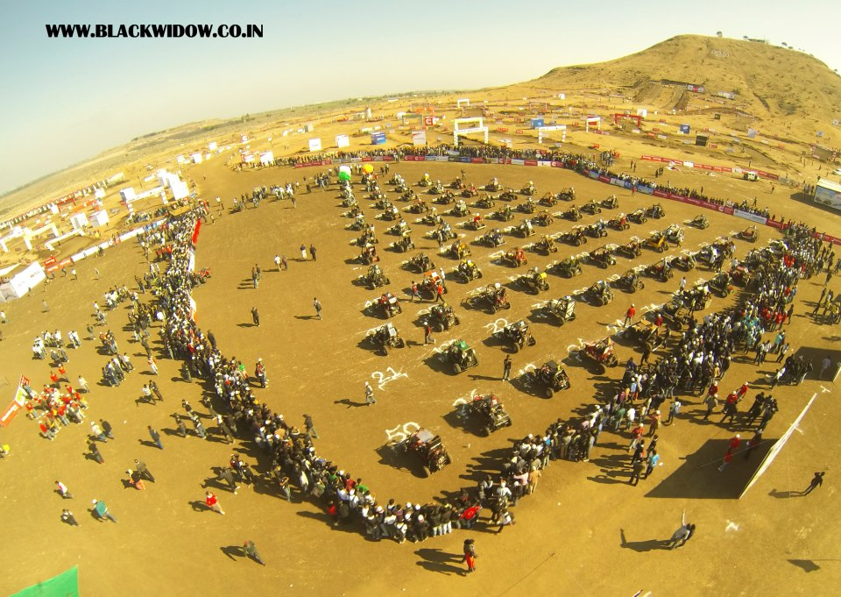
Starting grid for endurance race

Slide 6


