Slide 1

JOYORY
SMART SHOPPING EXPERIENCE
YASH GAJERA
NAIMISH GONDALIYA
KEVIN VASANI

Slide 2
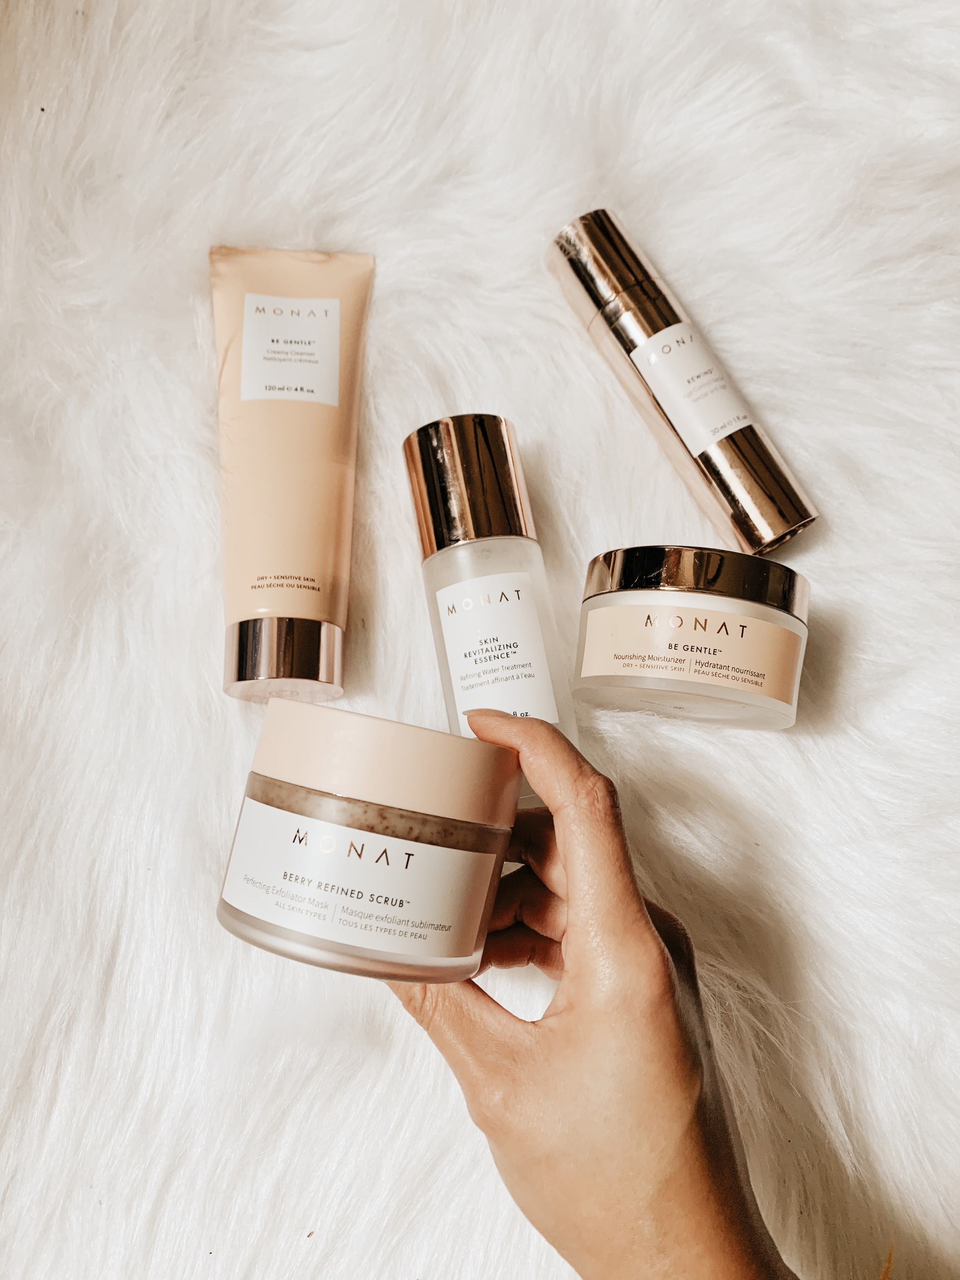
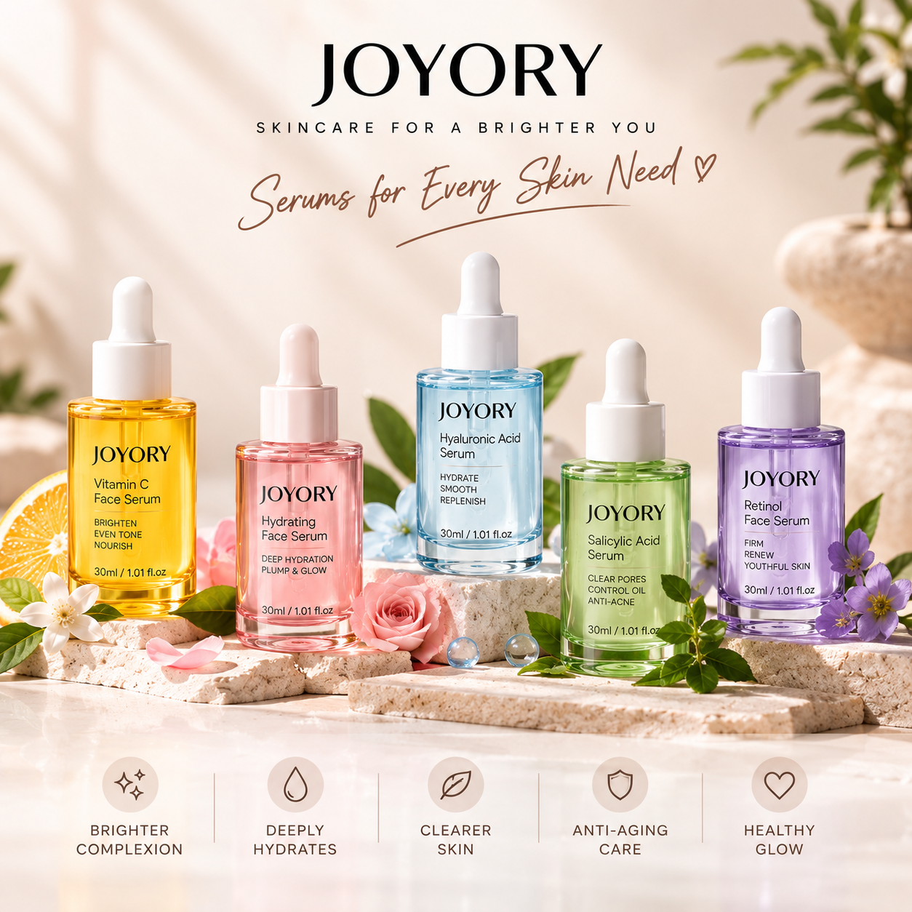
INTRODUCTION
Joyory Personal Skin Intelligence Engine is an AI-powered skincare solution that goes beyond basic product recommendations.
It analysis the user's skin, existing routine, environmental conditions, and product responses to provide personalized skincare guidance.
It doesn’t just recommend skincare products—it understands your skin, learns from your experience, and continuously adapts your routine to you.

Slide 3
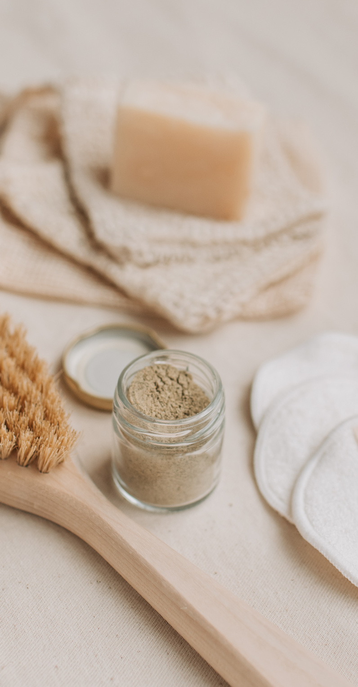
OBJECTIVE
  Routine Compatibility Detection to identify potential conflicts between multiple skincare products.
  Progressive Weekly Routine Planning to introduce products gradually and systematically
  Personal Skin Response Learning by tracking user feedback and product experiences.
  Weather-Based Skincare Adaptation using real-time environmental conditions.
  Capture a face image and analyze it using Gemini AI API for personalized skincare insights and recommendations.
  Automatically reorder functionality

Slide 4
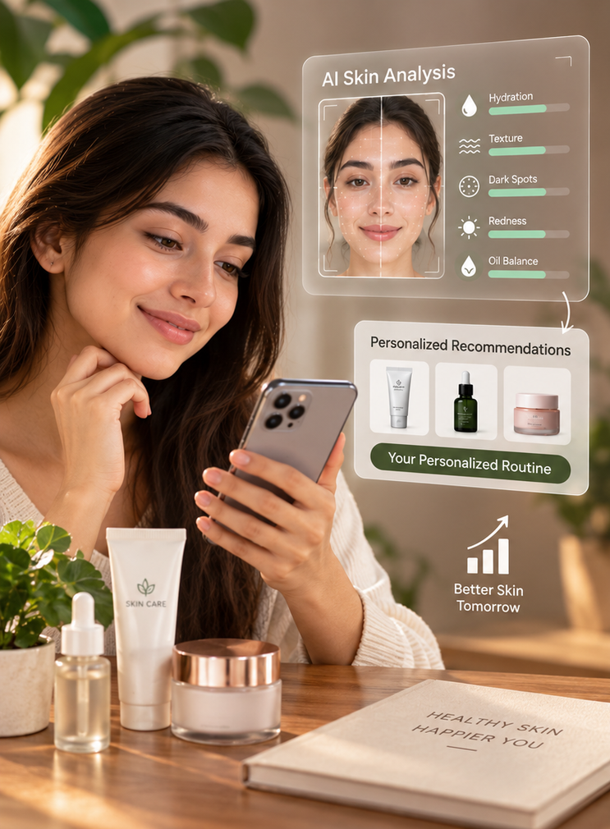
FUTURE IMPLEMENTATION
  Make face recognise better
  Create app for user experience better and daily routine notification
  Continuously analyzes user feedback, skin changes to automatically refine and personalize future skincare recommendations
  Learns from customer feedback after each product usage to provide personalized recommendations over time.

Slide 5
TECHNOLOGY
  Frontend :
React.js, Tailwind, React Bits
  Backend :
Python Django, Django Rest Framework, JWT Authentication
  Database :
SQLite ( Django default )
  AI Tools :
ChatGPT, Gemini, Clude, Antigravity
  APIs:
Gemini AI ( Face Analysis ), Open Weather API
Job Position
Job Position

Slide 6


