Slide 1


Case Study
Presentation by Team Explore more

Slide 2

Our Challenges
Prominent challenges faced by our Entrehealth.inc company are:
How to increase no. of sales?
How to utilize leftover stock?
What will be Marketing strategies?

Slide 3
How to increase no. of sales?

Slide 4
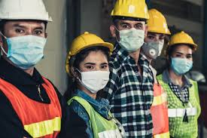
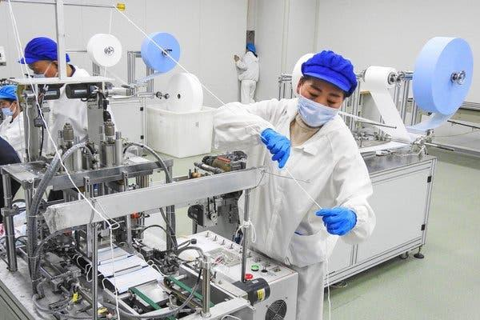
#1
Collaborations with:-
Mining companies
Chemical factories
Hospitals and health care centres
Can supply mask, sanitizers & gloves.
No risk.
All season customer.

Slide 5
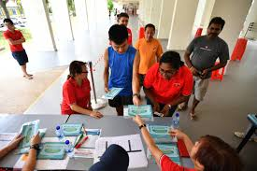
#2
When the vaccine comes, it won't be given to everyone at the same time. First it will be given to the doctors and prominent members of the society. So we have to ensure that while the others are given vaccine, we sell our products at maximum amount to the common people,

Slide 6
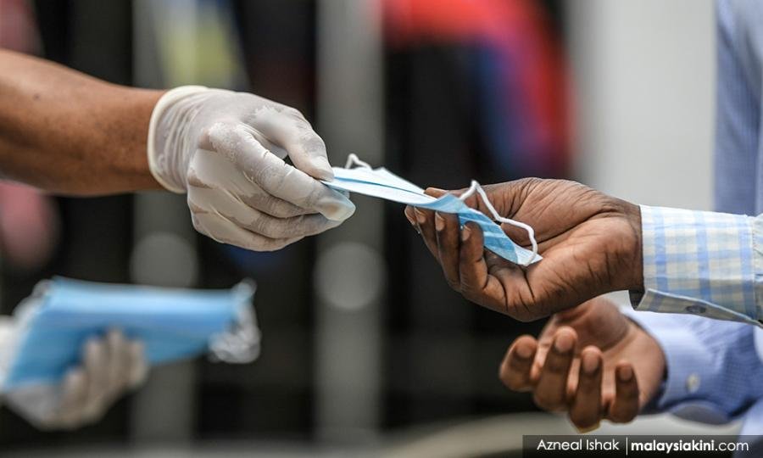
#3
Selling the products with slightly raised amount from the original and market rate (adding the price of mask)and giving the mask for free.

Slide 7
How to Utilize leftover stock?
abc

Slide 8

Establishing sanitization points at places that have been considered unhealthy for hospitals. Also ensuring that we sell our products in maximum amount to those who can buy the products but do not have the facilities.

Slide 9
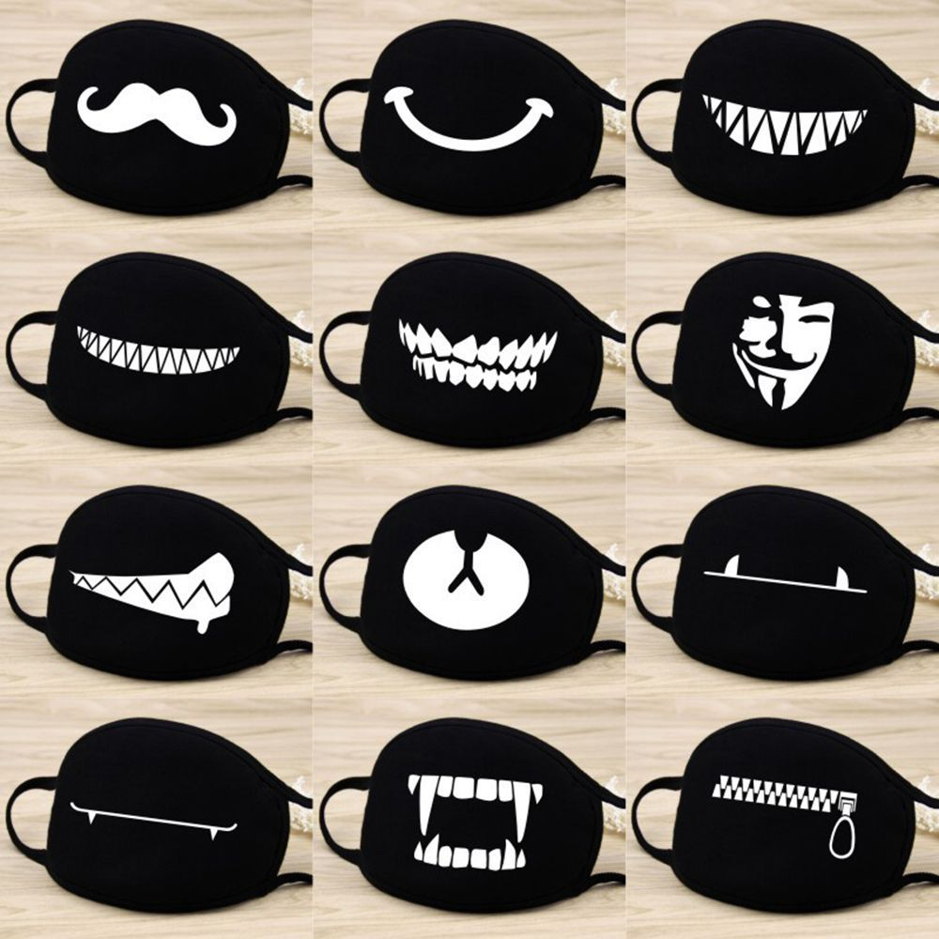
With the help of NGOs,we can distribute masks among small scale industries at subsidized price where workers have to work in unfavourable conditions.

Slide 10
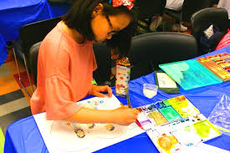

Organising competitions at art colleges and schools. We can give them some of our materials and ask them to add their own creativity to it. We can take their ideas and sell some of them as limited editions.
Using the leftover plastic materials for making sanitizer holders.

Slide 11
Marketing strategies

Slide 12
Campaigning for use of masks, gloves and sanitizing products in small scale factories.
1.Spreading Awareness- We need to ensure that people know about us and the seriousness of the situation
Working with NGOs to avail every worker with masks and other products to prevent the harmful effects of working in unfavourable conditions.

Slide 13
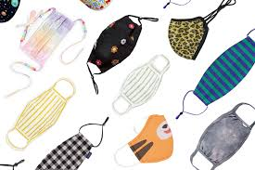

2. Cover in new way
Wherever you go, it’s your style and personality that's seen first
‘Funk Masks - Cover in new way.
Making masks a new style statement among youths
Making and distributing attractive and colourful masks and sanitizer holders among children

Slide 14
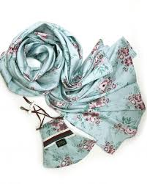
​3.The more attractive and eye catching the product the more inclined people will be to buy it
​Collaborating with the social societies and asking them to wear our masks/use our products at maximum when working/painting. People passing by will see them and think that it's the latest fashion and therefore buy our products.

Slide 15

Online marketing
The Internet is becoming the town square for the global village of tomorrow
-Bill Gates
In the present scenario where everyone is connected through internet, showcasing our product online is surely profitable
Online advertising using google ads would attract more people
Participating in forums like facebook,reddit, tumblr.
Blogs are good way to promote our products through comments and articles.
online store would give a thrust to our sales.

Slide 16

Conclusion
“Keeping You Well”
Our Company Policies:
We give good salary to our employee.
We do not compromise with quality of our product.
We are always ready to grow more.

Slide 17



references
1.www.google.com google search engine
2.www.wikipedia.com wikipedia
3.https://aws.amazon.com/solutions/case-studies for case study examples
4.https://www.neilpatel.com for online marketing references

Slide 18

Our team
Mihir Mantri
Kanak Ramteke
Yash Gautam
Sanskriti Singh

