Slide 1

COFFEE SALES
DATA ANALYSIS
Python • Pandas • NumPy • Matplotlib
Created by : Yash Gode
Analyze • Visualize • Interpret • Recommend

Slide 2
2. Project Description & Objectives
Why the analysis was performed
Project Description
Objectives
This project focuses on analysing coffee sales transaction data using Python, Pandas, NumPy, and Matplotlib to uncover sales patterns, product performance, revenue trends, and customer purchasing behaviour. The analysis involved data inspection, cleaning, validation, KPI creation, exploratory data analysis (EDA) and visualization.
The dataset contains 3,547 sales transactions across 8 coffee products, with information such as transaction amount, coffee type, time of day, weekday, month, date, and hour. The project transforms raw transaction data into meaningful business insights that can support sales planning, product strategy, staffing, and promotional decisions.
• Measure overall sales performance.
• Evaluate product revenue contribution.
• Identify monthly and hourly sales patterns.
• Compare weekday revenue.
• Create business-facing visualizations.
• Generate suggestions from observed patterns.
COFFEE SALES • PYTHON DATA ANALYTICS

Slide 3
3. About the Dataset
Structure, fields and observed coverage
ROWS
COLUMNS
File Type
3,547
11
.CSV

Slide 4
4. KPI Cards
Above is the KPI cards figures
TOTAL REVENUE
TRANSACTIONS
PRODUCTS
AVG. TRANSACTION
₹112,245.58
3,547
8
₹31.65
• Analyze transaction-level coffee sales data.
• Clean and validate the dataset using Pandas.
• Build KPIs and visualizations using NumPy and Matplotlib.
• Convert findings into practical business suggestions.

Slide 5
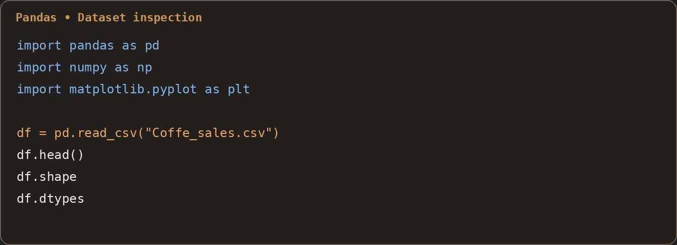
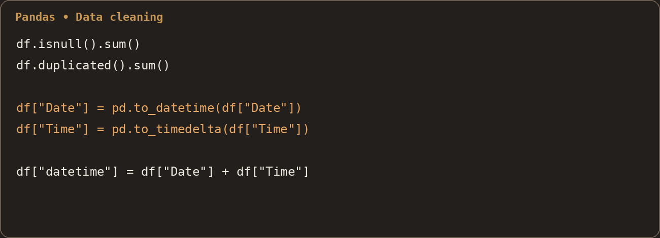
4. Analysis Using Pandas & Data Cleaning
Inspect → validate → transform
• Shape and data types
• Missing values: 0 across all columns
• Unique / categorical values
• Duplicate rows: 0
• Date and time conversion
Transformation
Date was converted to datetime, Time to time delta and a combined datetime field was created. Year, Month and Day fields were also derived for analysis.

Slide 6
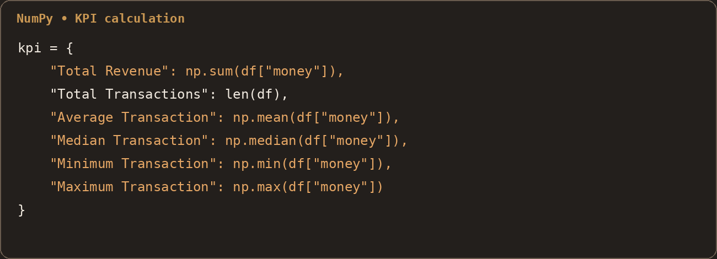
5. KPI Cards with NumPy Code
Core metrics calculated from the transaction values
TOTAL REVENUE
TRANSACTIONS
₹112,245.58
3,547
AVERAGE
MEDIAN
₹31.65
₹32.82
MINIMUM
MAXIMUM
₹18.12
₹38.70
These KPIs establish the baseline for product and time-based comparisons.

Slide 7
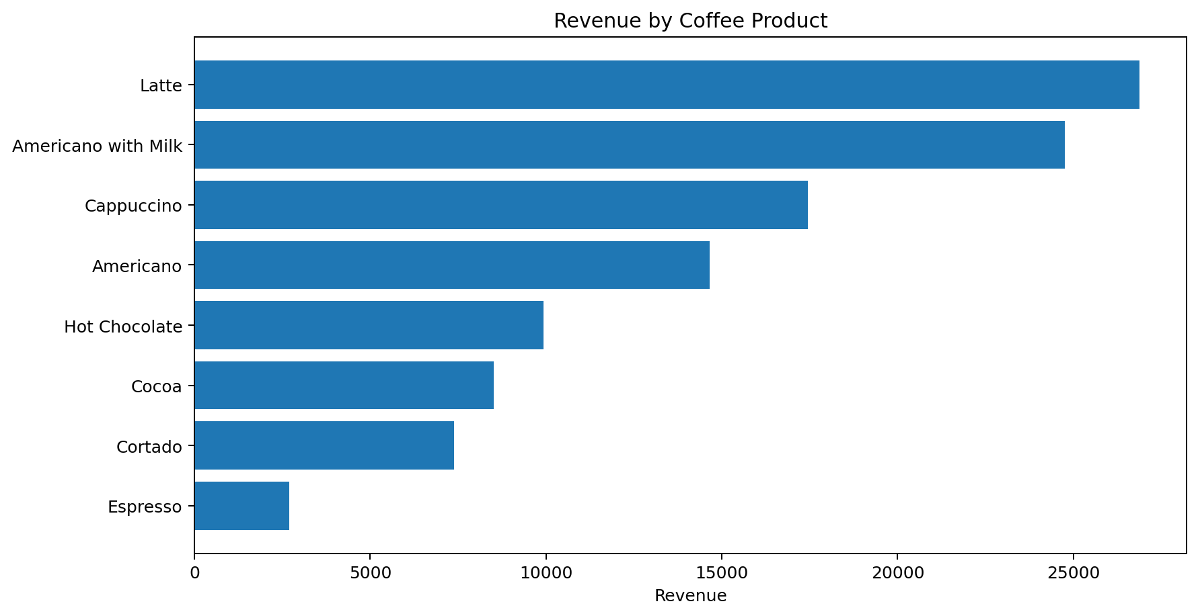
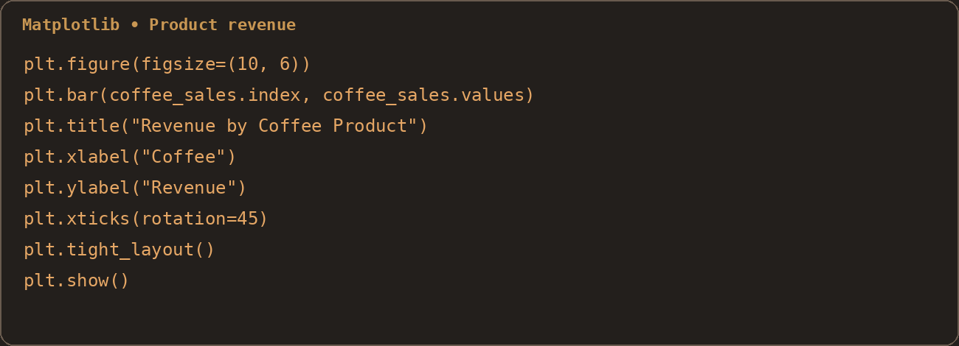
1 Revenue by Product
The bar chart ranks products by total revenue, making product contribution easy to compare.
Visualization description
The bar chart ranks products by total revenue, making product contribution easy to compare.

Slide 8
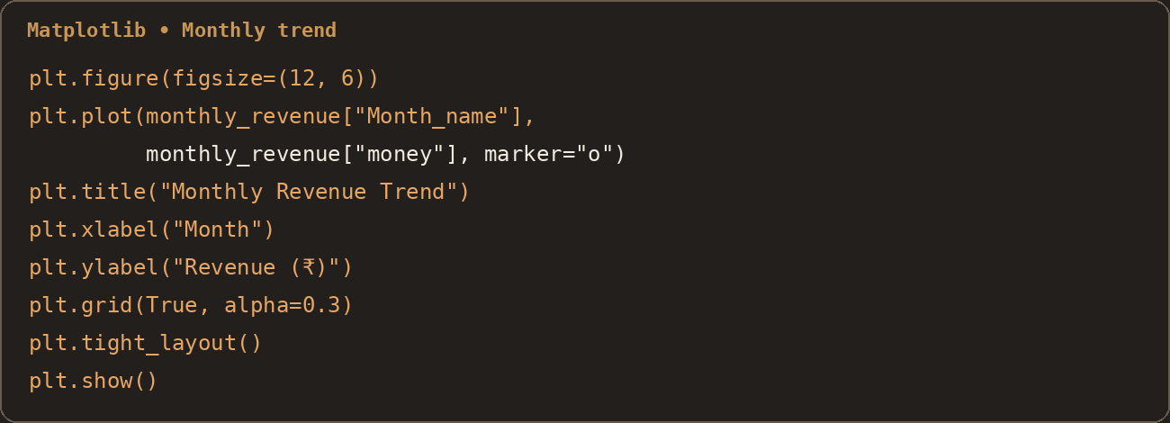
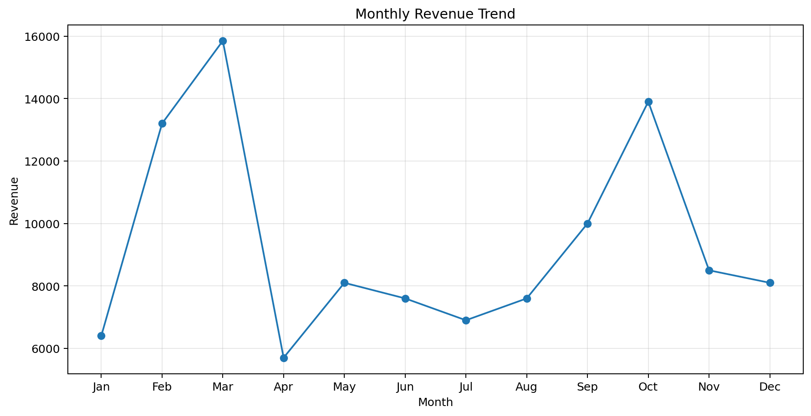
6.2 Visualization — Monthly Revenue Trend
The line chart tracks revenue movement month by month and highlights peaks and dips.
Visualization description
The line chart tracks revenue movement month by month and highlights peaks and dips.

Slide 9
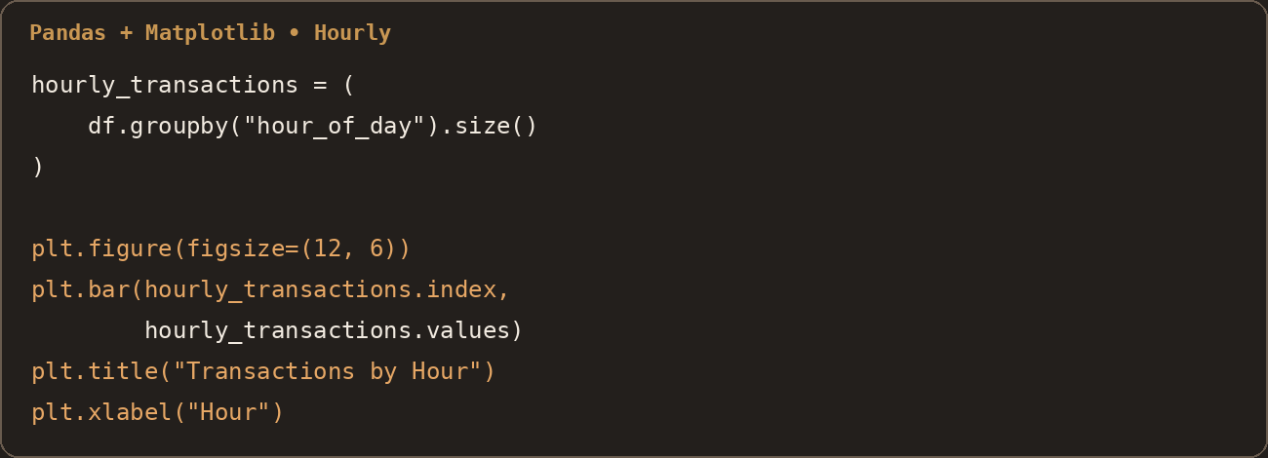
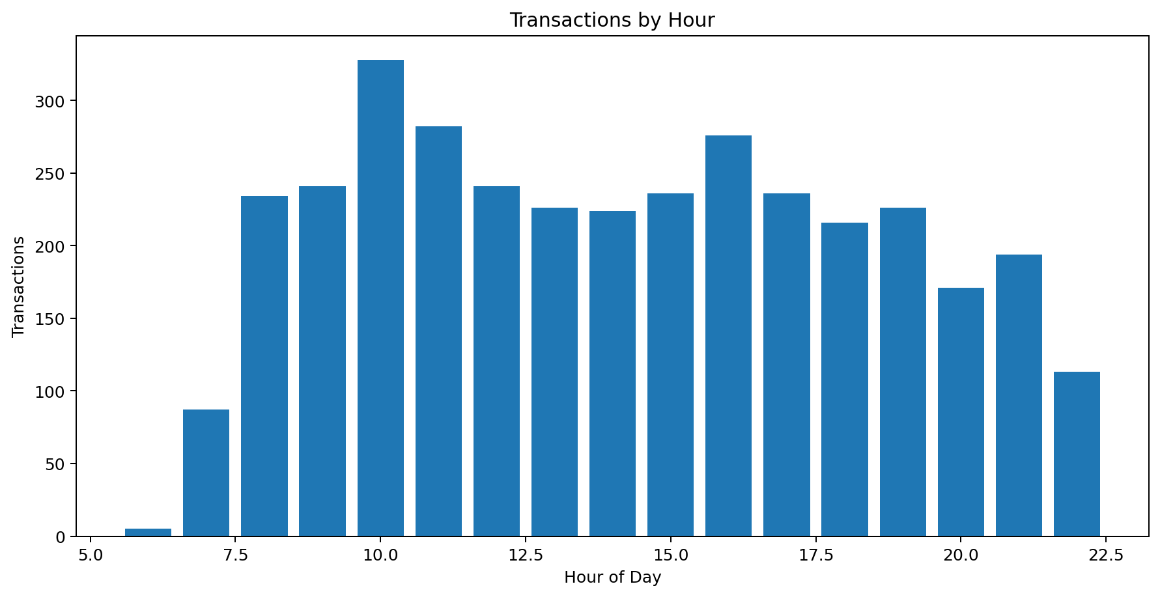
3. Transactions by Hour
The hourly column chart groups transactions by hour and shows the strongest demand periods.
Visualization description
The hourly column chart groups transactions by hour and shows the strongest demand periods.

Slide 10
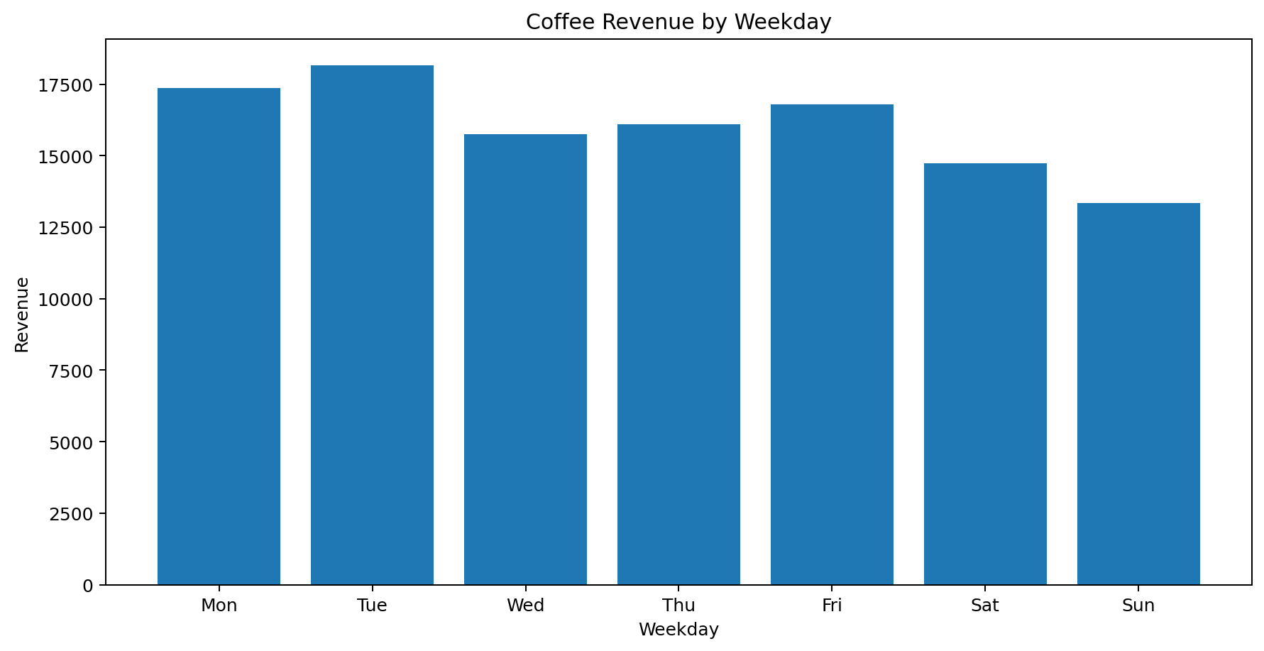
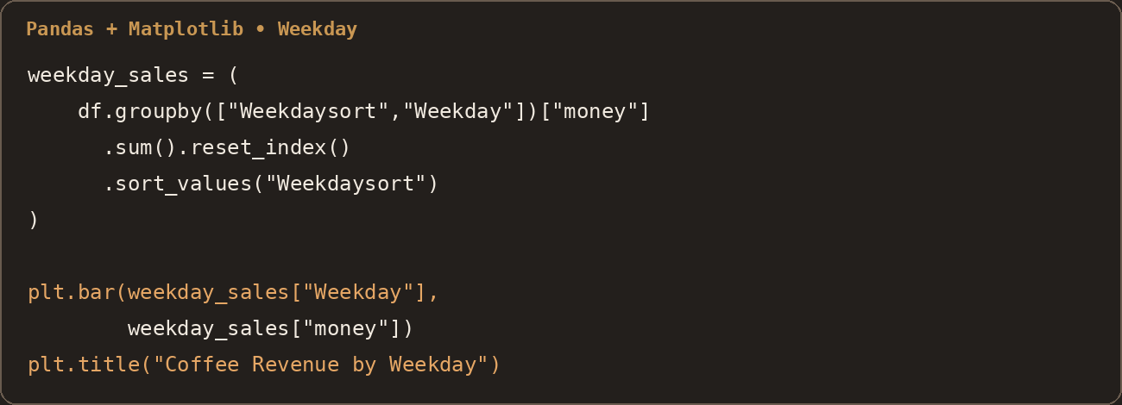
4. Revenue by Weekday
The weekday chart compares total revenue across Monday - Sunday.
Visualization description
The weekday chart compares total revenue across Monday -Sunday.
Tuesday is highest; Sunday is lowest.

Slide 11
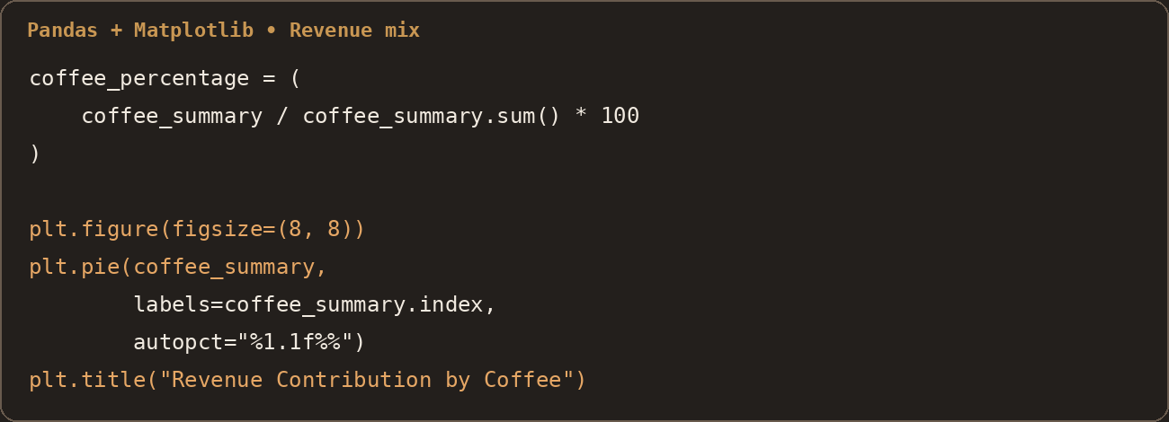
5. Revenue Contribution by Coffee
The project also calculated each coffee's percentage contribution to total revenue; the source notebook visualizes this as a pie chart.
Visualization description
The project also calculated each coffee's percentage contribution to total revenue; the source notebook visualizes this as a pie chart.
Latte + Americano with Milk ≈ 46.0% combined.

Slide 12
7. Final Findings & Suggestions
Business interpretation based on the analyzed data
01
Product mix
Latte and Americano with Milk together contribute about 46.0% of revenue.
02
Peak hour
The hourly chart shows the highest transaction activity around 10 AM.
03
Weekday pattern
Tuesday revenue is ₹18,168.38; Sunday revenue is ₹13,336.06.
04
Monthly movement
The displayed monthly trend peaks in March and reaches its low point in April.
05
Data quality
No missing values and no duplicate records were found.
Key Suggestions
• Keep high-contribution products prominent and test cross-selling.
• Plan staffing and inventory readiness around the late-morning peak.
• Use weekday patterns as an input for staffing and promotion planning.
• Investigate the March to April change further before making seasonal decisions.

Slide 13
Thank you
• Demonstrates practical data-analysis skills using transaction data.
• Connects Python outputs to business questions.
• Communicates results through KPIs, charts and recommendations.
COFFEE SALES • PYTHON DATA ANALYTICS

