Slide 1


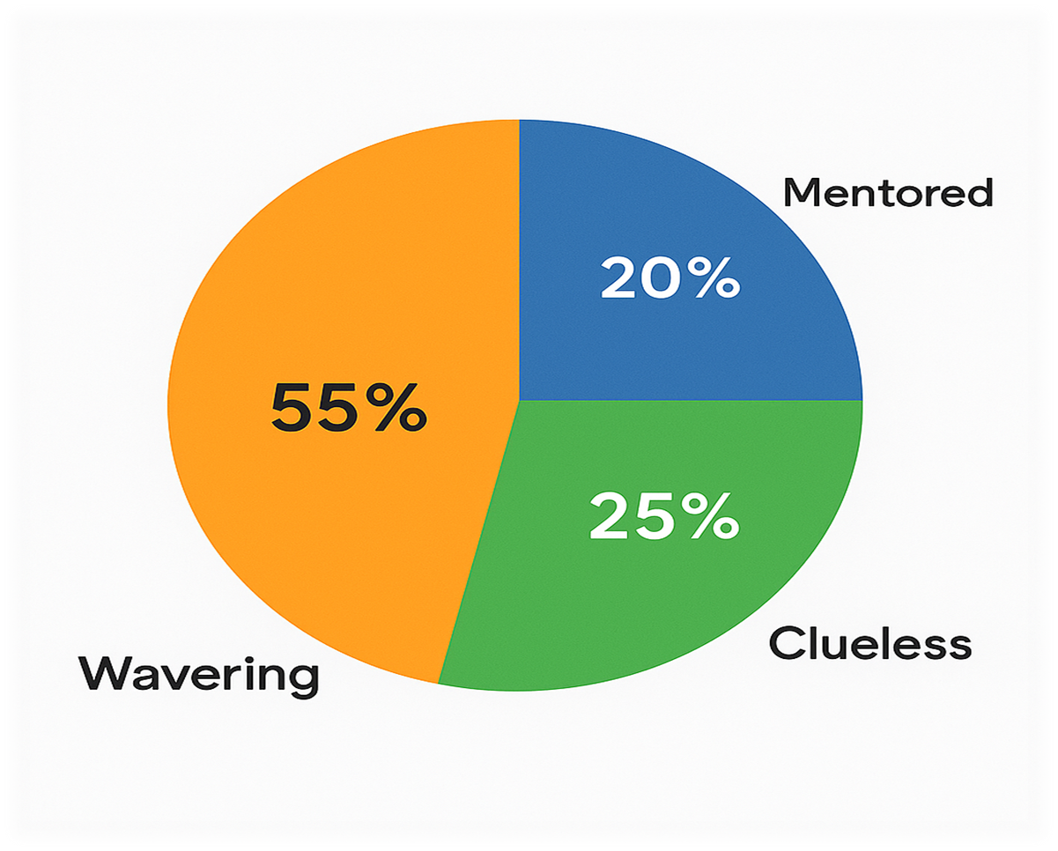
SPRINTHACKS 3.0
Problem Statement:-”BTech students are under constant academic pressure. On top of that, they’re expected to upskill, build projects, join hackathons, find internships, and craft the perfect resume — all while jumping between dozens of scattered platforms like YouTube, Coursera, Devfolio, LinkedIn, and more. It’s overwhelming, inefficient, and frustrating.”
Theme:-Educational Technology
Project Name:-GradWise
Team Name:-DOMinators
Team Leader:-Yash Goel (Backend Dev.)
hhjj
hiii

Slide 2

🧩 Problem Statement The Problem: Scattered Resources, Overwhelmed Students
🎓 BTech students are expected to master skills, build projects, participate in hackathons, apply for internships, and polish their resumes — all while juggling demanding academics.
🧩Although there are already ample platforms available — YouTube, GyanSetu, Coursera, Devfolio, LinkedIn, Internshala, and more — BUT following UP ON all of them is not realistic.
It becomes a time-consuming, frustrating mess of tabs, trackers, and lost progress.
❌ The result? Students are overwhelmed, progress is scattered, and AI tools can't help effectively due to fragmented data.
📉 Every year, over 1 million BTech students graduate in India, yet only a fraction secure decent jobs — especially in tier-2 and tier-3 colleges, where access to guidance and exposure is limited.
hiii

Slide 3

💡 The Solution: GradWise
🌐How it works:
"Early-year students often lack guidance and a clear roadmap for upskilling. Without a central platform to track progress, they miss key opportunities and realize it too late."
Gradwise brings everything a BTech student needs into one personalized dashboard. From curated courses and hackathons to internship listings, resume tools, certifications, and career guidance — GradWise is your all-in-one growth companion
🌟Why it works:
By centralizing student activity and progress, our AI assistant delivers smarter, more accurate recommendations tailored to each individual’s tech stack, goals, and learning pace.
No more scattered progress OVER MANY DIFFERENT PLATFORMS . No more decision fatigue.
🧠 No more tab-hopping or scattered progress. GradWise integrates learning, opportunities, and career tools under a single roof, powered by AI that actually understands your goals.

Slide 4
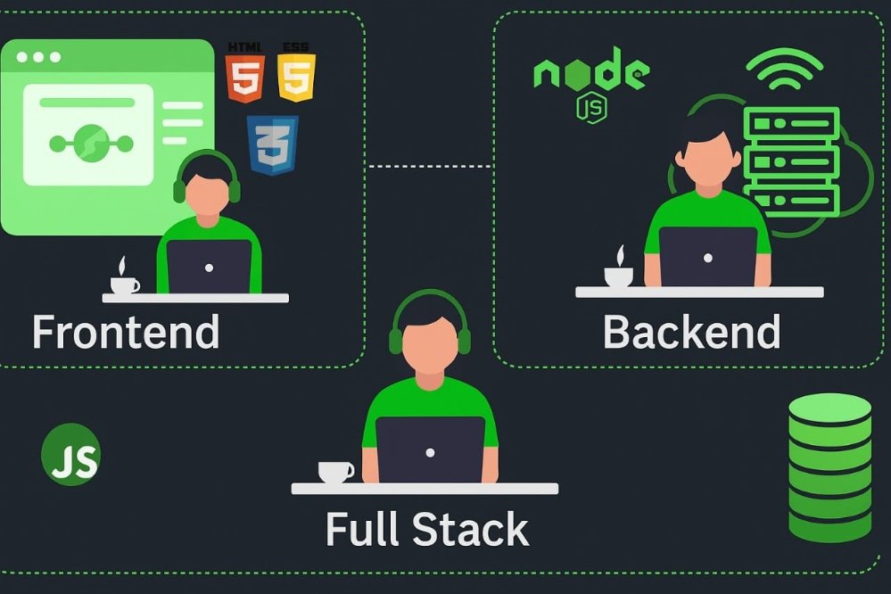
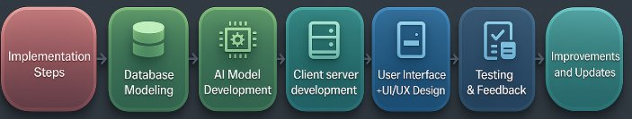
🛠Tech
Stack Used:-
->MERN Stack
->AI USED : Open AI + Our OWN Model for Better accuracy and security is under developemnt​
-> + additional supporting tools and libraries
O’
HACK
CLOCK

Slide 5
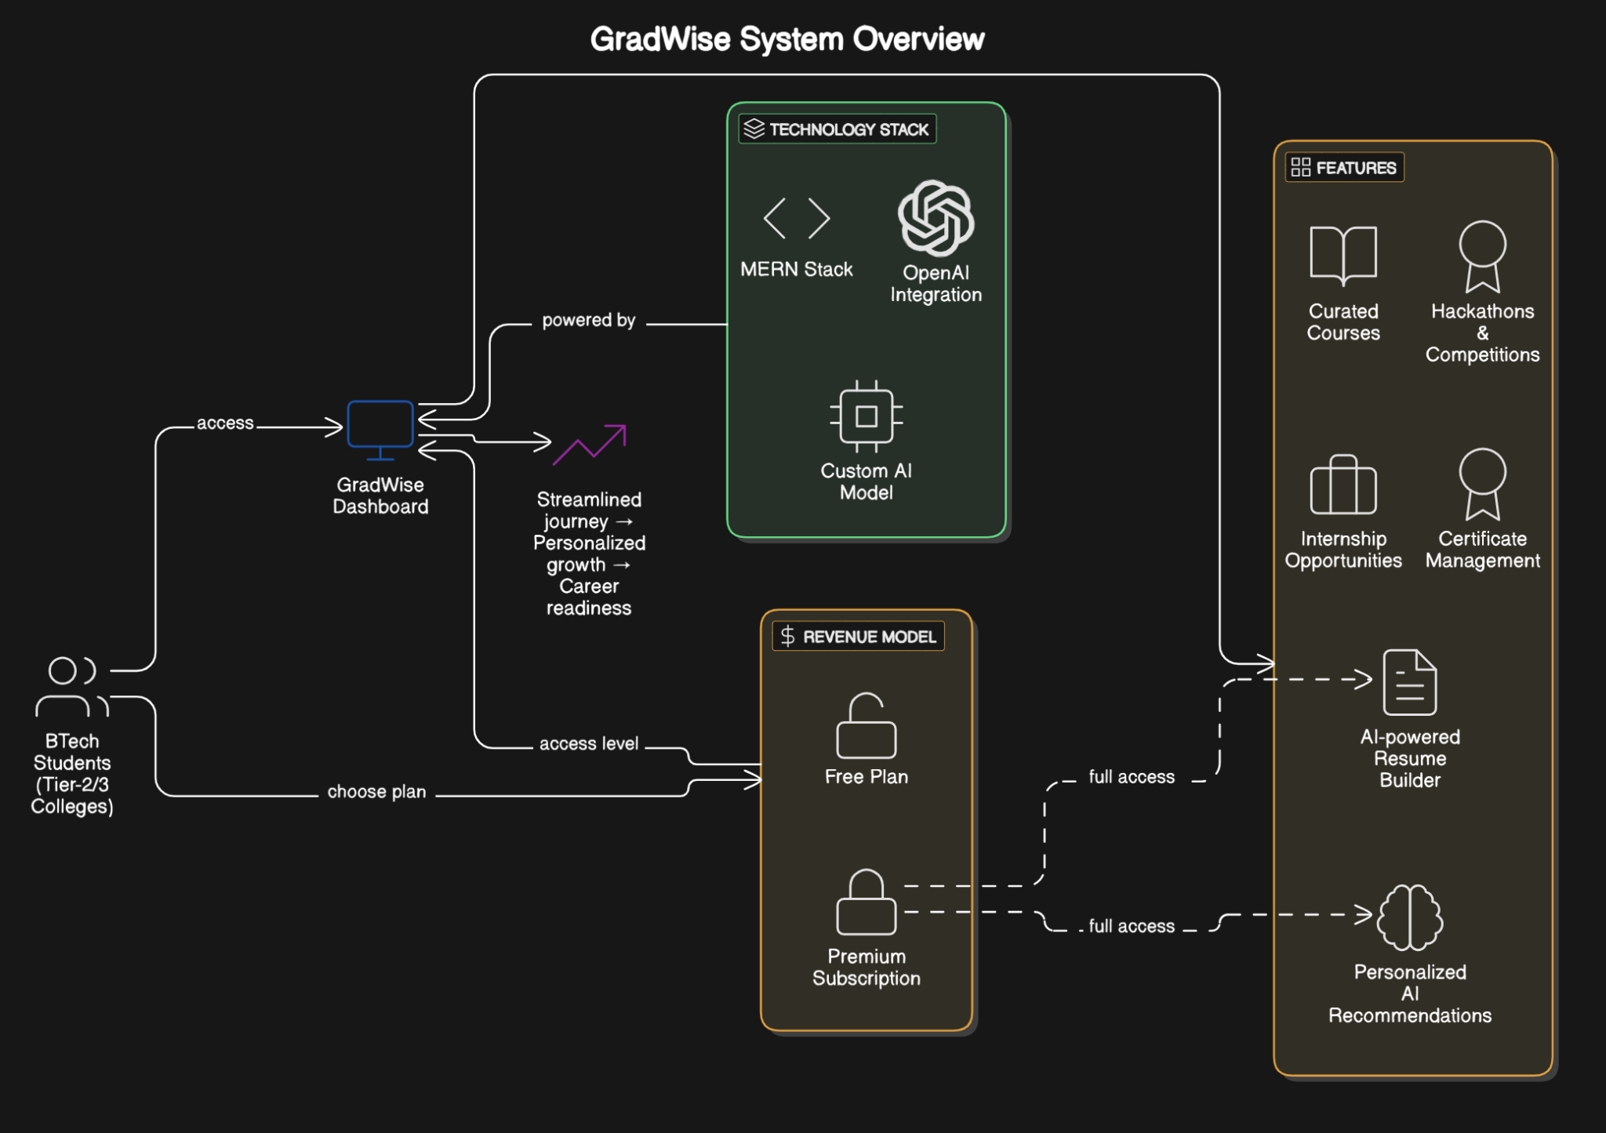
Workflow and System Architecture:-

Slide 6
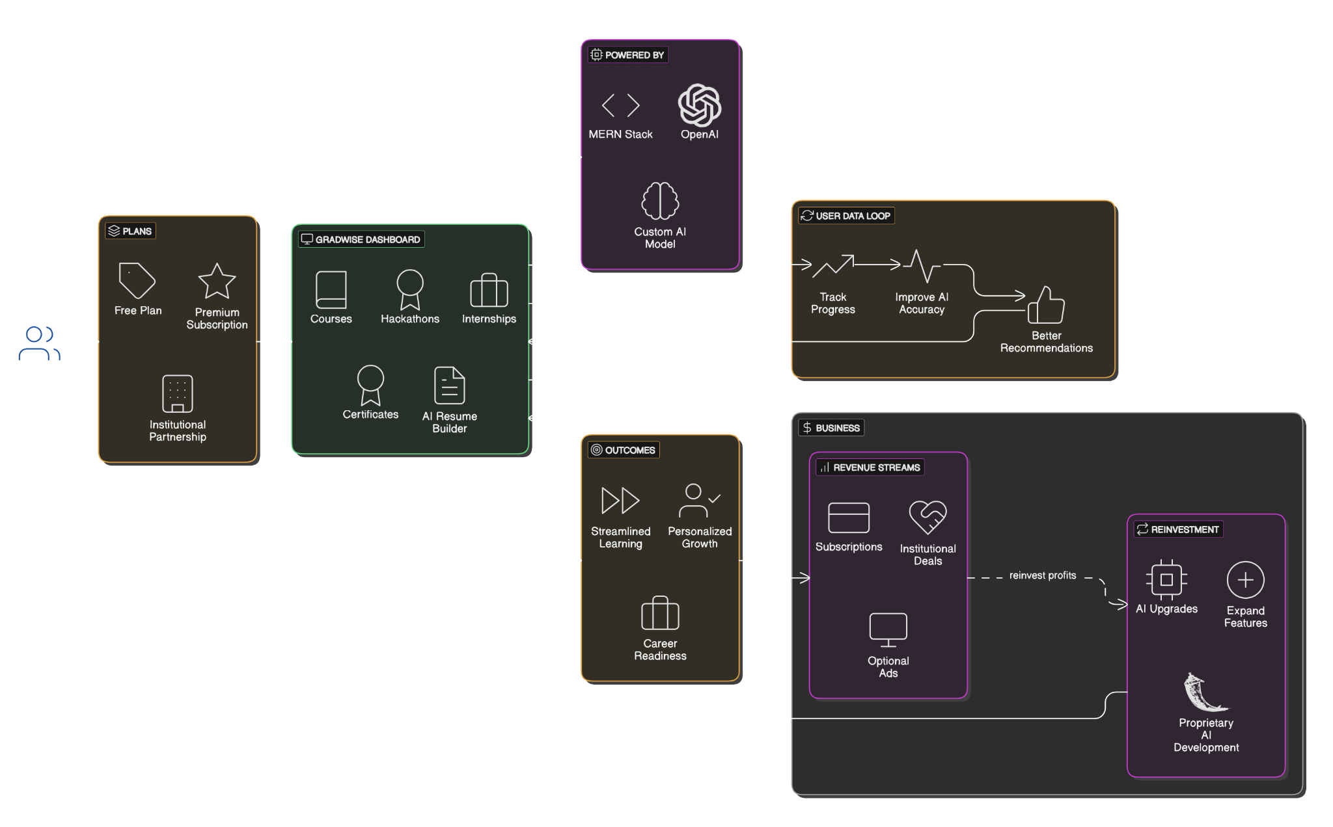
Business Revenue Model:-

Slide 7
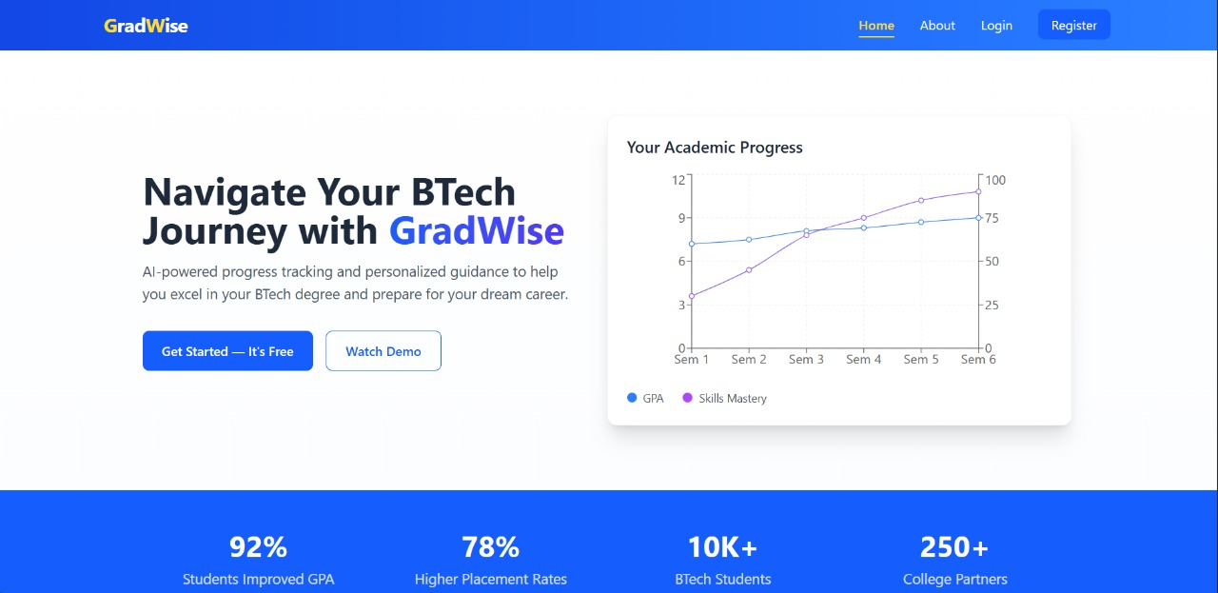
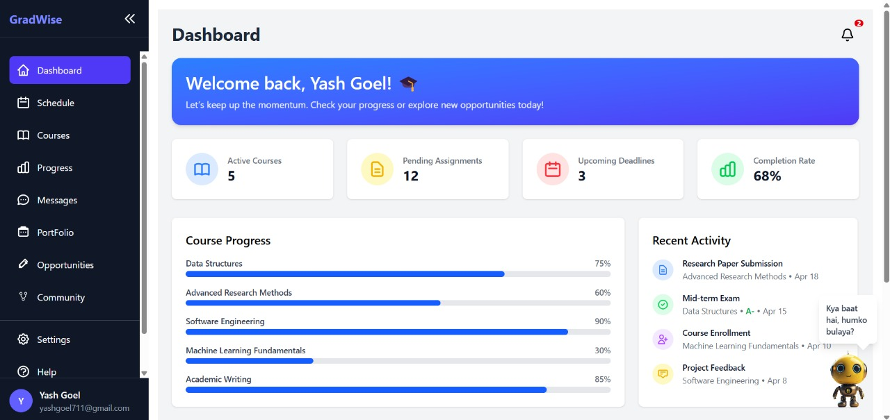
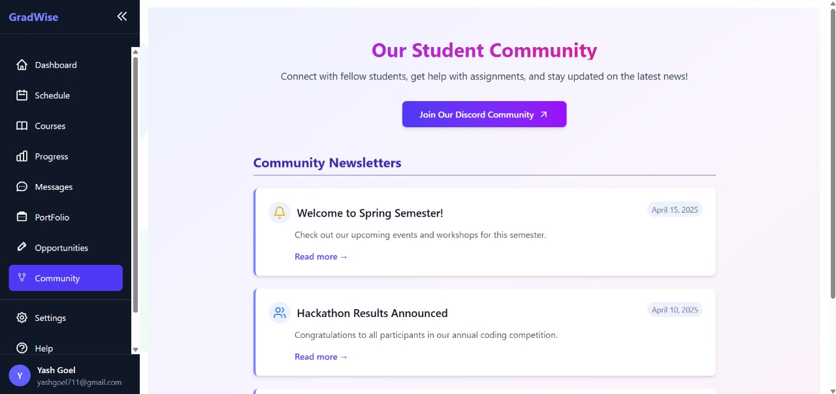
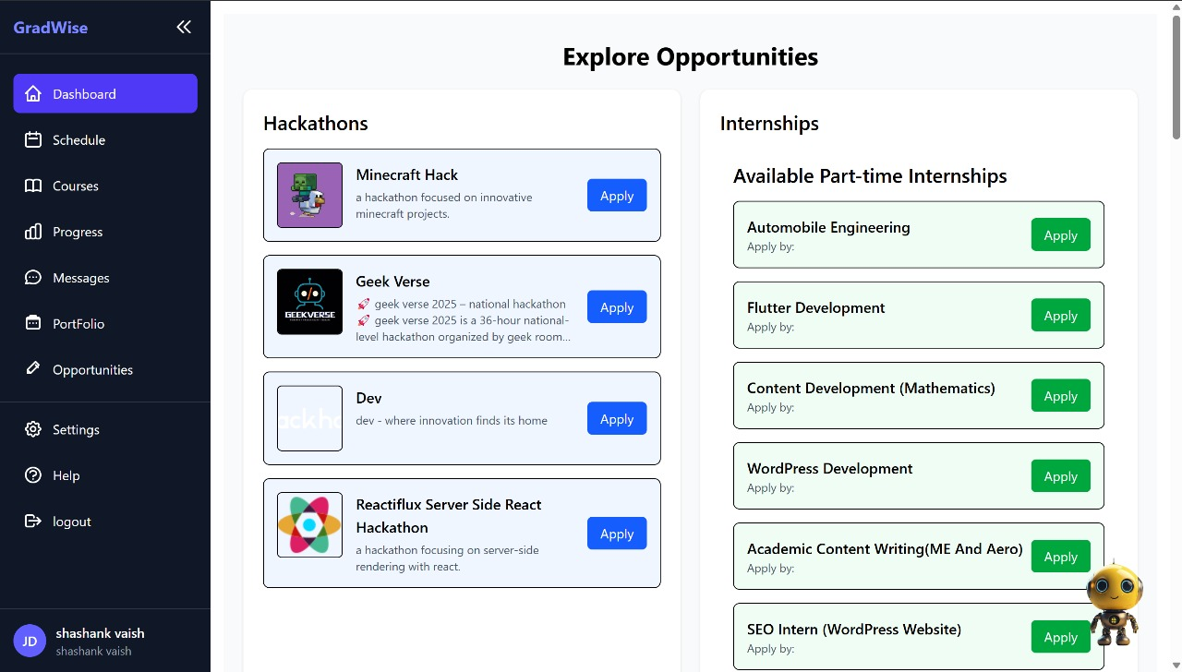
Our Prototype Images:-

Slide 8


Conclusion
Summary:-
🚀 GradWise simplifies the student journey by bringing courses, AI help, hackathons, internships, and scheduling—all in one place. With smart tracking and personalized recommendations, it helps students grow faster and smarter.
It’s not just a platform—it’s a launchpad for future-ready graduates.
Team
Details:-
🎓VAIBHAV KUMAR SINGH FRONTEND DEVELOPER
🎓VIHAAN KAUSHIK FRONTEND DEVELOPER
🎓SHASHANK VAISH BACKEND DEVELOPER
THANK YOU !
From - DOMinators

