Slide 1


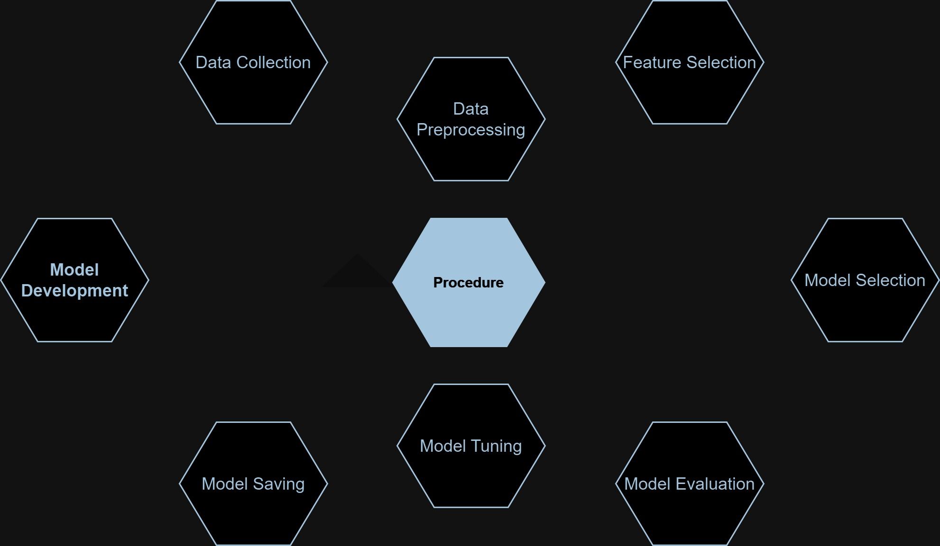

SYMBIOSIS INSTITUTE OF TECHNOLOGY (SIT)
DEPARTMENT OF ROBOTICS AND AUTOMATION
TITLE: Bank Loan Modelling Classification
Himonish Gupta (22070127025) & Yash Golani (22070127072)
INTRODUCTION
This study analyzes a local bank’s Personal Loan Campaign dataset to predict liability customers' likelihood of accepting personal loans. With only 9.6% acceptance in the previous campaign, the focus is on exploring customer attributes and deploying classification models to optimize targeted marketing strategies.
OBJECTIVES & AIMS:
The aim of this study is to analyze the Bank's Personal Loan Campaign dataset and develop a predictive model with high accuracy score to determine the likelihood of liability customers accepting personal loans.
METHODOLOGY
The proposed method for predicting whether a customer would accept the loan or not involves the following steps:
Methods KNN (K-Nearest Neighbors) Gaussian Naïve Bayes Logistic Regression Evaluation 1. Confusion matrix 2. Precision, recall, and F1-score 3. ROC AUC score | Diagram
RESULTS:
The accuracy of the k-NN
classifier on the
training set was 1.000,
while on the test set,
it was 0.970.
CONCLUSIONS:
In conclusion, the k-Nearest Neighbor classifier, after oversampling with SMOTE and hyperparameter tuning, demonstrated strong performance with high accuracy on both the training and test sets. It achieved particularly high precision, recall, and F1-score for class 0, indicating its effectiveness in correctly identifying instances of the majority class.
Algorithm | Accuracy Score
KNN | 0.97
Gaussian Naïve Bayes | 0.89
Logistic Regression | 0.94
ACKNOWLEDGEMENT
Dr. Satish Kumar

