Slide 1
MAC Layer Protocols for Wireless Networks

Slide 2
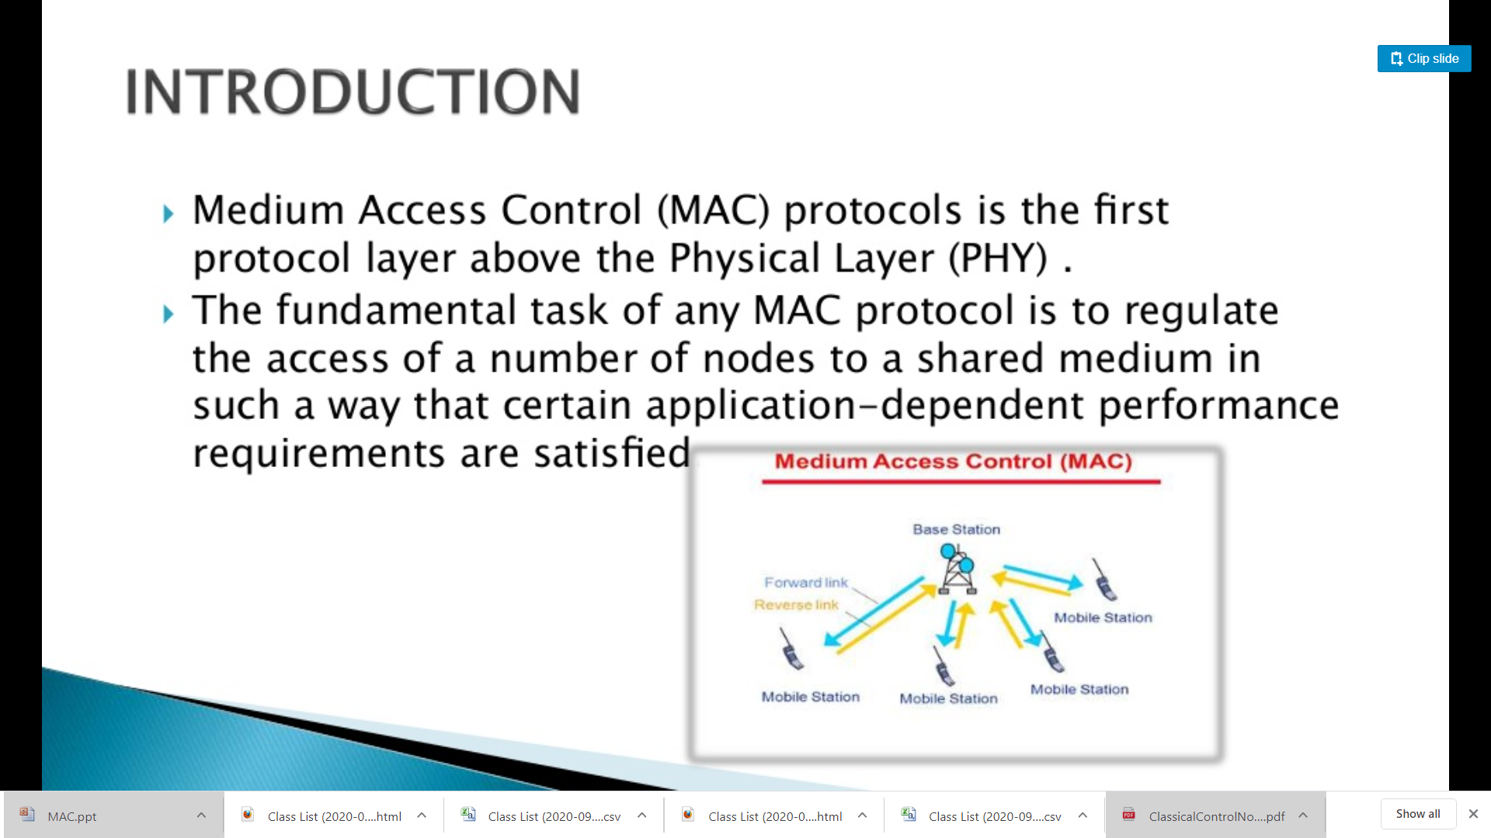

Slide 3
What is MAC?
MAC stands for Media Access Control. A MAC layer protocol is the protocol that controls access to the physical transmission medium on a LAN.
It tries to ensure that no two nodes are interfering with each other’s transmissions, and deals with the situation when they do.

Slide 4
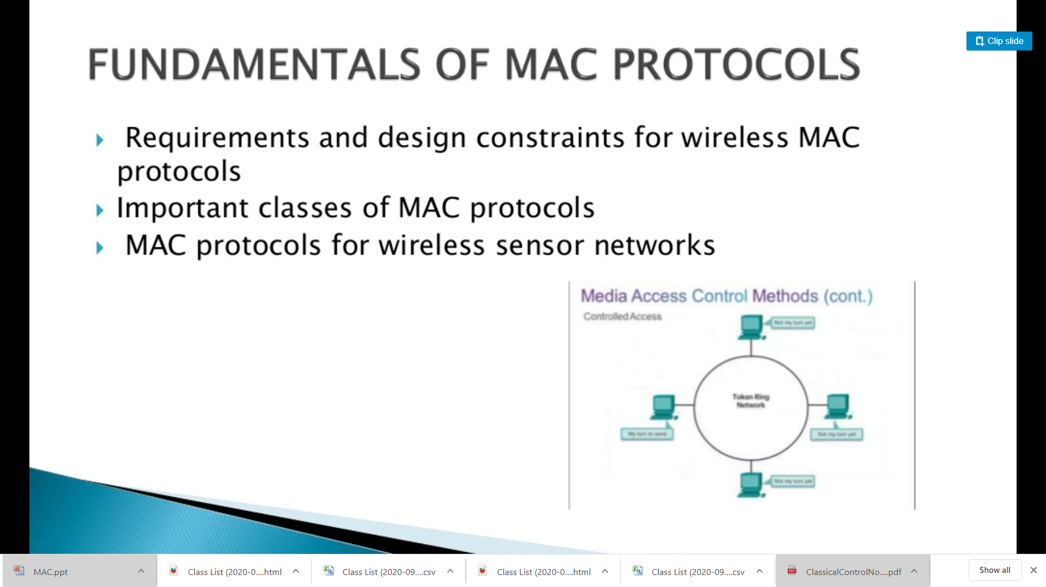


Slide 5
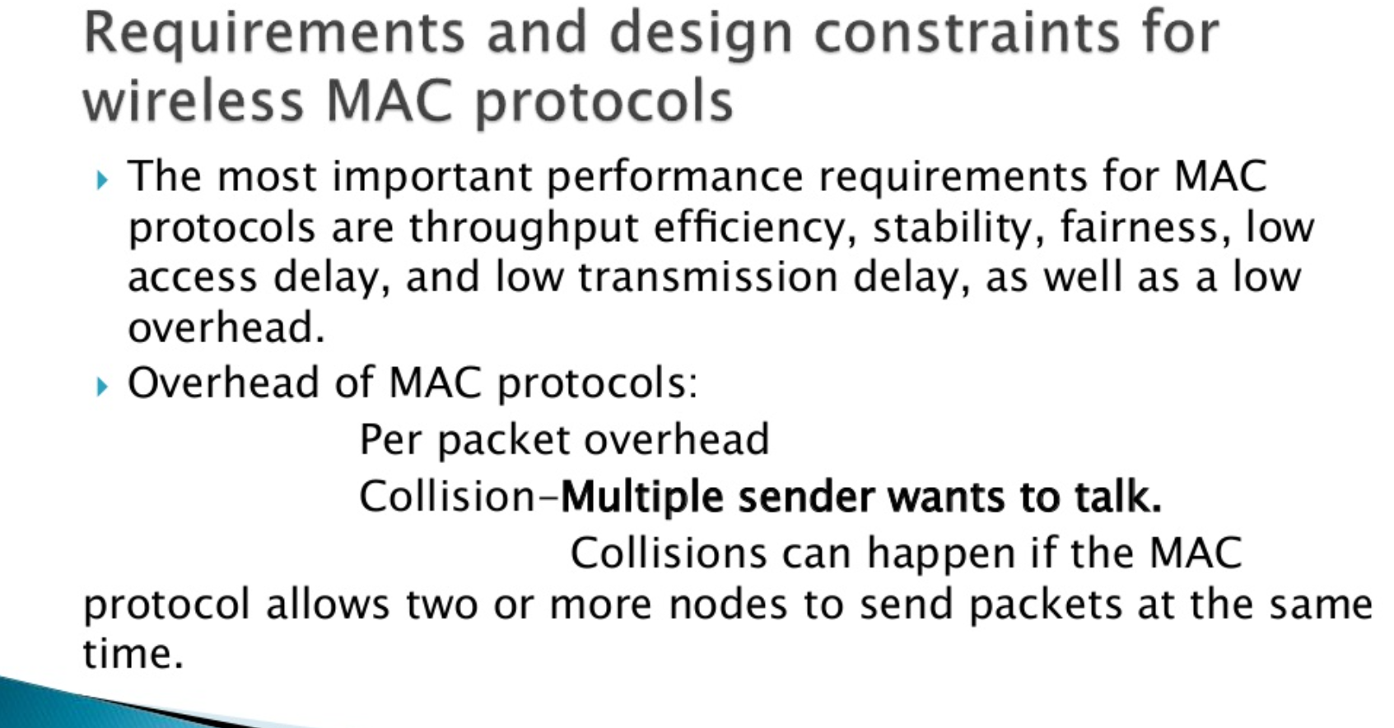

Slide 6
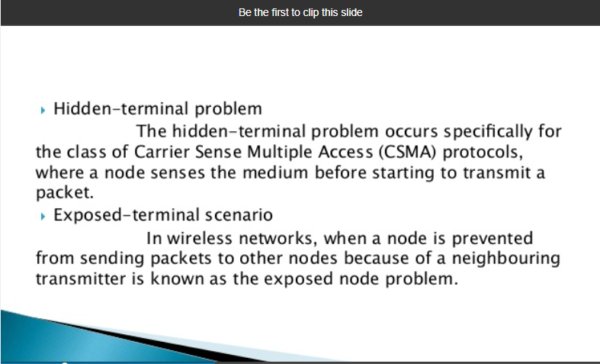

Slide 7
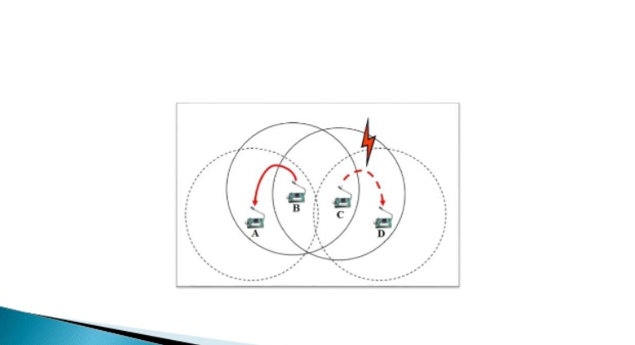

Slide 8
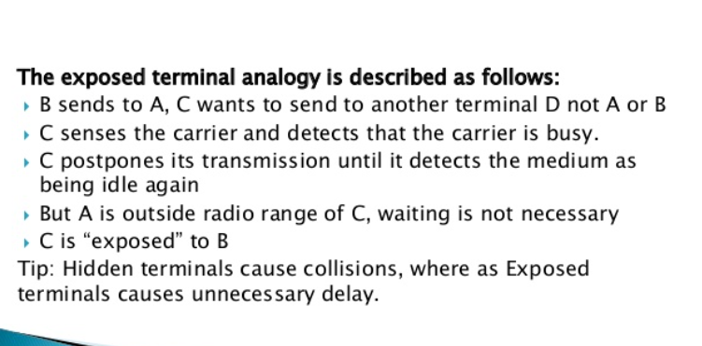

Slide 9
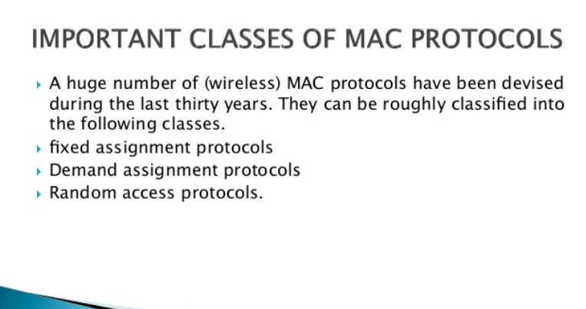

Slide 10
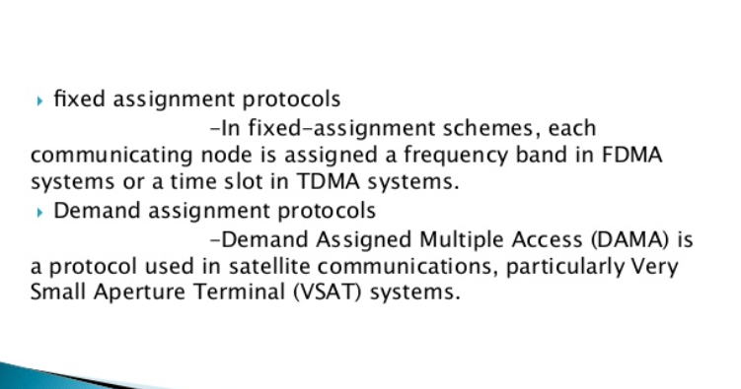

Slide 11
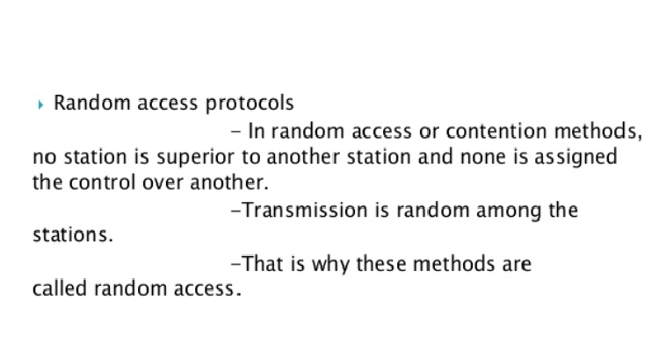

Slide 12
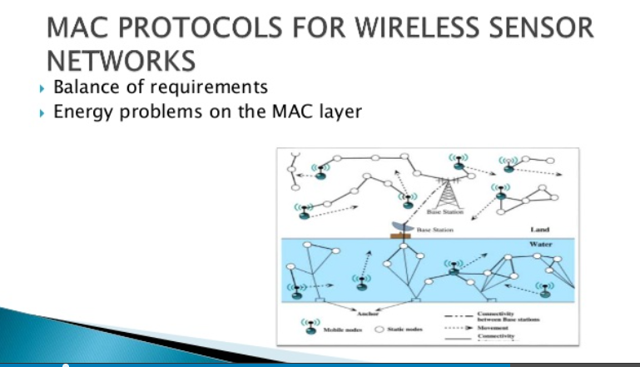

Slide 13
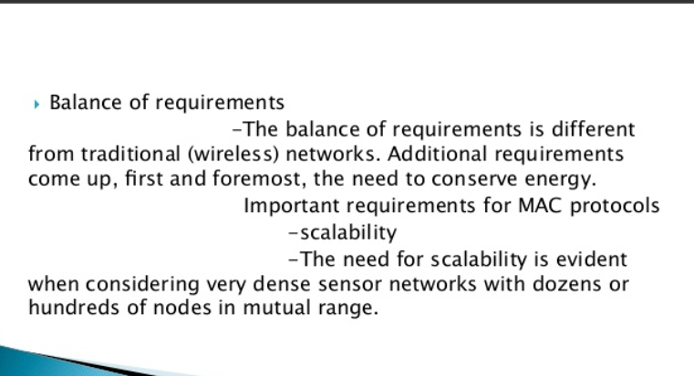

Slide 14
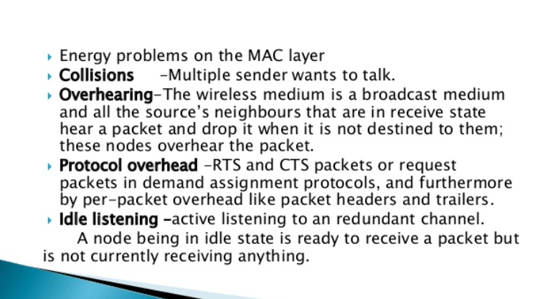

Slide 15
CSMA/CD MAC
CSMA/CD architecture used in Ethernet is a common MAC layer standard.
It acts as an interface between the Logical Link Control sublayer and the network's Physical layer.

Slide 16
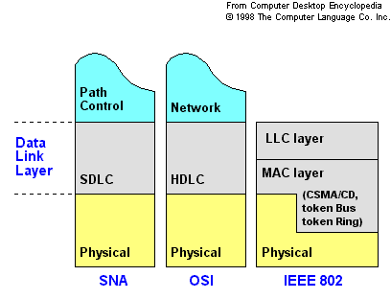

Slide 17
Normal Ethernet Operation
B
C
Address mismatch
packet discarded
Address mismatch
packet discarded
Send data
to node D
Address match
packet processed
Transmitted packet seen
by all stations on the LAN
(broadcast medium)
A
D
Data
Notes:
Normal Ethernet Operation
Node A needs to transmit data to Node D.
Node A builds a packet.
Node A checks to see if the cable plant is clear (no one else is currently transmitting).
Node A transmits the packet while listening to the cable.
If there were no collisions, node A returns to listen mode.
Another station wishing to transmit should detect the cable plant is busy when node A is transmitting and enter into defer mode.
That station will try again later.
There is no priority scheme used with Ethernet.
All stations have equal access to the cable plant.
An Ethernet station is allowed to transmit a packet as small as 64 bytes, as large as 1518 bytes (18 bytes of MAC header or trailer information) or any size in between.

Slide 18
Ethernet Collisions
B
C
Data transmission for A
Collision
Data transmission for C
A
D
Notes:
Ethernet Collisions
Node A needs to transmit data to Node D.
Node A builds a packet.
Checks to see if the cable plant is clear (no one else is currently transmitting).
Transmits packet while listening to the cable.
Before Node A’s transmission reaches node C, node C accomplishes the above steps and also starts to transmit.
There is a collision on the cable plant caused by node A and C.
All stations invoke the backoff algorithm.
This deference should allow the cable plant to stabilize.
When the cable is clear, it will be available for any station to transmit.
No special treatment is given to the stations that were involved in the collision.
It is the hope of the backoff algorithm that no two controllers will generate the same two backoff times and attempt to simultaneously transmit.
Even if they do, it is not a fatal error.
Each controller’s backoff algorithm will generate a longer backoff with each successive collision.

Slide 19

Ethernet Transmission Flowchart
transmit packet
assemble packet
deferring
on?
yes
no
start
transmission
send jam signal
transmission
done
?
no
collision
detect?
yes
increment attempts
yes
too many
attempts
?
yes
no
done
transmit ok
done excessive
collision errors
compute and wait
backoff time

Slide 20
Interference / Collisions
Packets which suffered collisions should be re-sent.
Ideally, we would want all packets to be sent collision-free, only once…
a
b
a and b interfere and hear noise only
b
b
a
c
a
c
d
Interference on node b
(“Hidden terminal problem”)
Interference on node b

Slide 21
MACA Protocol
Contention-based protocols
  CSMA — Carrier Sense Multiple Access
    Ethernet (CSMA/CD) is not enough for wireless (collision at receiver cannot detect at sender)
A
B
C
Hidden terminal: A is hidden from C’s CS

Slide 22
Hidden Terminal Problem
Data
Data
A
B
C
  A and C want to send data to B
  A senses medium idle and sends data
  C senses medium idle and sends data
  Collision occurs at B

Slide 23
Collision Avoidance w/ RTS/CTS
1.RTS
2.CTS
2.CTS
A
3.Data
B
C
  A and C want to send to B
  A sends RTS (Request To Send) to B
  B sends CTS (Clear To Send) to A
  C “overhears” CTS from B
  C waits for duration of A’s transmission

Slide 24
Overview of MAC Protocols
Contention-based protocols (contd.)
  MACAW — improved over MACA
    RTS/CTS/DATA/ACK
    Fast error recovery at link layer
  IEEE 802.11 Distributed Coordination Function (DCF)
    Largely based on MACAW
    Called CSMA/CA

Slide 25
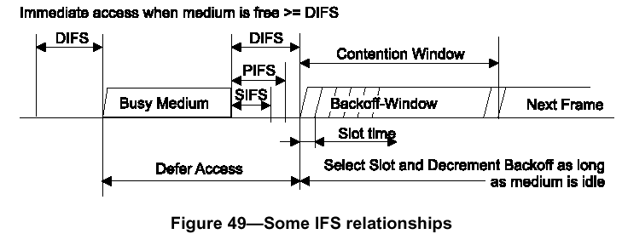
802.11 DCF (Distributed Coordinate Function)
Station listens before transmission
If medium is free for more than DIFS: transmits
Otherwise, uses exponential backoff mechanism

Slide 26
Interframe space (IFS)
SIFS : used by ACK, CTS, poll response
(short)
PIFS : used by PC (point coordinator) when issuing polls
(point)
DIFS : used by ordinary asynchronous traffic
(distributed)
Notes:
SIFS - 16 µsec. Slot Time - 9 µsec. AIFS[0] = (2 * 9) + 16 = 34 µsec = DIFS. AIFS[1] = (4 * 9) + 16 = 52 µsec → (52 – 34) / 9 = 18/9 = 2 Slots ...
slot: 9us. SIFS: 16us. PIFS: 25us. DIFS: 34us. AIFS: >=34us.
SIFS : Short Interframe Space. – PIFS : PCF Interframe Space. – DIFS : DCF Interframe Space. – AIFS : Arbitration Interframe Space (used for QoS)
AIFS = SIFS + AIFSN * aSlotTime.
AIFS[0] = PIFS + 1 µs; AIFS[1] = PIFS + 5µs; AIFS[2] = DIFS; therefore, AIFS[0] < AIFS[1] < AIFS[2]; where PIFS = SIFS + SLOT = 25 µs and DIFS =SIFS + 2*SLOT = 34 µs.

Slide 27
IEEE 802.11 DCF
Distributed coordinate function: ad hoc mode
  Virtual and physical carrier sense (CS)
    Network allocation vector (NAV), duration field
  Binary exponential backoff
  RTS/CTS/DATA/ACK for unicast packets
  Broadcast packets are directly sent after CS

Slide 28
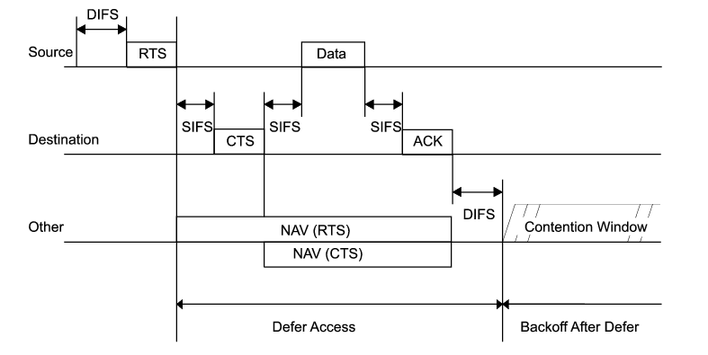
Virtual Carrier Sense
Timing relationship

Slide 29
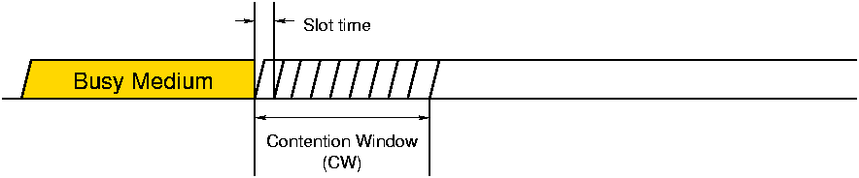
Random Backoff
Time
Pick a timeslot chosen uniformly in [0, CW]
Listen up to chosen slot
  Transmit if nobody else started transmitting
  Wait if somebody else started transmitting
Notes:
In CSMA, each node picks a timeslot uniformly at random in the contention window.
This means that every slot has an equal chance of being chosen by a node.
However, if someone else starts transmitting before your chosen slot, you need to remain quiet.
Therefore…

Slide 30
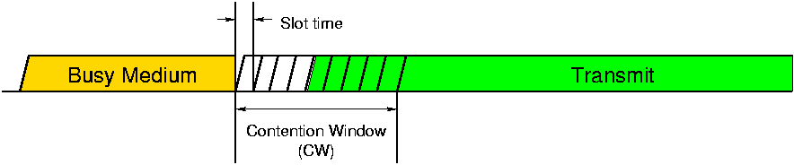
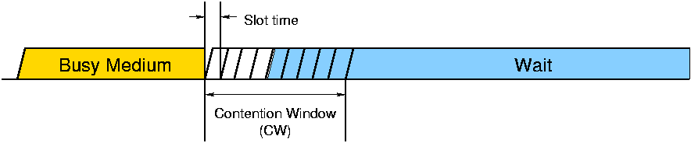
Example: A Successful Transmission
A and B happened to choose different slots
  Node A chooses slot 4, hears nothing, transmits
  Node B chooses slot 8, hears Node A, waits
Slot choice (slot #4)
Node A:
Slot choice (slot #8)
Node B:
Time
Success: exactly one node in first non-vacant slot
Notes:
Now let’s look at how this works in practice.
B hears A’s transmission, so when B’s chosen slot comes, it continues to wait.

Slide 31
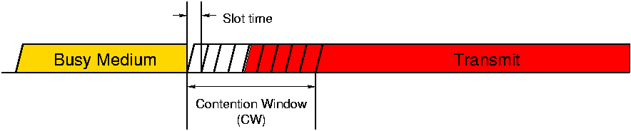
Example: A Collision
A and B happened to choose slot 4
  Both listen and hear nothing
  Both transmit simultaneously
Node A:
Slot choice (slot #4)
Time
Node B:
Slot choice (slot #4)
Collision: ≥ 2 nodes in first non-vacant slot

Slide 32
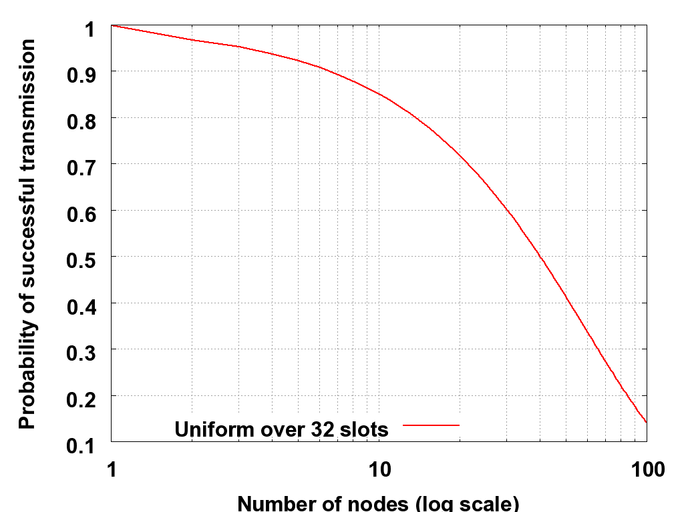
High Contention Causes Collisions in CSMA
Unacceptable collision rate above
~15 transmitting sensors
Uniform distribution “fills up,” quickly

Slide 33
Binary Exponential Backoff (BEB)
Creating more slots for solving the collision problem

Slide 34
Problems with BEB
Takes time for every node to increase CW
  Especially if traffic is spatially-correlated and bursty
Waste backoff slots if collisions cause CW to increase
BEB causes performance to suffer

Slide 35
Q&A

