Slide 1

Car Sales Dashboard
Tool: Power BI
Dataset: Car Sales CSV
Created by: Yash Patel

Slide 2

Project Objective
To create an interactive dashboard for analyzing car sales data.
Understand sales trends across time, customer demographics, and car specifications.

Slide 3

KPIs Used
• Total Sales (Sum of Price)
• Average Car Price
• Sale Quantity (Distinct Count of Car ID)
• Monthly Sales Trend
• Model-wise Performance
• Regional Sales Distribution

Slide 4

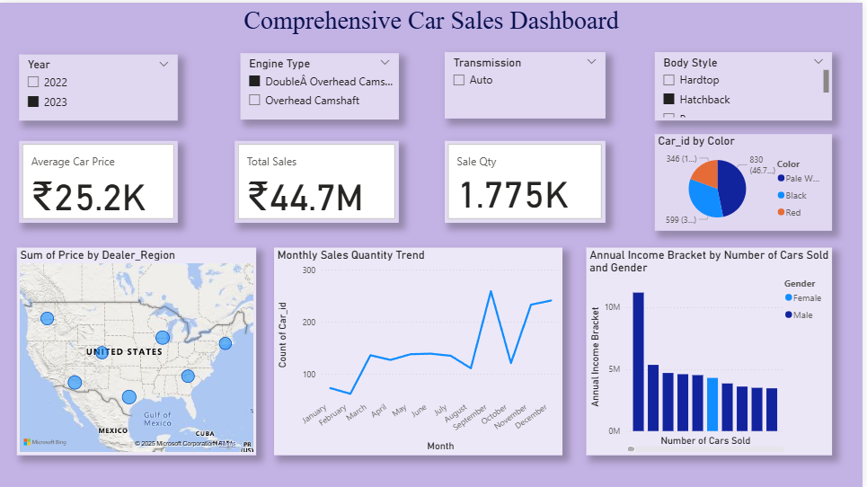
Dashboard Screenshot

Slide 5

Key Insights
📈 Highest Sales Month: [e.g., september]
🚗 Top Selling Model: [e.g., Toyota]
📍 Highest Revenue Region: [e.g., southern and eastern U.S.]
⚠️ Lowest Profit Segment: [e.g., Luxury ]

Slide 6
Recommendations
• Focus marketing on high-performing regions and car models.
• Investigate reasons behind low-margin vehicle categories.
• Expand availability of top-selling cars to more regions.

Slide 7
Features Used in Power BI
• Visuals: Line, Bar, Card, Pie, Map, Slicer
• Slicers for Date, Gender, Engine Type, etc.
• Clean formatting and color theme for clarity
• Interactive filters and KPI cards

