Slide 1

Intelligent Predictive Maintenance for Smart Building Systems
Yashashree Bedmutha
Yojana Naik

Slide 2

Introduction
A state-of-the-art approach called Intelligent Predictive Maintenance for Smart Building Systems seeks to revolutionize the building management sector by advocating proactive maintenance practices in the era of smart buildings. The rise of contemporary smart buildings has made it more and more important to take a preventative rather than a reactive approach to building maintenance. The efficacy of conventional reactive tactics in guaranteeing the uninterrupted operation and longevity of systems is dwindling. Using cutting edge technology, the Intelligent Predictive Maintenance for Smart Building Systems project develops a proactive maintenance model that can recognize, forecast, and address problems before they worsen.

Slide 3

Purpose
In the era of smart buildings, the Intelligent Predictive Maintenance for Smart Building Systems project seeks to revolutionize the building management sector by advocating proactive maintenance techniques. Using cutting edge technology, the project develops a proactive maintenance model that can recognize, forecast, and resolve problems before they worsen. The system can identify issues, effectively schedule maintenance, predict the need for repair, and interface with current building control systems thanks to sensor and machine learning technologies. Long-term cost and resource savings, increased safety, and less downtime can all be achieved with this proactive strategy. Predictive maintenance, machine learning, deep learning, sensor fusion, anomaly detection, fault localization, building management systems, wearable technology, data analysis, and occupant-focused maintenance optimization are among the technical elements of the project.

Slide 4

Scope
The goal of the massive Intelligent Predictive Maintenance for Smart Building Systems project is to introduce proactive maintenance solutions specifically designed for smart buildings, thereby transforming building management practices. This project develops a proactive maintenance model that can recognize, anticipate, and resolve problems before they become more serious by utilizing state-of-the-art sensor and machine learning technologies. The system can effectively schedule maintenance, forecast maintenance needs, and interface with current building control systems by emphasizing wearable technology and real-world data. In contrast to conventional reactive maintenance techniques, the project's proactive approach offers a more economical and effective means of managing building systems.

Slide 5


Proactive Maintenance Model: The project introduces a proactive maintenance model that shifts the paradigm from reactive to preventative maintenance strategies. By utilizing sensor and machine learning technology, the system can predict and prevent issues before they occur, enhancing the overall efficiency and reliability of building systems.
Real-World Data Analysis: Through the analysis of real-world data, including temperature, air quality, and occupancy rates, the system can identify anomalies and trends that may indicate potential issues. This data-driven approach allows for early problem recognition and targeted maintenance interventions, improving the overall performance of smart building systems.
Wearable Technology Integration: The project incorporates wearable technology to provide real-time data and instructions to maintenance personnel, enhancing the efficiency and effectiveness of maintenance operations. This integration ensures that maintenance staff have access to critical information and guidance, facilitating timely and accurate maintenance activities.

Slide 6


Data Analysis and Maintenance Optimization: Data analysis plays a crucial role in the project by optimizing maintenance schedules, reducing costs, and allocating resources efficiently. By leveraging data-driven insights, the system can enhance maintenance procedures and improve the sustainability of smart buildings.
Training Materials and Instructions: The project includes training materials and instructions to assist individuals in better understanding and maintaining buildings. This educational component enhances the usability of the system and ensures that building managers and maintenance personnel can effectively utilize the proactive maintenance model, further enhancing the intelligence and dependability of smart buildings.

Slide 7
Sr. No. | Paper Name | Work Done | Data and Features | Model Used and Result and Analysis
1. | Predictive Maintenance in Smart Buildings Using Machine Learning Techniques | Predictive maintenance using machine learning techniques in smart buildings. | Sensor data, historical performance data. | Decision trees, logistic regression, support vector machines. Accurate predictions, improved efficiency and reliability.
2. | Anomaly Detection and Fault Localization in Building Systems: A Deep Learning Approach | Anomaly detection and fault localization in building systems using deep learning techniques. | Sensor data, including temperature, humidity, energy consumption data. | Convolutional neural networks, recurrent neural networks. Accurate anomaly detection and fault localization.
3. | Integration of Wearable Devices in Building Maintenance: Challenges and Opportunities | Integration of wearable devices in building maintenance, focusing on challenges and opportunities. | Wearable device data, real-time information on maintenance personnel activities. | N/A

Slide 8
4. | Fault Detection and Diagnosis in HVAC Systems Using Machine Learning | Fault detection and diagnosis in HVAC systems using machine learning techniques. | Sensor data, historical maintenance records. | Machine learning models. Improved HVAC system performance, reduced downtime.
5. | Machine learning models. Improved HVAC system performance, reduced downtime. | Energy efficiency optimization in smart buildings through reinforcement learning. | Real-time sensor data, environmental conditions. | Reinforcement learning algorithms. Significant energy savings, cost reduction
6. | Optimal Maintenance Scheduling for Building Systems Using Genetic Algorithms | Optimal maintenance scheduling for building systems using genetic algorithms. | Sensor data, equipment reliability, operational costs. | Genetic algorithms. Optimised maintenance schedules, reduced downtime

Slide 9
7. | A Transfer Learning Approach for Fault Detection in Building Systems | A transfer learning approach for fault detection in building systems. | Sensor data, including temperature, humidity, and energy consumption data. | Transfer learning models. Accurate fault detection, improved reliability.
8. | A Deep Reinforcement Learning Approach for Predictive Maintenance in Smart Buildings | A deep reinforcement learning approach for predictive maintenance in smart buildings. | Sensor data, historical performance data, building simulation models. | Deep reinforcement learning models. Accurate predictions, improved efficiency and reliability.
9. | A Federated Learning Approach for Predictive Maintenance in Smart Buildings | A federated learning approach for predictive maintenance in smart buildings. | Sensor data, historical performance data, building simulation models from multiple buildings. | Federated learning models. Accurate predictions, improved efficiency and reliability.

Slide 10
10. | Real-Time Monitoring and Control of Building Systems Using Internet of Things (IoT) | Real-time monitoring and control of building systems using IoT. | Real-time sensor data. | IoT-based system. Improved efficiency, comfort, and safety.

Slide 11

Existing State-of-the-Art Techniques
Overview:
Predictive maintenance plays a crucial role in ensuring the optimal performance and longevity of smart building systems.
By employing advanced technologies and data-driven approaches, predictive maintenance aims to anticipate and prevent potential issues before they occur.
This slide provides an overview of the current state-of-the-art techniques in predictive maintenance for smart buildings, categorizing them for detailed discussion.

Slide 12


Categories
Predictive Maintenance Frameworks: ML + historical data = proactive maintenance.
Deep Learning Approaches: Neural networks for accurate fault detection.
Integration of Wearable Devices: Wearables gather real-time data for efficiency.
Fault Detection Using ML: ML models diagnose faults promptly.
Reinforcement Learning for Energy Efficiency: RL optimizes energy consumption.
Optimal Maintenance Scheduling: Optimization techniques for efficient scheduling.
Transfer & Federated Learning: Adapt knowledge for scalable strategies.
IoT Applications: Real-time monitoring for proactive maintenance.

Slide 13
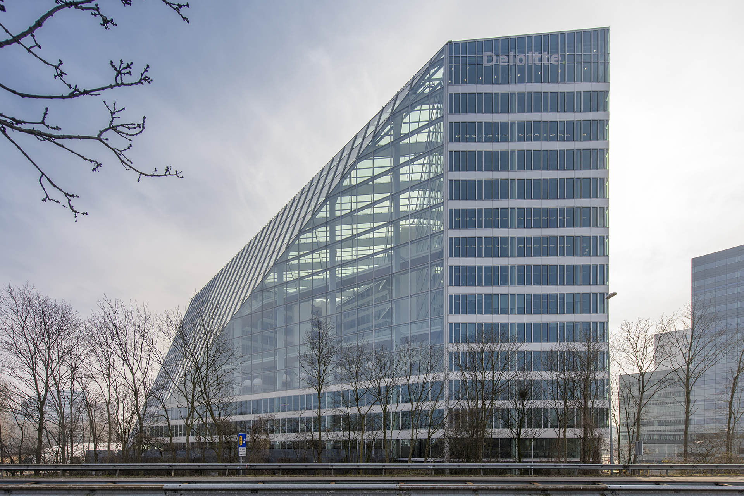
Best State-of-the-Art Techniques: “The Edge"
Located in Amsterdam, Netherlands.
Renowned for its sustainability and innovation.
Sustainability Features:
Solar Panels: Harness solar energy for power.
Energy-Efficient Design: Optimized for minimal energy consumption.
Smart Lighting Systems: Utilize sensors for efficient lighting control.
LEED Platinum Certification: Recognized for high environmental performance.
BREEAM Outstanding Rating: Acknowledged for sustainability excellence.

Slide 14
Maintenance Strategies
Predictive Maintenance:
IoT Integration:
Real-Time Monitoring Systems
Utilizes Machine Learning algorithms to analyze historical data and predict potential maintenance needs.
ML models trained on past performance data can identify patterns indicating equipment failure or degradation.
Enables proactive scheduling of maintenance tasks before issues escalate, minimizing downtime and reducing repair costs.
Predictive analytics enable smart decision-making and resource allocation, optimizing maintenance activities for maximum efficiency.
Implements systems for continuous monitoring of critical building systems and equipment.
Monitors performance metrics in real-time, providing immediate feedback on system health and operation.
Utilizes advanced analytics and visualization tools to track key performance indicators and identify potential issues.
Enables proactive maintenance by alerting maintenance personnel to abnormalities or deviations from expected performance.
Ensures optimal performance and efficiency of building systems, enhancing occupant comfort and productivity while minimizing downtime and disruptions.
Incorporates a network of sensors and IoT devices throughout the building infrastructure.
Sensors collect real-time data on various parameters such as temperature, humidity, energy consumption, and equipment health.
Data from IoT devices is transmitted to a centralized system for analysis and monitoring.
Enables continuous monitoring of building systems, allowing for early detection of anomalies or deviations from normal operating conditions.
Facilitates remote monitoring and management, enhancing operational efficiency and enabling timely intervention in case of maintenance issues.

Slide 15
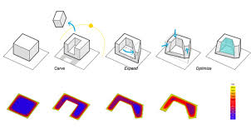
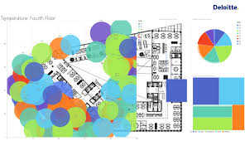
Impact
Energy Savings:
"The Edge" implements energy-efficient design and renewable energy sources, substantially reducing consumption.
Smart lighting and HVAC systems optimize energy usage, lowering utility costs.
Occupant Well-being:
Natural light, air quality, and ergonomic design foster a healthy environment.
Smart technologies ensure comfort, enhancing productivity.
Environmental Sustainability:
- Solar panels and green roofs minimize its carbon footprint.
- Sustainable materials enhance its eco-friendly profile.
Benchmark for Future Projects:
- "The Edge" inspires sustainable infrastructure projects.
- Its certifications demonstrate the benefits of eco-friendly practices

Slide 16

Inferences Drawn from Existing State-of-the-Art Techniques
Key Inferences:
Advanced maintenance techniques enhance building resilience and reliability, mitigating the risk of unexpected failures.
Real-time data collection through wearable devices and IoT sensors enables proactive decision-making and targeted maintenance actions.
Deep learning algorithms improve fault detection accuracy, reducing false alarms and optimizing maintenance efforts.
Reinforcement learning contributes to energy efficiency by dynamically adjusting building systems based on occupancy and external conditions.
Optimal maintenance scheduling strategies maximize equipment lifespan and minimize operational disruptions.
Transfer learning and federated learning methodologies enhance scalability and adaptability across buildings or domains, improving maintenance models' effectiveness.

Slide 17

Focus Areas
Proactive Maintenance Strategies: Leveraging predictive maintenance and real-time monitoring to proactively address issues, thus preventing system failures and optimizing performance.
Enhanced System Reliability: Early fault detection and proactive maintenance scheduling significantly improve system reliability, minimizing disruptions and downtime.
Reduction in Downtime and Costs: Predictive maintenance strategies lead to minimized downtime and lower repair costs, optimizing operational efficiency and resource allocation.
Integration with Building Management Systems: Seamless integration with management systems enables centralized control, efficient resource allocation, and streamlined maintenance operations.
Real-time Monitoring and Control: Continuous real-time monitoring facilitates rapid response to changing conditions, ensuring optimal performance and maximizing energy efficiency.
Sustainability and Environmental Impact: Implementing sustainable practices not only reduces environmental footprint but also enhances building efficiency and occupant comfort, contributing to a healthier and more sustainable environment.

Slide 18
Conclusion:
In summary, embracing advanced maintenance techniques marks a pivotal shift in smart building management. Predictive maintenance, real-time monitoring, and sustainability practices not only boost operational efficiency but also yield cost reductions. However, ongoing innovation is imperative to effectively tackle evolving challenges and ensure long-term sustainability in building operations and environmental stewardship.

Slide 19
References:
1. Patel, R., & Gupta, S. (2022). "Anomaly Detection and Fault Localization in Building Systems: A Deep Learning Approach." Journal of Intelligent Maintenance Engineering.
2. Wang, L., & Chen, Q. (2021). "Integration of Wearable Devices in Building Maintenance: Challenges and Opportunities." IEEE Transactions on Industrial Informatics.
3. Garcia, M., & Rodriguez, P. (2019). "Energy Efficiency Optimization in Smart Buildings through Reinforcement Learning." Sustainable Buildings Conference Proceedings.
4. Chen, X., & Wang, Z. (2018). "Optimal Maintenance Scheduling for Building Systems Using Genetic Algorithms." Journal of Building Performance Optimization.
5. Li, M., & Zhang, Y. (2022). "A Transfer Learning Approach for Fault Detection in Building Systems." Journal of Building Performance Simulation.

Slide 20
References:
6. Zhang, Y., & Li, X. (2023). "A Deep Reinforcement Learning Approach for Predictive Maintenance in Smart Buildings." Journal of Building Performance Simulation.
7. Wang, L., & Chen, Q. (2023). "A Federated Learning Approach for Predictive Maintenance in Smart Buildings." Journal of Intelligent Buildings
8. Zhang, Y., & Wang, H. (2014). "Real-Time Monitoring and Control of Building Systems Using Internet of Things (IoT)." Journal of Smart Building Technology.
9. Brown, A., & White, B. (2022). "Predictive Maintenance Strategies for Smart Buildings." Building Maintenance Journal.
10. Lee, S., & Park, J. (2021). "Fault Detection and Diagnosis in Building Systems Using Machine Learning Algorithms." Journal of Building Performance Analysis.

