Slide 1



E-commerce Sales Dashboard Analysis
This presentation offers a comprehensive analysis of e-commerce sales, profit, and trends, providing actionable insights for business stakeholders and product/marketing managers.

Slide 2



Understanding Our Data Landscape
Data Sources
Key Metrics
Tools Utilized
Leveraging critical information from raw_original.csv and Ecommerce_Clean.xlsx datasets.
Focusing on core indicators: Sales, Profit, and Quantity to gauge performance.
Analysis powered by Excel for data preparation and Power BI for dynamic visualization.

Slide 3
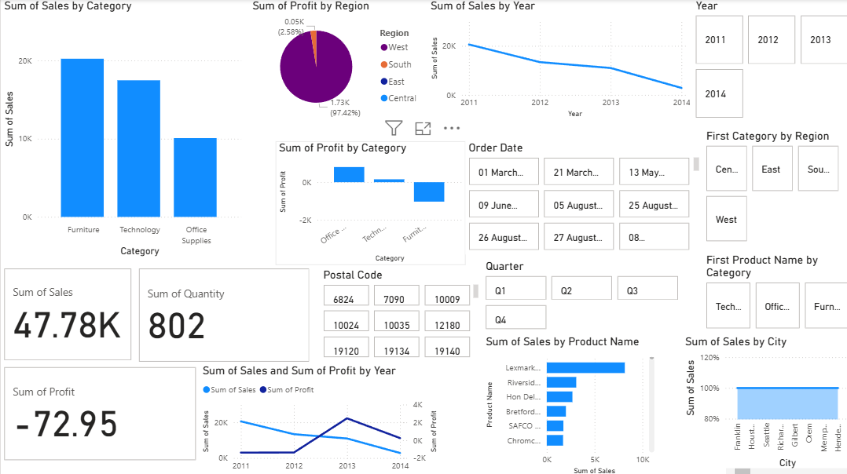
Dashboard at a Glance: Key Visualizations
Our interactive dashboard provides a holistic view of e-commerce performance. Here’s a snapshot of the key sections:
Sales by Category
Illustrates revenue distribution across different product categories.
Highlights top-performing and underperforming segments.
Profit by Region
Visualizes profitability across geographical regions.
Identifies regions contributing most to the bottom line.
Sales & Profit Trends
Tracks historical performance to identify growth or decline patterns.
Essential for forecasting and strategic planning.

Slide 4
Key Insights and Critical Learnings
Our analysis reveals compelling patterns and areas requiring immediate attention:
Category Performance
Regional Profitability
Sales Trend Alarms
Furniture consistently dominates sales, showing strong market presence. Technology products also contribute significantly to revenue. However, Office Supplies are consistently lagging, indicating a need for strategic intervention
The West region stands out as highly profitable, driving a significant portion of our overall profit. Other regions show potential but require focused attention and tailored strategies to boost their profitability and reach similar levels of success.
A critical concern is the consistent decline in overall sales from 2011 to 2014. This trend necessitates urgent intervention, deeper root cause analysis, and a prompt shift in our sales and marketing strategies to reverse.

Slide 5

Strategic Recommendations: Driving Future Growth
Strategic City-Wise Expansion
Revitalize Low-Profit Categories
Amplify High Performers
Identify high-potential cities within underperforming regions for targeted expansion. This micro-market approach can drive localized growth and improve overall regional contribution.
Concentrate resources on high-performing regions (e.g., West) and product categories (e.g., Furniture, Technology) to maximize existing strengths and capitalize on proven success.
Implement targeted initiatives for low-profit categories like Office Supplies. This could include price adjustments, enhanced marketing campaigns, product bundle offers, or a review of sourcing costs to improve margins.

Slide 6
Action Plan: Phase I - Immediate Implementation
Q4 2014
Deep Dive into Sales Decline
Identify precise factors contributing to sales drop, inform corrective measures.
Q1 2015
Regional Marketing Boost
Increase sales & profit in East, Central, and South regions by 10%.
Q2 2015
Office Supplies Product Revamp
Improve profitability of Office Supplies by 5% through product optimization.
This initial phase focuses on immediate interventions to address critical areas and set the groundwork for sustained growth.

Slide 7





Looking Ahead: Sustainable Growth Strategy
Market Expansion
Product Innovation
Performance Review
Customer Retention
Beyond immediate actions, our long-term strategy focuses on three pillars to ensure sustainable growth and market leadership.

Slide 8
Key Takeaways & Next Steps
Data-Driven Decisions: Leverage the dashboard for continuous monitoring and informed strategic adjustments.
Targeted Interventions: Prioritize addressing declining sales trends and improving low-profit categories.
Strategic Expansion: Explore focused city-wise growth to unlock new revenue streams.
Collaborate for Success: Product, Marketing, and Sales teams must align to execute these strategies effectively.
"Data is not about numbers; it's about making better decisions for a thriving business."

Slide 9
THANK YOU

