Slide 1
UBER
YASH PATEL

Slide 2
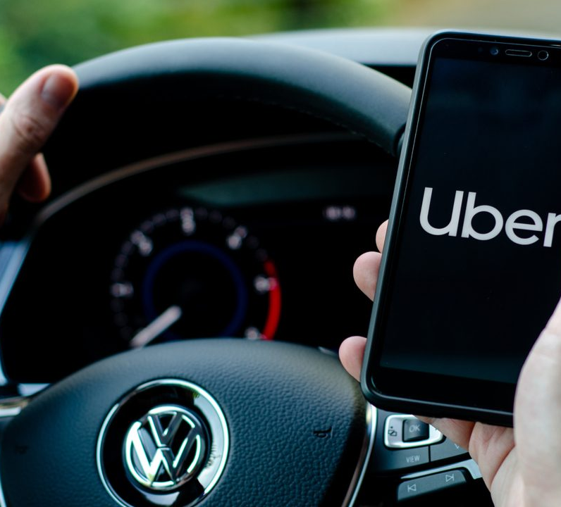
INTRODUCTION
Uber is a technological platform that has revolutionized urban transportation and has given taxi drivers and cab companies a lot of headaches. In short, it is an app that connects drivers to users who need a ride, using a smartphone as a tool.

Slide 3


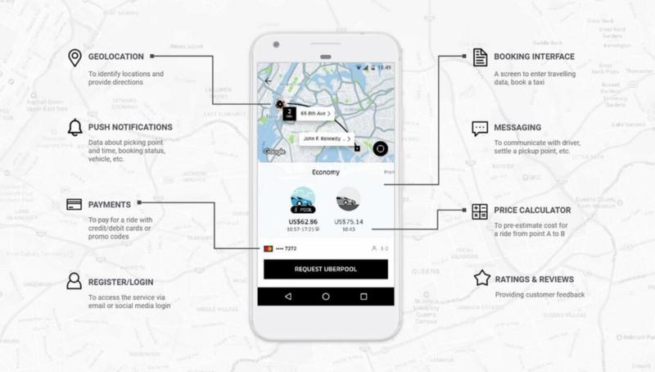




Slide 4
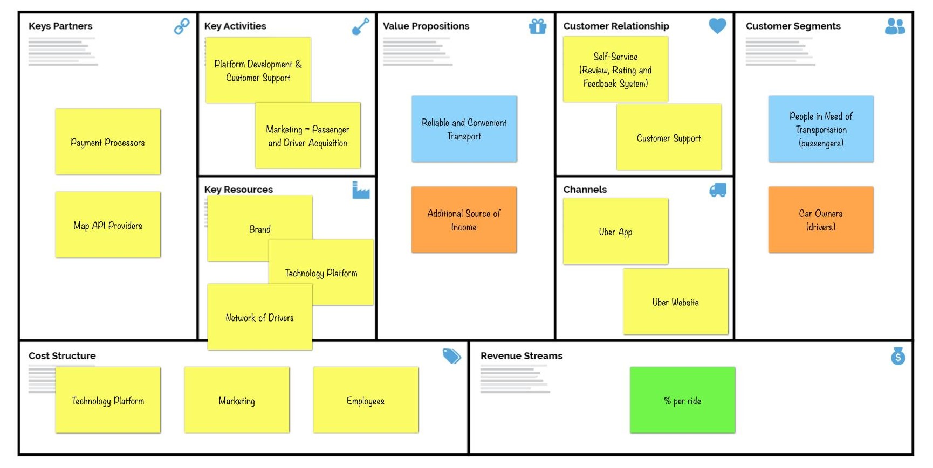

Slide 5
FEASIBILITY ANALYSIS
Technical
Economical
Organizational

Slide 6
Technical Feasibility
Current Scenario, User Familiarity with the software
New Development Compatibility
Database Software
Technical Expertise

Slide 7
Economic Feasibility
Understanding target market and competition
Projection of current and future revenues
Asset Utilization

Slide 8
Organizational Feasibility
Operational and Scheduling
Improved decision making
Business Experts
Management

Slide 9
INCLUSIONS & EXCLUSIONS
Must have:
Critical thinking to design application
Prepare all documents that will make good progress on the project
Should have:
Interactive Website
Mobile Application
Good Customer Services

Slide 10
PROJECT CHARTER & METHODOLOGY, PHASES

Slide 11
PROJECT CHARTER
Customer Segments
Value Propositions
Channels
Customer Relationships
Key Resources
Key Activities
Key Partners
Revenue Stream
Roles & Responsibilities

Slide 12
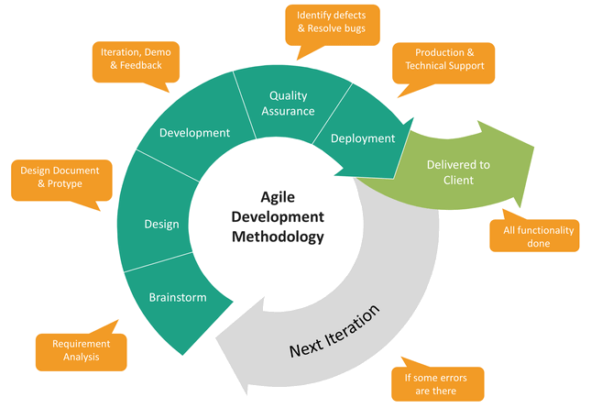
METHODOLOGY

Slide 13
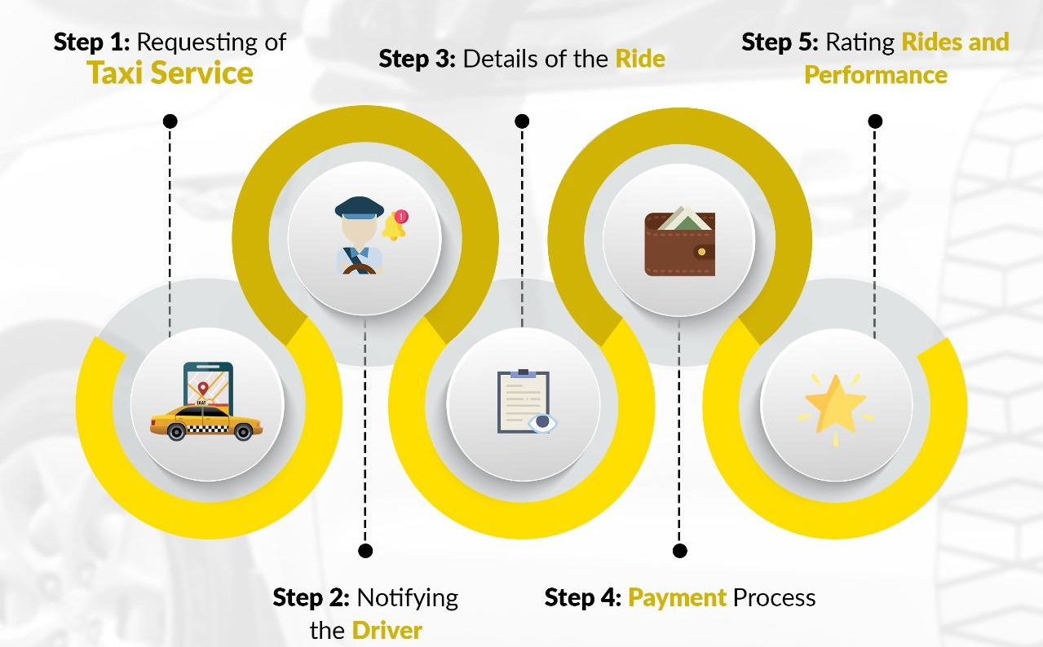

Slide 14
PURPOSE PHASES
Initiation: Feasibility Study, Stakeholder Engagement Plan
01
Planning: Project Milestones, Cost Management Plan
02
Execution: System Design, Development, Testing, Deployment
03
Monitoring & Control: Monitoring Project Progress, Incorporating the feedback from the client
04
Closeout: Prepare lessons learned report, Recommendations for future development
05

Slide 15
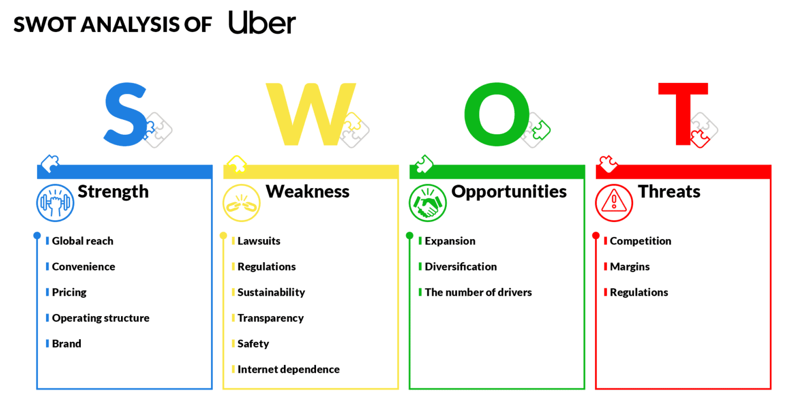
UBER'S SWOT ANALYSIS

Slide 16
STRENGTHS
Global reach: Uber is a worldwide company, making it the most recognizable brand in the industry, since it operates in 85 countries;
Convenience: Uber is accessible to anybody with an internet connection and a smartphone. The app is easy to use, offers interaction with the drivers, provides several payment methods, and is usually cheaper than regular taxis;
Pricing: The company uses multiple variables to determine the price of a trip, also bringing more advantages for the drivers;
Operating structure: Uber doesn’t have employees, which allows the company to invest much more back in the business and R&D;
Brand: Uber has the widest coverage in the industry, was the first one to be launched, and also had a lot of attention from the media.

Slide 17
WEAKNESSES
Lawsuits: Uber has been involved in many lawsuits which have been affecting its image and reputation;
Regulations: The company has a history of problems with governments regarding regulations and laws of the taxi industry;
Sustainability: Uber does not have internal policies to minimize the impact on the environment;
Transparency: As it is a private company, Uber does not need to open up its finances, but this lack of transparency puts in check whether they are investing in R&D or others;
Safety: Like any other transportation, Uber riders are subject to robbery, abuse, and other safety issues;
Internet dependence: It relies on the internet and smartphones to run, but the majority of emerging countries still face difficulties in those matters.

Slide 18
OPPORTUNITIES
Expansion: Uber has a huge opportunity to expand into new markets around the planet;
Diversification: The company has already added food delivery to its services, but it can still diversity its business and offers, especially niching down to categories of transportation, for example;
The number of drivers: Whether it is a result of an economic crisis or not, the company has been able to attract many drivers. This increases the offer for cars, which pleases the consumers, thus raising the number of regular users.

Slide 19
THREATS
Competition: The high level and rising number of rivals may jeopardize Uber’s expansion, thus making it difficult to grow as planned;
Margins: Uber keeps low rates that result in low margins. For example, it has an 80% market share in Brazil, but it is still unprofitable there;
Regulations: Governments may impose strict rules that can endanger Uber businesses in many countries.

Slide 20
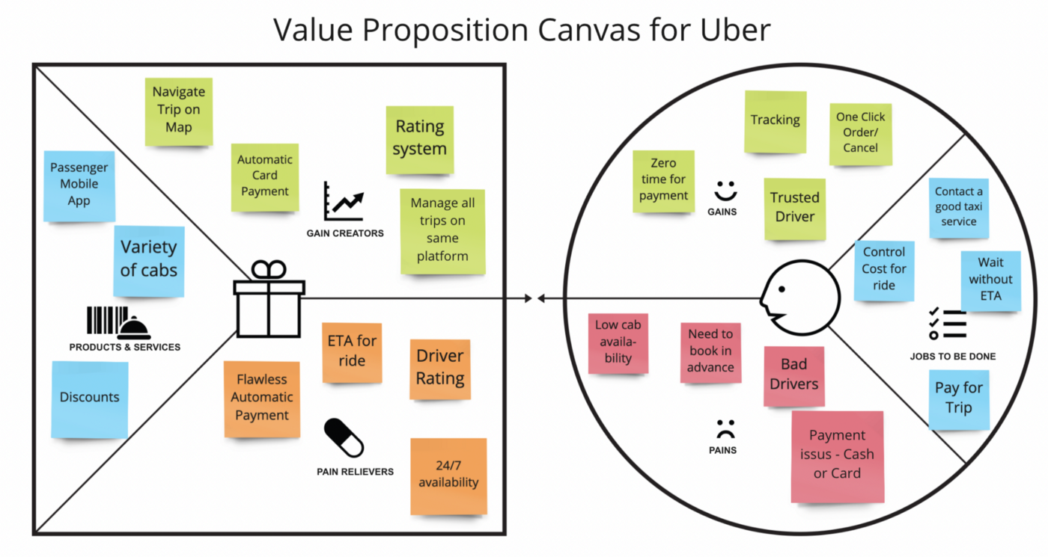
VALUE PROPOSITION

Slide 21
VALUE PROPOSITION FOR PASSENGERS
On-demand cab bookings (Convenient)
Real-time tracking
Accurate ETA's
Cashless rides
Lower wait time for a ride
Upfront pricing
Multiple ride options

Slide 22
VALUE PROPOSITONS FOR DRIVERS
Flexibility to drive on their own terms
Better income
Lower idle time to get new rides
Training sessions
Assistance in getting vehicle loans
Better trip allocation

Slide 23
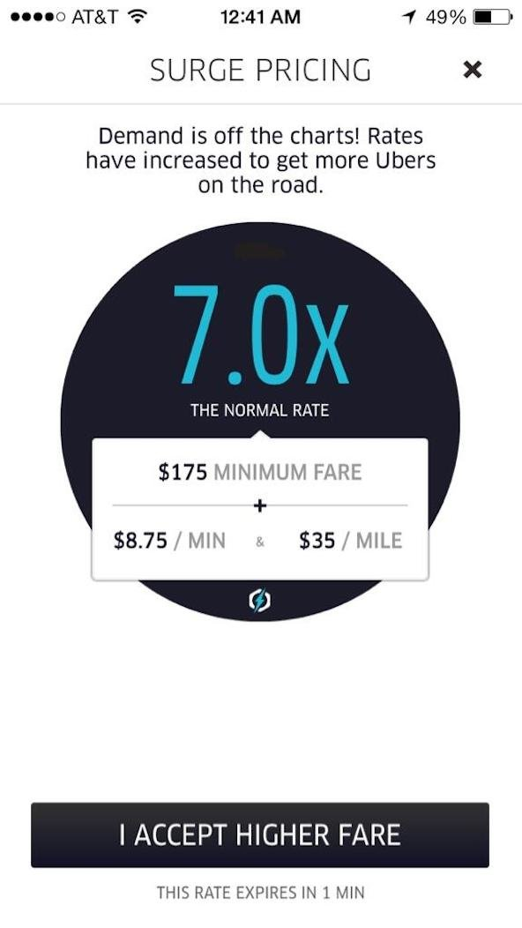
COST STRUCTURE
Surge Pricing:
Whenever there is a higher demand for cabs than what can be served at that moment (for example, at the airport after a flight lands), the fare goes up based on a surge price calculation algorithm.
Some drivers move to the surge region to earn extra (increases supply) and some passengers opt to wait to get a ride (reduces demand). This way Uber is able to manage the demand-supply mismatch situation better.

Slide 24
UBER KEY PARTNERS
Drivers
Riders
Investors
Map API providers

Slide 25
UBER KEY ACTIVITIES
Marketing
Sales promotions to acquire new customers
Communication with the driver, customers, and partners
Customer support

Slide 26
UBER KEY RESOURCES
Platform (app)
Network (Drivers & Riders)
Brand Image

Slide 27

RISK MANAGEMENT

Slide 28
RISK MANAGEMENT
Understand. Ensure your ability to offer foresight based upon an exceptional understanding of the business—it’s objectives, priorities, challenges, and market.
Gather. Collect and understand the internal and external information needed to get a clear picture of your business’s priorities and objectives.
Synthesize. Use all the information gathered to profile an area of risk, and identify the key risk indicators (KRIs) for assessing that risk.
Socialize. Hold regular conversations with stakeholders to ensure alignment.
Evaluate. Seek feedback throughout the process to ensure you’re baselining the right risks and data points.

Slide 29
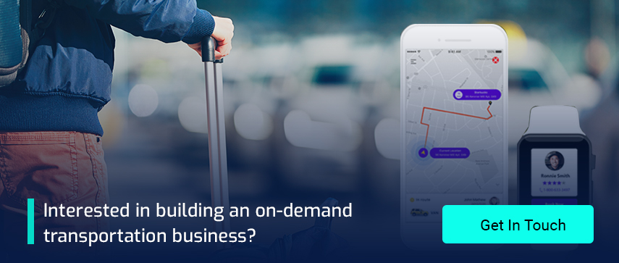

Slide 30
THANK YOU

