Slide 1
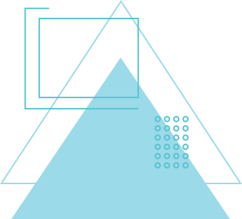
PROJECT PRESENTATION
THEME 1: TEAM COLLABORATION AND PROJECT MANAGEMENT PLATFORM
TEAM:- ALGOBYTES

Slide 2
THEME 1: TEAM COLLABORATION AND PROJECT MANAGEMENT PLATFORM
Design and develop a web-based platform to enable teams to effectively organize, track, and manage their tasks and projects. The platform should focus on:
Improving team collaboration
Increasing productivity
Providing real-time updates on project progress

Slide 3
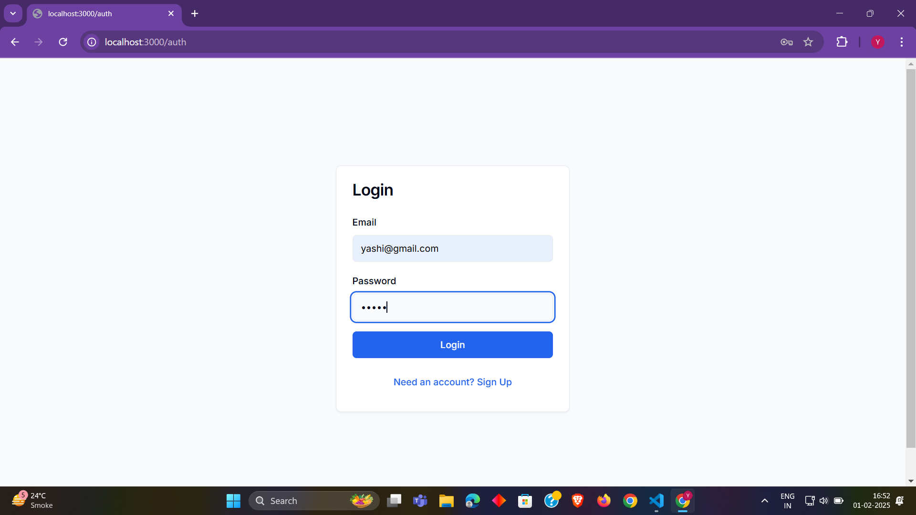
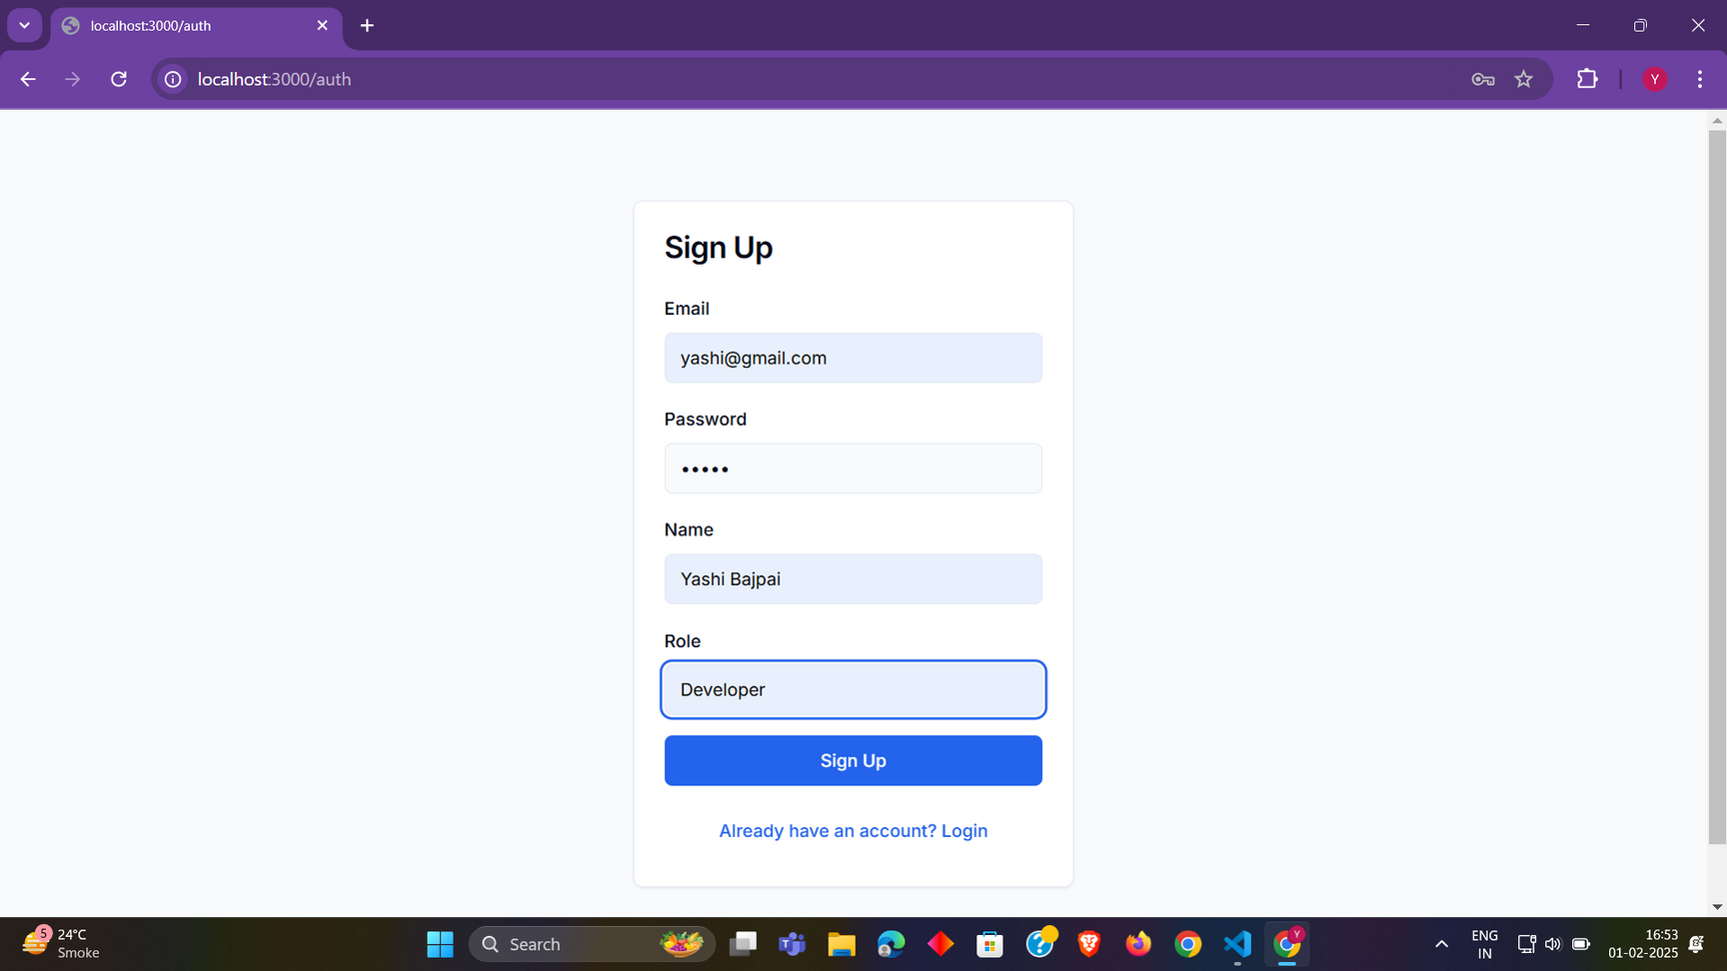
LOGIN/SIGNUP PAGE
Secure Authentication: Login/signup with secure authentication.
User-Friendly Interface: Simple, intuitive account creation and login.
Session Management: Secure access to personalized dashboards.

Slide 4
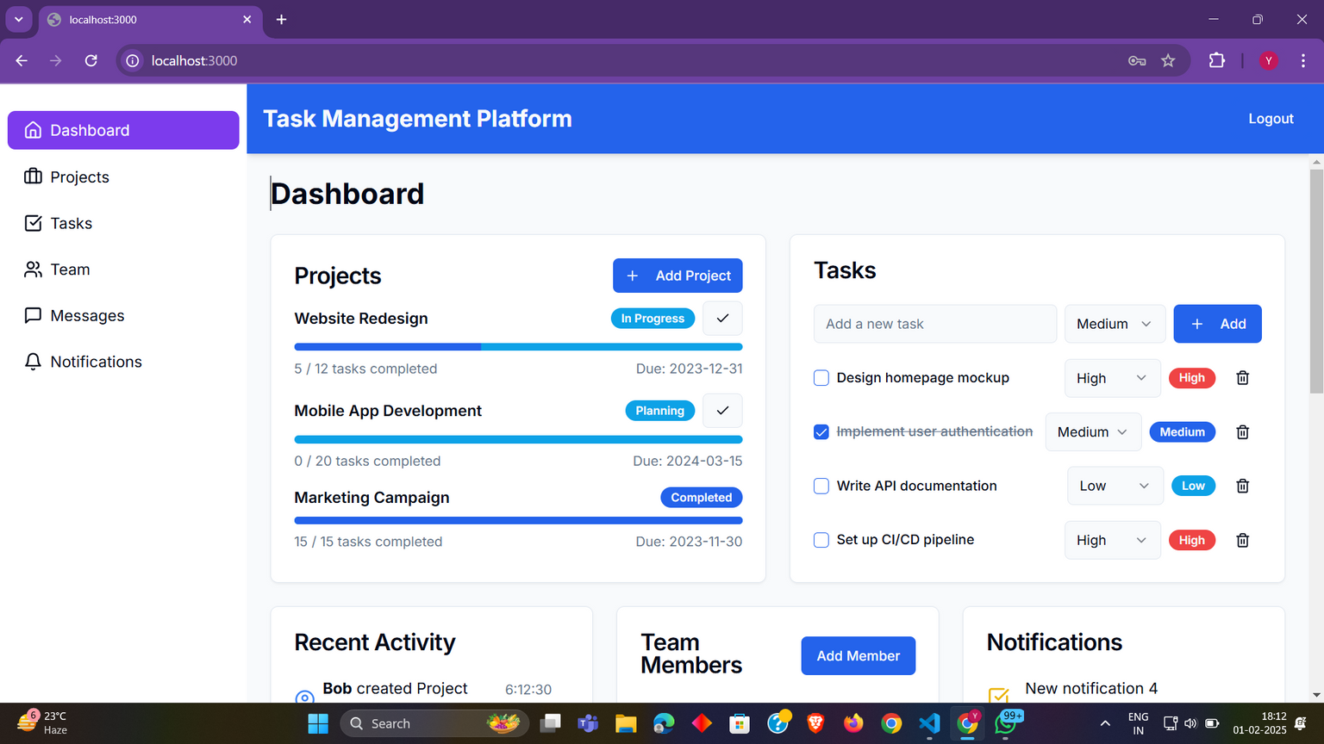



USER DASHBOARD
Task management
with daily
updates.
Navbar for quick access to various sections.

Slide 5
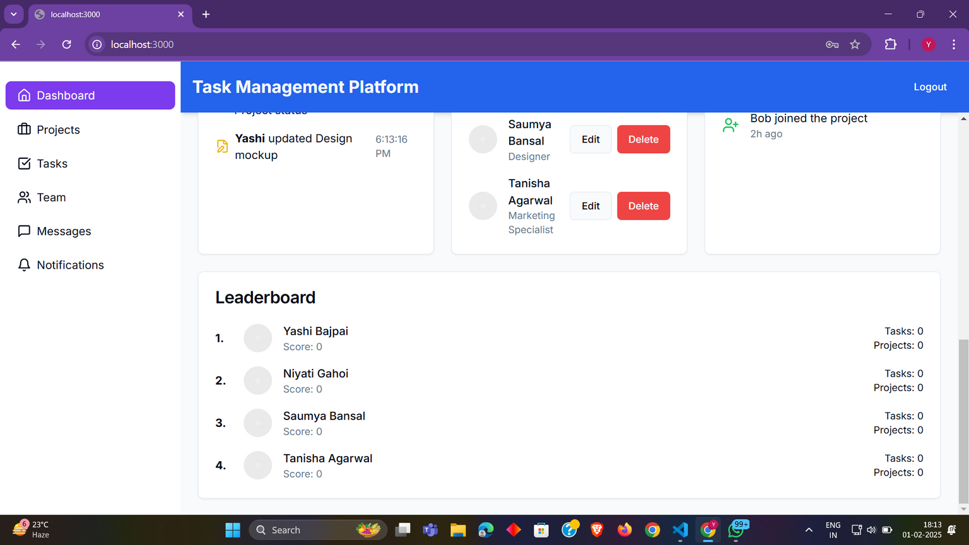
USER DASHBOARD
Leaderboard to
motivate
and track team
progress.

Slide 6
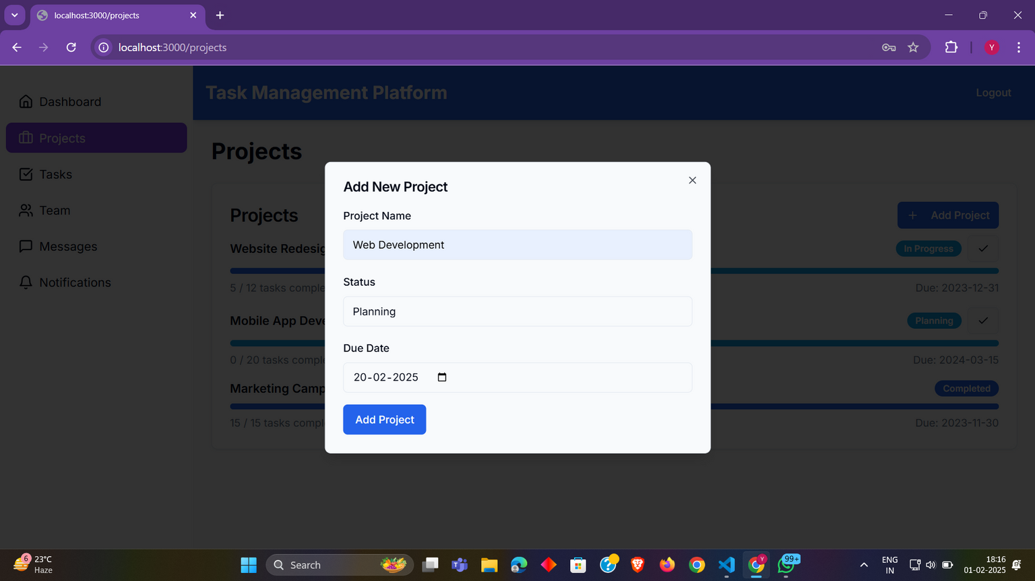
PROJECT PANEL
User can add new project and
track progress.

Slide 7
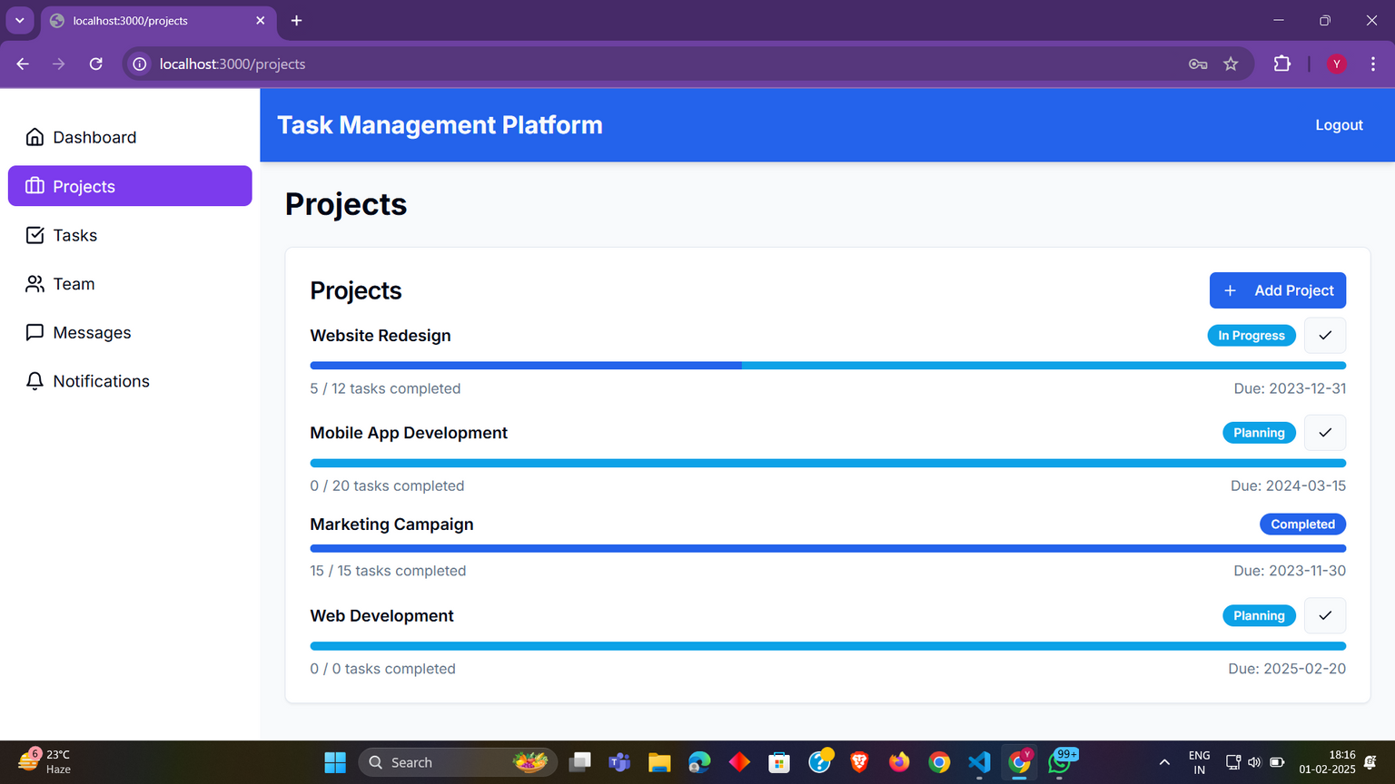
PROJECT PANEL
View project status,mark completed,view pending tasks, and deadlines.

Slide 8
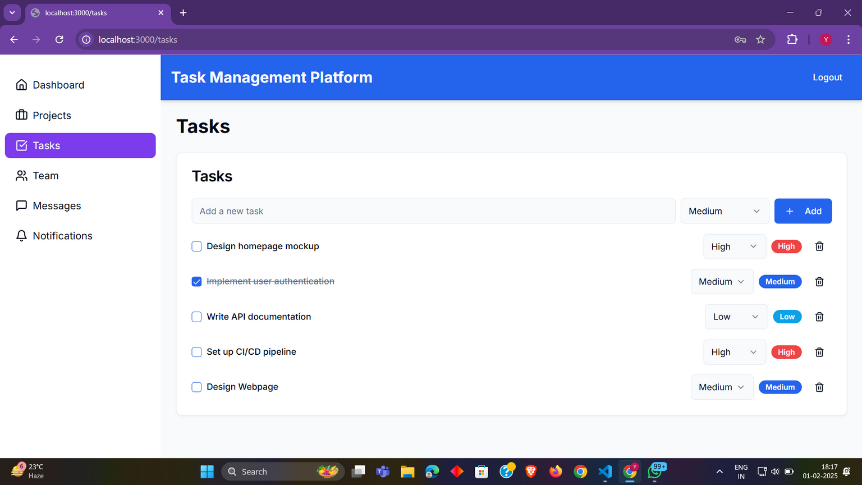
TASK MANAGEMENT
Task management is simplified with options to add, edit, and delete tasks throughout the day

Slide 9
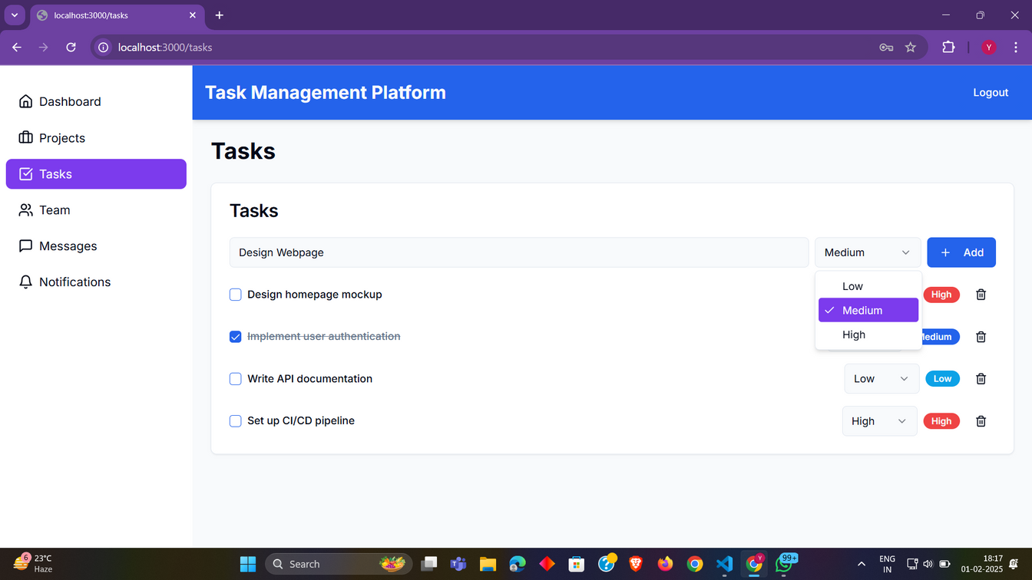
TASK MANAGEMENT
User can manage priority of the tasks for meeting deadlines.

Slide 10
TASK MANAGEMENT
User can mark their task as completed

Slide 11
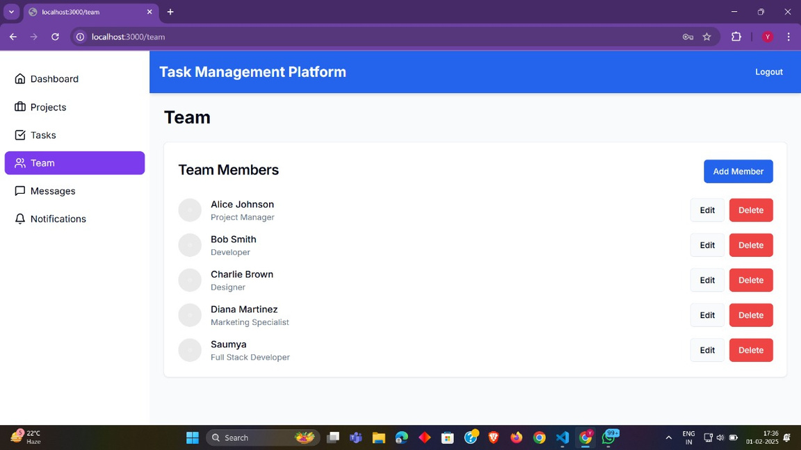
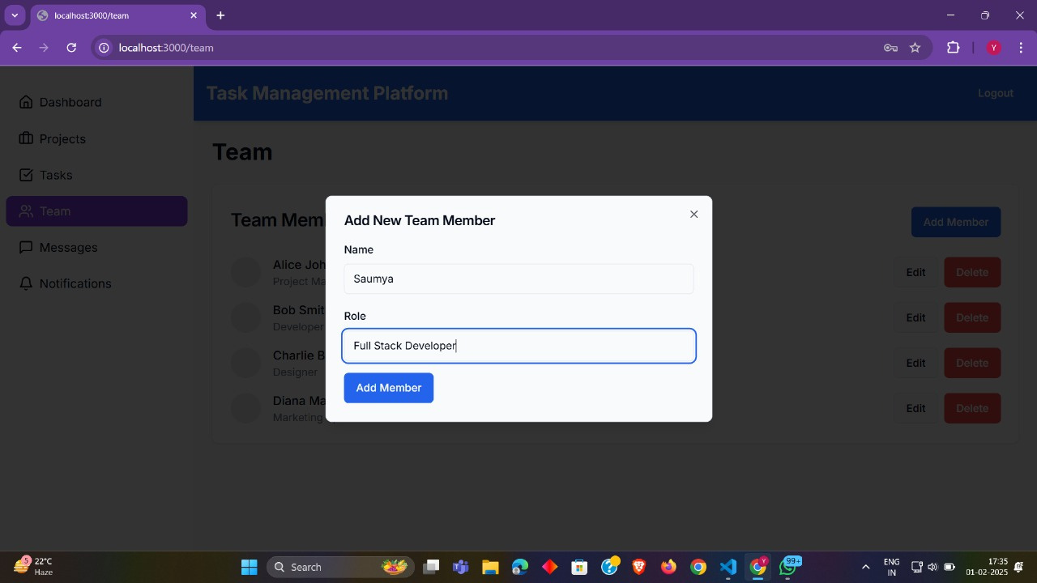
TEAM SECTION
Allowing project leaders and users to manage their team efficiently.
Allow to add
a new team member with
role.

Slide 12
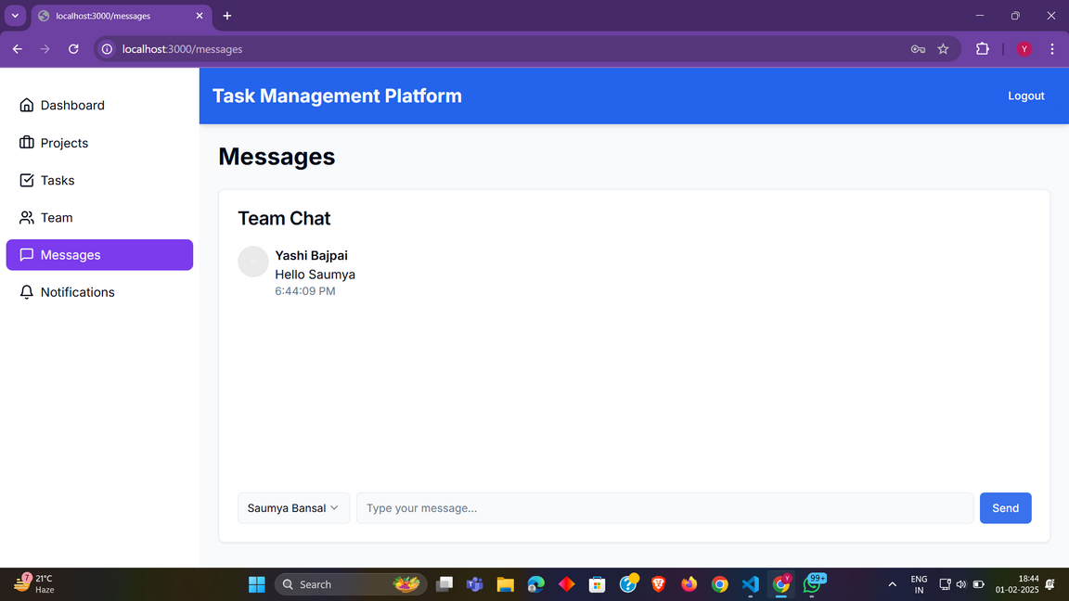

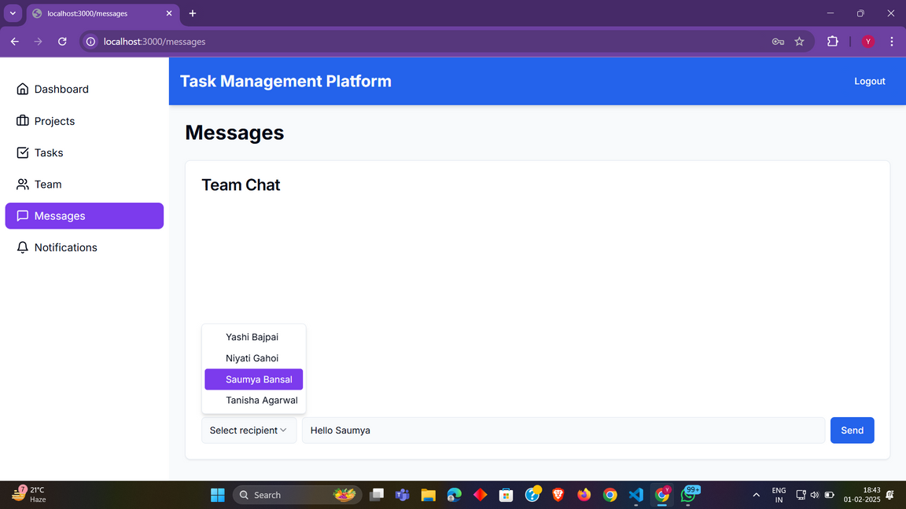
REAL-TIME CHATTING
User can select recepient to whom he/she wants to send message or any update
The real-time chat feature helps teams communicate instantly, ensuring quick decision-making and problem-solving.

Slide 13
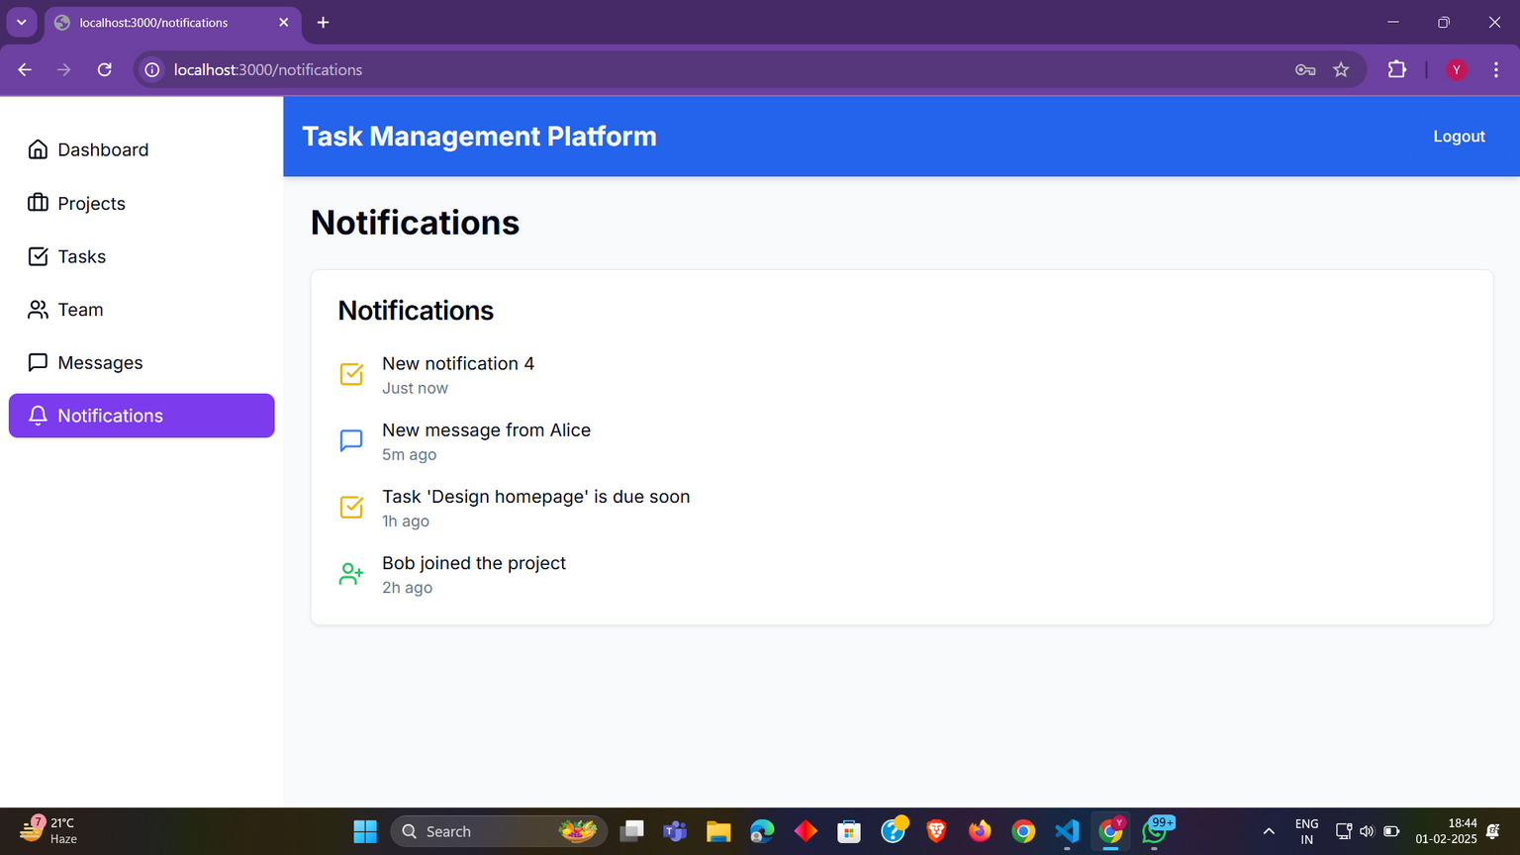
NOTIFICATIONS
Notifications keep users informed of important updates like task assignments, project changes, and messages.

Slide 14
CONCLUSION
Our Task Management and Project Collaboration Platform enhances productivity by streamlining task tracking, project management, and real-time communication. With authentication, notifications, and leaderboard features, it fosters accountability and teamwork. Future enhancements like AI-based task suggestions and Kanban boards will further improve efficiency, making it an essential tool for modern team collaboration and seamless project execution

Slide 15
THANK YOU

