Slide 1
S T A C W A R S · PS 2
SOLAR RADIATION
ANALYSIS & PREDICTION
Voyage-123 decoded: read the sun, power the Rebellion
Team: The Stack Avengers
Team Lead: Yashica Singla

Slide 2
1 · The Problem and Our Plan
Voyage-123 logged radiation, temperature, humidity, wind, sunrise and sunset. We turn raw logs into insight, a day-wise report and a prediction model.
A · Visualise
B · Infer
C · Solar day
Bonus · Predict
4 marks
3D + 2D plots: radiation vs time and 2+ parameters, outliers
5 marks
Peak hour, strongest driver, temp/humidity link, outliers
5 marks
Pandas/NumPy daily report, peak day, top 5 days
6 marks
Regression model, RMSE and R²
Load + clean
Datetime
Visualise
Infer
Daily report
ML model
PDF report
Python · Pandas · NumPy · Matplotlib · Seaborn · Plotly · scikit-learn · GitHub
The Stack Avengers · STAC WARS PS2 · 1

Slide 3
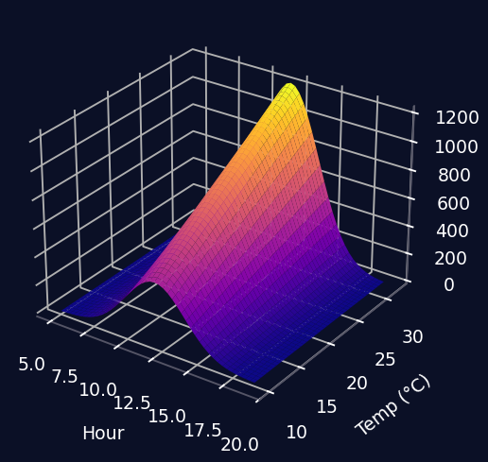
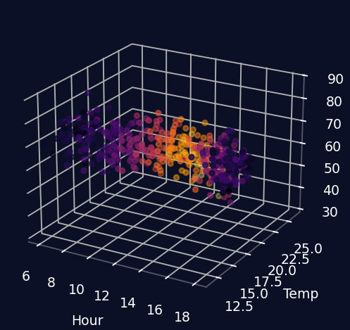
2 · Part A: 3D Visualisation Models
3D surface: radiation = f(hour, temperature)
3D scatter: hour × temp × humidity, colour = radiation
Why 3D
Tool
Shows joint effect of two drivers that a flat scatter hides.
Plotly (interactive, rotatable) in notebook; static export in report.
The Stack Avengers · STAC WARS PS2 · 2

Slide 4
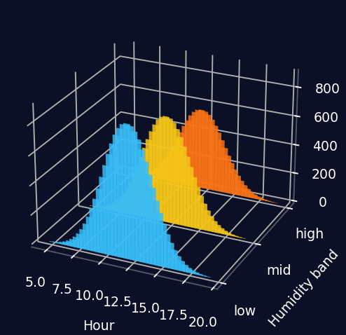
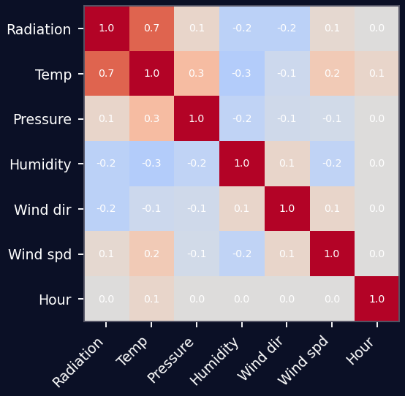
3 · More Models: Bars and Correlation
3D bars: hourly radiation by humidity band
Correlation heatmap (all parameters)
Reading it
Illustrative charts: shape of the models, not real Voyage-123 data. Real plots replace these after running the notebook.
Clear sky (low humidity) lifts the noon peak; humid bands sit lower.
The Stack Avengers · STAC WARS PS2 · 3

Slide 5
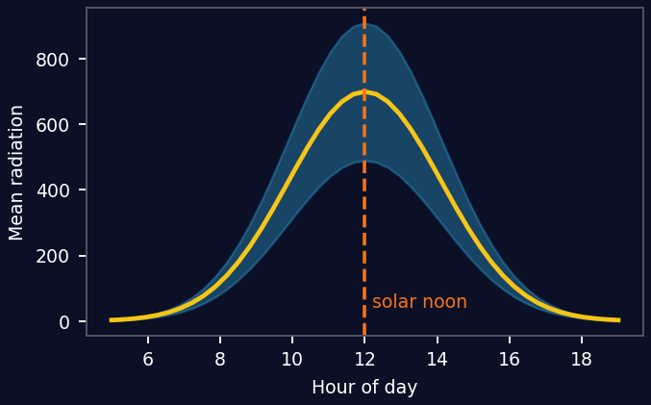
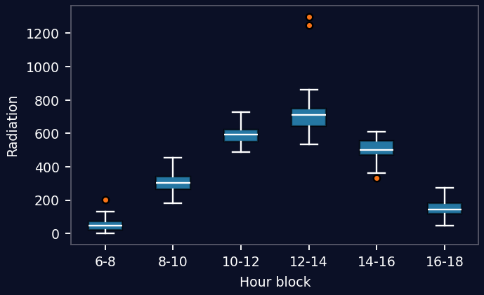
4 · Part B: Inferences We Will Prove
Mean radiation by hour (peak near solar noon)
Boxplot by hour block (outliers in orange)
Peak time
Top driver
Temp / humidity
Outliers
Hourly mean; expect solar noon
Rank corr() with Radiation
Temp up, humidity down; explain
IQR / z-score; night readings, spikes
The Stack Avengers · STAC WARS PS2 · 4

Slide 6
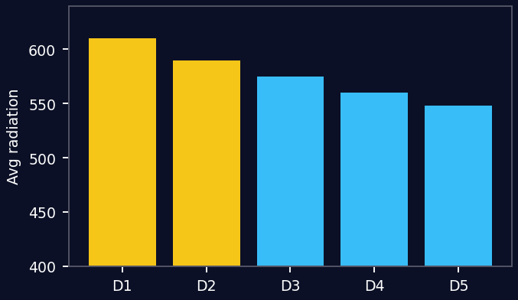
5 · Part C: Solar Day Analysis
Pandas pipeline
df['Datetime']=Date+Time
daily=df.groupby('Date')['Radiation']
.agg(['max','mean'])
peak=df.loc[df.Radiation.idxmax()]
delay=peak.Datetime-peak.Sunrise
daily.nlargest(5,'mean')
Top 5 days by average radiation
Sunrise
Peak radiation
Sunset
Report: peak time, hours after sunrise, day length; temp, humidity, wind at peak
The Stack Avengers · STAC WARS PS2 · 5

Slide 7
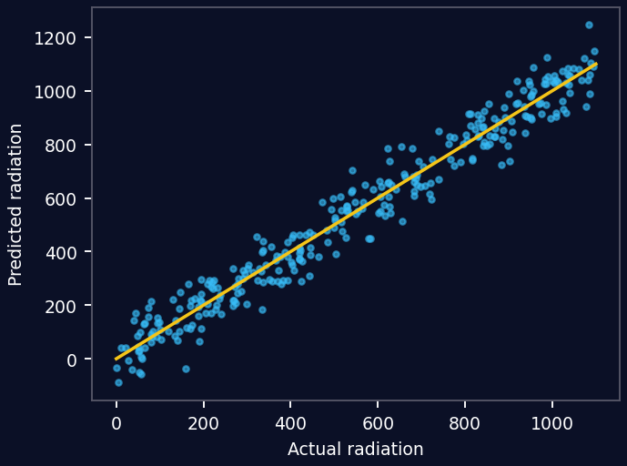
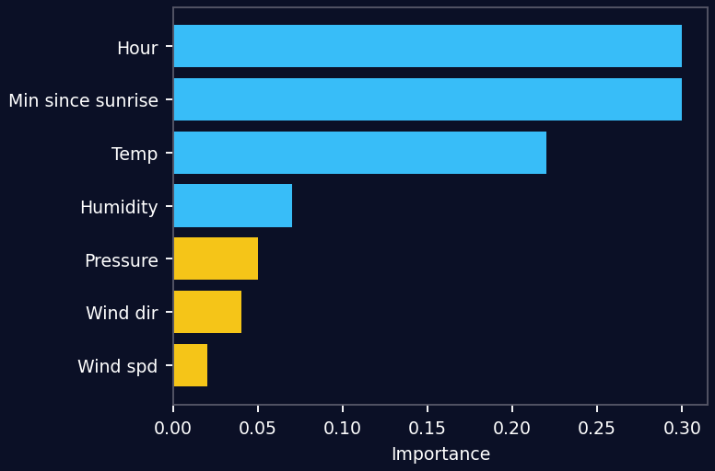
6 · Bonus: ML Prediction Model
Scores
RMSE
__
R²
__
(after run)
Predicted vs actual (Random Forest)
Feature importance
Method
Features: temp, pressure, humidity, wind, hour, minutes since sunrise · 80/20 split plus time-based split · Linear Regression baseline vs Random Forest
The Stack Avengers · STAC WARS PS2 · 6

Slide 8
7 · How We Make the Report
1. Introduction
2. Visualisations
3. Inferences
4. Day report
5. ML scores
6. GitHub link
Process
GitHub repo
Export notebook figures, caption every plot, copy numbers straight from code output, one team review of the final PDF
TeamName_SolarRadiation/
solar_analysis.ipynb
report.pdf
README.md
The Stack Avengers · STAC WARS PS2 · 7

Slide 9
Thank You
The Stack Avengers · Team Lead: Yashica Singla
May the Code Be With You

