Slide 1


GameHub
Yashi Gautam – E22CSEU1519

Slide 2
Introduction
Today, I'm delighted to share my knowledge on the topic of creating terminal-based games using arrays as the fundamental data structure.

Slide 3
TicTacToe
The terminal's version of Tic Tac Toe is a straightforward and nostalgic game. It restores, in digital form, the core elements of the beloved Xs and Os game without the use of gaudy graphics. Players make their moves on the terminal, which serves as a canvas. Each move is a step in the strategic dance toward either a friendly draw or triumph. The simple yet entertaining way to revisit an ageless childhood classic on the computer is with the terminal-based Tic Tac Toe, whose minimalistic style brings out the fun of the game itself.

Slide 4
Sudoku Game
Experience the mental challenge of Sudoku, a puzzle beloved by millions. In constructing this game, I employed arrays to store and manipulate the numbers on the grid, providing players with endless puzzles to solve.

Slide 5
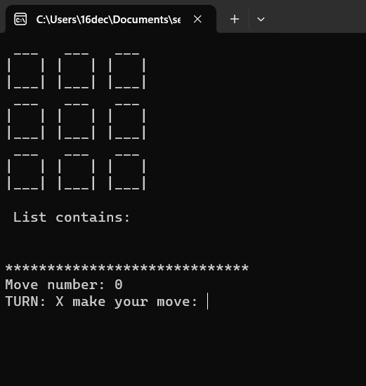
Screenshots

Slide 6
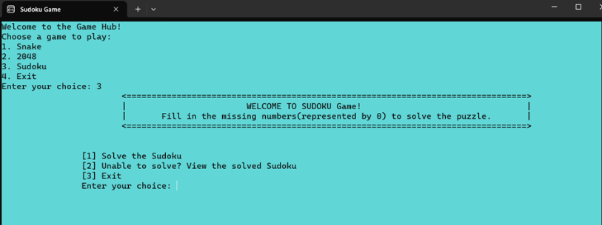
Screenshots

Slide 7
Conclusion
Recapping the two games— TicTacToe and Sudoku—we can appreciate the power of arrays and linked list in game development. Arrays proved essential for managing game state, storing data, and enabling smooth interactions. Their versatility makes arrays a go-to data structure for game developers.

