Slide 1
Banking Analytics
Presented by yashik

Slide 2
Bank Loan Analysis RePORT
Tool Used: Tableau
Dataset: Bank Loan Analytics
Objective:
To analyze loan performance, revenue, and risk indicators using KPIs.

Slide 3
Introduction
About the Project
This project focuses on analyzing business/operational data to generate meaningful insights.
The objective is to transform raw data into clear, actionable information for decision-making.
A centralized dashboard/report has been developed to monitor performance and trends.
Purpose
Understand overall performance and growth patterns
Identify strengths, risks, and improvement opportunities
Support management with data-driven decisions

Slide 4
Scope
Data collection and validation
Data visualization and analysis
Performance monitoring across key metrics
Tools & Technology
Data Processing & Validation
Visualization Dashboard (Tableau/ Reporting Tool)
Structured database sources

Slide 5
Data Overview
Total Rows Used: 66,000 (approx.)
Total Columns Used: 15+
Important Columns:
Loan ID, Funded Amount, Total Interest, Collection, State,
Branch, Religion, Grade, Age, Product Group,
Loan Status, Default Flag, Delinquent Flag, Verification Status

Slide 6
Objectives - KPIs
1. Total Funded Amount
2. Total Loans
3. Total Collection
4. Total Interest
5. Default Loan Rate
6. Delinquent Loan Rate
7. Default Loan Count
8. Delinquent Client Count
9. Non Verified Loan %

Slide 7
Process
Step 1: Data Cleaning (Null check, format correction)
Step 2: Created Calculated Fields
Step 3: Built Charts (State, Grade, Religion, Age, Product)
Step 4: Dashboard Design and KPI Cards

Slide 8
KPI Calculation Logic
Total Funded Amount = SUM(Funded Amount)
Total Collection = SUM(Collection)
Total Interest = SUM(Total Interest)
Total Loans = COUNT(Loan ID)
Default Rate = Default Count / Total Loans * 100
Delinquent Rate = Delinquent Count / Total Loans * 100
Non Verified % = Not Verified Count / Total Loans * 100
Profit Insight = Total Collection - Funded Amount

Slide 9
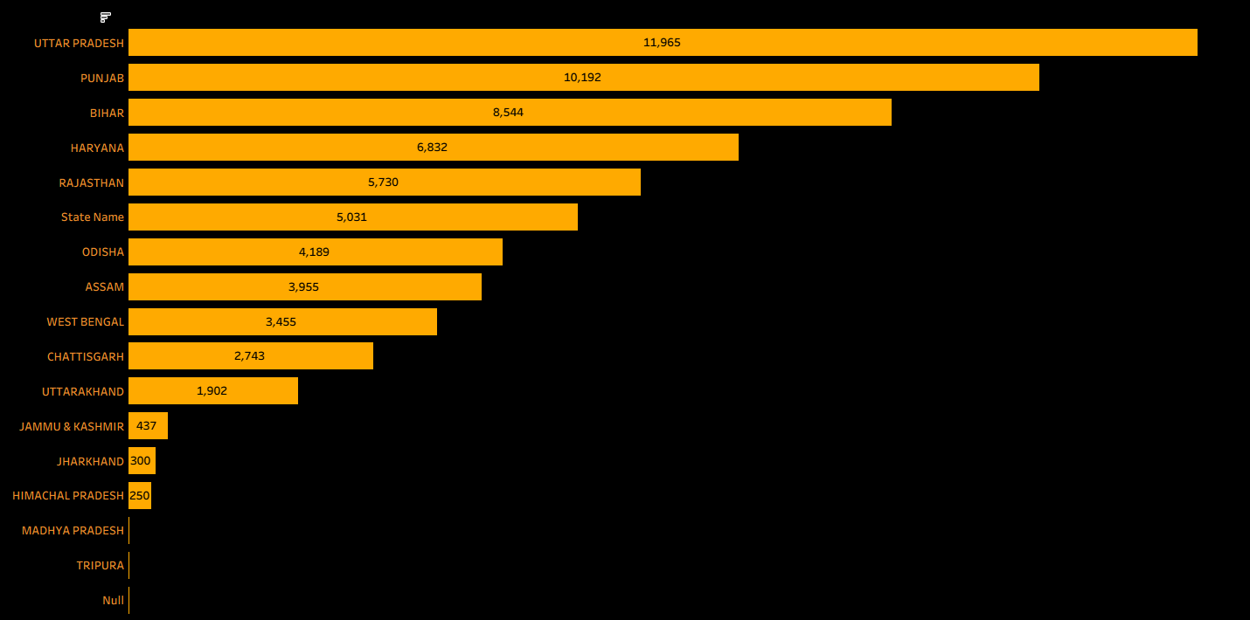
State Wise Loans
Insights:
Uttar Pradesh and Punjab dominates
Bihar, Haryana and Rajasthan and Mid range clusters
Odisha ,Assam, West Bengal contribute moderately
Jammu & Kashmir, Uttarakhand and Himachal Pradesh are at bottom
Overall distribution skewed to specific states, showing imbalance

Slide 10
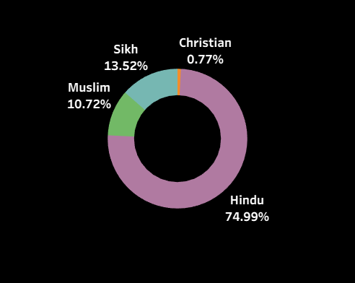
Religion Wise Loans
Insights:
Loan uptake is dominated by Hindus, with Sikhs and Muslims as significant contributors,
while Christians remain marginal.
This distribution may reflect both population proportions and access to financial services.

Slide 11
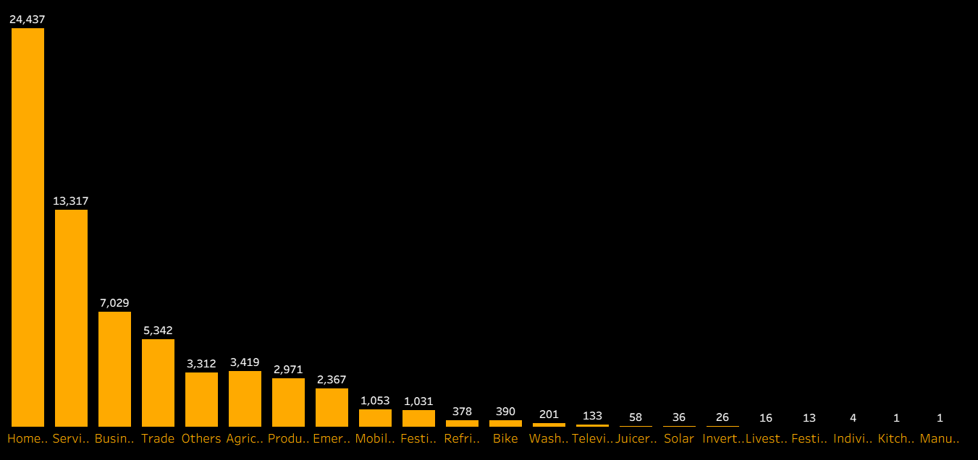
Product -Group Wise Loans
Insights:
Loan demand is concentrated in housing, services, and business,
while consumer goods and niche categories remain marginal.
This reflects a mix of basic needs, livelihood support, and selective consumer spending.

Slide 12
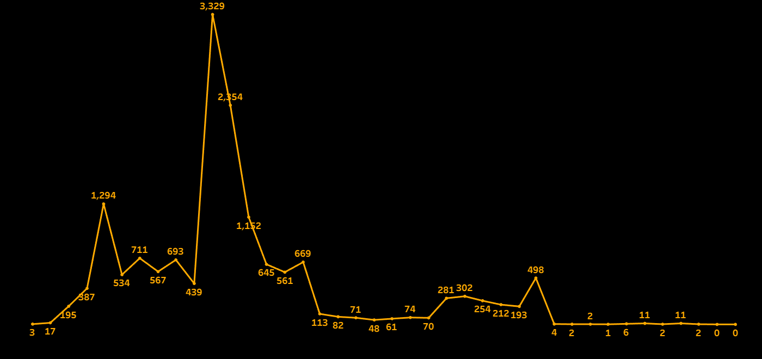
Disbursement Trend
Insights:
The disbursement trend shows three phases: rapid growth leading to a one‑time peak, followed by a steady decline and eventual near‑zero activity. This indicates the process was event‑driven rather than sustainable, highlighting the need for strategies that maintain consistency beyond peak periods.

Slide 13
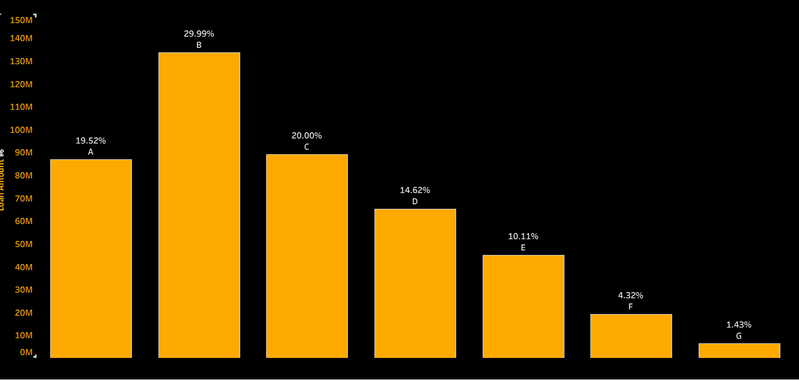
KPI -10
Grade wise Loans
Insights:
Category B dominates with nearly 30% of total loans, while A and C together contribute another 40%. The rest are much smaller, with G at just 1.4%, showing a highly skewed distribution where lending is concentrated in a few categories.

Slide 14
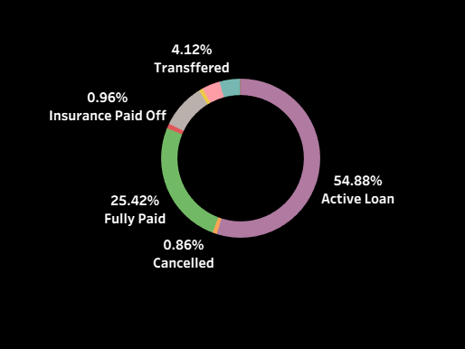
KPI -15
Loan Status wise Loans
Insights:
Over half of loans remain active (55%), while about a quarter are fully paid. The rest—transferred, insured, or cancelled—make up less than 6%, showing a portfolio that is largely ongoing with relatively low closure or risk events.

Slide 15
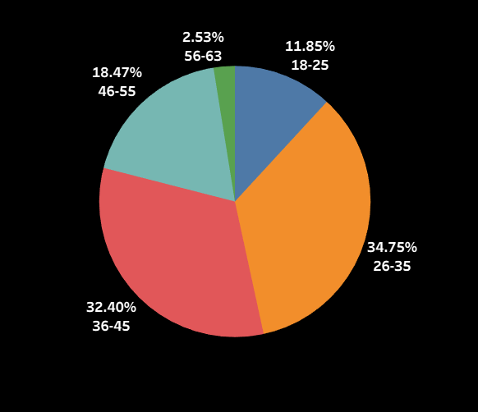
Age Group wise Loans
Insights:
The dataset is dominated by younger working‑age groups, with 26–35 (35%) and 36–45 (32%) together making up over two‑thirds of the population. Older groups above 55 are minimal, showing a strong concentration in the prime earning and borrowing age range.

Slide 16
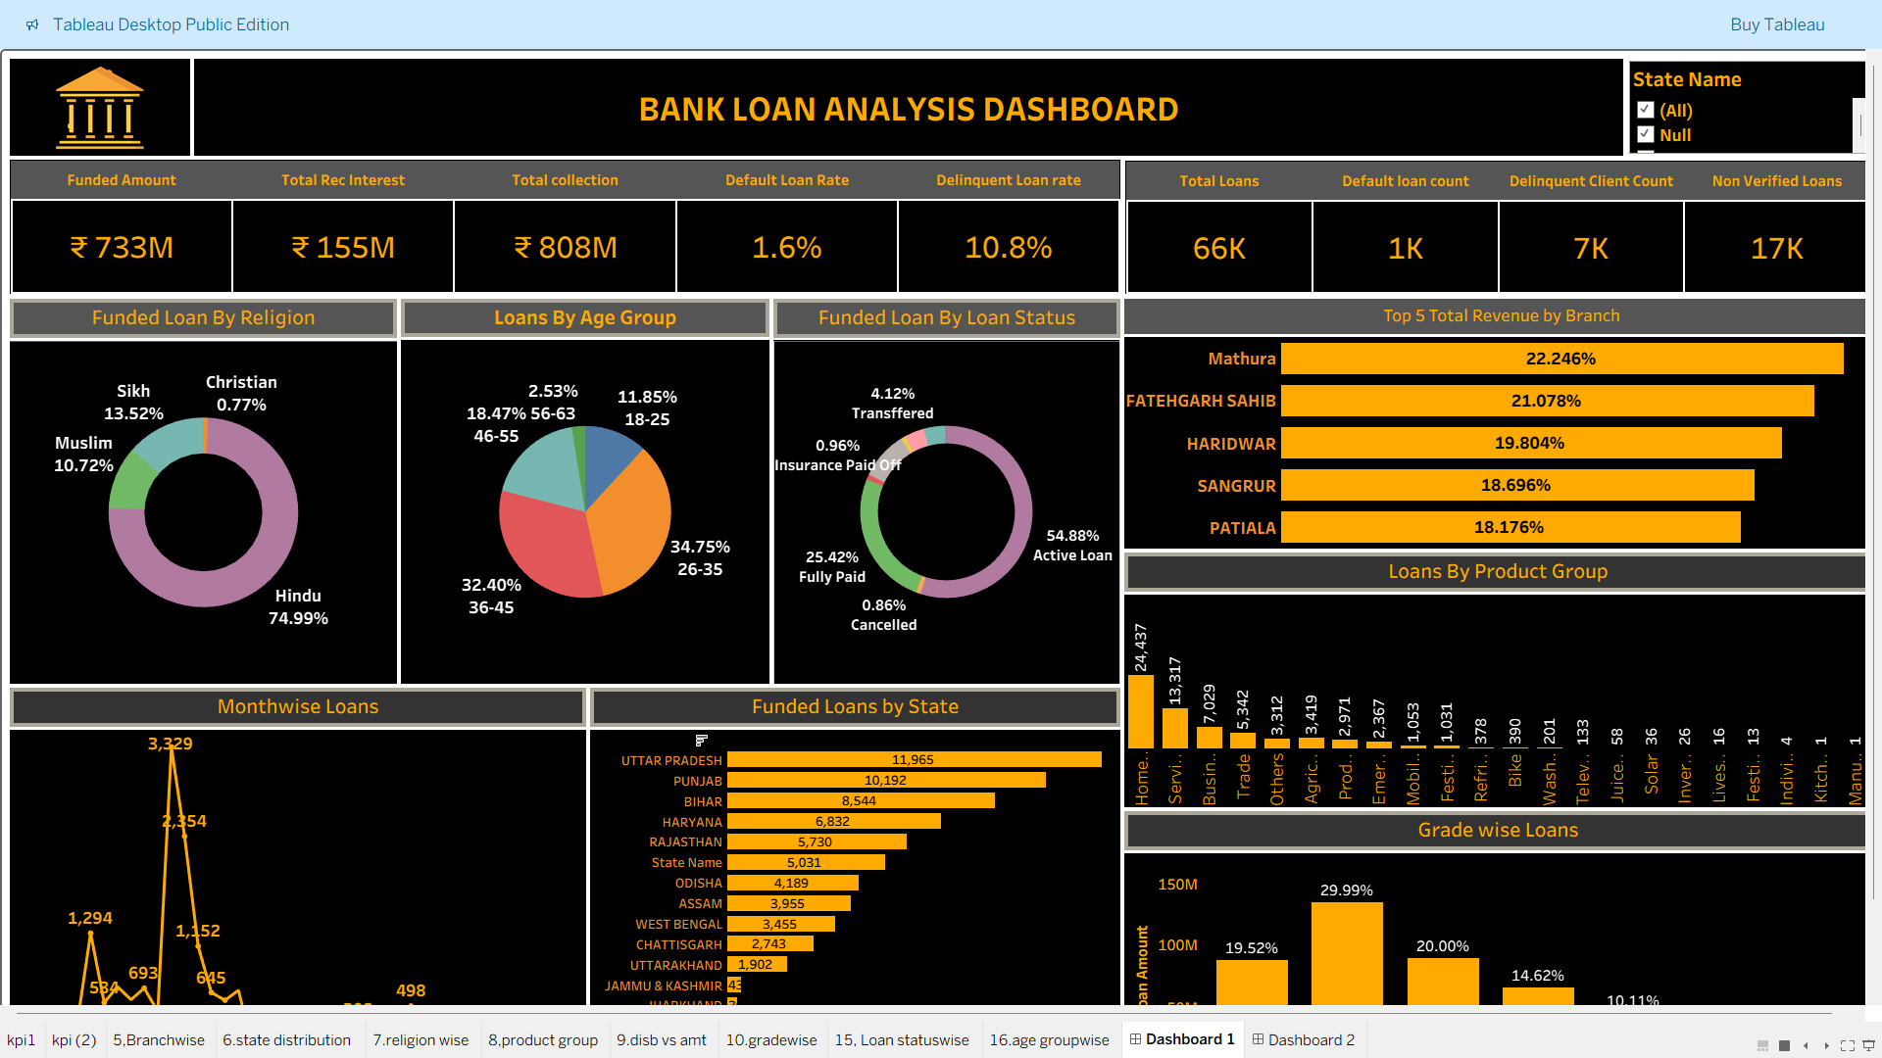
Dashboard (Tableau):

Slide 17
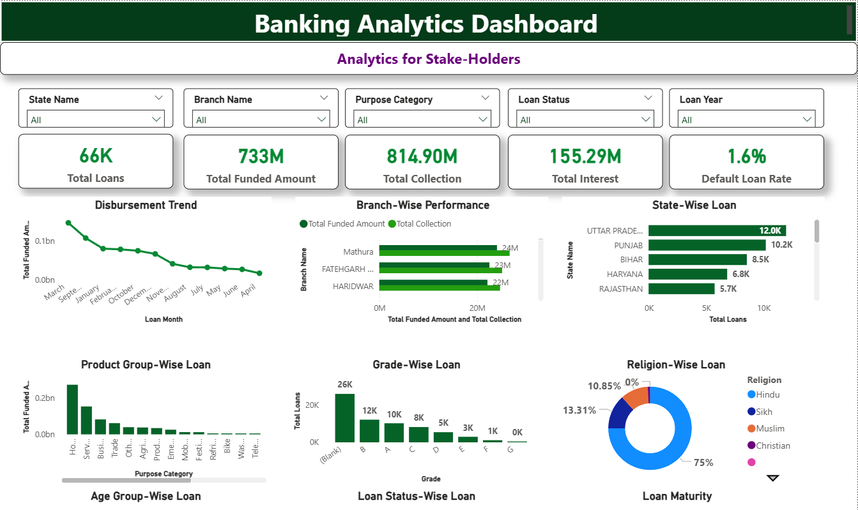
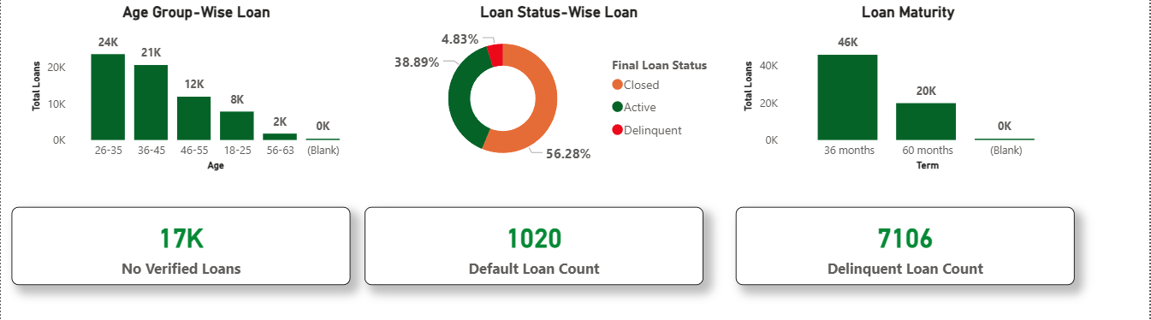
Dashboard (POWER BI):

Slide 18
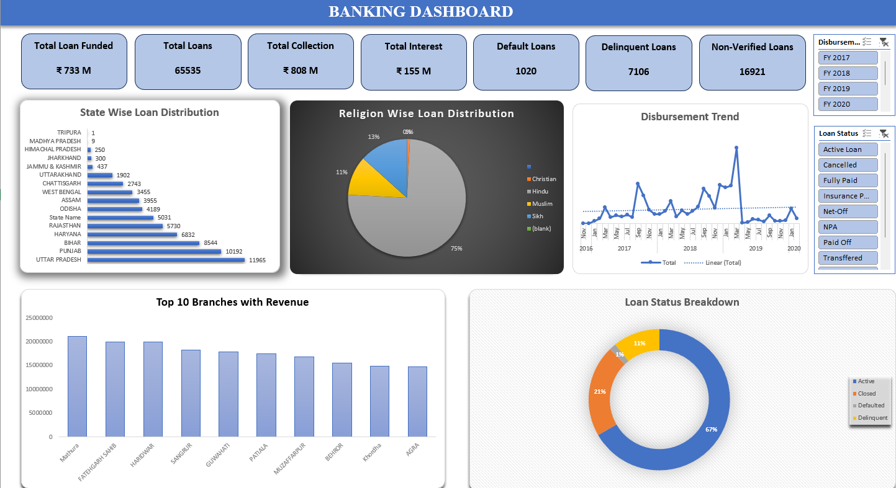
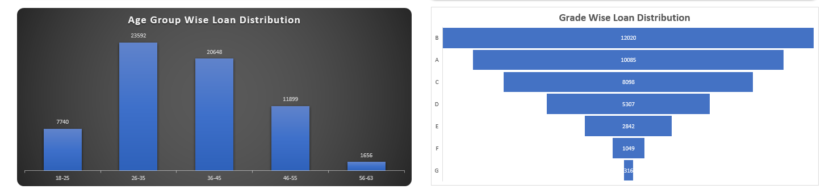
Dashboard (EXCEL):

Slide 19
Key Dashboard Insights
Total Funded: ₹733M
Total Collection: ₹808M
Default Rate: 1.6%
Delinquent Rate: 10.8%
Highest Loan State: Uttar Pradesh
Top Revenue Branch: Mathura

Slide 20
Recommendations & Insights
Reduce Delinquent Loans
Monitor Non-Verified Loans
Focus on High Performing Branches
Strengthen Credit Checks for Low Grades
Target 26-35 Age Group for Growth

Slide 21
Challenges & Learnings
Challenges:
Data Cleaning, Calculation Errors, Date Formatting
Learnings:
KPI Logic, Tableau Calculated Fields,
Dashboard Design & Data Visualization

Slide 22
Conclusion
Bank is financially strong (Collection > Funded)
Default rate is low
Delinquent rate needs improvement
Dashboard supports data-driven decision making

Slide 23


