Slide 1
E-STORE
    By : Yashik Mahajan

Slide 2
The website E-Store deals with
  The online marketing of
  lifestyle products.
  Electronic items.
  Watches.

Slide 3
Introduction to development tools
We made our model with the help of HTML,CSS ,Boostrap, MYSQL,PHP.
We use netbeans as our editor.
We used Wampp OR Xammp server to run our program.

Slide 4
Project specification
In this module front end as well as back end is also there.
Only admin can use both back end and front end.
Admin has right of all options.
User can use only front end.

Slide 5
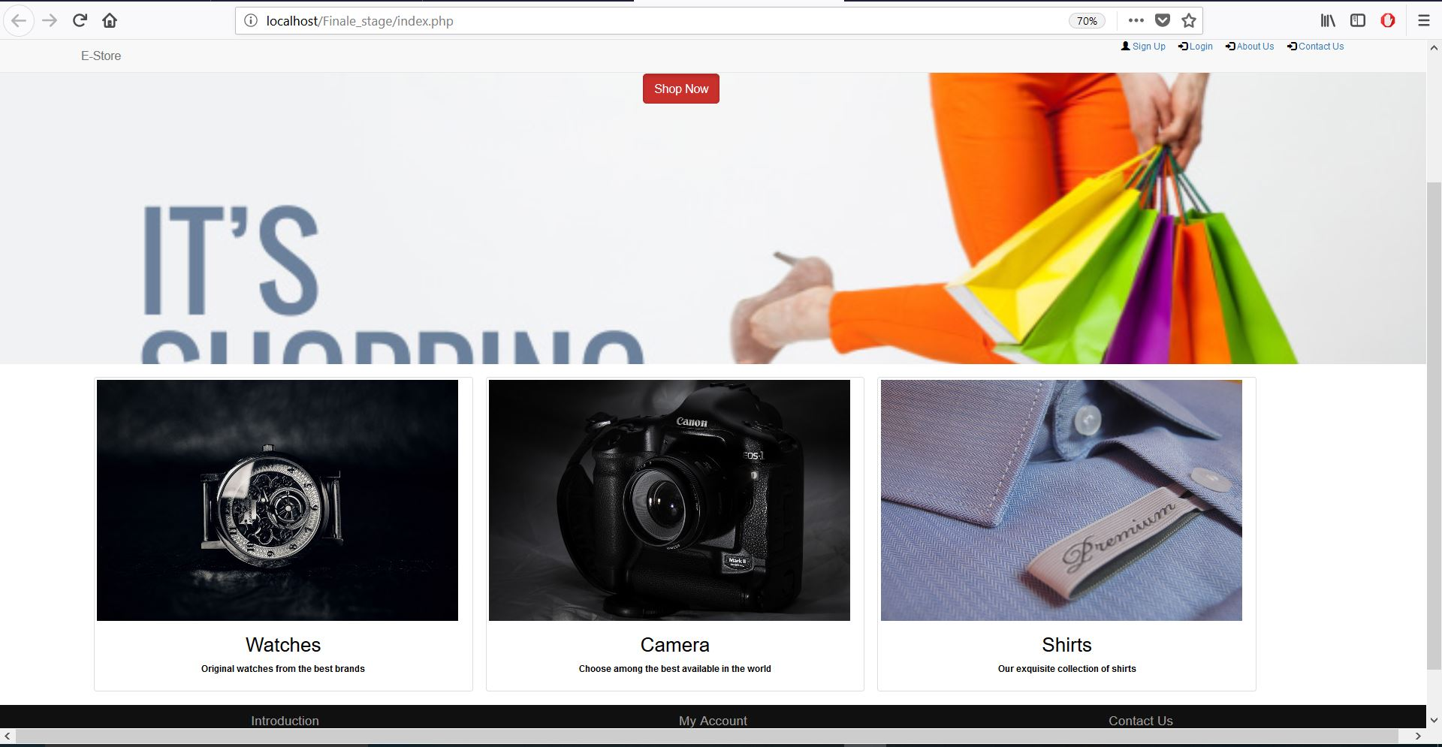
Homepage

Slide 6
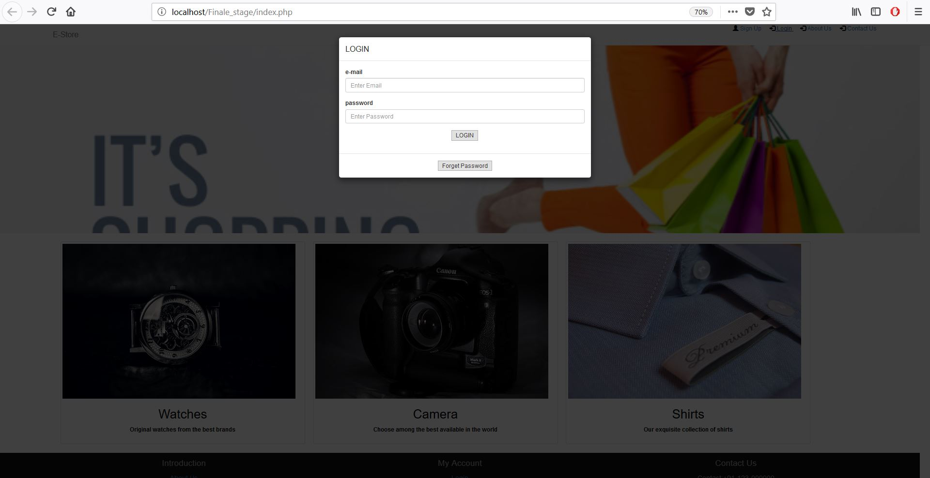
Login page

Slide 7
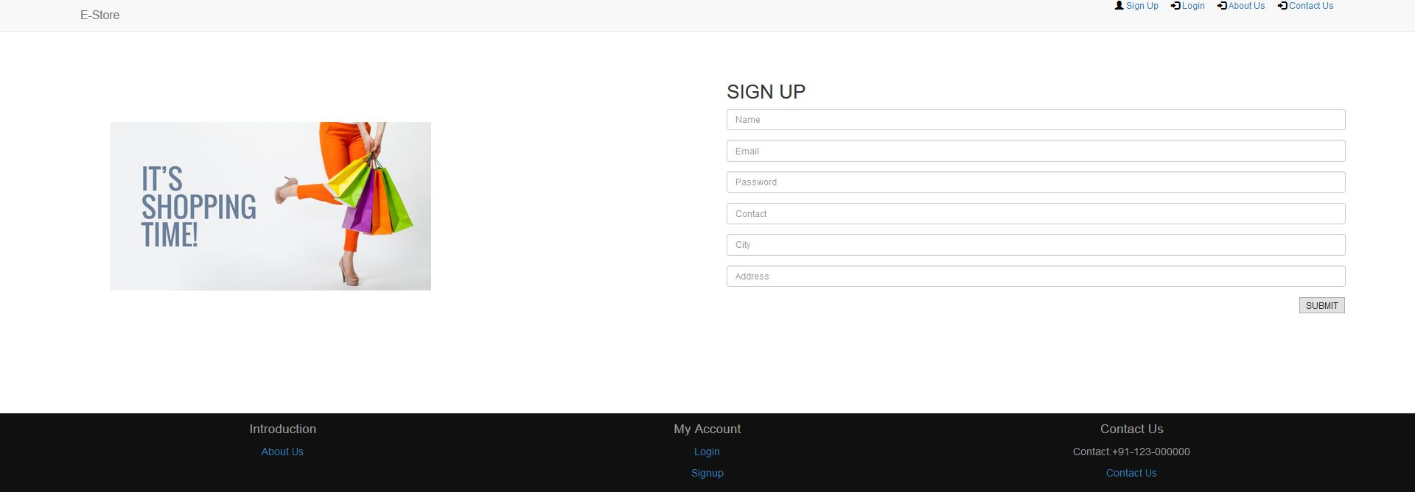
Sign up page

Slide 8
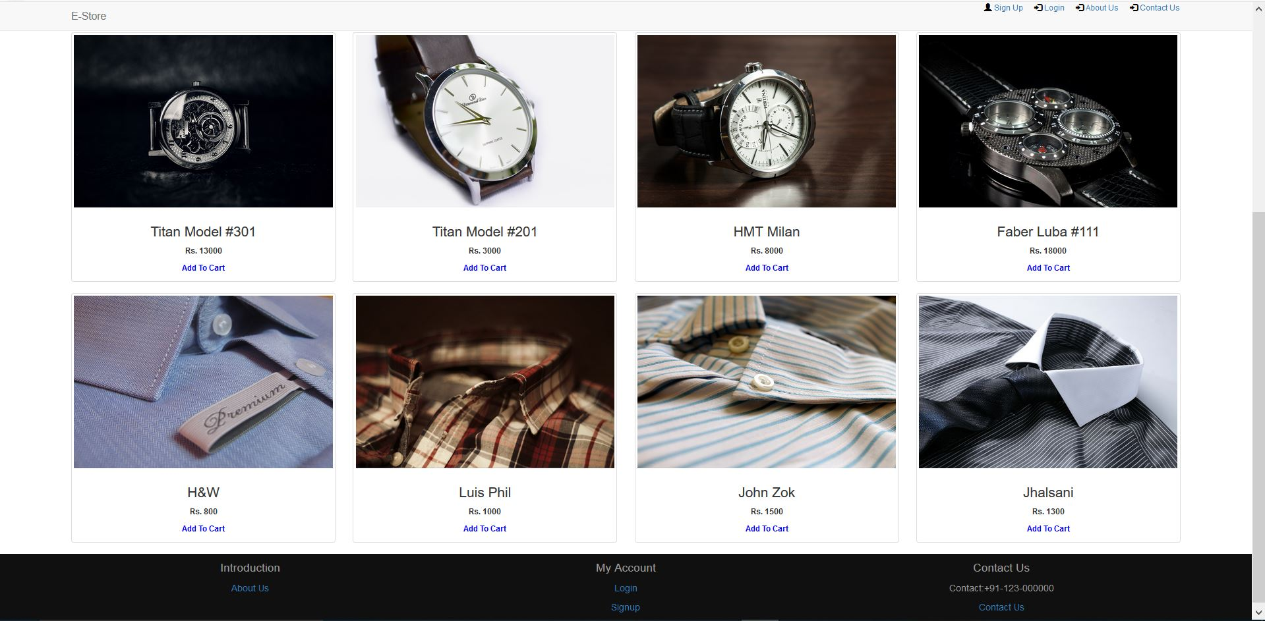
Products page for not registered users

Slide 9
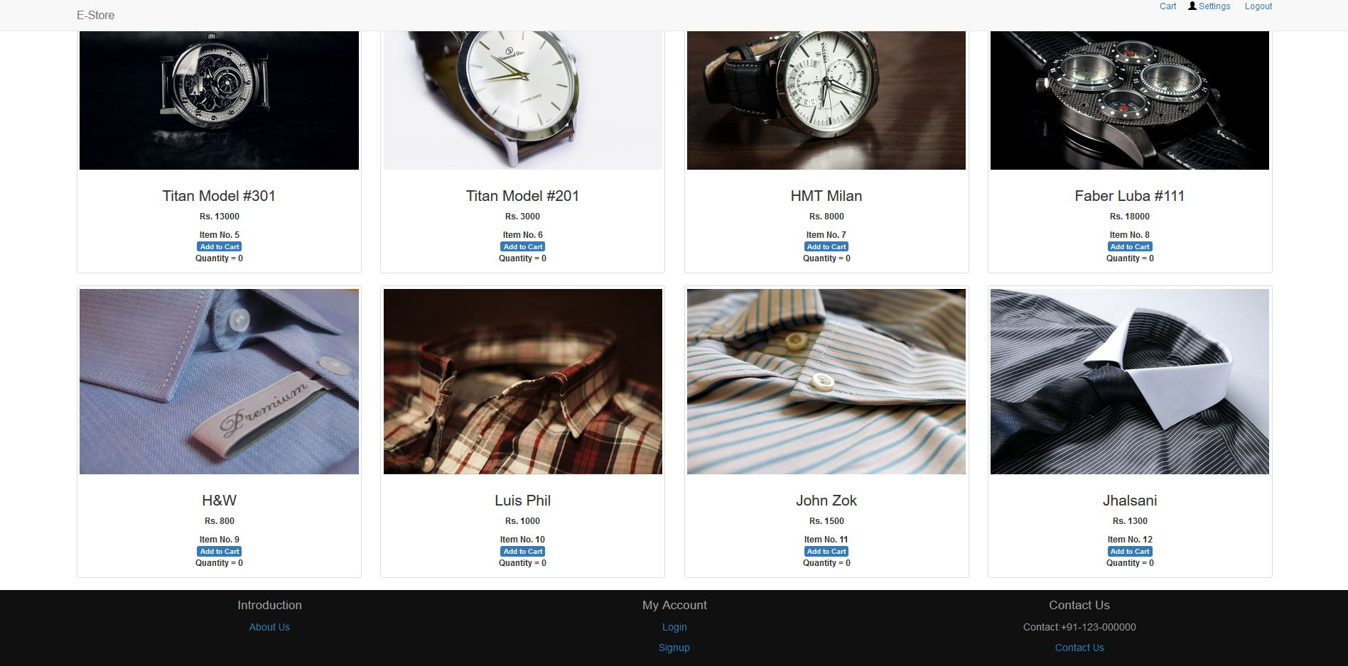
Products page for registered users

Slide 10
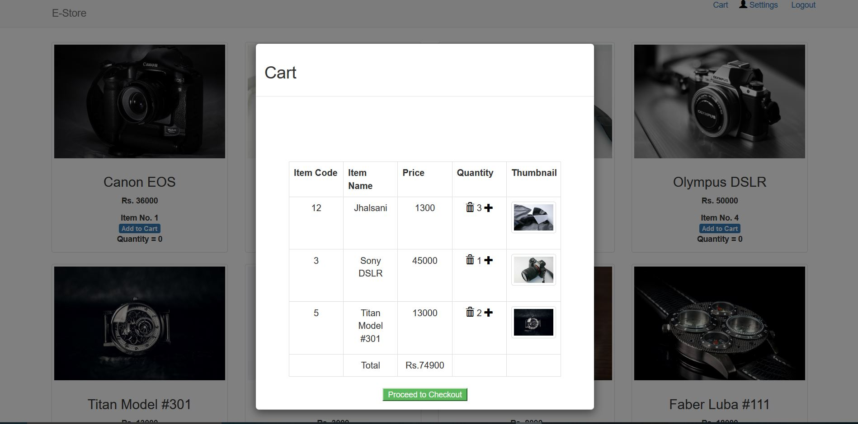
cart page displaying all the selected items for purchase

Slide 11

Forget Password

Slide 12
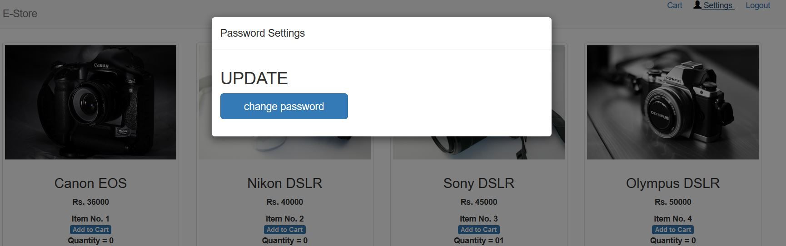
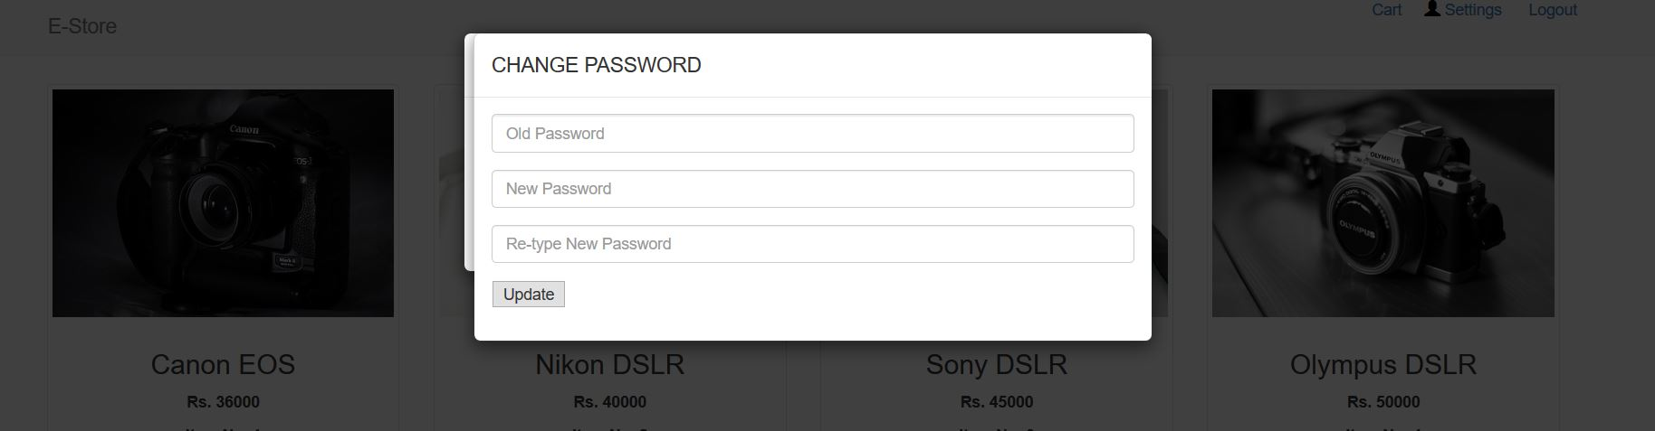
Settings page

Slide 13
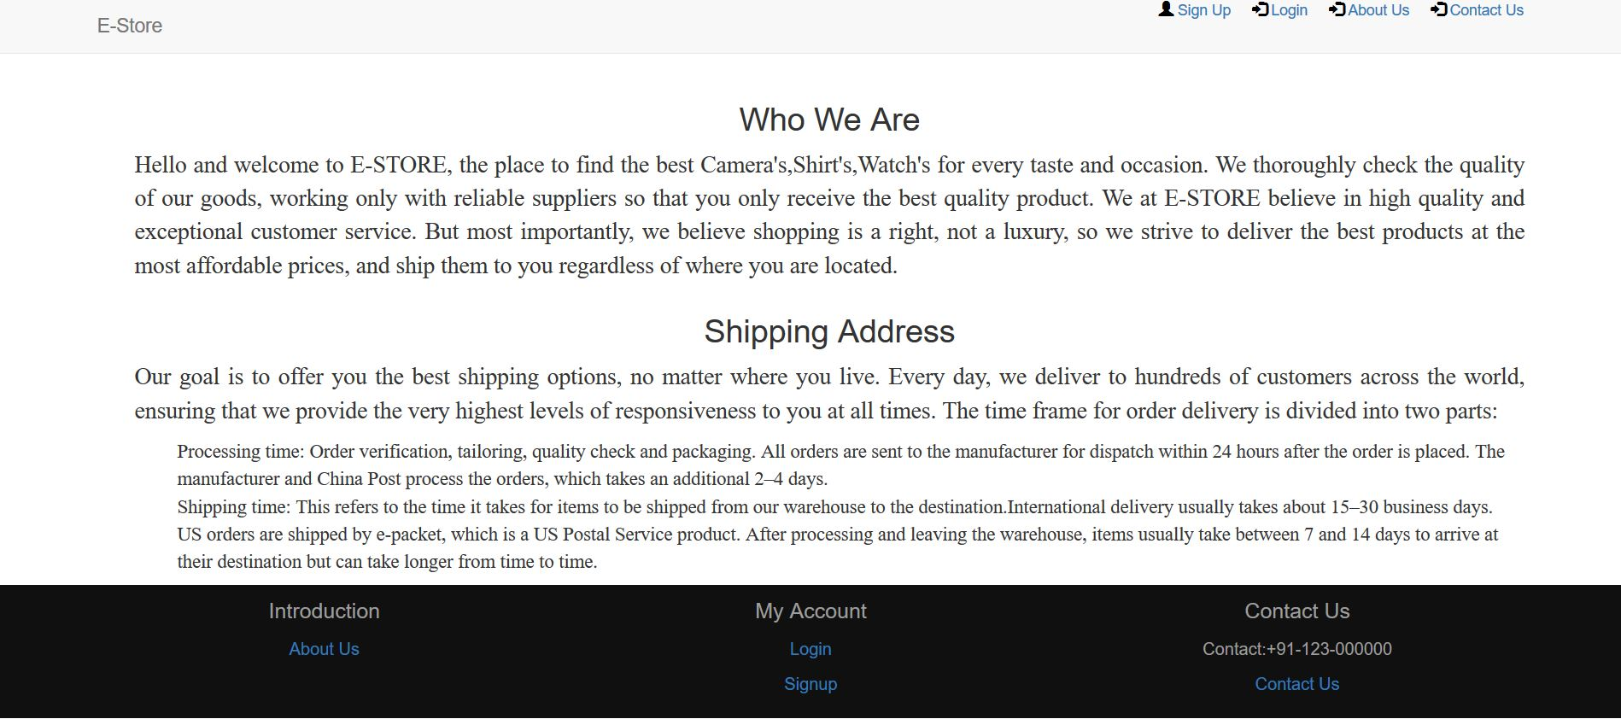
About Us

Slide 14
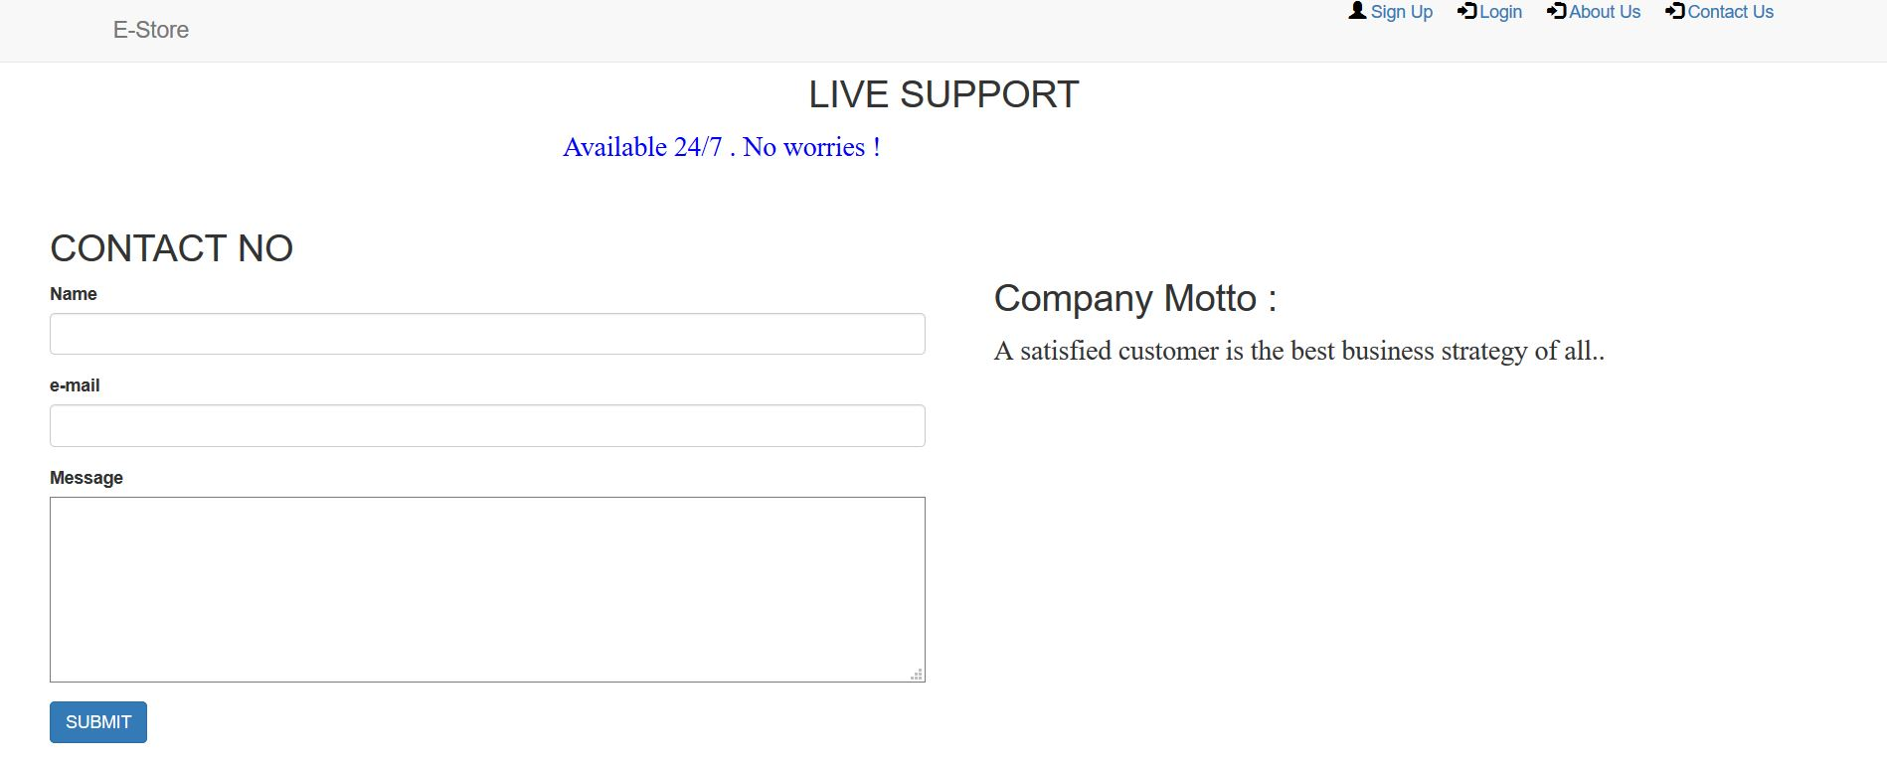
Contact US

Slide 15
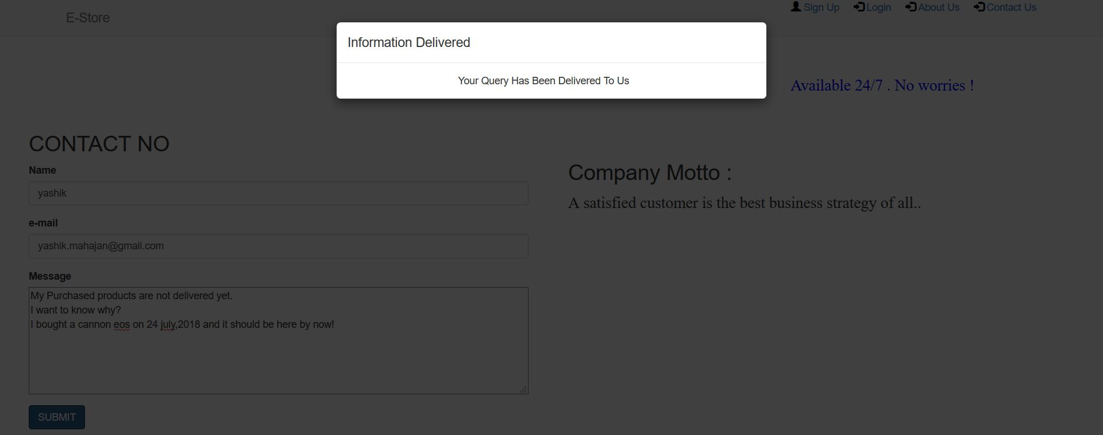
Submit Button Response from Contact Us

Slide 16
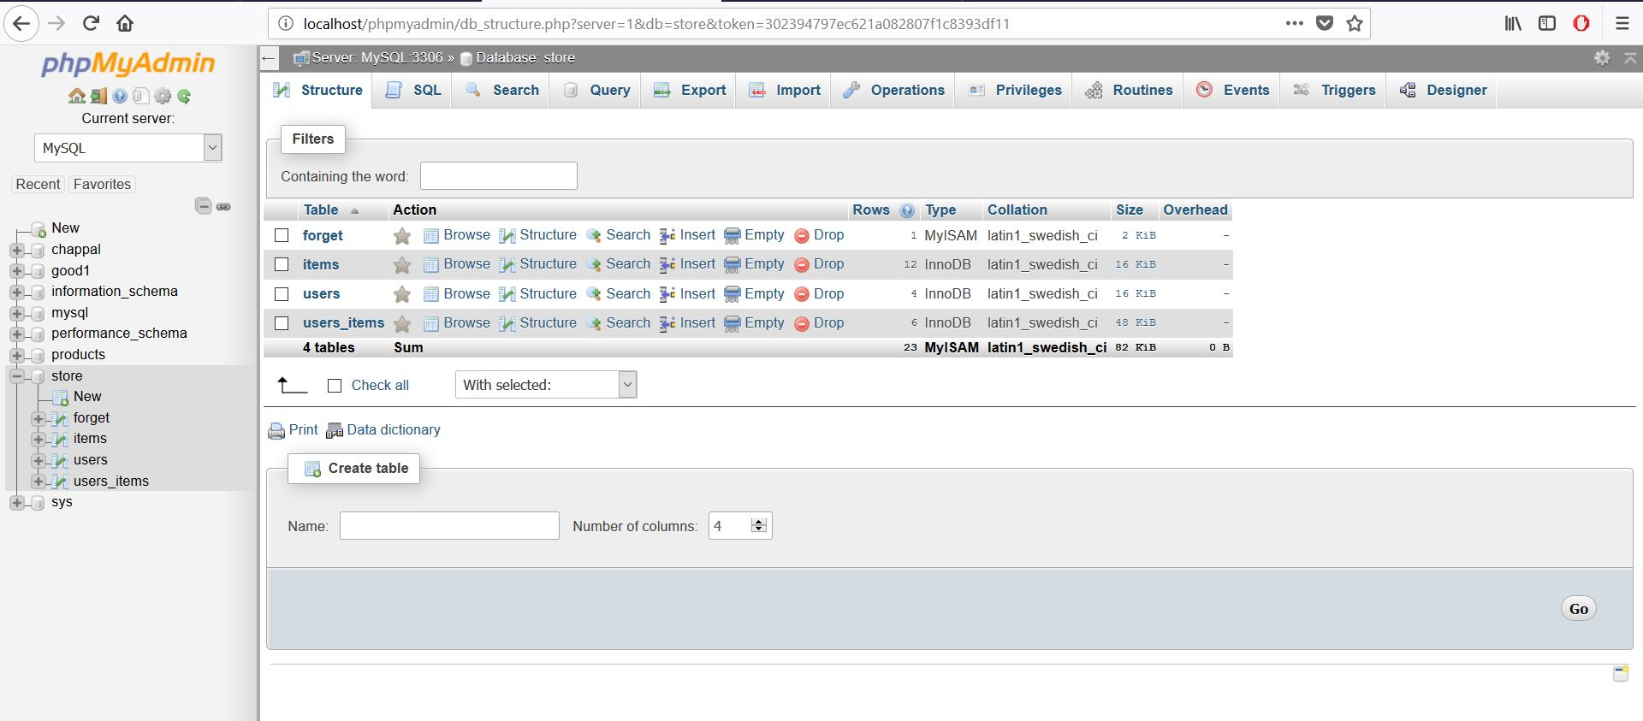
Back End Tables

Slide 17
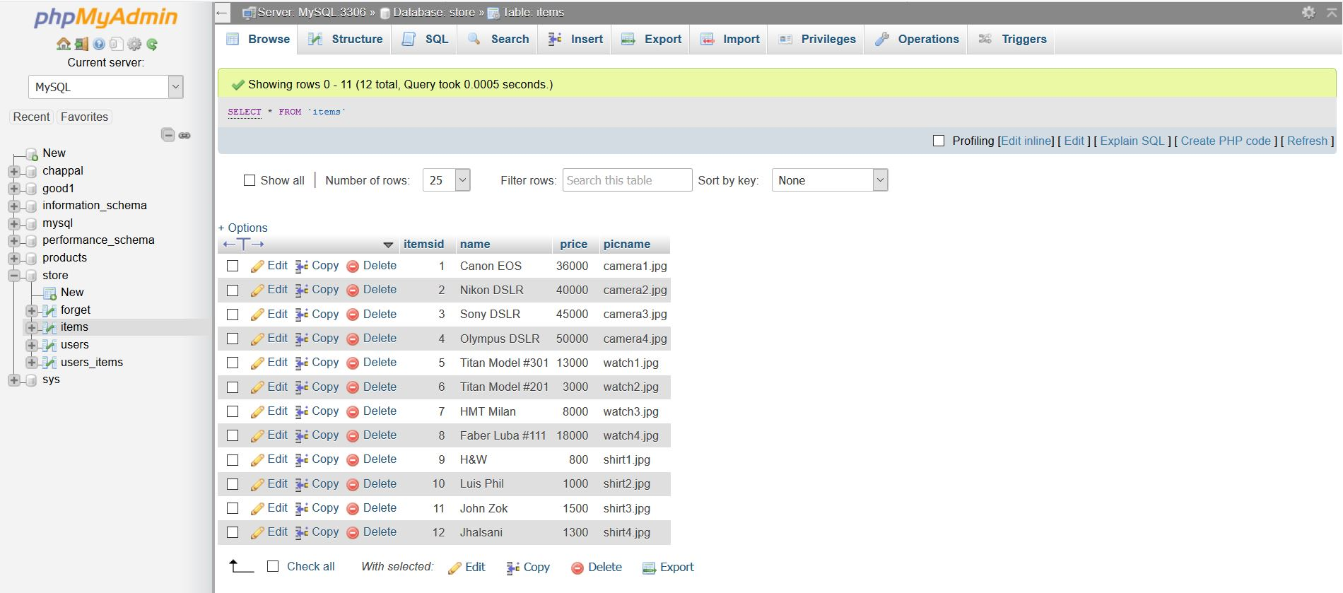
Items

Slide 18
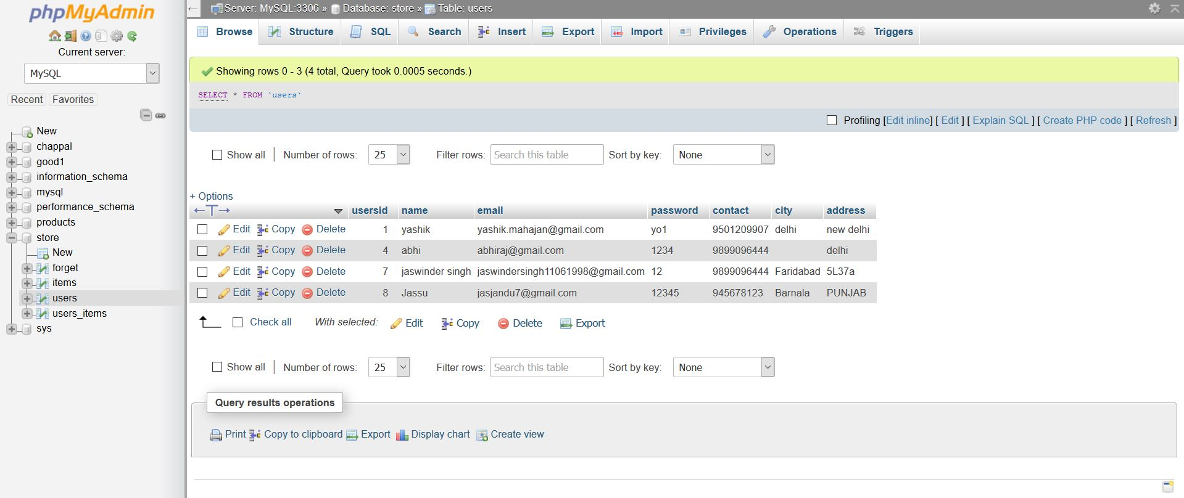
Users

Slide 19
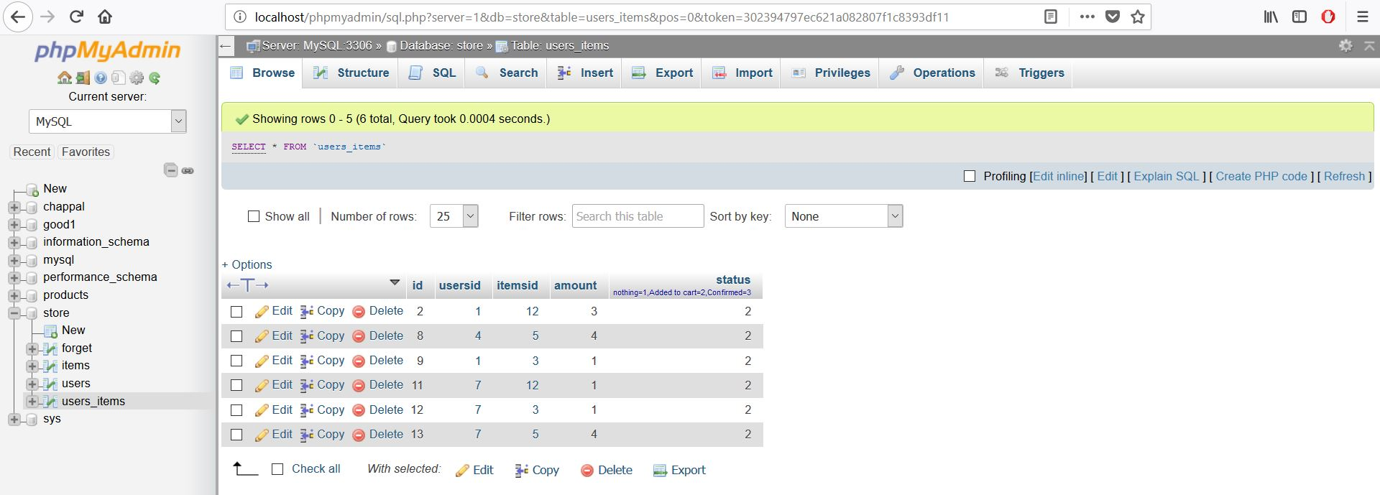
Users_items

Slide 20
THANK YOU

