Slide 1
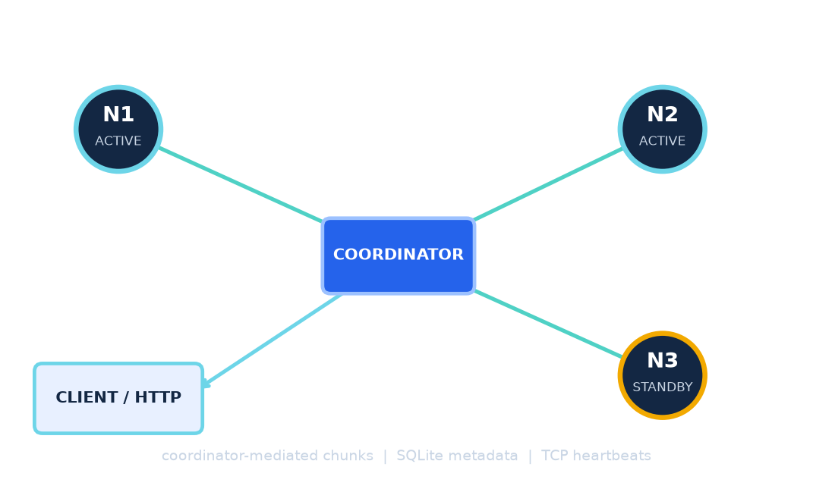
FINAL YEAR PROJECT PRESENTATION
FAULT TOLERANT P2P
DISTRIBUTED STORAGE SYSTEM
A Distributed Approach to Reliable, Secure, and Verifiable File Storage
A distributed storage prototype exploring file distribution, replication, integrity verification, and recovery from storage-node failures.
PROJECT DETAILS
Presented by: [STUDENT NAME] Roll Number: [ROLL NUMBER]
Department: [DEPARTMENT NAME]
Institution: [COLLEGE / UNIVERSITY NAME]
Project Guide: [GUIDE NAME]
Academic Year: [ACADEMIC YEAR]
FAULT TOLERANT P2P | ACADEMIC PROTOTYPE
01

Slide 2
ROADMAP
Presentation Overview
From the storage problem to implementation evidence and next experiments.
01
02
03
04
05
Problem
Design
Mechanisms
Evidence
Close
Why distribution and fault tolerance matter
Requirements, architecture, algorithms
Storage, security, monitoring, repair
Tests, methodology, measured status
Limitations and contribution
Question → design choices → implementation → evidence → what remains to be tested
FAULT TOLERANT P2P • ACADEMIC PROTOTYPE
02

Slide 3
01 • CONTEXT
Introduction to Distributed Storage Systems
Distribute bytes across nodes; coordinate access, placement, and verification.
Single-machine storage
Distributed storage
• One host stores and serves the file.
• Data is stored on multiple networked computers.
• A host or disk outage can interrupt access to that copy.
• Clients use a service rather than managing each disk.
• Simple to reason about; capacity is tied to the machine.
• Replication may create an alternate copy, with extra storage and coordination cost.
Node A
Node B
Node C
Distribution creates options; explicit replication, monitoring, and integrity checks are needed to make those options useful.
FAULT TOLERANT P2P • ACADEMIC PROTOTYPE
03

Slide 4
01 • MOTIVATION
Problem Statement
Illustrative failure scenario — availability of the remaining copy is not a measured outcome.
Node A
Challenges: locate replicas • detect failures • verify bytes • repair mappings
copy becomes unavailable
Client
requests file
Coordinator
metadata + selection
Node B
alternate copy
Project motivation
Combine selected storage, monitoring, integrity, and repair mechanisms in a small prototype, then state clearly what has and has not been verified.
FAULT TOLERANT P2P • ACADEMIC PROTOTYPE
04

Slide 5
02 • GOALS
Objectives of the Project
Project objectives are goals; later slides separate implemented behavior from evidence.
01
Distributed storage
02
Reliability
• Upload and retrieve files
• Maintain configured replicas
• Split bytes into chunks
• Monitor liveness with heartbeats
• Track files and chunks in metadata
• Attempt standby-based repair
03
Security + integrity
04
Evaluation
• AES-256-GCM encryption
• Use unit tests for components
• SHA-256 chunk checks
• Measure performance
• Merkle root and linked audit
• Test live failure and recovery
FAULT TOLERANT P2P • ACADEMIC PROTOTYPE
05

Slide 6
02 • CONTEXT
Existing Approaches and Their Trade-offs
Centralized systems can also use redundancy; compare design trade-offs, not product quality.
Approach
Potential advantage
Potential limitation
Single machine
Simple deployment
Host failure may interrupt access to its copy
Centralized service
Straightforward coordination
Control service may be a bottleneck or dependency
Distributed, no replicas
Data spread across nodes
Node loss can make its portion unavailable
Distributed + replicas
Alternate copies may aid availability
More storage, traffic, and coordination
This project explores the final row as a prototype; it makes no benchmark or superiority claim.
FAULT TOLERANT P2P • ACADEMIC PROTOTYPE
06

Slide 7
02 • APPROACH
Proposed System
A coordinator-led local prototype combines storage, metadata, integrity checks, and repair logic.
N1 + N2
ACTIVE • R=2
Client
Flask API
SQLite
HTTP
upload / download
metadata
N3
STANDBY
Design intent: retain alternate encrypted chunks and use node-health information to guide retrieval and attempted repair.
Code fact: upload requires at least two ACTIVE nodes; N3 begins as STANDBY.
FAULT TOLERANT P2P • ACADEMIC PROTOTYPE
07

Slide 8
03 • REQUIREMENTS
Functional and Non-Functional Requirements
Requirements indicate desired behavior; code and test scope determine the evidence level.
Functional requirements
Quality attributes to evaluate
• POST /files accepts multipart field file.
• Integrity: compare expected and computed hashes.
• GET /files/<id> returns reconstructed bytes.
• Availability: test retrieval after selected failures.
• GET /status reports node metadata.
• Security: use encryption; review key and transport handling.
• TCP nodes support STORE and FETCH.
• Performance: measure request latency and throughput.
• Heartbeats update coordinator-side liveness.
• Maintainability: separate API, storage, metadata, and helpers.
• Repair copies affected chunks when a source and standby are available.
• Evidence status: no benchmark or end-to-end recovery run yet.
FAULT TOLERANT P2P • ACADEMIC PROTOTYPE
08

Slide 9
03 • ARCHITECTURE
High-Level System Architecture
Data plane and control plane are separated; arrows show the inspected coordinator-mediated flow.
DATA PLANE
DATA: blue
METADATA: teal
N1
N2
REPAIR: amber
Flask coordinator
HEARTBEAT: green
ACTIVE
ACTIVE
Client
SQLite
app.py / storage.py
5 metadata tables
HTTP
N3
STANDBY
heartbeats from N1–N3
TCP node ports 6001–6003
CONTROL PLANE
Heartbeat listener
Failure detector
Replica repair
TCP :6100
1 s scan • 4 s timeout
survivor → standby after ACK
Implementation note: nodes are coordinator-managed; peer discovery and node-to-node coordination are not implemented.
Code: app.py • storage.py • heartbeat_monitor.py • node_process.py • refs [1–3, 7]
FAULT TOLERANT P2P • ACADEMIC PROTOTYPE
09

Slide 10
03 • IMPLEMENTATION
Major Modules and Source Responsibilities
Module names and functions below are present in the repository.
API / client
coordinator/app.py • upload(), download(), status()
Workflow
coordinator/storage.py • upload_bytes(), download_bytes()
Metadata
coordinator/db.py • init_db(), file/chunk/replica helpers
TCP client
coordinator/node_client.py • store_chunk(), fetch_chunk()
Storage node
node/node_process.py • STORE/FETCH server + heartbeat_loop()
Chunk / crypto
chunking.py • split_file(); crypto.py • aes_encrypt(), aes_decrypt()
Integrity / audit
merkle.py • build_merkle_root(); audit.py • append/verify
Health / repair
heartbeat_monitor.py • check_all_nodes_once(); recovery.py • recover_failed_node()
FAULT TOLERANT P2P • ACADEMIC PROTOTYPE
10

Slide 11
04 • DATA PATH
File Upload and Storage Workflow
Metadata is persisted only after all replica STORE acknowledgements succeed.
1 Request
2 Validate
3 Chunk
4 Protect
5 Place
6 Store
7 Record
POST /files
multipart: file
field present
2 ACTIVE nodes
split_file
1 MiB pieces
AES-GCM
Merkle root
replica_set
2 nodes
TCP STORE
ACK each copy
SQLite rows
UPLOAD audit
Success condition
Failure nuance
Each chunk is acknowledged by both selected nodes before file/chunk/replica metadata is inserted.
A failed later store can leave orphaned node files; the incomplete file is not made visible in metadata.
Source: coordinator/app.py • storage.py • placement.py • node_client.py
FAULT TOLERANT P2P • ACADEMIC PROTOTYPE
11

Slide 12
04 • DATA PATH
File Retrieval and Reconstruction
Verification order follows coordinator/storage.py.
1 Request
2 Lookup
3 Fetch
4 Check
5 Decrypt
6 Aggregate
7 Rebuild
GET /files/<id>
file + ordered chunks
try replicas not DOWN
SHA-256 encrypted bytes
AES-GCM authentication
Merkle root over cipher
join + size check
Fallback behavior
Failure behavior
Missing, unreachable, or hash-mismatched replicas are skipped while another mapped copy is available.
No valid replica, GCM authentication failure, Merkle mismatch, or size mismatch prevents success.
Source: coordinator/storage.py • crypto.py • merkle.py
FAULT TOLERANT P2P • ACADEMIC PROTOTYPE
12

Slide 13
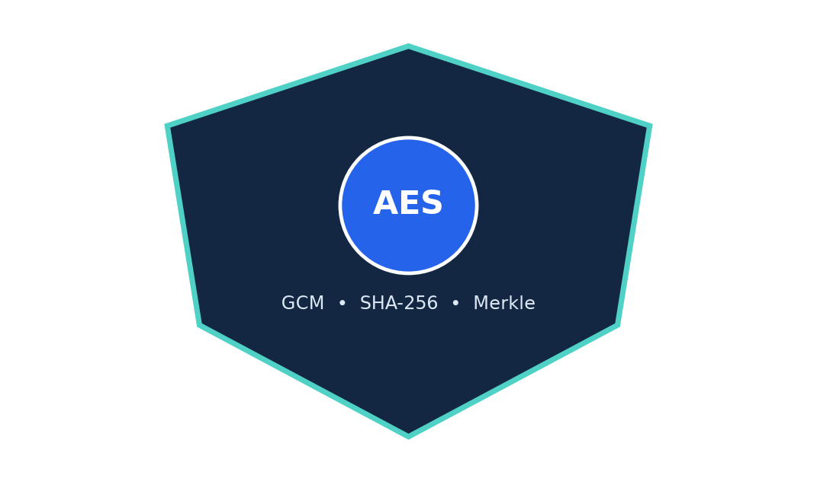
05 • DATA PROTECTION
Chunking, Encryption, and Integrity Processing
Encryption, authentication, and hash comparison have different roles.
File
Chunk
Encrypt
Digest
Merkle
Store
original bytes
1 MiB max
AES-256-GCM
SHA-256
root over encrypted chunks
replicas + metadata
AES-GCM
Checks
Random 12-byte nonce and 16-byte tag; stored layout is nonce || ciphertext || tag.
SHA-256 compares encrypted chunk bytes. Merkle root summarizes the encrypted chunk sequence.
Demo limitation: AES key is a static source-code constant; do not use it for sensitive data.
Standards/API: AES [4] • SHA-256 [5] • PyCryptodome [6]
Source: config.py • crypto.py • chunking.py • storage.py
FAULT TOLERANT P2P • ACADEMIC PROTOTYPE
13

Slide 14
05 • STORAGE DESIGN
Replication and Deterministic Data Placement
Configured factor R=2; actual health still depends on successful stores and node availability.
N1
ACTIVE
Chunk ID
Placement index
SHA-256 prefix
first 8 bytes mod |ACTIVE|
N3
STANDBY
N2
ACTIVE
primary = sorted_ACTIVE[index] • secondary = sorted_ACTIVE[(index + 1) mod n]
With the initial ACTIVE set {N1, N2}, every chunk is placed on both nodes. Upload refuses fewer than two ACTIVE nodes.
FAULT TOLERANT P2P • ACADEMIC PROTOTYPE
14

Slide 15
06 • NODE HEALTH
Heartbeat-Based Failure Detection
Configured interval 1 s • timeout 4 s • detector scans once per interval.
age > 4 s → mark DOWN
HEARTBEAT
HEARTBEAT
HEARTBEAT
HEARTBEAT
MISSED
t₀
t₀+1s
+2s
+3s
+4s
scan
Detection is suspicion
Actual state rule
Timeout cannot distinguish a crashed node from delay, packet loss, or a coordinator/network outage.
Only ACTIVE nodes with a previously received heartbeat are checked; unseen nodes are ignored.
Source: config.py • heartbeat_monitor.py • node_process.py
FAULT TOLERANT P2P • ACADEMIC PROTOTYPE
15

Slide 16
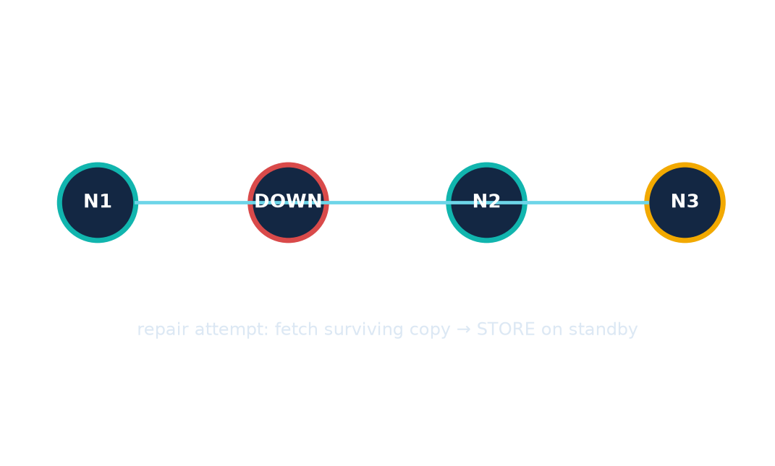
06 • NODE HEALTH
Standby Recovery and Replica Repair
Code implements copy attempts and promotion; full end-to-end recovery remains unverified.
1
Mark failed ACTIVE DOWN
2
Select a STANDBY
3
Find surviving mapped replica
4
FETCH then STORE each chunk
5
Remap only after STORE ACK
6
Promote standby ACTIVE
Important
Promotion can occur even if some chunks were not repaired; do not equate N3 ACTIVE with complete restoration.
Source: heartbeat_monitor.py • recovery.py • db.py
FAULT TOLERANT P2P • ACADEMIC PROTOTYPE
16

Slide 17
07 • INTEGRITY
Merkle-Tree Integrity Verification
Project tree leaves are hashes of encrypted chunks; odd leaves are duplicated at a level.
MERKLE ROOT
stored in files.merkle_root
H(L₁ || L₂)
H(L₃ || L₄)
pair hash
pair hash
H(C1)
H(C2)
H(C3)
H(C4)
encrypted chunk hash
encrypted chunk hash
encrypted chunk hash
encrypted chunk hash
Construction: hash each encrypted chunk → hash adjacent digest pairs → repeat to one root; duplicate an odd final leaf.
Source: coordinator/merkle.py • storage.py • tests/test_merkle_audit.py
FAULT TOLERANT P2P • ACADEMIC PROTOTYPE
17

Slide 18
07 • INTEGRITY
Hash-Linked Audit Log
Each record hash binds its event, timestamp, and predecessor digest.
ENTRY 1
ENTRY 2
ENTRY 3
ENTRY 4
UPLOAD
prev = 000…000
hash = h₁
DOWNLOAD
prev = h₁
hash = h₂
PROMOTE
prev = h₂
hash = h₃
RECOVERY
prev = h₃
hash = h₄
Verification: recompute each entry hash and compare the predecessor link.
ALTERED EVENT → HASH MISMATCH
Detects inconsistent edits if the verifier retains trusted chain state; not an immutable external ledger.
Source: coordinator/audit.py • db.py • tests/test_merkle_audit.py
FAULT TOLERANT P2P • ACADEMIC PROTOTYPE
18

Slide 19
08 • IMPLEMENTATION
Implementation and Technology Stack
Only technologies present in requirements or imported project code are shown.
CLIENT
Python CLI • Requests
HTTP API
Flask • upload / download / status
COORDINATION
Python modules • placement • recovery
METADATA
SQLite • files / chunks / nodes / replicas / audit
NODE I/O
TCP sockets • framed JSON STORE / FETCH
CRYPTO
PyCryptodome AES-GCM • hashlib SHA-256
Testing: pytest • Benchmark plotting dependency: Matplotlib • Deployment: local loopback prototype
Framework and storage references: Flask [1] • SQLite [2] • Python sockets [3]
FAULT TOLERANT P2P • ACADEMIC PROTOTYPE
19

Slide 20
09 • EVIDENCE
Testing Strategy and Verified Test Result
Previous repository audit: 11 unit tests passed; that result was not rerun for this deck.
Unit-test evidence
Not established by that result
• Chunk split/reassemble and empty input
• Live upload/download across child processes
• AES-GCM round trips, wrong key, tampering
• Retrieval after an actual node termination
• Placement and SQLite schema
• Complete standby replica restoration
• Merkle root and audit tamper detection
• Failure-detection or recovery latency
• Stale ACTIVE heartbeat marking
• Performance under repeated or concurrent load
11 TESTS REPORTED
Unit tests check components; end-to-end experiments exercise the running system.
pytest docs [8]
Evidence: repository tests • previous audit report
FAULT TOLERANT P2P • ACADEMIC PROTOTYPE
20

Slide 21
09 • EVALUATION PLAN
Experimental Evaluation Methodology
Proposed metrics only — no benchmark or end-to-end recovery experiment has been executed.
Latency
Throughput
Replica overhead
Detection
Repair
• elapsed request time
• successful bytes / elapsed time
• additional replica bytes
• node stop → DOWN state
• DOWN → repair/promotion
• mean = Σt / n
• bytes ÷ seconds
• extra / original
• record wall-clock ms
• separate copy and total
Controlled run checklist
Record file sizes • trial count • OS/hardware • topology • fixed-port availability • all failures
No values are reported: existing benchmark scripts write under experiments/results and were left unexecuted.
FAULT TOLERANT P2P • ACADEMIC PROTOTYPE
21

Slide 22
09 • EVALUATION
Results and Current Implementation Evidence
Separate source presence, prior unit evidence, and missing system-level measurements.
Capability
Evidence status
What is still unknown
Upload / retrieval routes
In source
No live E2E run
AES-GCM / SHA-256
In source + unit tests
Selected component checks
Merkle helper
In source + unit tests
No scale/performance data
Audit hash chain
In source + unit test
Tamper check is component-level
Heartbeat detector
In source + unit test
No real failure timing
Standby repair routine
In source
End-to-end recovery unrun
Benchmarks
Scripts present
Not executed
No benchmark values, recovery duration, success rate, or storage-overhead result is available.
FAULT TOLERANT P2P • ACADEMIC PROTOTYPE
22

Slide 23
10 • NEXT STEPS
Limitations and Future Enhancements
Separate established architectural limits from evaluation work still to be done.
Current constraints / open evidence
Future work
• Single coordinator and local SQLite metadata
• Isolated upload/download benchmark series
• Loopback defaults; no peer discovery or consensus
• Controlled one-node failure and repair trials
• No HTTP/TCP authentication or TLS
• Network delay, partition, and concurrent-failure tests
• Static demo key; no external key management
• Replica consistency and repair validation
• No automatic reintegration of restarted DOWN nodes
• Secure key provisioning and authenticated transport
• Benchmarks and end-to-end recovery unmeasured
• Multi-host and workload scaling evaluation
FAULT TOLERANT P2P • ACADEMIC PROTOTYPE
23

Slide 24
10 • SUMMARY
Conclusion and Project Contribution
A prototype foundation for investigating resilient storage—not a production availability claim.
STORAGE
INTEGRITY
RECOVERY
HTTP file operations
1 MiB encrypted chunks
TCP node I/O
SHA-256 comparisons
Merkle root check
Hash-linked audit events
Heartbeat-based DOWN state
Standby copy attempts
Evidence still needed
Initial unit-test evidence exists. Controlled experiments are needed to quantify performance and establish end-to-end recovery effectiveness.
Distributed storage + integrity verification + failure monitoring = a foundation for investigating resilient systems.
FAULT TOLERANT P2P • ACADEMIC PROTOTYPE
24

Slide 25
CLOSING
References and Acknowledgements
[1] Flask Documentation
[5] NIST FIPS 180-4, Secure Hash Standard
https://flask.palletsprojects.com/en/stable/
https://csrc.nist.gov/pubs/fips/180-4/upd1/final
[2] SQLite Documentation
[6] PyCryptodome AES API
https://sqlite.org/docs.html
https://pycryptodome.readthedocs.io/en/latest/src/cipher/aes.html
[3] Python socket module
[7] Repository README, configuration, source, tests
https://docs.python.org/3/library/socket.html
Local project files inspected for implementation claims
[4] NIST FIPS 197, AES
[8] pytest documentation
https://nvlpubs.nist.gov/nistpubs/FIPS/NIST.FIPS.197-upd1.pdf
https://docs.pytest.org/en/stable/
Acknowledgements: [GUIDE / LAB / INSTITUTIONAL ACKNOWLEDGEMENTS]
THANK YOU • QUESTIONS AND DISCUSSION
FAULT TOLERANT P2P • ACADEMIC PROTOTYPE
25

