Slide 1
Title
FAULT TOLERANT P2P
DISTRIBUTED STORAGE SYSTEM
Student: [Student Name] • Roll: [Roll Number]
Department/Institution: [Department] / [Institution]
Guide: [Guide Name] • Academic year: [Academic Year]
Fault Tolerant P2P Distributed Storage System
1

Slide 2
Outline
Problem and objectives
Verified architecture and workflows
Algorithms, security, and implementation
Testing evidence and experimental status
Limitations and conclusion
Fault Tolerant P2P Distributed Storage System
2

Slide 3
Introduction
Distributed storage spreads data across networked nodes.
Replication can preserve access to another copy after a node loss.
This repository is a local educational prototype.
Fault Tolerant P2P Distributed Storage System
3

Slide 4
Problem statement
A failed storage node can hide a sole copy.
Replica placement and metadata are needed to find chunks.
Retrieval should detect missing or corrupted data.
Repair requires an available copy and destination.
Fault Tolerant P2P Distributed Storage System
4

Slide 5
Objectives
Encrypt and split file contents into fixed chunks.
Store two replicas across active nodes.
Reconstruct data and validate stored chunks.
Detect stale nodes and attempt standby repair.
Fault Tolerant P2P Distributed Storage System
5

Slide 6
Existing systems
Centralized platforms can also use redundancy.
This project demonstrates mechanisms, not production availability.
A single coordinator and SQLite remain common failure points.
No consensus, partition policy, or multi-coordinator HA.
Fault Tolerant P2P Distributed Storage System
6

Slide 7
Proposed system
Flask coordinator manages API workflows.
SQLite persists file/chunk/node/replica/audit metadata.
N1/N2 ACTIVE; N3 STANDBY.
TCP nodes store local encrypted chunk blobs.
Fault Tolerant P2P Distributed Storage System
7

Slide 8
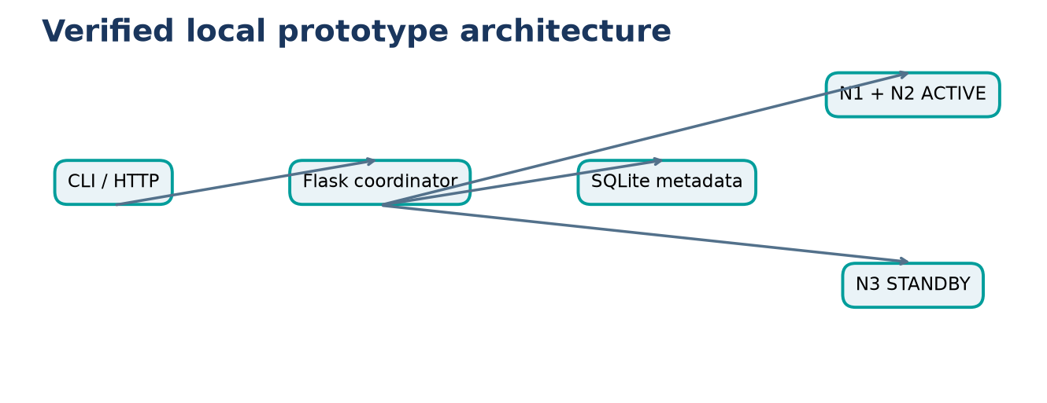
Architecture
Fault Tolerant P2P Distributed Storage System
8

Slide 9
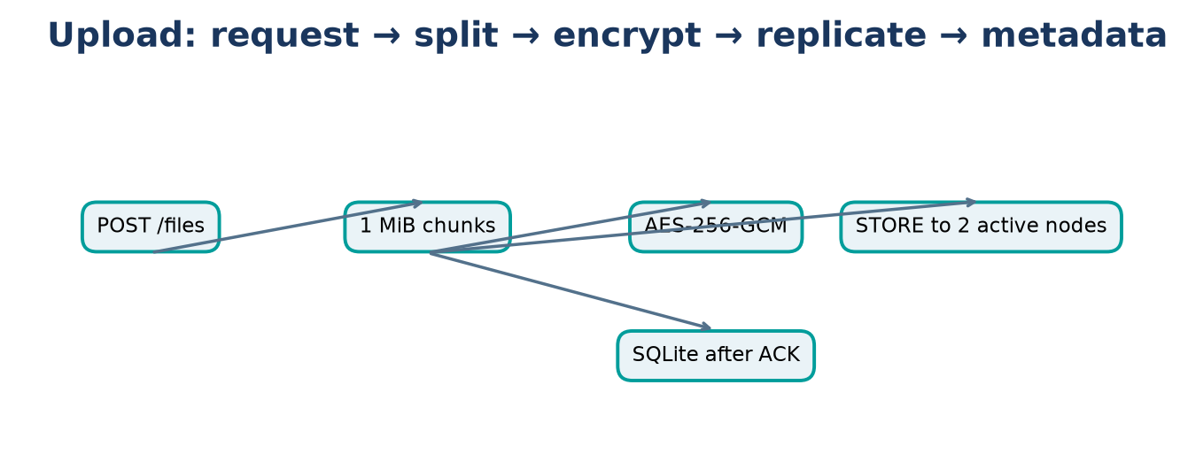
Upload workflow
Fault Tolerant P2P Distributed Storage System
9

Slide 10
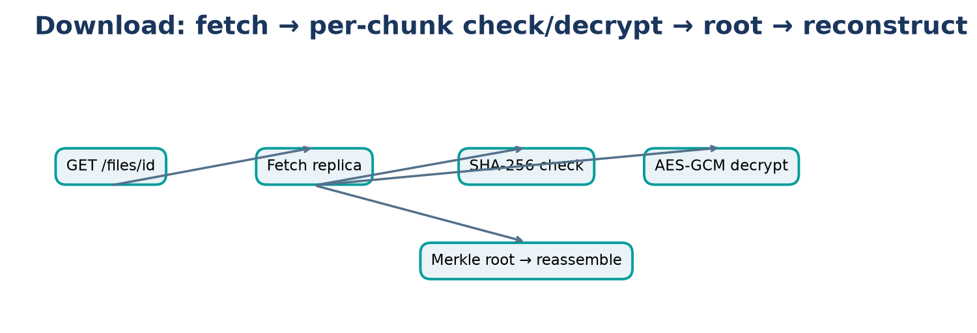
Retrieval workflow
Fault Tolerant P2P Distributed Storage System
10

Slide 11
Methodology
Bytes → chunks → encryption → placement → TCP STORE.
Persist metadata only after successful replica ACKs.
Download reverses path and checks integrity.
Fault Tolerant P2P Distributed Storage System
11

Slide 12
Major modules
app.py/API; storage.py pipeline; db.py metadata.
crypto.py/chunking.py/merkle.py/audit.py.
placement.py/node_client.py/node_process.py.
heartbeat_monitor.py and recovery.py.
Fault Tolerant P2P Distributed Storage System
12

Slide 13
Algorithms
Placement: SHA-256 chunk ID prefix modulo sorted active count; next circular node.
Failure: heartbeat age exceeds 4 s after first heartbeat.
Integrity: encrypted chunk SHA-256, Merkle root, GCM authentication.
Audit chain links event hash to prior event.
Fault Tolerant P2P Distributed Storage System
13

Slide 14
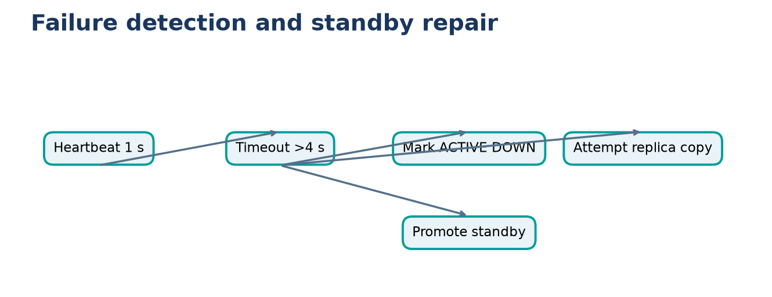
Failure and repair
Fault Tolerant P2P Distributed Storage System
14

Slide 15
Security
AES-256-GCM: random 12-byte nonce + ciphertext + 16-byte tag.
Static demo key; no external key management.
No HTTP/TCP authentication or TLS.
Hash is integrity evidence, not confidentiality.
Fault Tolerant P2P Distributed Storage System
15

Slide 16
Implementation/tools
Python, Flask, SQLite, TCP sockets, PyCryptodome.
Requests client, pytest, Matplotlib.
Versions appear in environment_details.json.
Fault Tolerant P2P Distributed Storage System
16

Slide 17
Experimental setup
3 nodes, replication factor 2; chunks 1 MiB.
Heartbeat interval 1 s, threshold 4 s.
Loopback ports: 5000, 6100, 6001–6003.
Hardware model and memory not recorded.
Fault Tolerant P2P Distributed Storage System
17

Slide 18
Evaluation methods
Upload/download harness defaults: 4 KiB, 64 KiB, 1 MiB; 3 trials.
Failure harness: 16 KiB; terminate N1; track DOWN and N3 ACTIVE.
Throughput formula documented in methodology.
Experiments unexecuted; fixed ports require isolation.
Fault Tolerant P2P Distributed Storage System
18

Slide 19
Performance results
No valid benchmark measurements are available.
CSV schema is present and contains no data rows.
No performance chart is shown to avoid invented results.
Fault Tolerant P2P Distributed Storage System
19

Slide 20
Fault/integrity results
Prior audit: 11 unit tests passed.
Tests cover components; no end-to-end recovery run.
No measured success rate or repair time is available.
Fault Tolerant P2P Distributed Storage System
20

Slide 21
Discussion
Implementation exists for placement, detection, repair, integrity.
Unit-test report does not establish runtime performance.
No automatic reintegration after restart.
One-node recovery depends on surviving replica and standby.
Fault Tolerant P2P Distributed Storage System
21

Slide 22
Limitations/future
Single coordinator/database and loopback configuration.
No secure key management, TLS, auth, peer discovery, garbage collection.
Concurrent failures and partitions unverified.
Future: HA metadata, secure transport, multi-host evaluation.
Fault Tolerant P2P Distributed Storage System
22

Slide 23
Conclusion
Encrypted two-replica chunk path and basic repair logic exist in code.
Prior unit tests reported passing.
Benchmarks and end-to-end recovery remain unmeasured.
Fault Tolerant P2P Distributed Storage System
23

Slide 24
References / Questions
Flask; SQLite; Python sockets; PyCryptodome AES.
NIST FIPS 180-4 SHA-2.
pytest and Matplotlib official documentation.
Questions
Fault Tolerant P2P Distributed Storage System
24

