Slide 1
NAME : Yashika COURSE : MCA 12 UID : 21MCA2627 PROJECT TITLE : OTP VERIFICATION USING PYTHON

Slide 2
WHAT IS TWILIO MODULE… Twilio is a web application programming interface (API) that software developers can use to add communications such as phone calling, messaging, video and two-factor authentication into their Python applications. How to install Package: “pip install twilio” Then use this command to use twilio API: “from twilio.rest import Client”

Slide 3
What is tkinter…. Tkinter is the standard GUI library for Python. Python when combined with Tkinter provides a fast and easy way to create GUI applications. Tkinter provides a powerful object-oriented interface to the Tk GUI toolkit. from tkinter import * from tkinter import messagebox

Slide 4
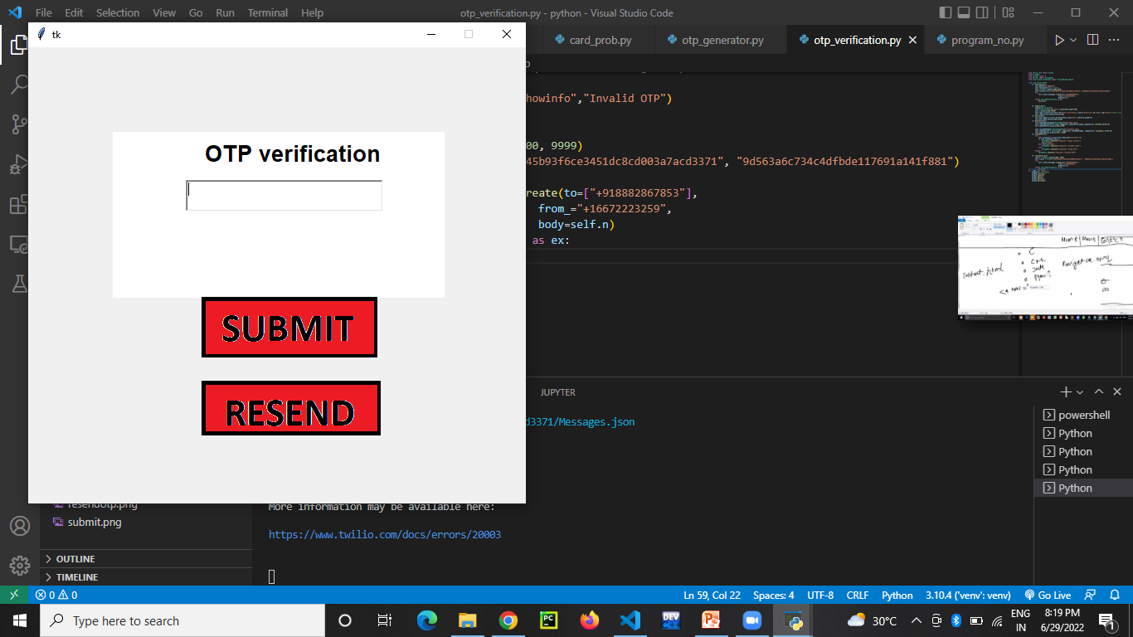
OTP VEIFICATION GUI..

Slide 5
GUI PART… Step 1:- LOGIN GUI PART def Labels(self): window=otp_verifier() self.c=Canvas(self,bg="white",width=400,height=200) self.c.place(x=100,y=100) self.Login_Title=Label(self,text="OTP verification",font=("Helvetica",20,"bold"),bg="white") self.Login_Title.place(x=210,y=110) def Entry(self): self.User_Name=Text(self,borderwidth=2,wrap="word",width=29,height=2) self.User_Name.place(x=190,y=160)

Slide 6
STEP 2:- ADDING TWO BUTTONS(SUBMIT AND RESEND) def Buttons(self): self.submitButtonImage=PhotoImage(file="submit.png") self.submitButton=Button(self,image=self.submitButtonImage,command=self.checkOTP,border=0) self.submitButton.place(x=208,y=300) self.resendOTPImage= PhotoImage(file="resendotp.png") self.submitButton = Button(self, image=self.resendOTPImage, command=self.resendotp, border=0) self.submitButton.place(x=208, y=400)

Slide 7
STEP 3:- AFTER CLICKING SUBMIT BUTTON THE CONTROL FLOW MOVE TO CHECKOTP() FUNCTION. def checkOTP(self): try: self.userInput=int(self.User_Name.get(1.0,"end-1c")) if self.userInput==self.n: messagebox.showinfo("showinfo","Login Success") self.n="done" elif self.n=="done": messagebox.showinfo("showinfo","already login") else: messagebox.showinfo("showinfo","wrong OTP") except: messagebox.showinfo("showinfo","Invalid OTP")

Slide 8
STEP 4: WHILE RESEND BUTTON CALL RESEND() FUNCTION. def resendotp(self): self.n = random.randint(1000, 9999) self.client = Client("AC9c45b93f6ce3451dc8cd003a7acd3371", "464d464fbd4214846ef253b4bcc87d29") try: self.client.messages.create(to=["+918882867853"], from_="+16672223259", body=self.n) except TwilioRestException as ex: print(ex)

Slide 9
STEP 5: TWILIO SEND OTP TO MOBILE NO. USING SID AND TOKEN ID def calling(self): self.geometry("600x550") self.resizable(False, False) self.n=random.randint(1000,9999) self.client=Client("AC9c45b93f6ce3451dc8cd003a7acd3371(SID)","464d464fbd4214846ef253b4bcc87d29 (TOKEN ID)") try: self.client.messages.create(to=["+918882867853"], from_="+16672223259", body=self.n) except TwilioRestException as ex: print(ex)

Slide 10
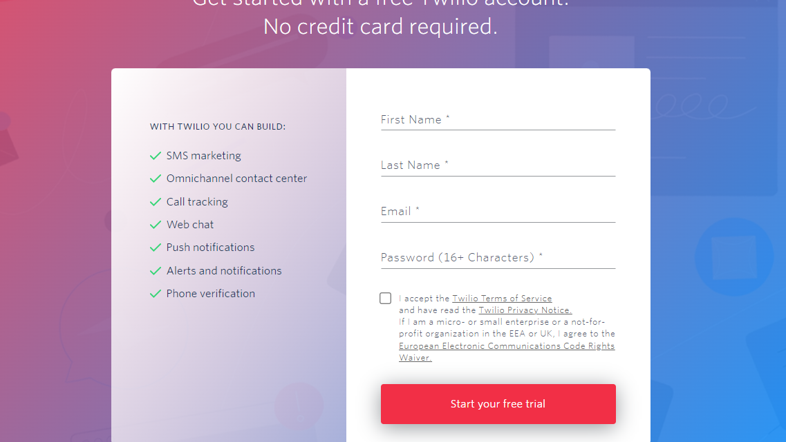
HOW TO GET SID AND TOKEN ID STEP 1: SIGN UP THEN LOGIN ON TWILIO WEBSITE

Slide 11
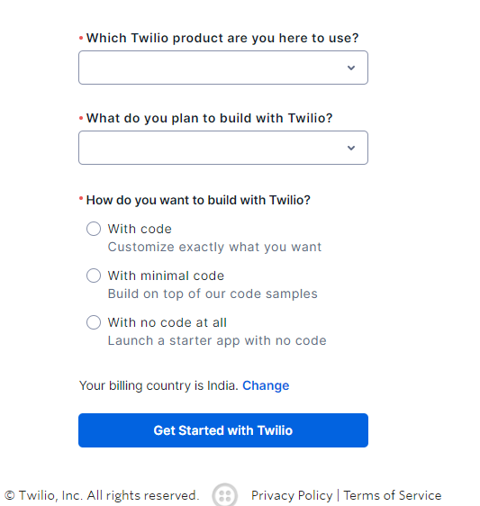
STEP 2: AFTER LOGIN FILL THE FORM

Slide 12
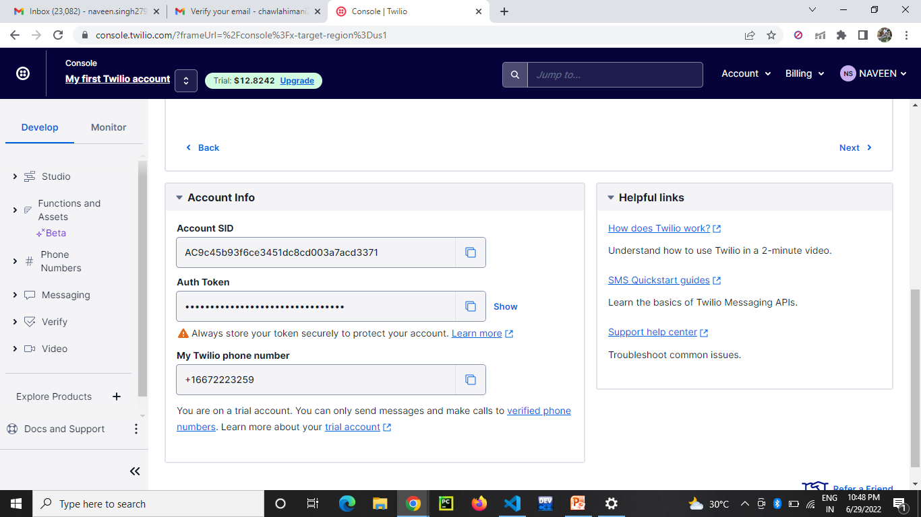
STEP 3: AFTER FILLING THE FORM, WEBSITE WILL REDIRECT TO THE DASHBOARD WHERE YOU CAN FIND SID, TOKEN NO., AND TWILIO PHONE NO., COPY THEM PASTE TO THE CALLING FUNCTION.

Slide 13
STEP 6:- MAIN FUNCTION(FUNCTION CALLING) if __name__=="__main__": window=otp_verifier() window.calling() window.Labels() window.Entry() window.Buttons() window.mainloop()

Slide 14
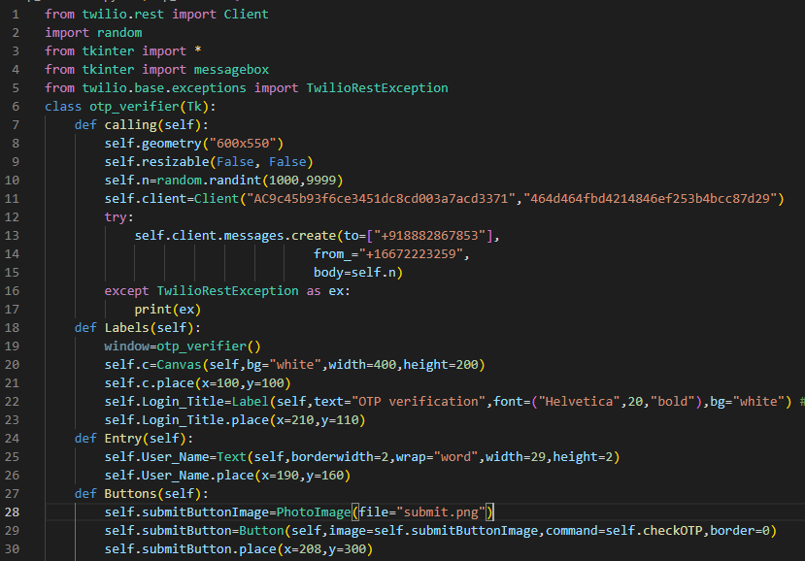
ENTIRE CODE

Slide 15
