Slide 1
Predicting Diabetes
TEAM MEMBERS:
Diksha - 2210990282
Divij Suri - 2210990292
Diya - 2210990300
Yashika Gaur - 2210990977
Under the supervision
Of
Dr. Jatin Arora
Chitkara University, Punjab

Slide 2
Introduction
Diabetes is a disease that is rapidly increasing worldwide, posing significant health challenges. It occurs when the pancreas fails to produce sufficient insulin, leading to elevated blood glucose levels in the body.
Harnessing the power of Artificial Intelligence and Machine Learning, we can predict the risk of diabetes.
By analyzing patient data such as age, insulin levels, glucose levels, and other relevant factors, ML algorithms can detect patterns that enable us to anticipate who might develop diabetes.

Slide 3
Research Outcome
Diabetes poses a significant threat to public health, leading to severe complications such as blindness, kidney failure, and heart attacks.
Between 2000 and 2019, there was a troubling 3% increase in diabetes-related mortality rates. In 2019 alone, diabetes and associated kidney diseases accounted for approximately 2 million deaths globally.
Living a healthy lifestyle is crucial for preventing diabetes. This means eating a balanced diet, staying active with regular exercise, managing your weight, and saying no to tobacco. These simple steps not only lower your risk of diabetes but also keep you feeling good and healthy overall.

Slide 4
Problem Statement
Despite advancements in healthcare, diabetes remains a global health concern with significant impacts on individuals and healthcare systems.
The challenge lies in early detection and proactive management to reduce complications and improve patient outcomes.
This project aims to develop a predictive model for identifying individuals at risk of diabetes, facilitating timely intervention and ultimately enhancing public health.

Slide 5
Introduction to Dataset
We obtained our diabetes dataset from Kaggle , which specifically focuses on women.
The dataset comprises of 768 rows and 9 columns
These columns consists of :
Pregnancies : Number of times Pregnant
Glucose : Glucose concentration
Blood Pressure : Diastolic Blood Pressure
Skin Thickness : skin fold Thickness
Insulin : serum insulin
BMI : Body Mass index
Diabetes Pedigree Function : Family history diabetes risk
Age : Age in years
Outcome : (0 for NO) (1 for YES)

Slide 6
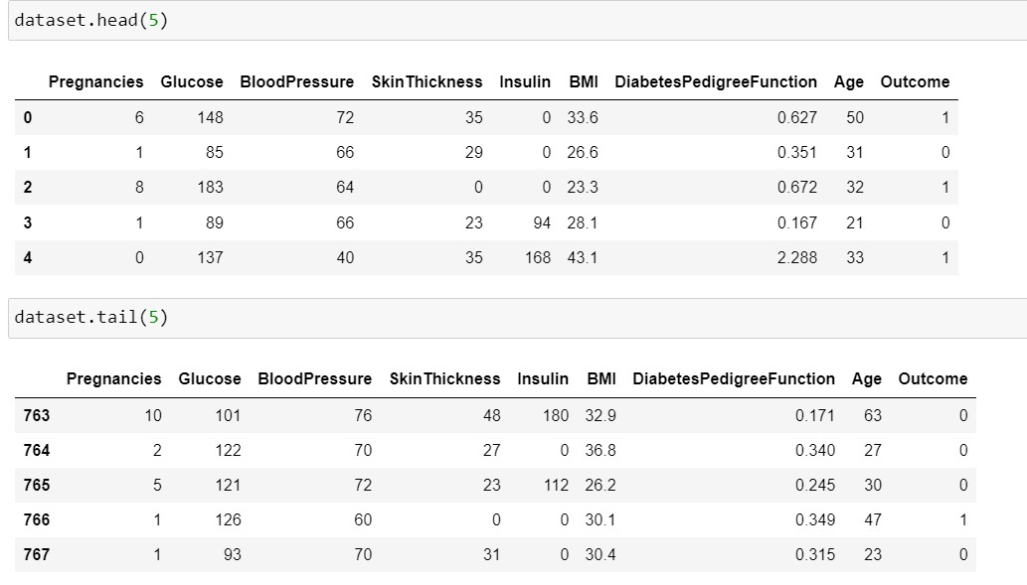
Dataset Snapshot

Slide 7
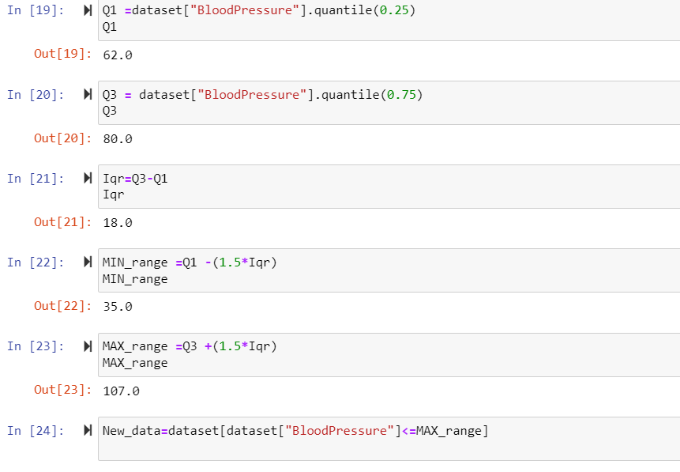
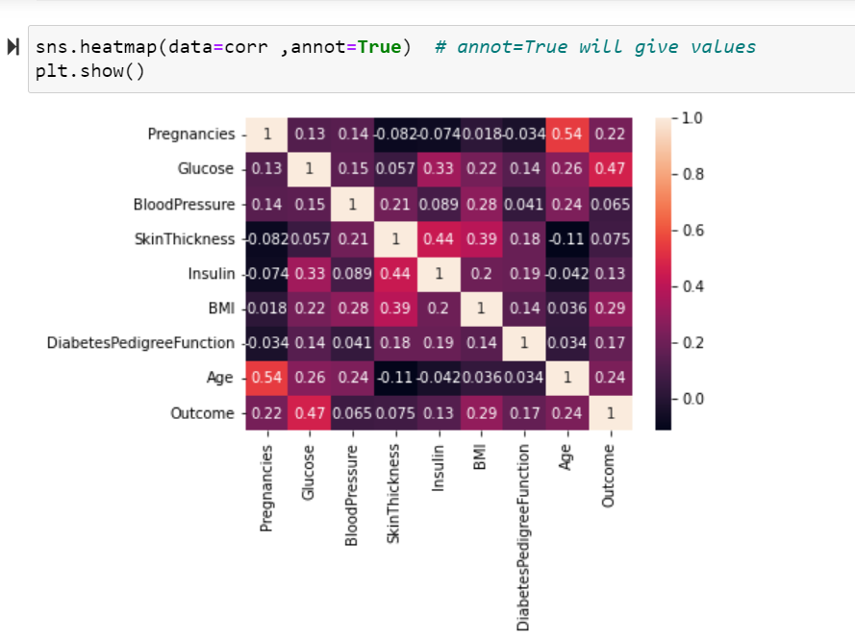
Code Snippets

Slide 8
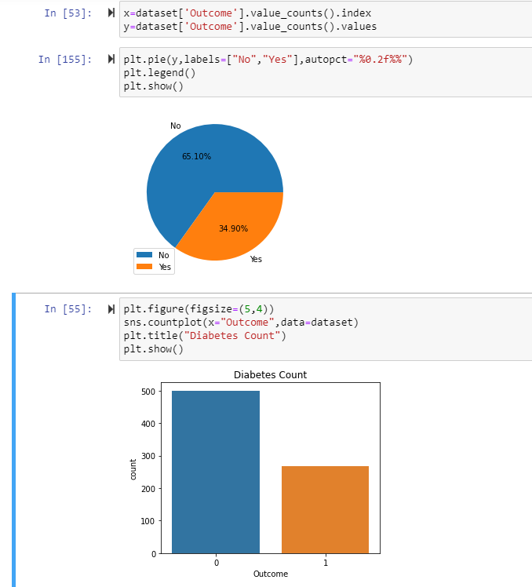
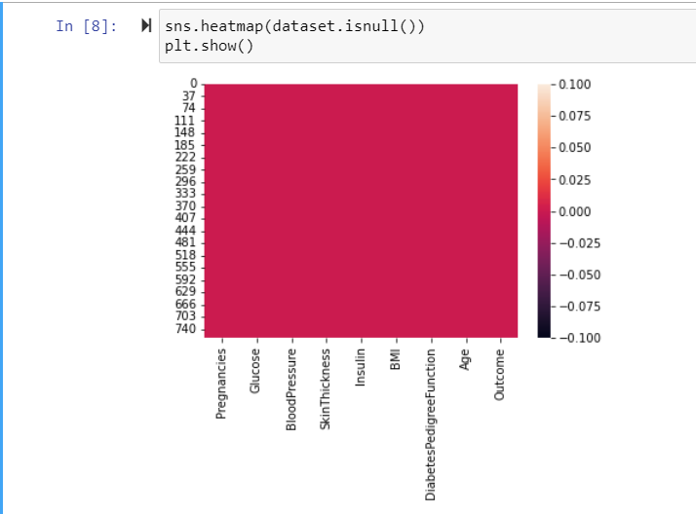
Code Snippets

Slide 9
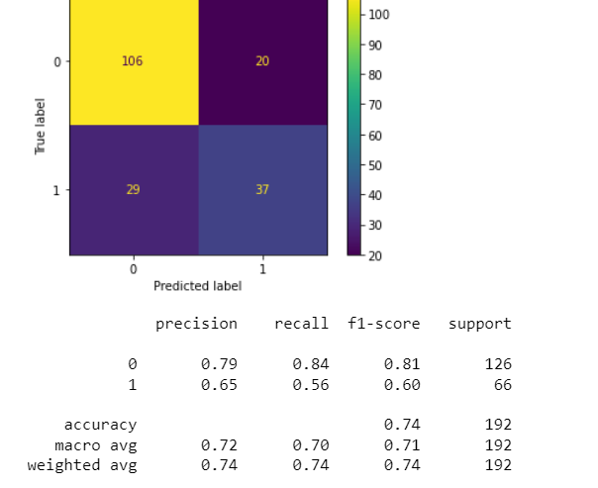
Result
Result of logistic regression

Slide 10
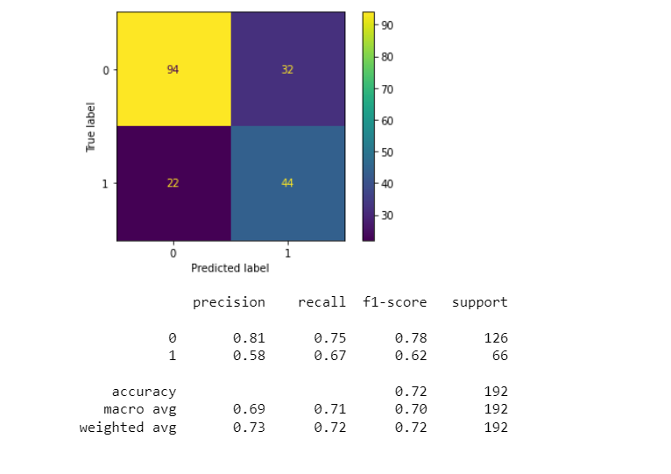
Result
Result of Decision Tree

Slide 11
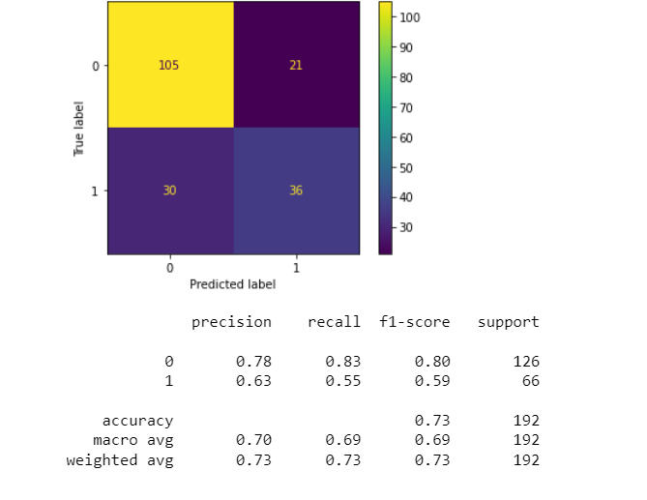
Result
Result of Neural Network

Slide 12
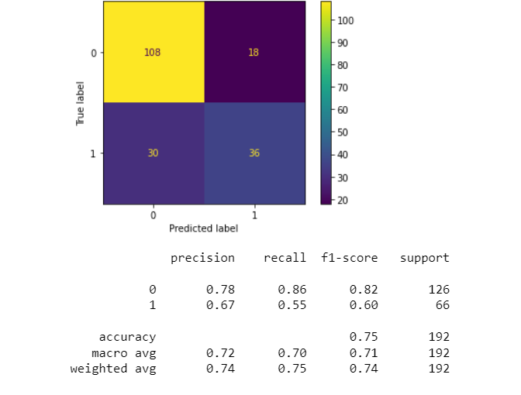
Result
Result of Standard Vector Machine

Slide 13
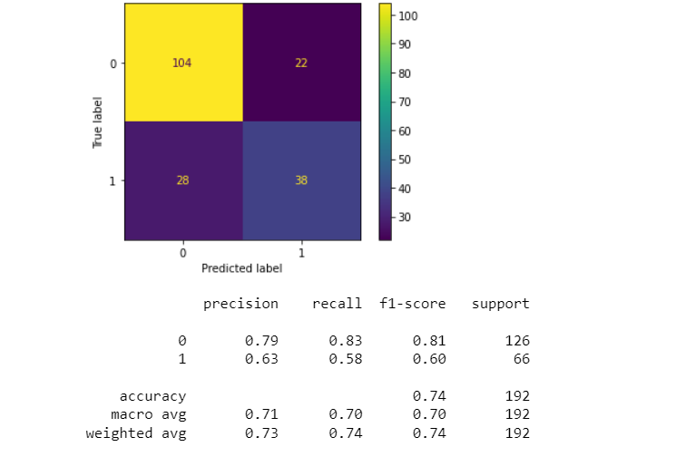
Result
Result of Random Forest

Slide 14
Tools and Technologies
Pandas - Data manipulation
NumPy - Numerical operations
Scikit-learn - Machine learning and preprocessing
Matplotlib - Data visualization
Seaborn - Data visualization

Slide 15
Conclusion
This project showed how we can use machine learning to predict diabetes.
By cleaning and preparing the data, training a simple Logistic Regression model, and evaluating its performance, we were able to make accurate predictions.
Key takeaways include the importance of clean data and that even simple models can be effective.
Overall, this project demonstrates how machine learning can help in diagnosing diabetes and improving healthcare..

Slide 16
References
We have taken reference from :
GeeksForGeeks : https://www.geeksforgeeks.org/machine-learning/
Data Set Link :
https://www.kaggle.com/code/paultimothymooney/predict-diabetes-from-medical-records/input

Slide 17


