Slide 1
Shelter Seek
Team Details → Diksha – 2210090282
Divij – 2210090292
Diya – 2210990300
Yashika – 2210990977
Under the supervision
of
Name of the Supervisor(s)
Mr Vikas Patel
Ms Parul
Name of Department/School
Chitkara University, Punjab

Slide 2

Introduction
The website makes it super easy for you to find houses you love .
If you're not looking to buy but want to rent a property, then this webiste would help tenants easily locate and explore properties that are available for rent..
It could include apartments, houses, or commercial spaces.

Slide 3
Motivation Of Research
The motivation behind creating a property website stems from addressing various challenges and needs within the real estate industry. Here are some key motivations :
1) Ease of Access:
Make property information easily accessible to a wide audience.
2) Give You the Right Info:
It's all about giving you the right information.
3) Put You First:
The website really cares about you. It's designed to put your needs first, providing solutions that match what you're looking for and making sure you have a good experience.

Slide 4
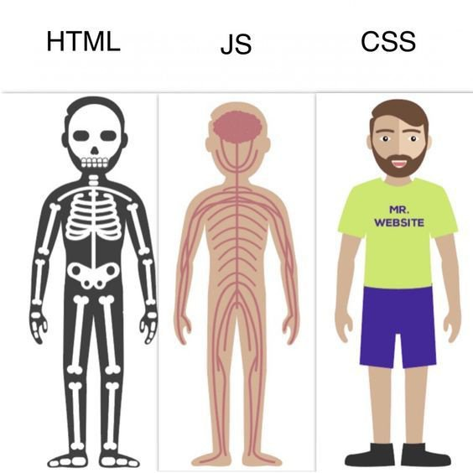
Tools & Technologies
In this we have used :
HTML → It is used for creating and structuring the content of web pages.
JAVASCRIPT → It is used to make webpage interactive.
CSS → It is used to style and layout webpage.

Slide 5
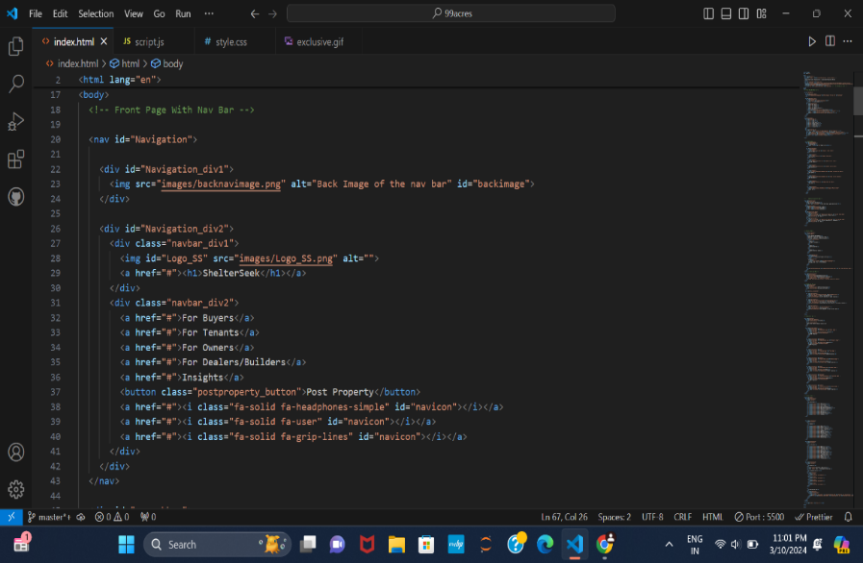
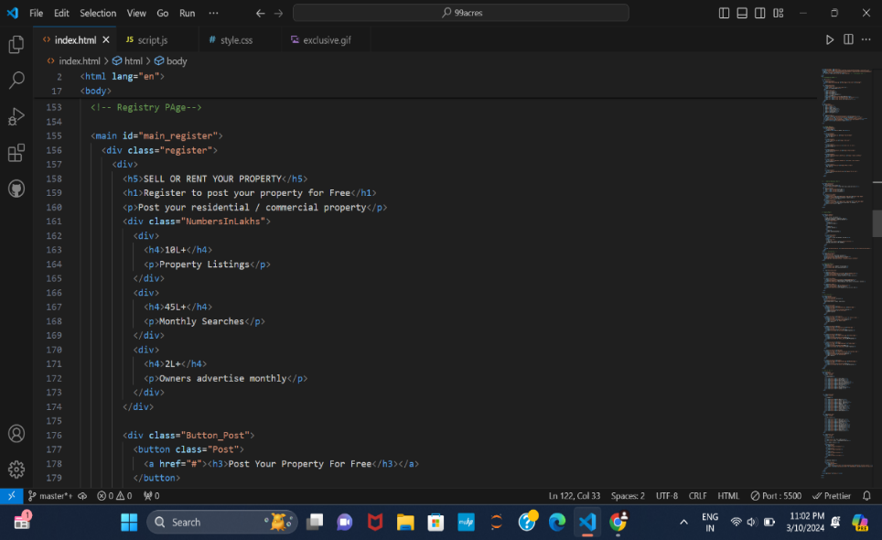
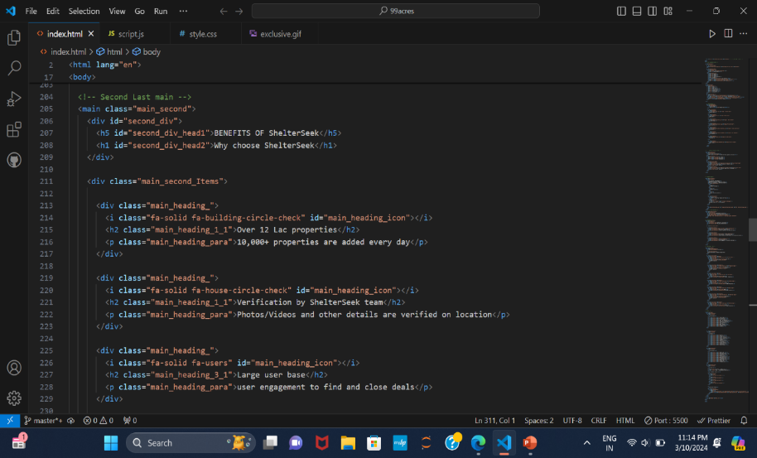
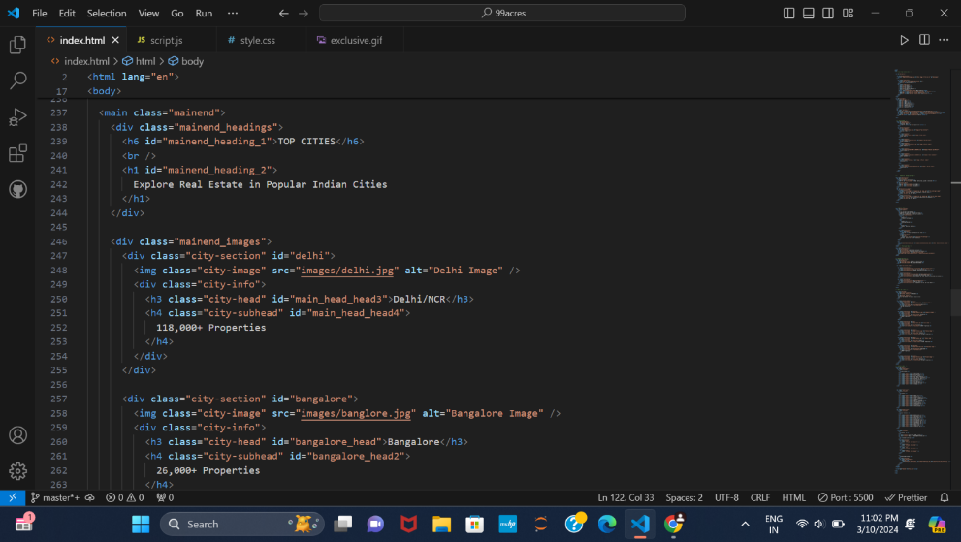
Code Snapshots (HTML Codes)

Slide 6
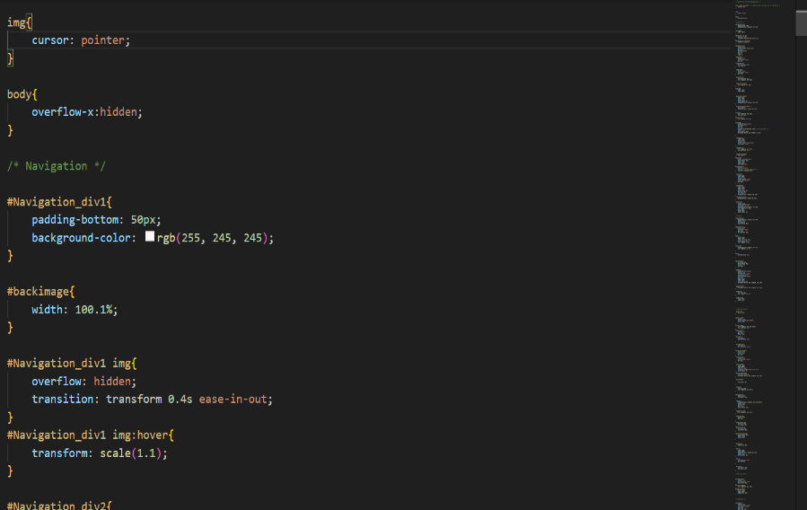
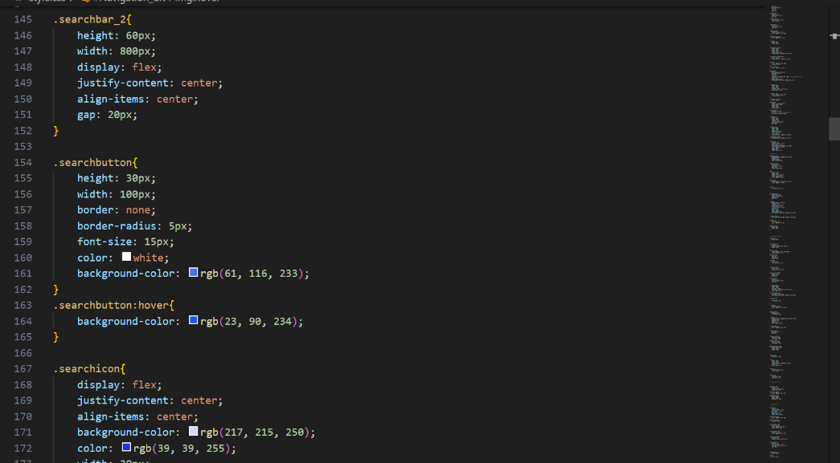
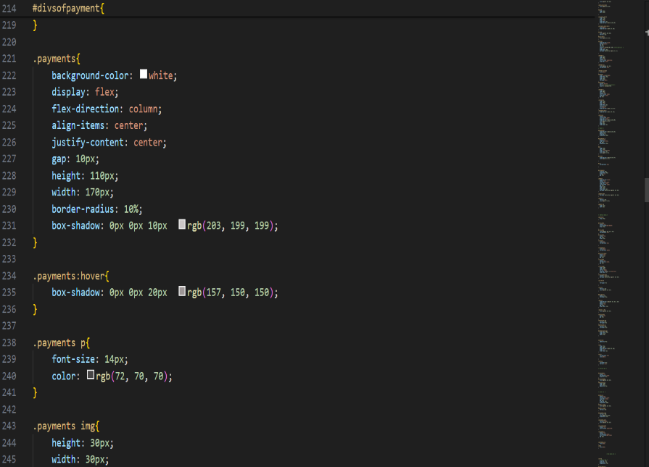
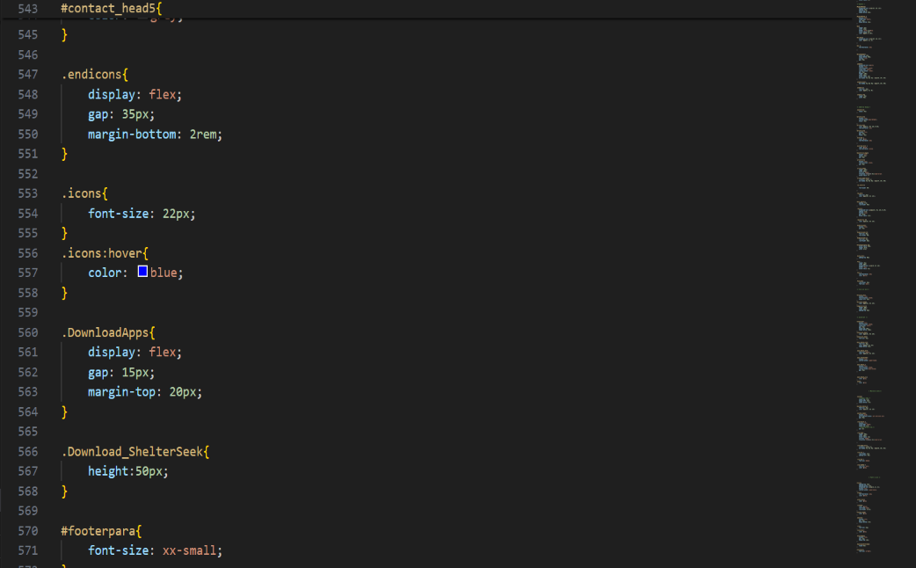
Code Snapshots (CSS Codes)

Slide 7
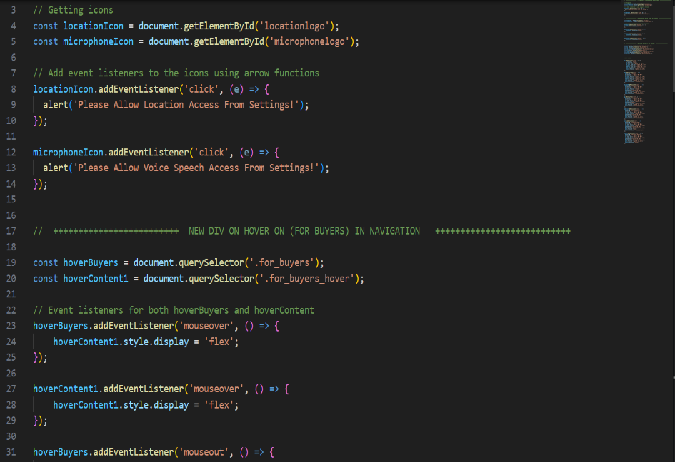
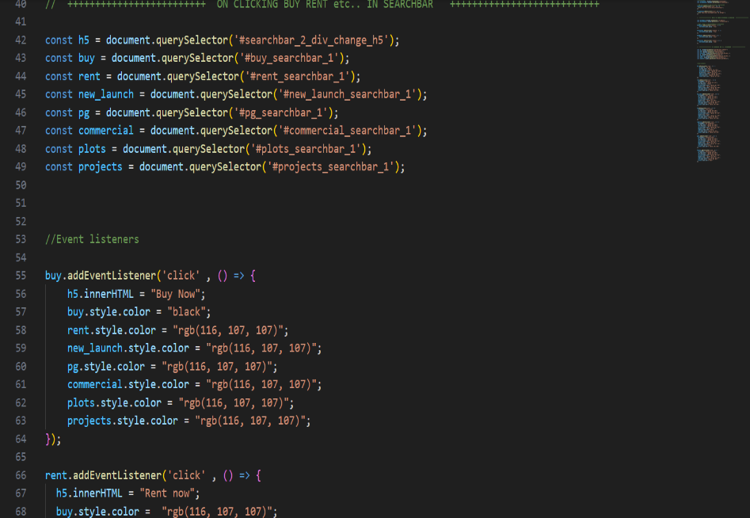
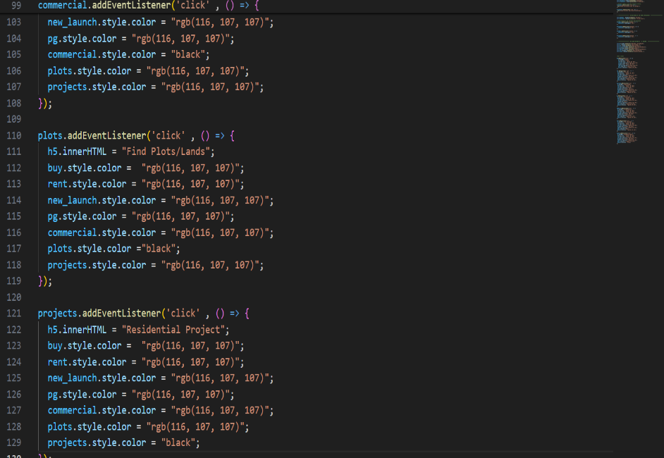
Code Snapshots (JS Codes)

Slide 8
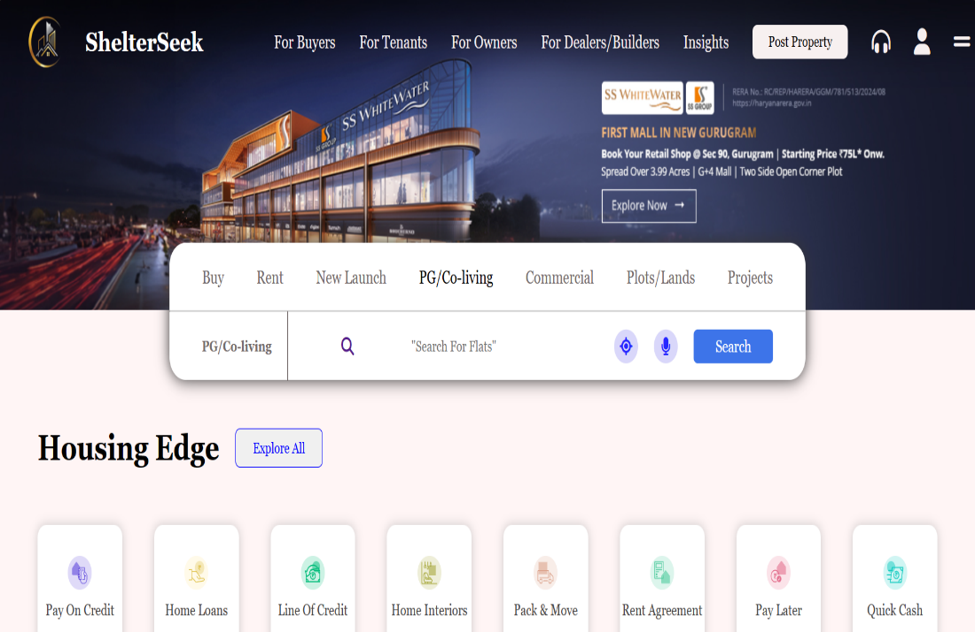
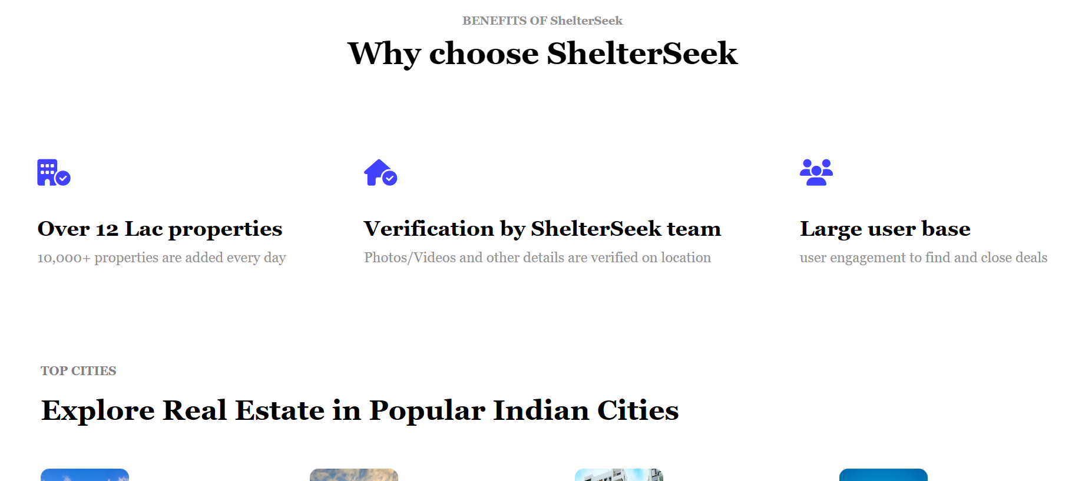
Result

Slide 9
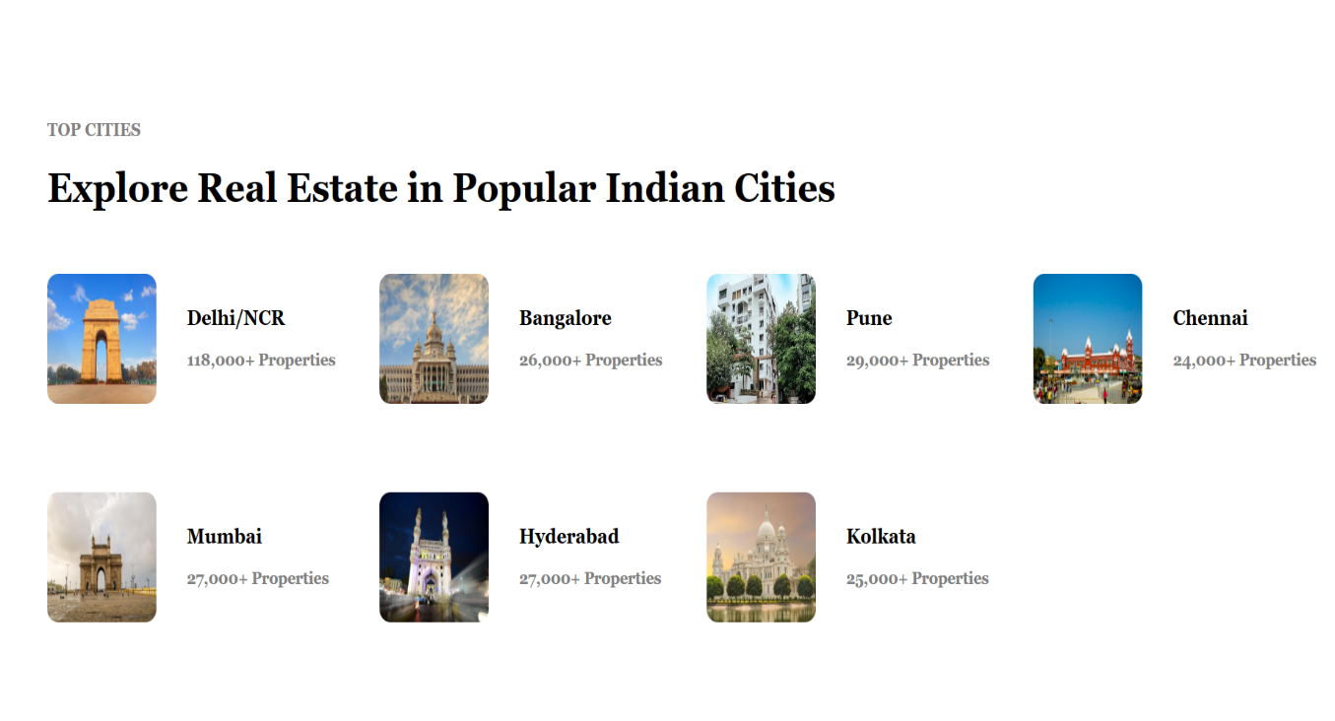
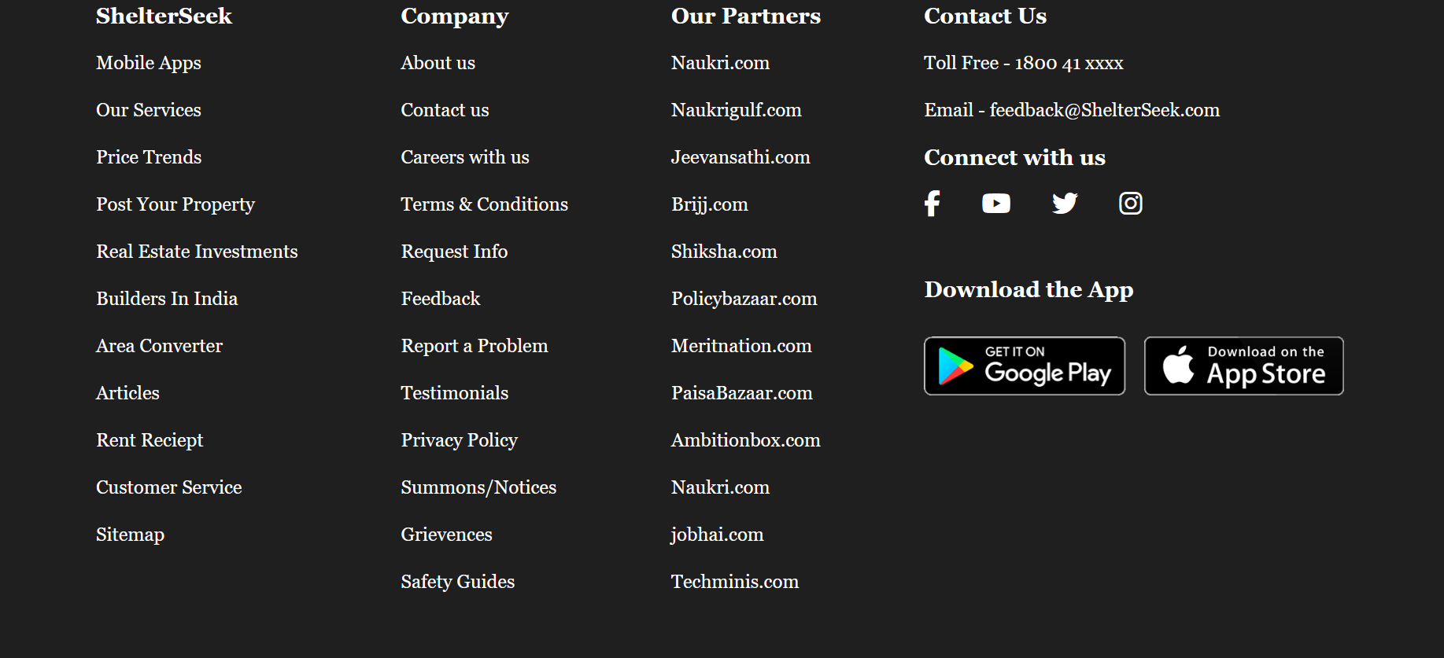

Slide 10

Conclusion/Theme Plan
In conclusion, a real estate website serves as a user-friendly platform designed to simplify the process of buying or renting properties.
It's like a user-friendly hub where you can quickly get all the info you need, compare options, and make smart decisions.

Slide 11
References
We have taken reference from :
99Acres → www.99acres.com
Housing → www.housing.com
W3Schools → www.w3schools.com

Slide 12


