Slide 1
HOTEL REVENUE MANAGEMENT
DASHBOARD
Revenue, Occupancy & Pricing Performance Analysis
Presented by: Yashika Sharma
B.Tech – CSE (Data Science)
ABES Engineering College, Ghaziabad
POWER BI + EXCEL

Slide 2
PROJECT OVERVIEW
Business context, purpose and analytical scope
BUSINESS CONTEXT
PROJECT PURPOSE
SCOPE
Hotel operations generate booking, occupancy, pricing and revenue data that can be difficult to interpret from raw tables alone.
Analyze room occupancy performance
Raw booking records
Track revenue and monthly trends
134,590
The project converts this information into a management-friendly analytical view.
Evaluate ADR and RevPAR
Observed period
Compare properties and room classes
Apr–Jul 2022
Support interactive business review
Primary tools
Power BI + Excel

Slide 3
PROBLEM STATEMENT
Why the dashboard was needed
CHALLENGES
BUSINESS NEED
Raw booking data is high-volume and difficult to interpret quickly.
Create a single interactive view that turns transactional booking data into understandable performance indicators.
Property, room-class and booking-status performance are spread across different fields.
The solution should make it easier to compare properties, room classes and monthly performance while preserving an auditable Excel analysis layer.
Pricing metrics such as ADR and RevPAR require calculated measures.
Monthly changes in occupancy and revenue need a common analytical timeline.
OUTPUT
Power BI dashboard + Excel PivotTables + Timeline + Business Insights

Slide 4
OBJECTIVES & PROJECT SCOPE
What the implementation was designed to deliver
Room occupancy
Seasonal / monthly trends
01
02
Measure and compare occupancy across the observed period and properties.
Track monthly revenue, occupancy, ADR and RevPAR movements.
Revenue optimization
Property & room class
03
04
Use ADR and RevPAR to analyze pricing and room-revenue performance.
Compare hotels and room classes using consistent measures.
Interactive reporting
Business insights
05
06
Provide slicers, synced filters and an Excel timeline for exploration.
Translate dashboard results into concise observations for management review.

Slide 5
DATASET & DATA PREPARATION
From raw booking records to analysis-ready tables
DATA SNAPSHOT
PREPARATION STEPS
1
Profile raw columns and data types
Booking records loaded
134,590
2
Prepare / append date tables
Date coverage
3
Create month, week and day-type attributes
April–July 2022
4
Create readable property labels
Key business fields
5
Relate fact and dimension tables for reporting
Property · Room Class · Status · Revenue
Note: the raw record count refers to the booking table loaded for analysis; dashboard KPIs are derived measures under the configured report model/filter context.

Slide 6
SOLUTION ARCHITECTURE & FLOW
End-to-end analytical workflow
RAW DATA
POWER QUERY
DATA MODEL
DAX MEASURES
POWER BI
EXCEL
Hotel booking records
Clean + transform
Facts + dimensions
KPIs & ratios
Interactive dashboard
PivotTables + Timeline
Core analytical layer
Occupancy • Realized Revenue • ADR • RevPAR • Booking Status • Property / Room Class performance

Slide 7
DATA MODEL & DAX MEASURES
Calculated metrics used to drive the dashboard
MODEL STRUCTURE
KEY DAX MEASURES
FACTS
fact_bookings
fact_aggregated_bookings
ADR
DIVIDE([Realized Revenue], [Successful Bookings], BLANK())
Average realized revenue per successful booking.
RevPAR
DIVIDE([Realized Revenue], [Total Capacity], BLANK())
DIMENSIONS
dim_date
dim_hotels
dim_rooms
Revenue generated per available room.
Occupancy %
Calculated occupancy measure from the aggregated booking / capacity layer.
Power Query also prepared readable property labels and date attributes such as month, week and day type.
DIVIDE with BLANK() was used so missing denominators do not display a false zero.

Slide 8
DASHBOARD FEATURES
What makes the report interactive and decision-oriented
1
KPI Cards
2
Synced Slicers
3
Property Analysis
Bookings, realized revenue, occupancy, ADR and RevPAR
Room Class, Month, Booking Status and property-focused filtering
Revenue, occupancy and RevPAR by property
4
Room Class Analysis
5
Trend Analysis
6
Excel Audit Layer
Revenue and ADR comparison across room classes
Monthly revenue, occupancy, ADR and RevPAR
PivotTables, Booking Date Timeline and written insights

Slide 9
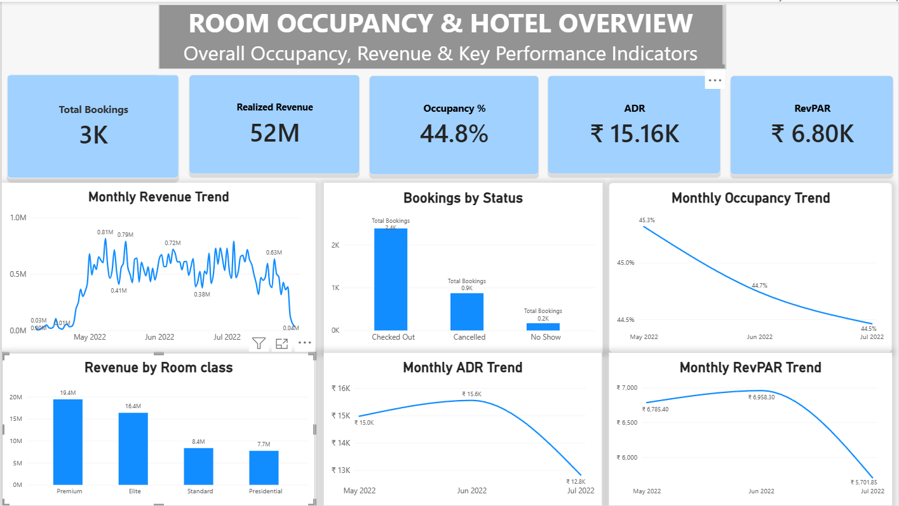
DASHBOARD PAGE 1 — ROOM OCCUPANCY & HOTEL OVERVIEW
Executive KPI view and hotel-wide performance trends
Power BI dashboard — overview, bookings, occupancy, room class, ADR and RevPAR

Slide 10
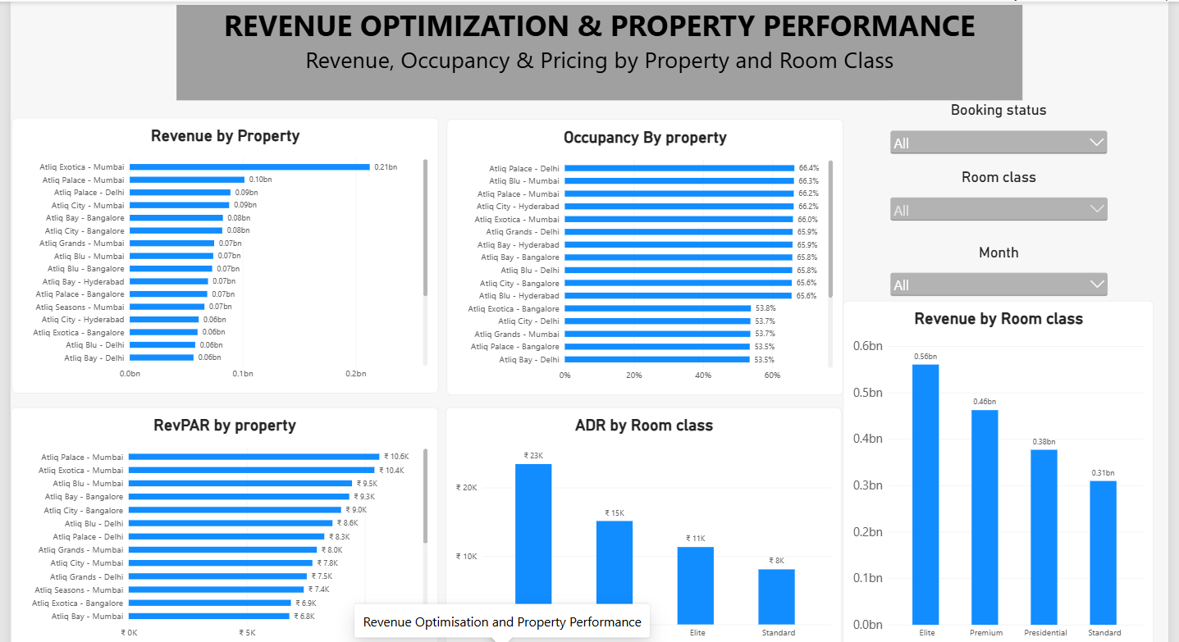
DASHBOARD PAGE 2 — REVENUE OPTIMISATION & PROPERTY PERFORMANCE
Property-level revenue, occupancy, RevPAR and room-class comparisons
Power BI dashboard — property ranking, occupancy and room-class performance

Slide 11
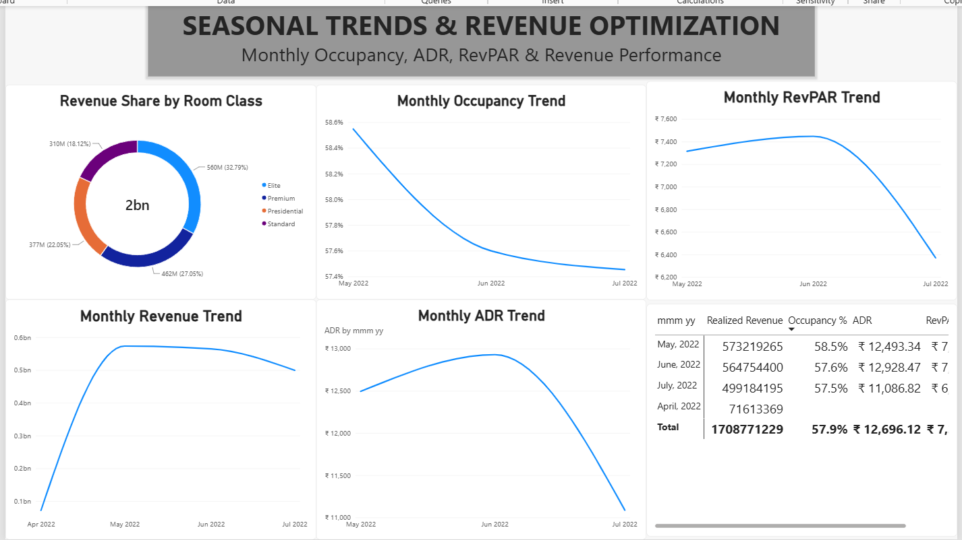
DASHBOARD PAGE 3 — SEASONAL TRENDS & REVENUE OPTIMISATION
Monthly occupancy, ADR, RevPAR and revenue pattern analysis
Power BI dashboard — monthly trends and room-class revenue share

Slide 12
EXCEL ANALYSIS LAYER
PivotTables, Timeline and auditable business insights
PIVOT ANALYSIS
TIMELINE
PT_MonthlyRevenue
Monthly realized revenue
BOOKING DATE
Jan Feb Mar Apr May Jun Jul
PT_RevenueByProperty
Revenue by property name
Interactive month filtering was linked to the PivotTables.
PT_BookingsByPlatform
Booking channels
PT_BookingsByStatus
Booking status distribution
INSIGHTS
A separate Business_Insights sheet documents the observed trends and data limitation.

Slide 13
KEY BUSINESS INSIGHTS
Observed results from the dashboard and Excel analysis
Executive KPI view
Monthly performance
The default dashboard shows 3K bookings, ₹52M realized revenue, 44.8% occupancy, ₹15.16K ADR and ₹6.80K RevPAR.
Occupancy declines through the observed May–July period, while ADR and RevPAR rise into June and then soften in July.
Property performance
Room-class mix
The property ranking highlights clear differences in revenue, occupancy and RevPAR across hotels.
The revenue-share visual shows Elite 32.79%, Premium 27.05%, Presidential 22.05% and Standard 18.12%.
Booking status
Management use
Excel analysis shows Checked Out as the largest status group: 94,411 of 134,590 records.
The combined dashboard and Excel layer supports faster comparison, trend review and follow-up analysis.
These are descriptive observations from the project data; they are not forecasts.

Slide 14
LIMITATIONS & FUTURE SCOPE
What the current version can and cannot claim
CURRENT LIMITATIONS
FUTURE SCOPE
Dataset covers April–July 2022 only.
Extend the dataset to 12+ months for stronger seasonal analysis.
Four months support monthly trend analysis but not a full-year seasonality study.
Add forecasting for occupancy, ADR and RevPAR.
April ADR and RevPAR are blank because a comparable denominator is unavailable in that context.
Add cancellation and customer-segmentation analysis.
Results are descriptive and depend on the configured report model and filters.
Introduce automated refresh and broader operational KPIs.

Slide 15
CONCLUSION
The project transforms hotel booking data into an interactive revenue-management view.
Power BI provides the interactive dashboard, while Excel adds PivotTables, a Timeline and written business observations for traceability.
THANK YOU
Questions & Discussion

