Slide 1

Network Automation
Network Automation
Network Automation

Slide 2
About Hughes
The connected future is here. It’s in upstate New Hampshire, where a freelance writer works online at home far from the city. It’s in Colombia, where a shop-owner sells affordable Wi-Fi and Internet access to rural villagers. It’s in the Southwest U.S., where a fast-casual restaurant chain can analyse data to improve the online experience for their customers. It’s in a military base in the Middle East, where service members connect with family and friends half a world away. It’s in the Congo, where a mobile network operator extends 3G cell service to customers in hard-to-reach places. It’s in India, where healthcare providers in towns and villages take online classes taught by experts from major urban clinics. It’s in the air, where travellers work or watch the latest movies and news, no matter where they are flying.
Making these connections is what Hughes is all about. We are industry leaders in both networking technologies and services, innovating constantly to deliver the global solutions that power a connected future for people, enterprises and things everywhere.
https://vimeo.com/258845721

Slide 3
Key Pointers
Network and it’s importance
Internet Overview
How Browser search works?
Network terminologies
Network Automation and it’s scope
Python Overview and it’s need for Network automation
Library and functions of Python
Lab Check – Ping of remotes connected via Router

Slide 4
Let’s Break it Down
Network
Automation
Python

Slide 5
What is Networking?
Α network is simply defined as something that connects things together for a specific purpose. The term network is used in a variety of contexts, including telephone, television, computer, or even people networks.
A computer network connects two or more devices together to share a nearly limitless range of information and services, including:
• Documents
• Email and messaging
• Websites
• Databases
• Music
• Printers and faxes
• Telephony and videoconferencing

Slide 6
Basic Network Terminologies
IP Address: An IP address, or simply an "IP," is a unique address that identifies a device on the Internet or a local network. It allows a system to be recognized by other systems connected via the Internet protocol.
Ping : Ping is a computer network administration software utility used to test the reachability of a host on an Internet Protocol network.
DNS : The Domain Name System is a hierarchical and decentralized naming system for computers, services, or other resources connected to the Internet or a private network. It associates various information with domain names assigned to each of the participating entities.
ARP: The Address Resolution Protocol is a communication protocol used for discovering the link layer address, such as a MAC address, associated with a given internet layer address, typically an IPv4 address.
Router: A router is a networking device that forwards data packets between computer networks. Routers perform the traffic directing functions on the Internet. Data sent through the internet, such as a web page or email, is in the form of data packets.
Mac Address : A media access control address is a unique identifier assigned to a network interface controller for use as a network address in communications within a network segment. This use is common in most IEEE 802 networking technologies, including Ethernet, Wi-Fi, and Bluetooth.
Default Gateway: A default gateway is the node in a computer network using the internet protocol suite that serves as the forwarding host to other networks when no other route specification matches the destination IP address of a packet.

Slide 7
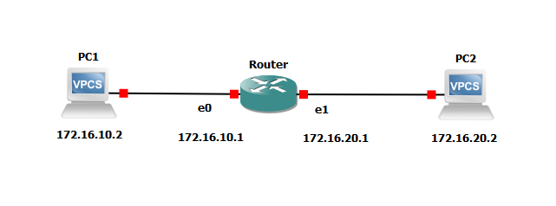
Example
1. ICMP creates an echo request payload
2. It then creates a packet with protocol field(01).The packet also contains source IP Address and destination IP Address
3. It checks whether the Destination IP address is on the local network,if not the packet needs to be sent to the default gateway.
4. The default gateway of PC1 is 172.16.10.1. For this the hardware address of router interface E0 must be known.
5. The PC1 will broadcast the ARP request to resolve the gateway IP into the hardware address.

Slide 8
Example Contd…
6. Now the frame is generated encapsulating the packet. The frame will have PC1 hardware address and E0 hardware address as destination address.
7. The frame is then sent through the physical medium one bit at a time.
8. The gateway receives the bits, builds the frame,and checks the destination hardware address.
9. The packet is pulled from the frame. IP receives the packet and checks the destination IP, which doesn’t match with the gateway IP.So it will look into its routing table.
10. If there is an entry for the destination network, the packet is switched to the exit interface(E1)

Slide 9
Example Contd…
11. Similarly the E1 needs to know the hardware address of the PC2.It will send a broadcast ARP to resolve the IP Address into hardware address.
12. Again the frame is created encapsulating the packet which contains the source hardware address as the hardware address of E1 and destination hardware address as of PC2.
13. Frame is sent to physical medium one bit at a time
14. PC2 receives the bit builds the frame, checks the destination hardware address, pulls the packet, and checks the destination address to be its own address.
15. The payload is handed to ICMP which understands that this is an echo request. It will discard the packet and generate the new payload as echo reply.
Same will continue for echo reply from PC2 to PC1.

Slide 10

Real Case Scenario: How Internet Works

Slide 11
World With & Without Internet
Here are some facts about Internet
• According to Google, the internet consisted of 5 Million Terabytes of Data way back in 2010.
• As of October 2018, there are more than 1.9 billion websites on the Internet.
• 85,000+ websites are hacked every day.
Facebook boasts of a massive 2.234 Billion users.
• 250 Billion emails are sent out daily.
• 400 Hours of video contents are uploaded on YouTube Every Minute.
• There are 4.9 Million apps on Google Play and Apple App Store combined.
• 51% of all internet’s traffic is Fake.
• 7 People control the whole internet. There are seven people assigned to the Internet Corporation for Assigned Names and Numbers (ICANN).

Slide 12
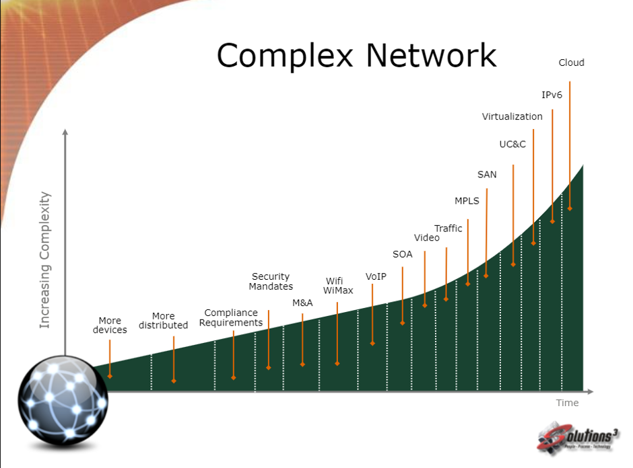

Slide 13
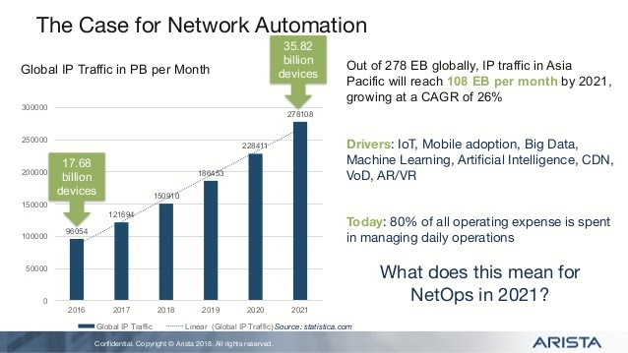

Slide 14
What is Automation?
Automation is configuring a machine to do something for you that you can already do manually. You might want to automate a task because it is tedious,repetitive, error prone, or some combination of these three. For example, you might want to configure a device running on any network Device OS to automatically enforce parts of your networking policies, or to have the device send e-mail to staff when an event occurs.
The approaches to automating a device can be categorized as either on-box, off-box, or a combination of both.
On-box scripts are installed on devices running on any network device. These scripts are invoked either directly or as a result of certain conditions being met. The two examples mentioned previously would be implemented with an on-box script.
In contrast, off-box automation is managing a device over a network from another system. The other system could be a network management system (NMS) or it could be your laptop. The advantages of this approach are the availability of modern languages and tools, such as the Python language, as well as the ability to manage multiple devices from a single system.

Slide 15
“Every Well-Defined Repeatable Task Can Be Automated”

Slide 16
Importance of Network Automation
Managed Increasing network Complexity and scale
Maintained cost optimization as the network grew
Integrated fault, availability, performance and configuration management
Quickly and easily deployed
Handled virtualization and complex services like MPLS
Adapted to new initiatives like cloud computing
Automated compliance management, diagnostics and remediation.

Slide 17



Examples of Network Automation
Reset the OSPF Process on 3 Routers
Create a New VLAN on all your Switches
Create a New Loopback interface on 5 routers
Timely Backup of Device Configuration
Current Traffic Status on Network Devices.
Updating Inventory.
Configuring new Devices with same configuration
Identification of devices running on older non supported OS
Polling Network devices and sending an email if any event triggers.

Slide 18
Python
It’s a general purpose programming language that is often applied in scripting roles.
Its friendly and Easy to learn
Open Source
What you can do with Python?
Python Package Index hosts thousands of third party modules which have inbuilt functions so that we can focus more on business logics.
Web and Internet Development
Database Access
Desktop GUIs
Scientific & Numeric
Education
Network Programming
Software & Game Development

Slide 19
Installing Python
Python is pre-installed in most Unix systems.
But for Windows OS, user can download from the https://www.python.org/downloads/
(Latest Python version is 3.8.1)
Python -V (command to know the installed python version)

Slide 20
Libraries used for Network Automation
Telnetlib
Netmiko
Paramiko
https://pypi.org/project/netmiko/

Slide 21
Lab
To check the reachability of the remote hosts after logging into the Router via SSH.

Slide 22
Automation Can be Difficult: Zero Consistency
Different Vendors have different CLI’s
Different vendors have different API’s
Different Vendors have different modules
Different vendors return the same date in different formats(XML,JSON etc).

Slide 23
Thank You ! Any Questions?

