Slide 1
Online Course Registration System
Yashika
RA2111026010321

Slide 2
Abstract
The advancement of technology has significantly transformed various aspects of education, including course registration processes. This project focuses on the design and implementation of an Online Course Registration System (OCRS) to streamline and enhance the efficiency of the registration process for students and administrators alike. The system aims to replace traditional paper-based methods with a user-friendly web-based platform accessible from anywhere with an internet connection.
Administrators have access to comprehensive dashboards where they can manage course offerings, set registration deadlines, monitor enrollment statistics, and generate reports. Additionally, the system incorporates automated notifications to remind students and administrators of important deadlines and updates.
The OCRS allows students to browse available courses, view course descriptions, prerequisites, and available slots. Upon selection, students can register for courses, drop courses, and modify their schedules within designated deadlines. The system employs secure authentication mechanisms to ensure data integrity and user privacy.
The design and implementation of OCRS involve utilizing modern web development technologies such as HTML, CSS, JavaScript for the frontend, and PHP, Python, or Java for the backend. A robust database management system like MySQL or PostgreSQL is employed to store and manage course data, student information, and registration records securely.

Slide 3
Project Modules and Functionality
1 - User Authentication and Management:
Entities:
Login
User
Roles
Functionalities:
2 – Profile Management :
Entity:
Student Profile
Functionalities:
Profile Creation: Enables students and administrators to create profiles with personal information.
Entity:
Course
Functionalities
User Login: Authenticates users during the login process.
Password Management: Enables users to reset or change their passwords securely.
User Authentication: Validates user credentials during login and registration.
Account Deactivation: Allows users to deactivate or delete their accounts if needed.
User Registration: Allows students and administrators to register securely.
Administrator Profile
Profile Editing: Allows users to update their profile information such as contact details, etc.
Privacy Settings: Enables users to manage their privacy settings for profile visibility.
Profile Viewing: Allows administrators to view profiles of students and other administrators.
3 – Course Management:
Course Editing: Enables administrators to update course details.
Course Deletion: Allows administrators to delete courses if necessary.
Course Enrollment: Allows students to enroll in available courses.
Seat Management: Tracks and manages available seats for each course.
:Course Creation: Allows administrators to create new courses with details like course code, name, unit, etc.

Slide 4
Project Modules and Functionality
4 - Enrollment Management:
Entities:
Functionalities:
5 – Notification Management:
Entities:
Functionalities:
Enrollment Record
Enrollment Tracking: Tracks student enrollments in courses.
Enrollment Modification: Allows administrators to modify student enrollments as needed.
Enrollment Reporting: Generates reports on course enrollment statistics.
Notification
Automated Notifications: Sends notifications to students and administrators about registration deadlines, course updates, etc.
Notification Management: Allows users to manage their notification preferences.

Slide 5
Project Modules and Functionality
6 – Security Management:
Entity:
Security Settings
Functionalities:
7 –Database Interaction
Entities:
Functionalities:
Compliance Policies
Data Encryption: Encrypts sensitive user data during transmission and storage.
Access Control: Implements role-based access control (RBAC) to manage user access to features and data.
Compliance: Ensures compliance with data protection regulations.
Logging and Auditing: Logs user activities for auditing purposes and to detect security incidents.
Database Connection
Data Retrieval: Retrieves course information, enrollment records, user profiles, etc., from the database.
Data Storage: Stores user-generated content, enrollment records, profile information, etc., securely in the database.
Query Optimization: Optimizes database queries for performance and scalability.
Backup and Recovery: Implements regular backups and recovery procedures to safeguard against data loss.

Slide 6
Issues that can arise in a business perspective for the application
1. User Engagement:
Low User Engagement: Users may find the registration process cumbersome or the system interface unintuitive, leading to low engagement levels.
Lack of Interactivity: Insufficient interactive features such as discussion forums or collaboration tools may reduce user engagement and participation.
Limited Course Offerings: If the system offers a limited range of courses, students may lose interest and seek alternative platforms with more diverse options.
2. Privacy and Security:
Data Breaches: Inadequate security measures could result in data breaches, compromising sensitive user information such as personal details, course enrollments, and financial transactions.
Unauthorized Access: Weak authentication mechanisms may allow unauthorized users to access and manipulate user accounts or course data.
Non-compliance with Regulations: Failure to comply with data protection regulations (e.g., GDPR, FERPA) could result in legal consequences and damage to the system's reputation.
3. Technical Challanges:
System Downtime: Technical issues or server failures may cause system downtime, disrupting course registration processes and user experience.
Scalability Issues: The system may struggle to handle a large volume of concurrent users during peak registration periods, leading to performance degradation or crashes.
Compatibility Issues: Incompatibility with certain web browsers or devices could hinder user accessibility and satisfaction.
4. Communication and support:
Poor Communication: Ineffective communication channels between administrators and students may result in missed deadlines, confusion regarding course offerings, or unresolved queries.
Lack of User Support: Insufficient user support mechanisms such as FAQs, help documentation, or customer service channels may frustrate users encountering issues or seeking assistance.
Feedback Handling: Failure to solicit and address user feedback effectively may lead to dissatisfaction and hinder system improvement efforts.
5. Administrative Challenges:
Course Management Complexity: Manual course management processes or outdated administrative tools may increase the workload for administrators and lead to errors or inefficiencies.
Enrollment Errors: Manual enrollment processes may result in data entry errors, duplicate enrollments, or mismatches between student records and course registrations.
Reporting and Analytics: Inadequate reporting and analytics capabilities may impede administrators' ability to track enrollment trends, assess system performance, and make data-driven decisions.

Slide 7
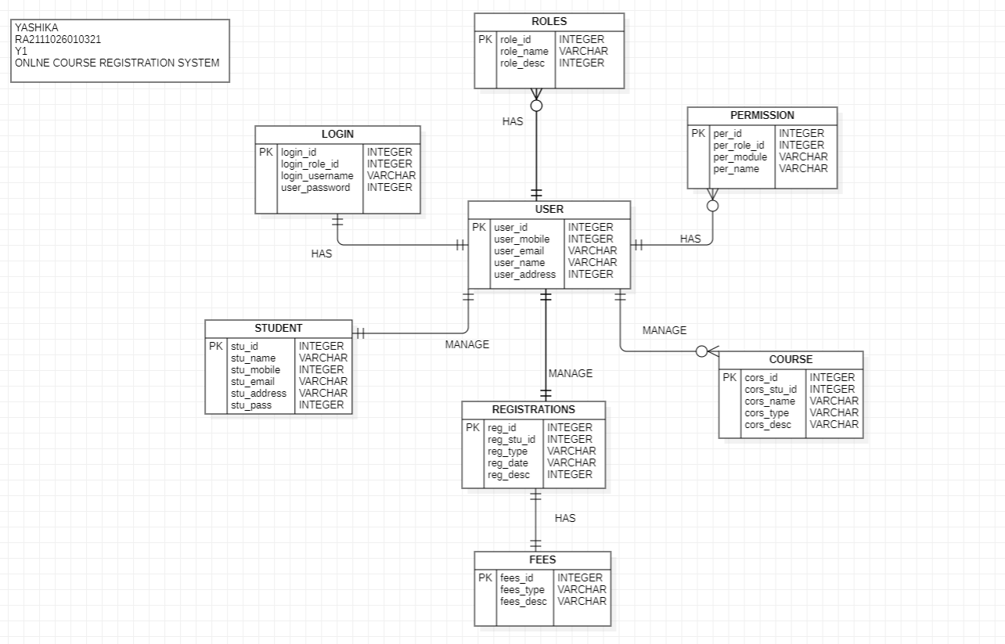
ER Diagram

Slide 8
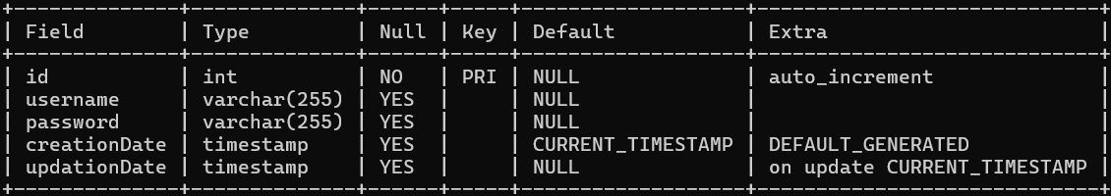
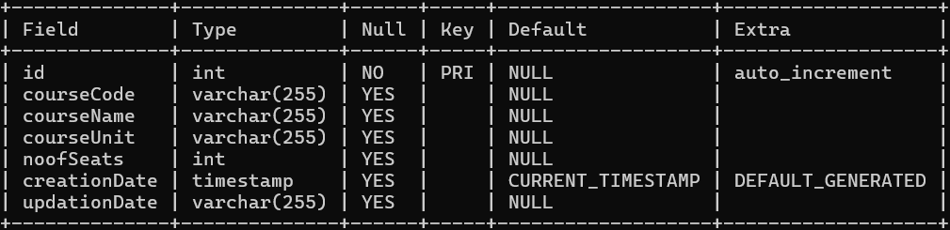
Relational Table
Admin Table:
Fields:
id (Primary Key)
username
password
creationDate
updationDate
Purpose: Stores information about administrators including their username, password, creation date, and last update date.
Course Table:
Fields:
id (Primary Key)
courseCode
courseName
courseUnit
noofSeats
creationDate
updationDate
Purpose: Stores information about courses offered including course code, name, number of units, available seats, creation date, and last update date.

Slide 9
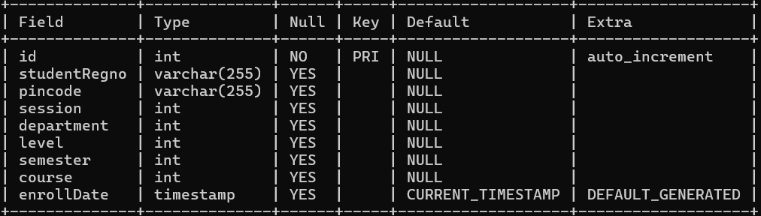
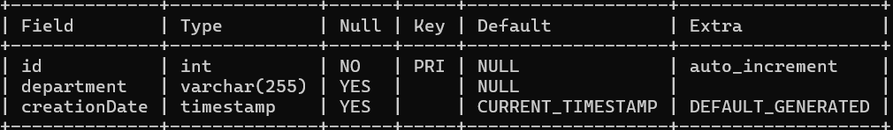
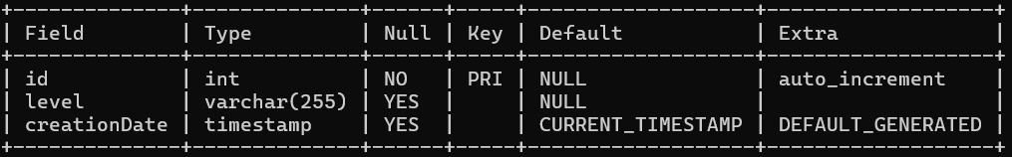
Relational Table
3 CourseEnrolls Table:
Fields:
id (Primary Key)
studentRegno
department
semester
course
enrollDate
Purpose: Records enrollment details of students for courses including registration number, pincode, session, department, level, semester, course, and enrollment date.
4. Department Table:
Fields:
id (Primary Key)
department
creationDate
Purpose: Stores information about departments including department name and creation date.
5. Level Table:
Fields:
id (Primary Key)
level
creationDate
Purpose: Stores information about academic levels including level name and creation date.

Slide 10
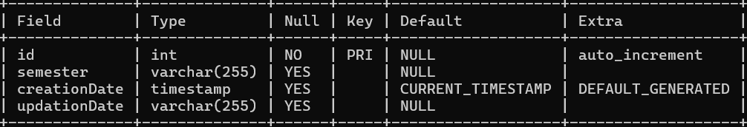
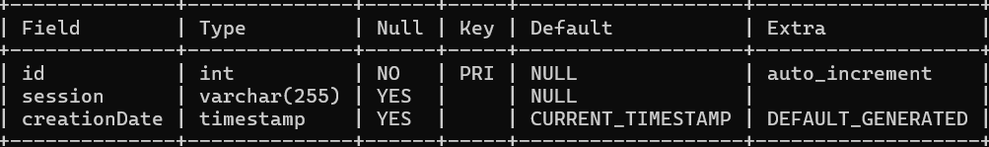
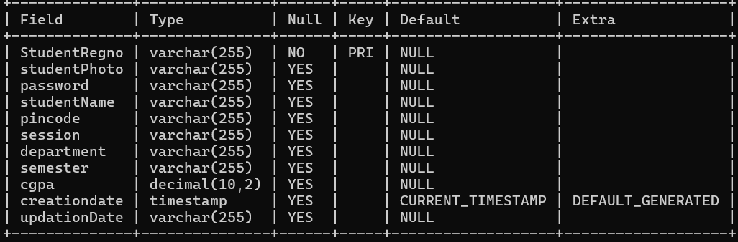
Relational Table
6. Semester Table:
Fields:
id (Primary Key)
semester
creationDate
updationDate
Purpose: Stores information about academic semesters including semester name, creation date, and last update date.
7. Session Table:
Fields:
id (Primary Key)
session
creationDate
Purpose: Stores information about academic sessions including session name and creation date.
8. Students Table:
Fields:
StudentRegno (Primary Key)
studentPhoto
password
studentName
department
semester
cgpa
Purpose: Stores information about students including registration number, photo, password, name, pincode, session, department, semester, CGPA, creation date, and last update date.

Slide 11
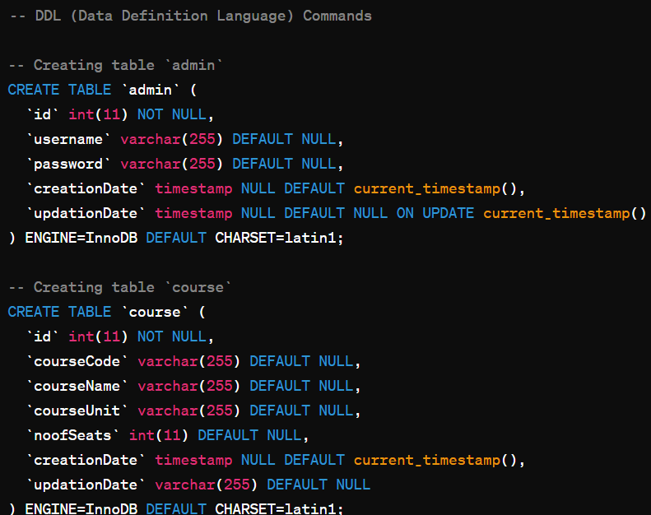
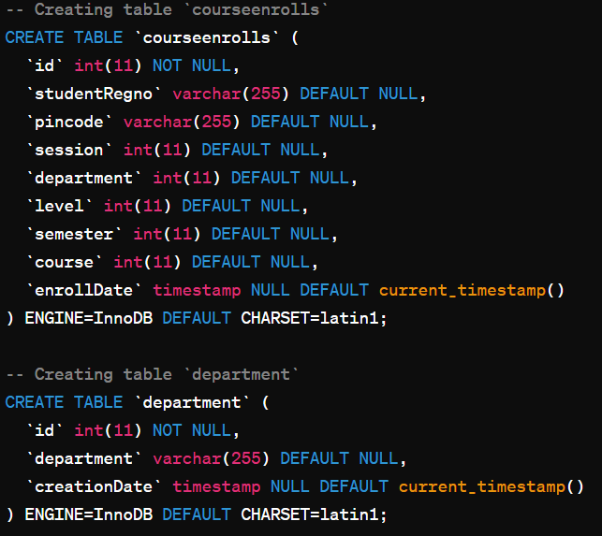
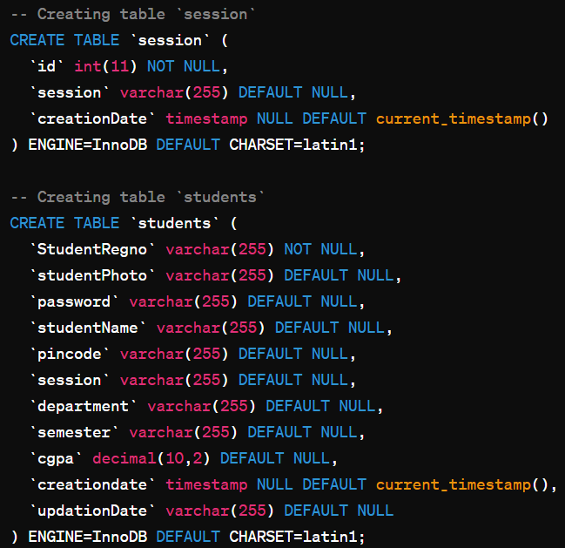
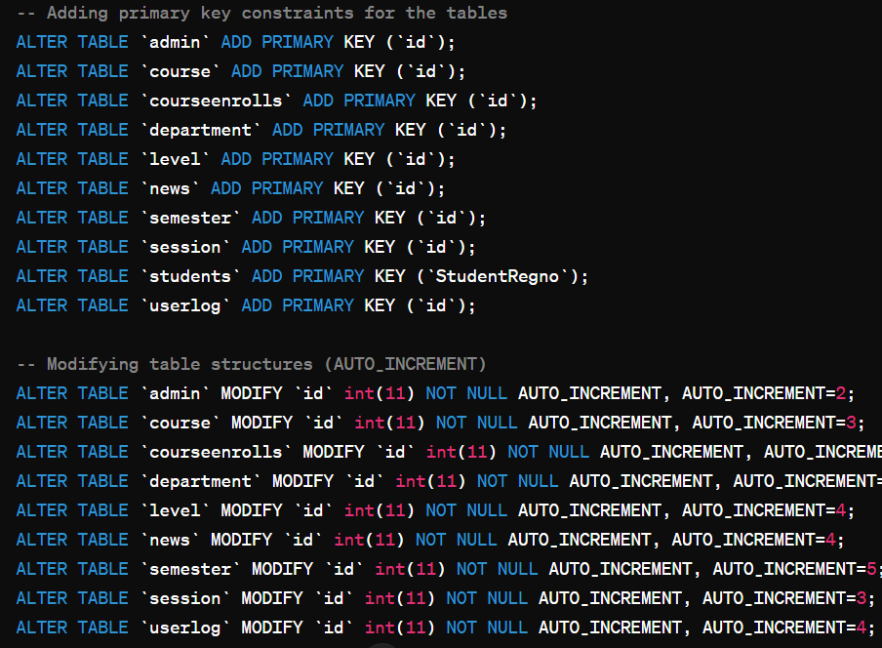
DDL (Data Definition Language) - Creating Tables:

Slide 12
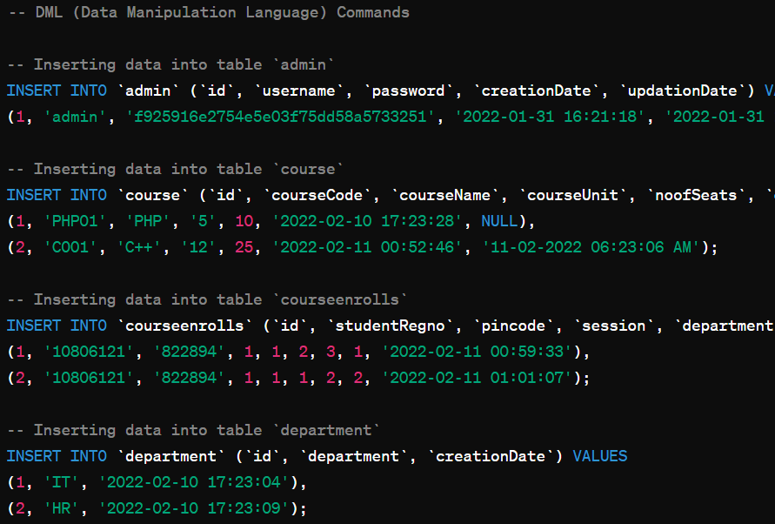
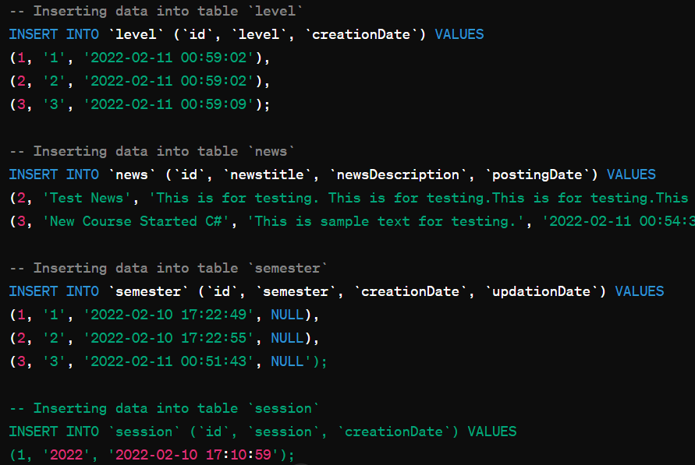
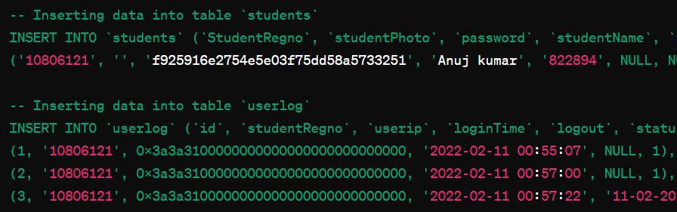
DML (Data Manipulation Language) - Inserting Sample Data:

Slide 13
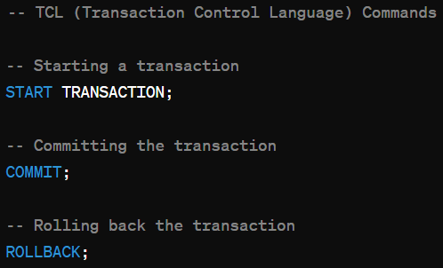
DCL (Data Control Language) - Granting Permissions (Example):
TCL (Transaction Control Language) - Committing Changes:

Slide 14
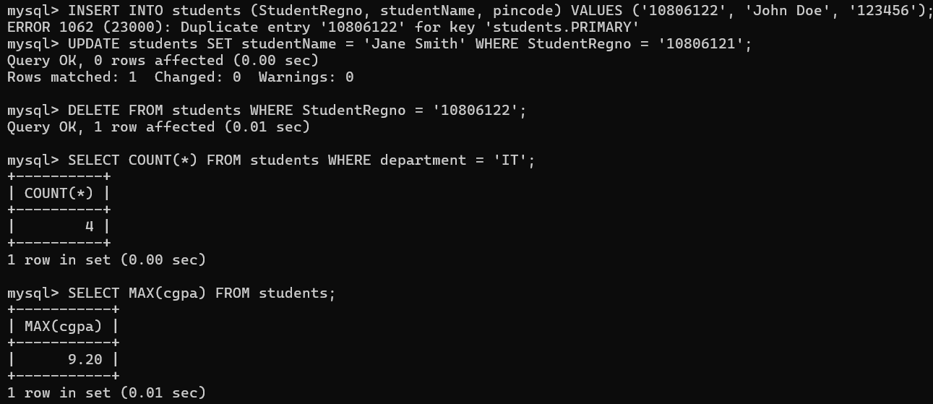
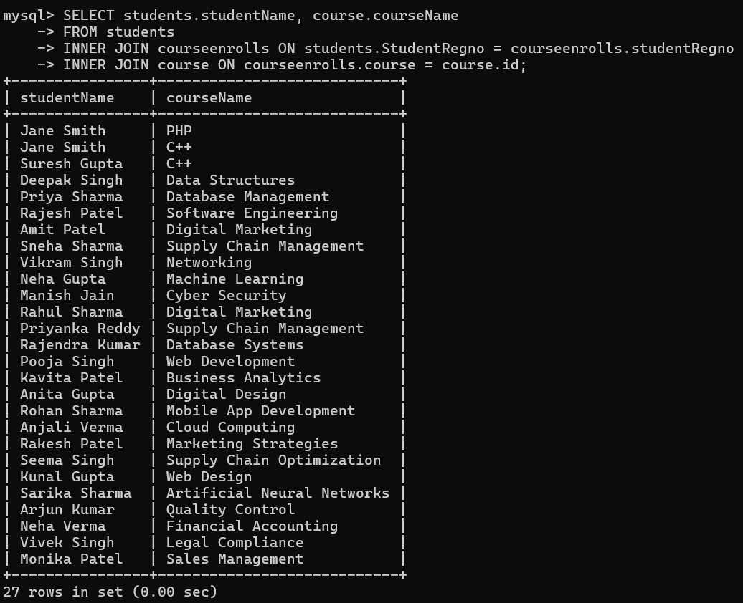
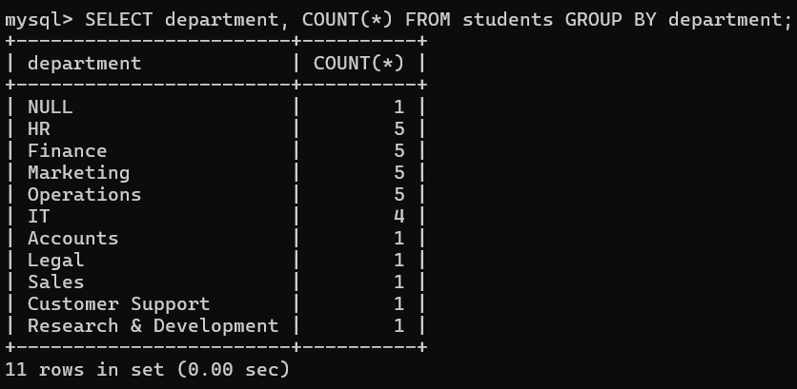
In-Built functions

Slide 15
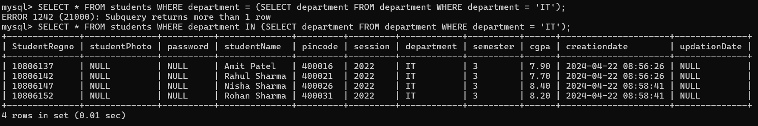
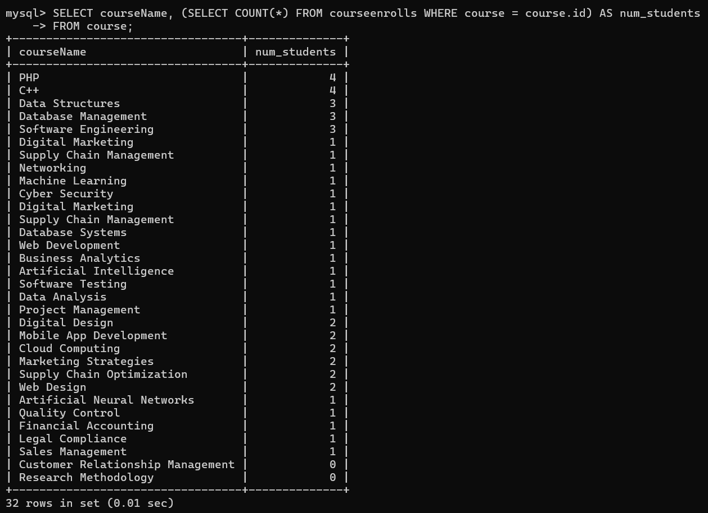
Nested Queries

Slide 16
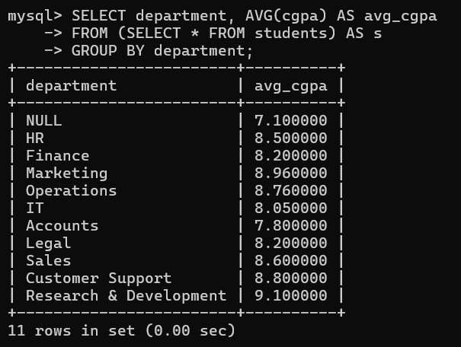
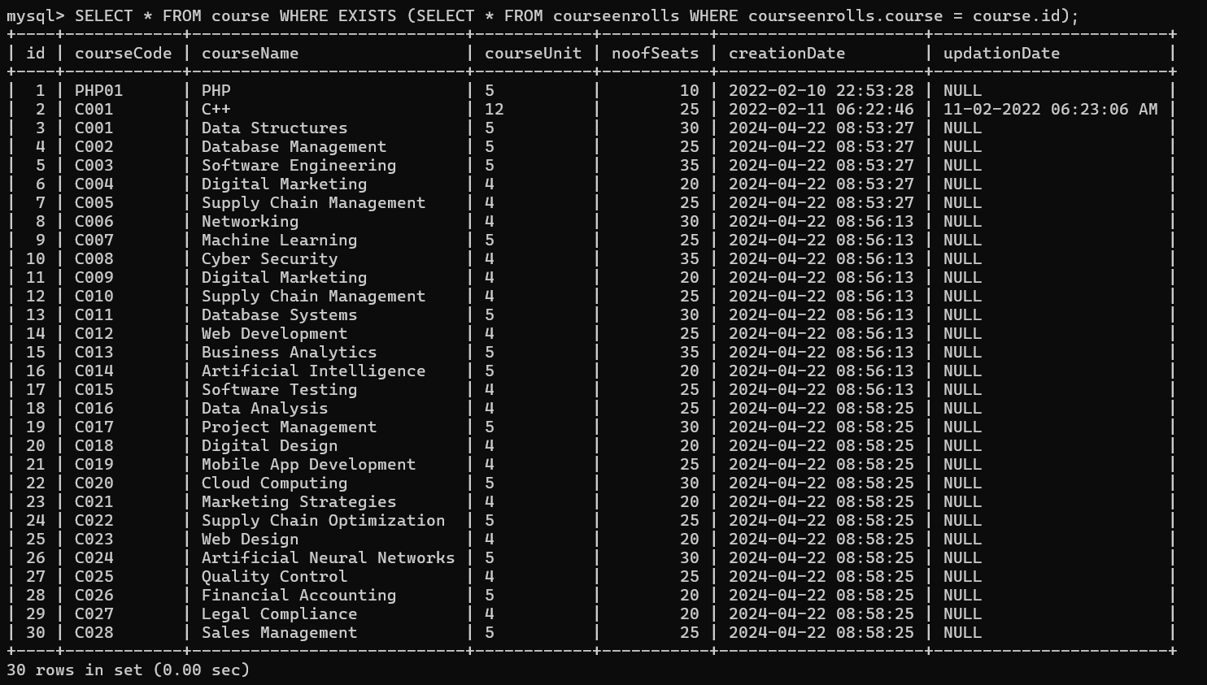
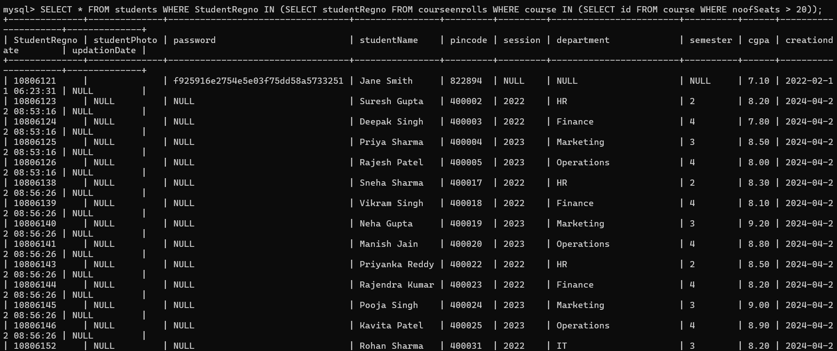

Slide 17
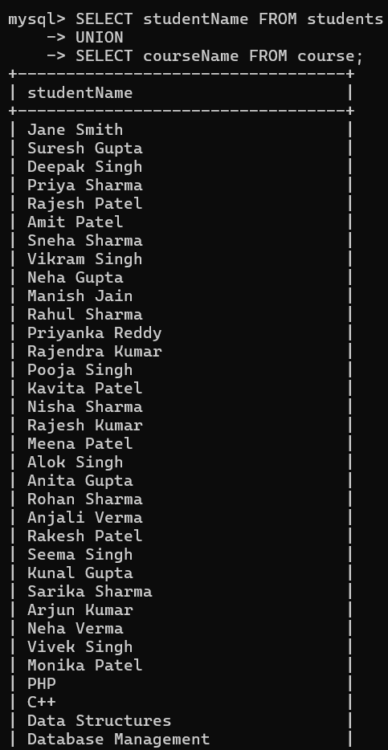
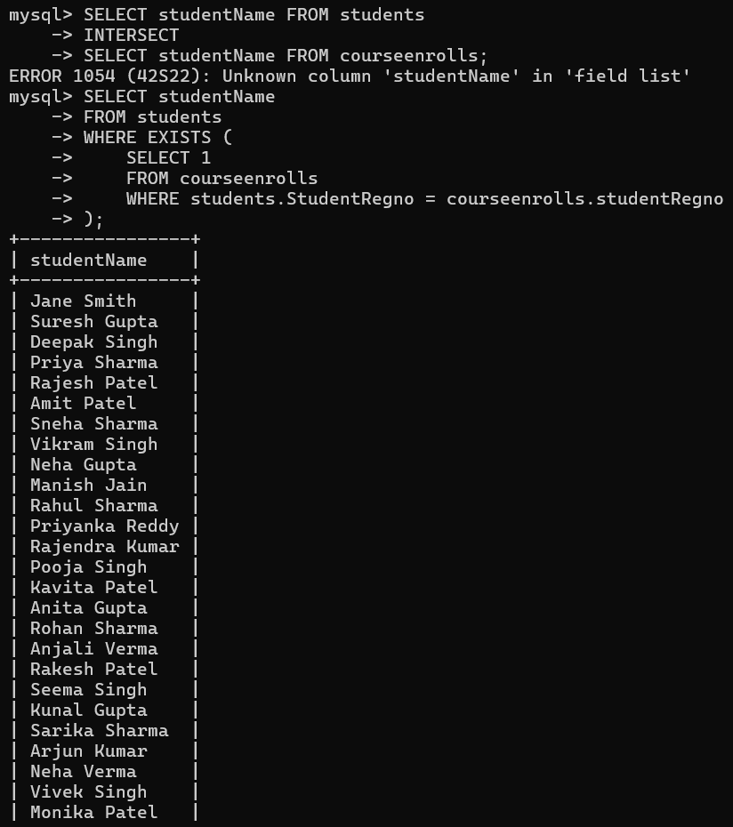
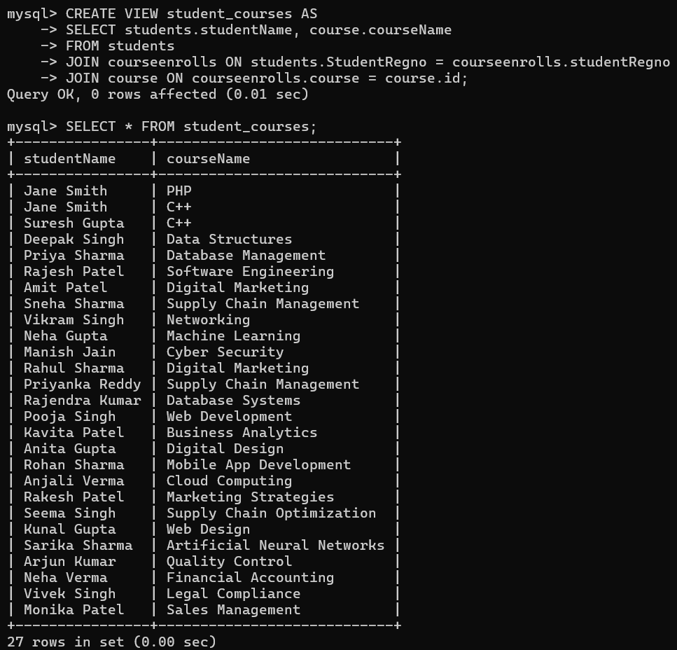
Set Operators and views

Slide 18
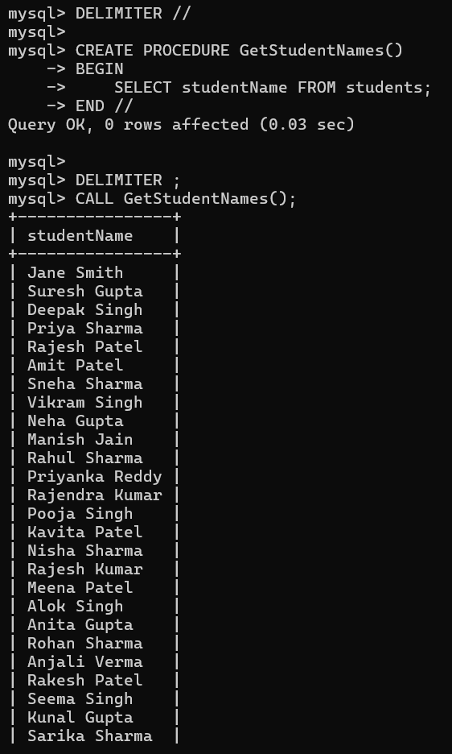
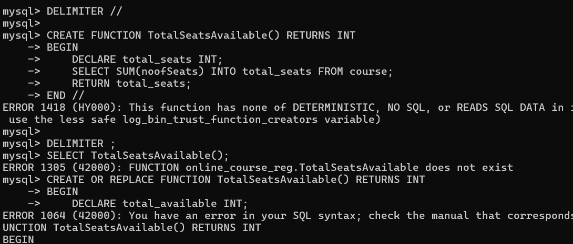
PL/SQL Procedures and functions

Slide 19
