Slide 1

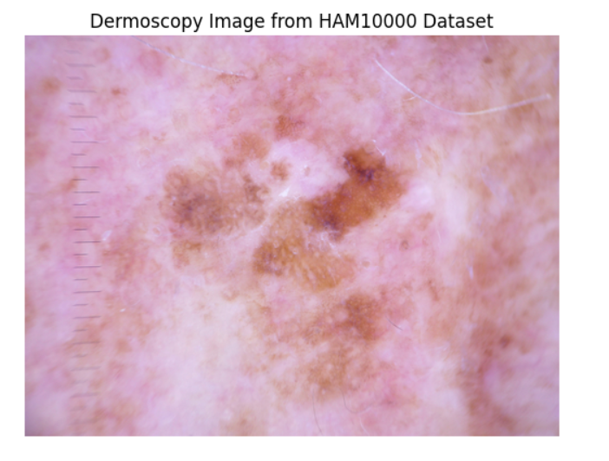

Skin Cancer Detection Using Deep Learning & Explainable AI (HAM10000)
AUTHOR - Yashika Sharma

Slide 2
Introduction
• Skin cancer is one of the most common cancers worldwide, often caused by prolonged exposure to UV radiation . Early detection is crucial for effective treatment. Traditional diagnosis can be slow and subjective, so AI-based tools can assist doctors by providing fast and reliable results.
• The goal is to build a deep learning model that classifies skin lesions into 7 categories using dermoscopic images . The model also uses Explainable AI (Grad-CAM) to highlight image regions influencing its decision, improving trust and transparency for clinical use.
• HAM10000 is a public dataset with over 10,000 dermoscopic images of 7 skin lesion types . It provides labeled skin images along with metadata, making it suitable for training deep learning models in medical image classification.

Slide 3

Objective
• Design and train a neural network that can automatically classify dermoscopic images into 7 different types of skin lesions . This supports faster and more accurate diagnosis of skin cancer.
• Cover all 7 types of skin lesions, The model is trained to recognize the following skin lesion types : Melanocytic nevi, Melanoma, Benign keratosis-like lesions, Basal cell carcinoma, Actinic keratoses, Vascular lesions, and Dermatofibroma.
• Enhance interpretability using Explainable AI Apply Grad-CAM (Gradient-weighted Class Activation Mapping) to highlight the regions of an image the model used to make its prediction . This helps doctors trust the model and understand its reasoning.

Slide 4
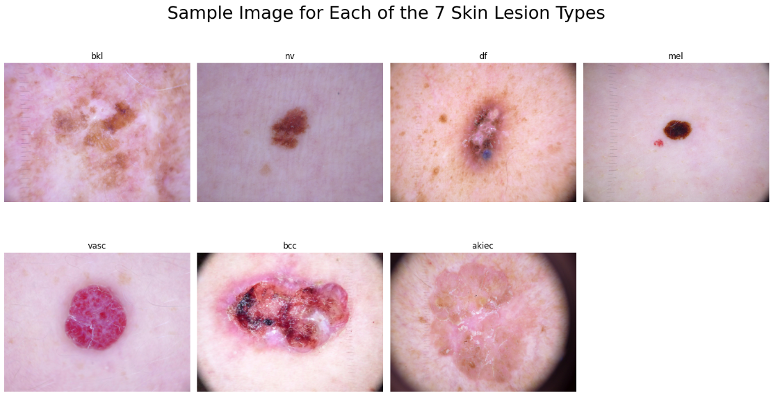
7 types of skin cancer each with label

Slide 5
Proposed Methodology
HAM 10000 dataset
↓
Image Preprocessing (Resizing, Normalization, Label Encoding)
↓
Data Augmentation (Rotation, Zoom, Flip, Shift)
↓
Model Training →
• Basic CNN
• ResNet50
• MobileNetV2
• DenseNet121
↓
Model Evaluation (Accuracy, Loss)
↓
Best Model Selection → DenseNet121
↓
Explainable AI using Grad-CAM (Visualize model focus)

Slide 6
Preprocessing & Augmentation
✔ Image Resizing:
- Resized to 64×64 or 224×224 pixels depending on the model
✔ Normalization:
- Pixel values scaled between 0 and 1
- Model-specific preprocessing used for pretrained networks
✔ Label Encoding:
- Mapped string labels to integers (e.g., 0 = Melanoma)
✔ Augmentation (using Image Data Generator):
- Rotation, zoom, width/height shift, horizontal flip
- Helps in improving generalization
✔ Train-Validation Split:
- 80-20 or via Image Data Generator `subset` parameter

Slide 7
Deep Learning Models
Model | Train Accuracy | Val Accuracy | Train Loss | Val Loss | Feature
Basic CNN | 81.85% | 68.85% | 0.4792 | 0.8857 | - Manually built simple convolutional network as baseline
ResNet50 | 82.02% | 68.85% | 0.4699 | 0.8857 | - Deep pretrained model with residual connections - Fine-tuned on HAM10000
MobileNetV2: | 70.57% | 72.50% | 0.7899 | 0.7386 | - Lightweight and fast pretrained model optimized for mobile
DenseNet121 + Grad-CAM | 94.57% | 83.03% | 0.2050 | 0.4747 | Dense convolutional network - Best performance with added explainability using Grad-CAM

Slide 8
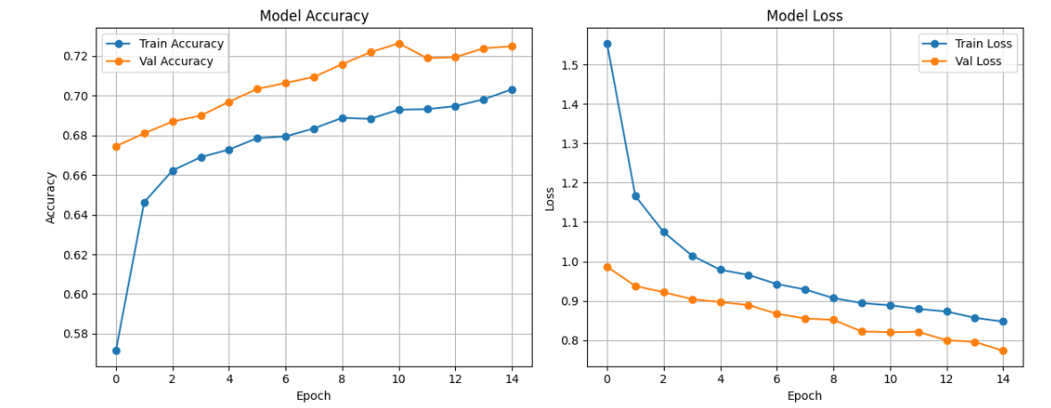
Model –DenseNet121
DenseNet121 + Grad-CAM achieved the highest accuracy — 94.57% (training) and 83.03% (validation) and 85.7% ( testing) with lowest validation loss of 0.4747.
Grad-CAM provided visual explanations, improving trust and helping doctors understand where the model focused.

Slide 9
Training Strategy
✔ Used transfer learning for pretrained models:
- Frozen base layers
- Added custom dense layers for classification
✔ Optimizers: Adam with learning rate decay
✔ Loss Function: Categorical Crossentropy .
✔ Callbacks Used:
- Early Stopping : Stops training if validation loss stops improving
- Reduce LR On Plateau : Reduces learning rate on plateau
- Model Checkpoint : Saves the best-performing model
✔ Evaluation Metrics:
- Accuracy
- Loss (Training and Validation)

Slide 10
Explainable AI – Grad-CAM
✔ Grad-CAM (Gradient-weighted Class Activation Mapping) is an Explainable AI technique.
✔ Why it's important:
- Increases transparency
- Helps doctors understand and trust the model’s decisions
✔ What it does:
- Visualizes which parts of the input image influenced the model’s prediction
✔ Use in this Project:
- Applied Grad-CAM to DenseNet121 predictions
- Focus maps showed that the model paid attention to lesion regions

Slide 11
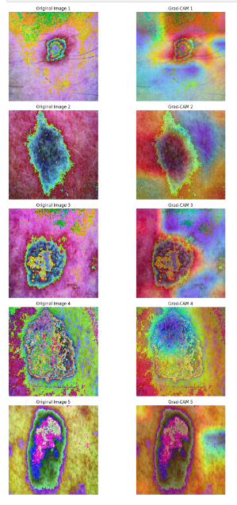
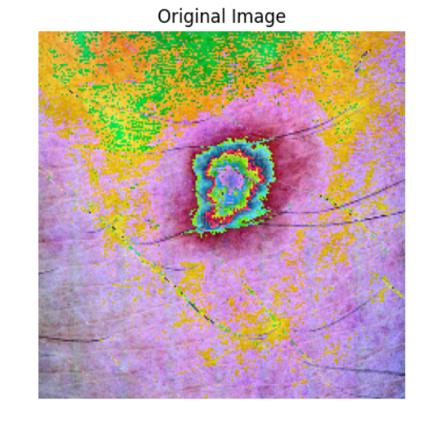
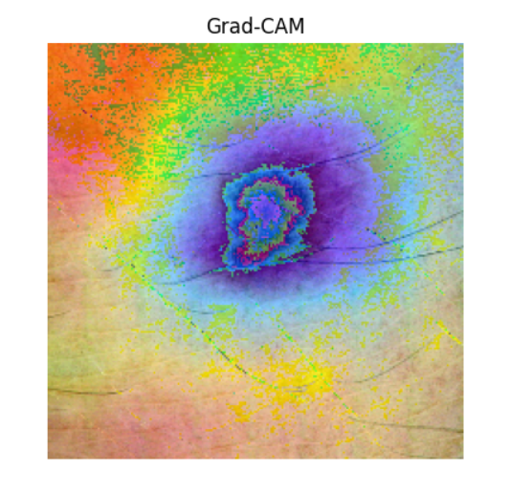
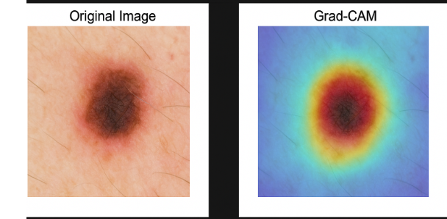
Grad-CAM results

Slide 12
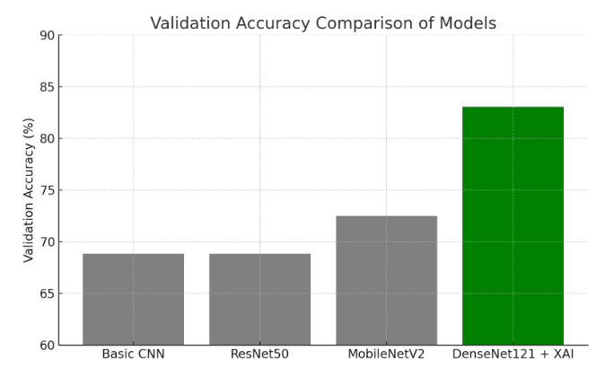
Concluded results
✓ Successfully built a skin cancer classification model using deep learning.→ Multiple architectures were trained, and DenseNet121 achieved the highest accuracy (94.57% train / 83.03% validation/ 85% testing ).
✓ The model can assist dermatologists in early diagnosis by :
Reducing workload by automating lesion classification Enhancing decision confidence through consistent predictions and visual explanations
✓ DenseNet121 with Grad-CAM was the best performer
both accurate and explainable.→ Grad-CAM visualizations confirmed the model focused on relevant lesion areas, building trust in clinical settings.
✓ Future Scope
Deploy the model as a mobile or web-based diagnostic support tool
Address class imbalance to improve rare lesion detection
Integrate patient history, age, and anatomical site metadata to further improve accuracy

Slide 13
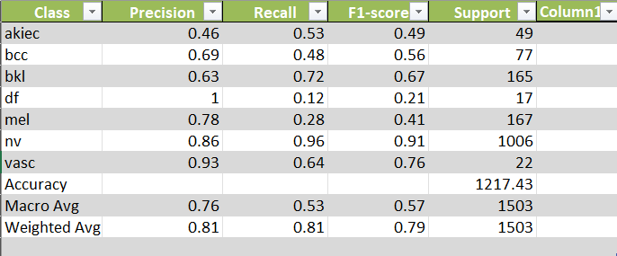
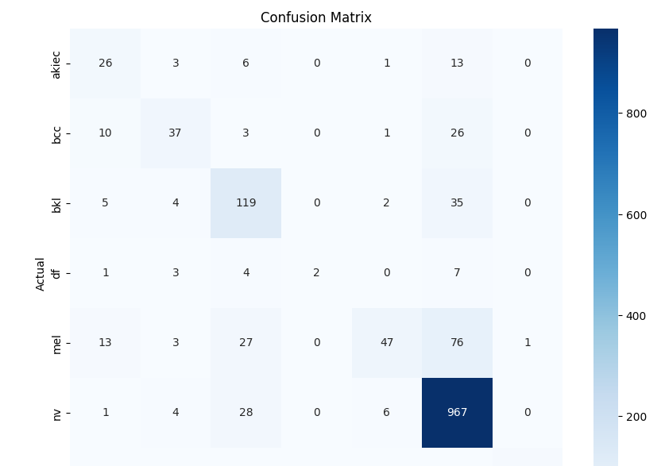

Slide 14
Thank You
✔ Dataset: HAM10000 from Kaggle
✔ Tools Used: Python, TensorFlow, Keras , Kaggle
✔ Techniques: CNN, Transfer Learning, Grad-CAM
✔ Special Thanks to: ELC Instructor & Thapar Faculty
Thank You!

