Slide 1
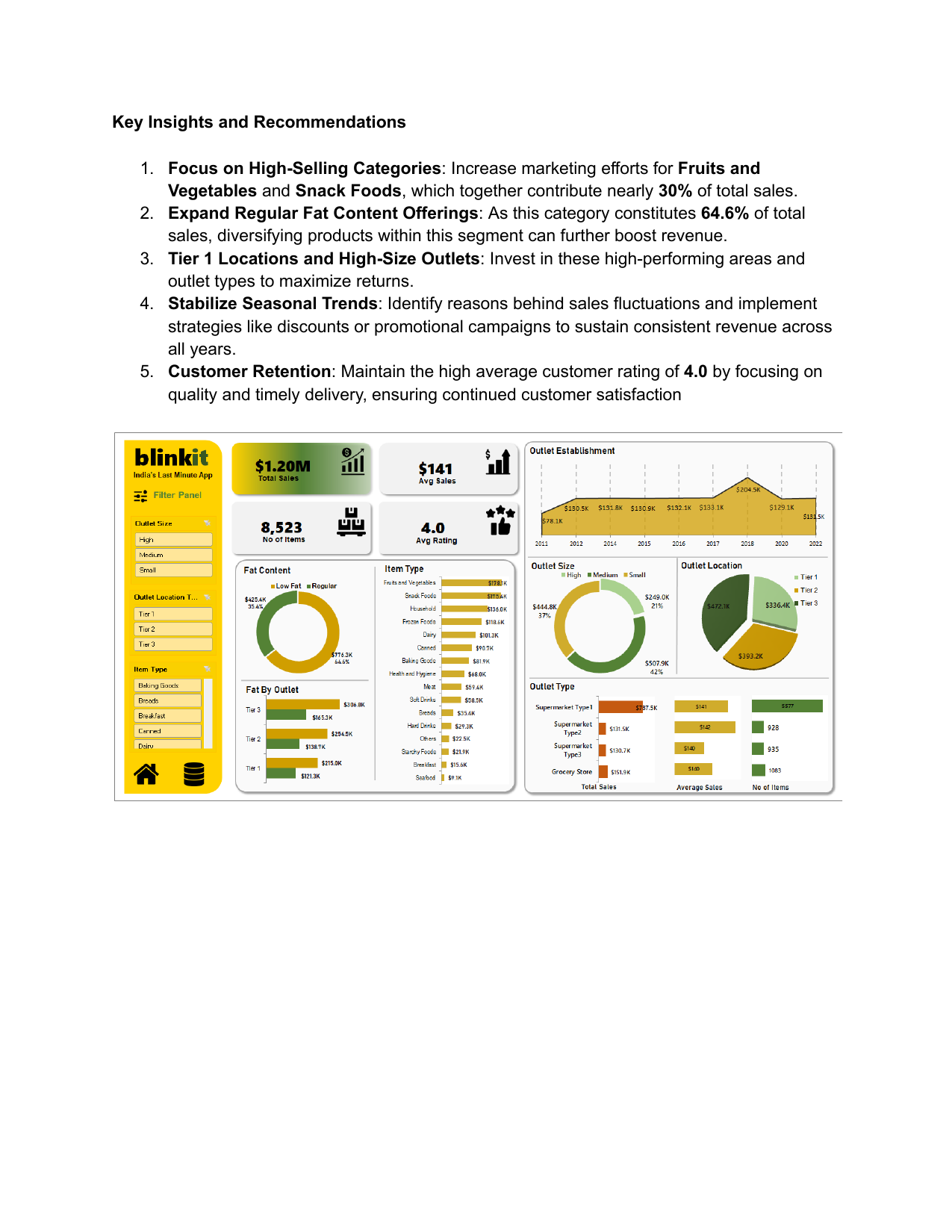
Blinkit Grocery Sales Analysis
Presentation-ready summary of dashboard performance, mix, and growth levers
Executive snapshot
$1.20M
$141
Total Sales
Avg Sales
8,523
4.0
No. of Items
Avg Rating
Sales reached $1.20M with a strong average rating of 4.0.
The business sold 8,523 items with average sales of $141 per transaction.
The dashboard points to clear growth pockets in high-volume categories, large outlets, and Tier 1 locations.
Notes:
[Sources] - Blinkit Grocery Sales Analysis Documentation.pdf, pages 1, 6 [/Sources]

Slide 2
Outlet Establishment Trend
Sales peaked in 2018, then settled into a lower but stable run-rate by 2022
Trend view
What stands out
2018 was the clear high point at $204.5K.
Sales then dropped back, but 2022 stabilized at about $131.5K.
This suggests the business can generate reliable revenue, but needs actions to smooth volatility.
Recommended response
Investigate what drove the 2018 surge and which elements were repeatable.
Use off-peak promotions to reduce seasonality pressure.
Track year-by-year drivers: category mix, outlet additions, pricing, and location effects.
Notes:
[Sources] - Blinkit Grocery Sales Analysis Documentation.pdf, pages 1, 2 [/Sources]

Slide 3
Product Mix: Fat Content and Item Types
Regular-fat products dominate today; Fruits & Vegetables and Snack Foods lead the sales mix
Fat content
Category leaders
Key message
Regular-fat products account for 64.6% of sales versus 35.4% for low-fat.
Tier 3 outlets contribute the most fat-content sales across both mix types.
Fruits & Vegetables and Snack Foods together contribute nearly 30% of total sales.
Action angle
Grow low-fat assortment to capture health-conscious shoppers.
Defend the top two categories with visibility, promotion, and availability.
Notes:
[Sources] - Blinkit Grocery Sales Analysis Documentation.pdf, pages 2, 3 [/Sources]

Slide 4
Where Sales Come From: Outlet Size and Location
Large formats and Tier 1 locations carry the strongest revenue contribution
Outlet size
Location split
Interpretation
High-size outlets contribute $507.9K, or 42% of total sales.
Medium-size outlets add another 37%, while small outlets lag at 21%.
Tier 1 locations lead with $472.1K; Tier 3 and Tier 2 trail behind.
Implications
Invest in high-performing outlet footprints.
Use local campaigns and supply-chain improvements to lift Tier 2 and Tier 3 markets.
Notes:
[Sources] - Blinkit Grocery Sales Analysis Documentation.pdf, pages 3, 4 [/Sources]

Slide 5
Outlet Type Contribution
Supermarket Type 1 is the clear engine of revenue and item volume
Takeaway: Supermarket Type 1 delivers 65.6% of total revenue ($787.5K), far ahead of other outlet formats.
Notes:
[Sources] - Blinkit Grocery Sales Analysis Documentation.pdf, pages 5 [/Sources]

Slide 6
Priority Recommendations
Five moves to convert the dashboard into action
1
Back the leaders
Put more visibility and inventory behind Fruits & Vegetables and Snack Foods, which together make up nearly 30% of sales.
2
Broaden regular-fat winners, test low-fat growth
Regular-fat items drive 64.6% of revenue today, while low-fat remains the white-space growth bet.
3
Invest where returns are strongest
Tier 1 locations and high-size outlets already outperform and should get priority expansion and marketing support.
4
Stabilize the demand curve
Use promotion calendars and post-2018 driver analysis to reduce volatility across years.
5
Protect customer loyalty
Maintain the 4.0 rating with quality, availability, and reliable delivery.
Notes:
[Sources] - Blinkit Grocery Sales Analysis Documentation.pdf, pages 6 [/Sources]

