Slide 1

CS 577-2
Introduction to Algorithms
Fall 2020

Slide 2
Plan for Today
Course overview
Administrativia
Stable marriage problem

Slide 3
Learning Objectives
Techniques for designing correct and efficient algorithms
Tools to reason about those aspects

Slide 4
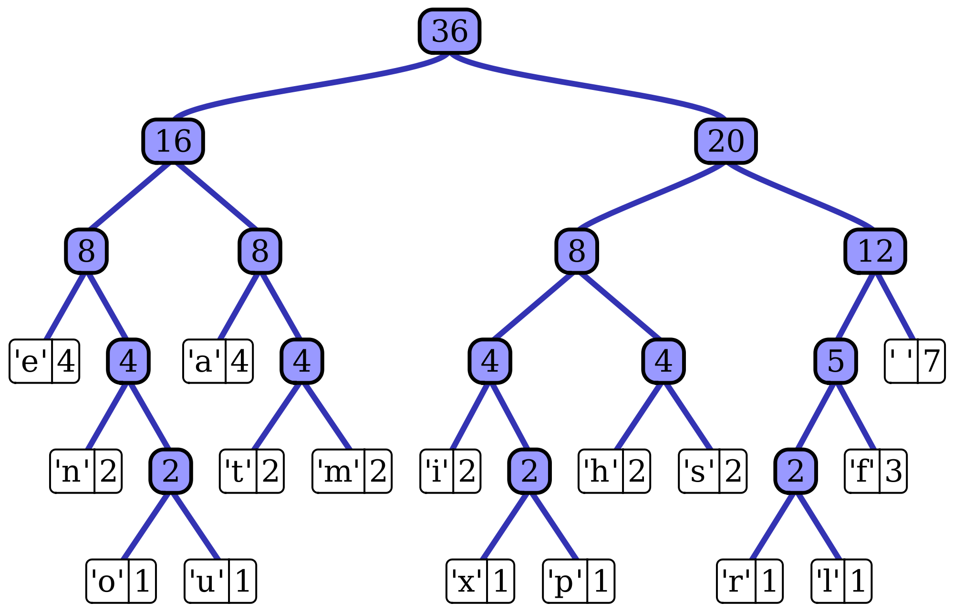
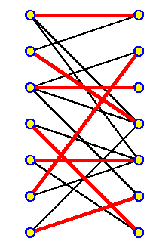
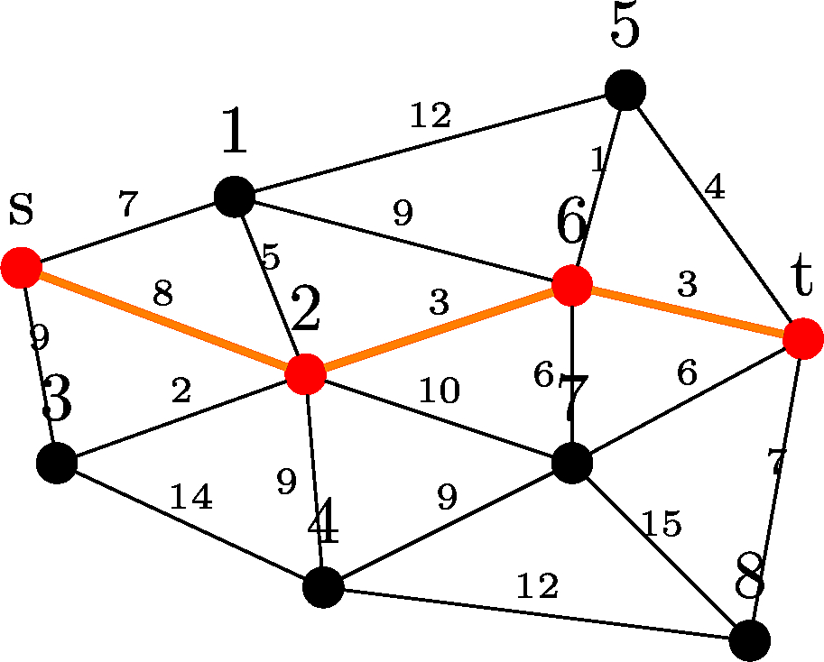
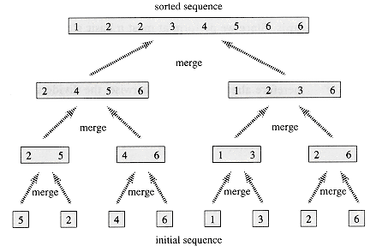
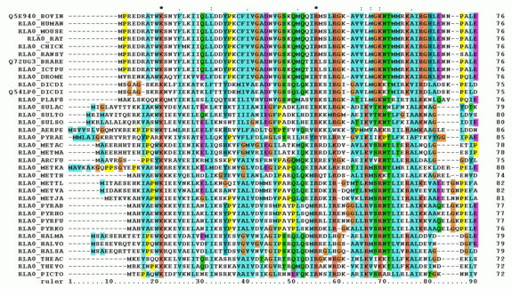
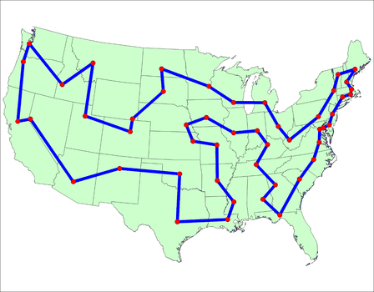
Topics
Graph primitives
Divide & conquer
Dynamic programming
Greed
Network flow
Computational intractability
  NP-completeness
Randomness

Slide 5
Prerequisites
CS 240: Introduction to discrete mathematics
CS 367: Introduction to data structures
or
CS 400: Programming III

Slide 6
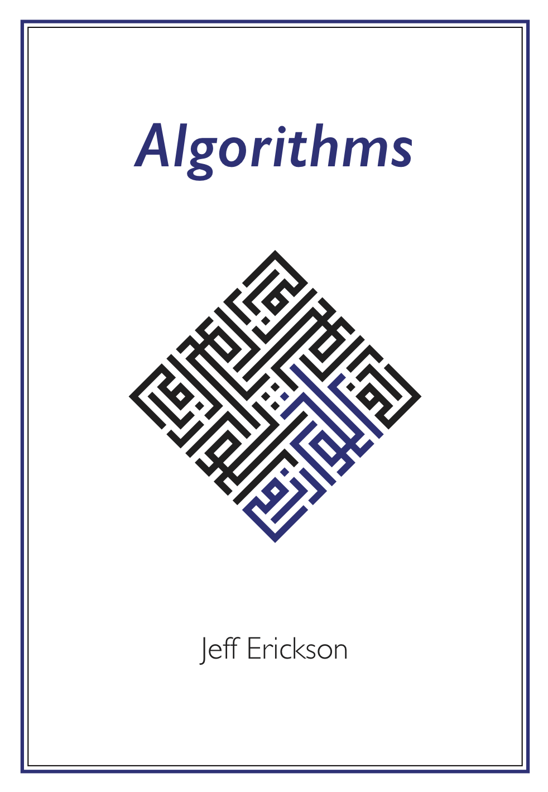
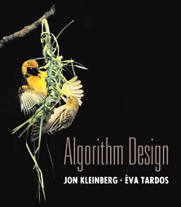
Recommended Text

Slide 7
Course Work
Homework (50%): weekly
  Warm-up problems (discussion session)
  Regular problems
  Graded: 1 warm-up + 1 regular per assignment
  Challenge problems
  Programming problem from ICPC (on-line judge)
Midterm 1 (15%): Tue 10/13, in lecture
Midterm 2 (15%): Tue 11/24, in lecture
Final (20%): Mon 12/14, 7:45am-9:45am

Slide 8
Logistics
Weekly drill:
  Lectures: Tueday & Thursday, 2:30pm-3:45pm. Recorded.
  Discussions: Friday. Attend your own session.
  Homework assigned/due: Tuesday/Monday.
One-on-one meetings: sign up via course calendar
  Office hours (instructor and TAs): 10 mins
  Help sessions (TAs): 30 mins
Ad-hoc review sessions: announced in due time
Piazza: on-line Q&A and announcements
Canvas: everything else (including Piazza sign-up)

Slide 9
Questions?
Let’s get started!

